Slide 1
We are honored to serve The BOLINAs COMMUNITY Public utility district
September 2023

Slide 2
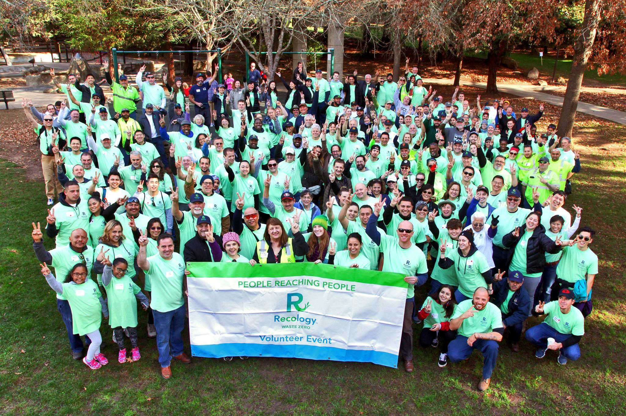
A Little About Us
Serving BCPUD since 2017
100% Employee Owned
Part of Teamsters Union 665
Provide recycle, compost, garbage, C&D, and recycle processing services
Recology Sonoma Marin | 2023
2
Notes:
We began servicing BCPUD on December 23, 2017, after acquiring the Ratto Group. It was a great holiday gift to us to be able to begin our operations in the North Bay
We are proud to provide recycle, compost, garbage, C&D, and recycle processing services to the Bolinas Community.
We are also a 100% employee owned company. ALL of our employees at every level own a piece of the company, and we all take great pride in our work. Since we don’t answer to outside shareholders, we are able to factor the environment into every decision made and better serve the communities that we live and work in.
Recology Sonoma Marin has 470 employees, and 87% of them live within the communities that we serve. We are also proudly part of Teamsters Union 665. Our Union employees receive full benefits, retirement plans, safety equipment, and living wages.

Slide 3
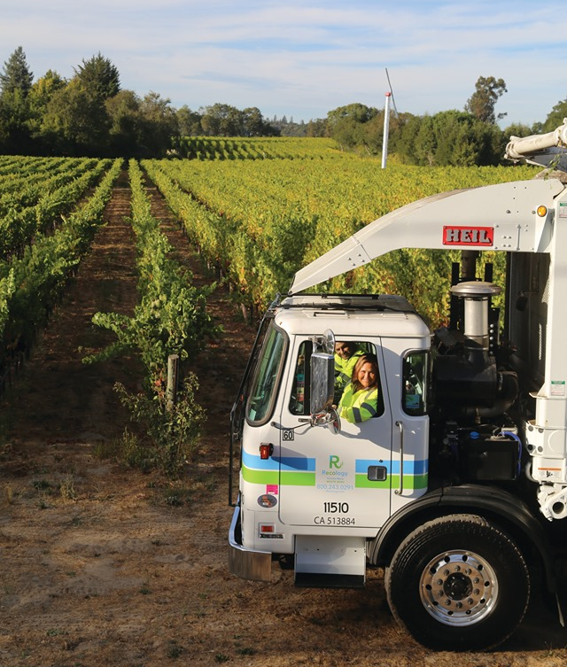
Recology Services Bolinas
Trash, recycling and organics for over 600 accounts
Up to 2 single stream recycling carts per customer with no sorting required
Up to 2 organics carts for yard waste and food waste
Two on-call clean up event per residential account each year
Battery recycling
Recology trucks and drivers spend over 60 hours per week servicing Bolinas
Plus admin and management time
Recology Sonoma Marin | 2023
3

Slide 4
City Donated Services
Around $37,000 in annual cart and bin service for the City
Free debris box hauls and associated disposal
Special event donations including:
Labor Day BBQ
Art Garden & Food Festival
Recology Sonoma Marin | 2023
4

Slide 5
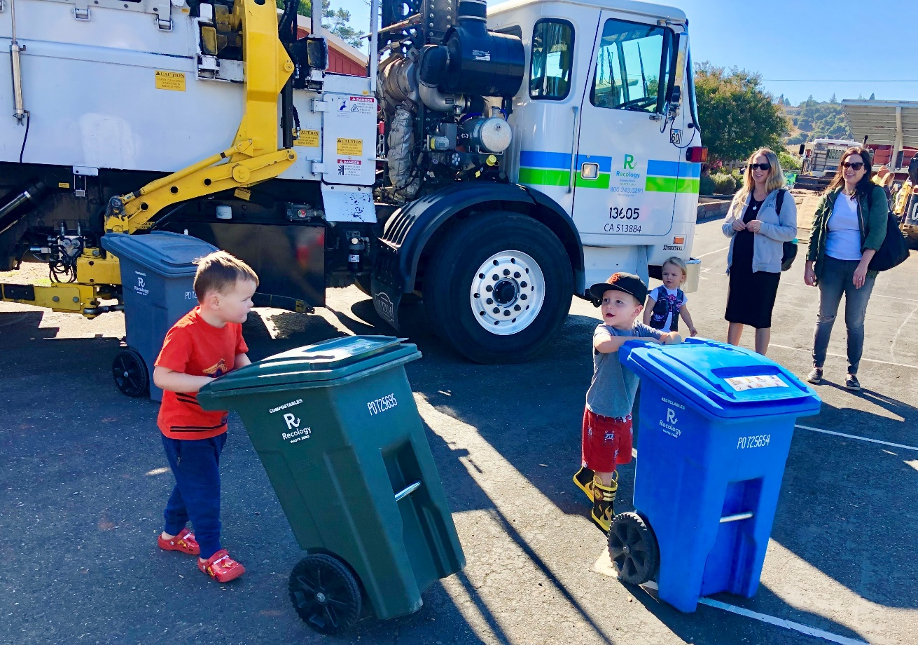
Environmental Health & Safety
Newer Rear-Loader vehicle in service
Operational sites & equipment are in high standing with all regulatory agencies
Regional Safety goals have been exceeded
Recology Sonoma Marin | 2023
5

Slide 6
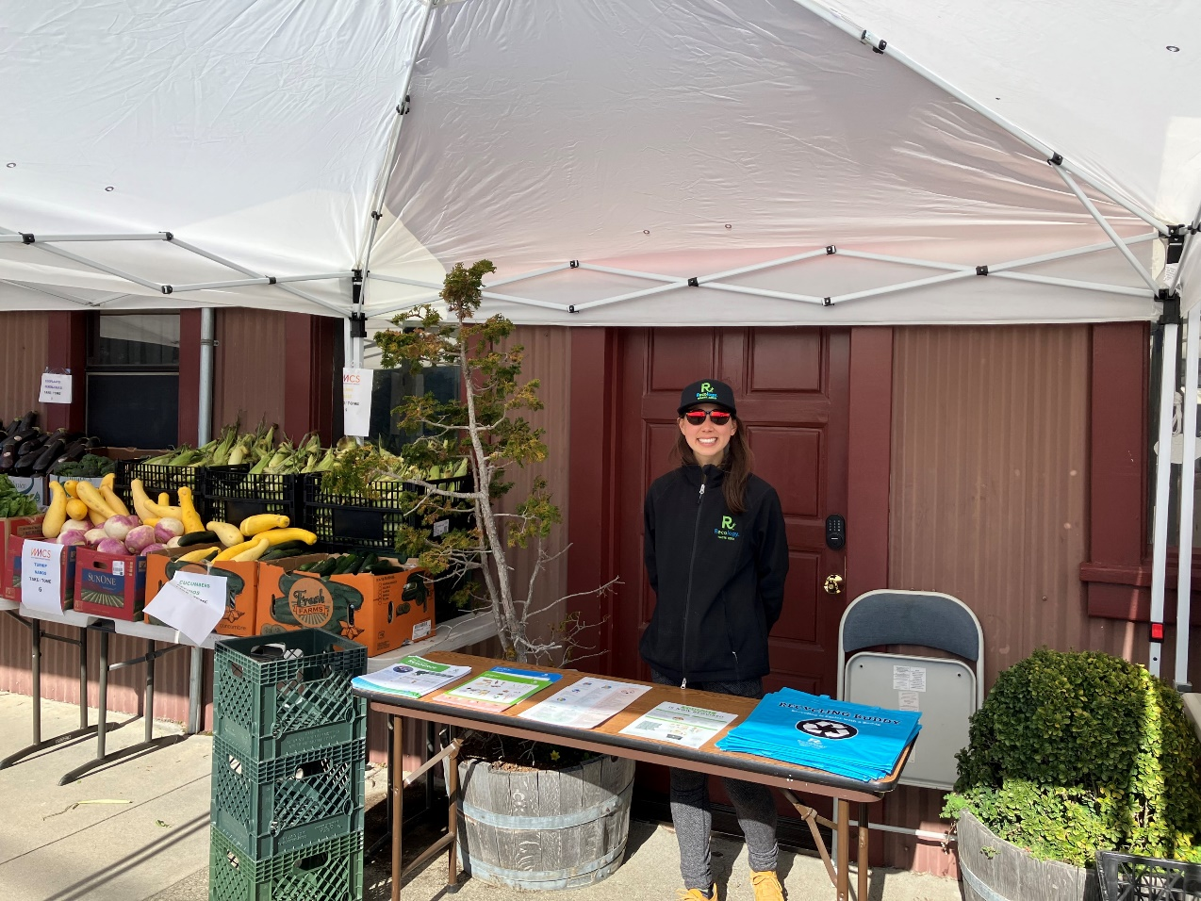
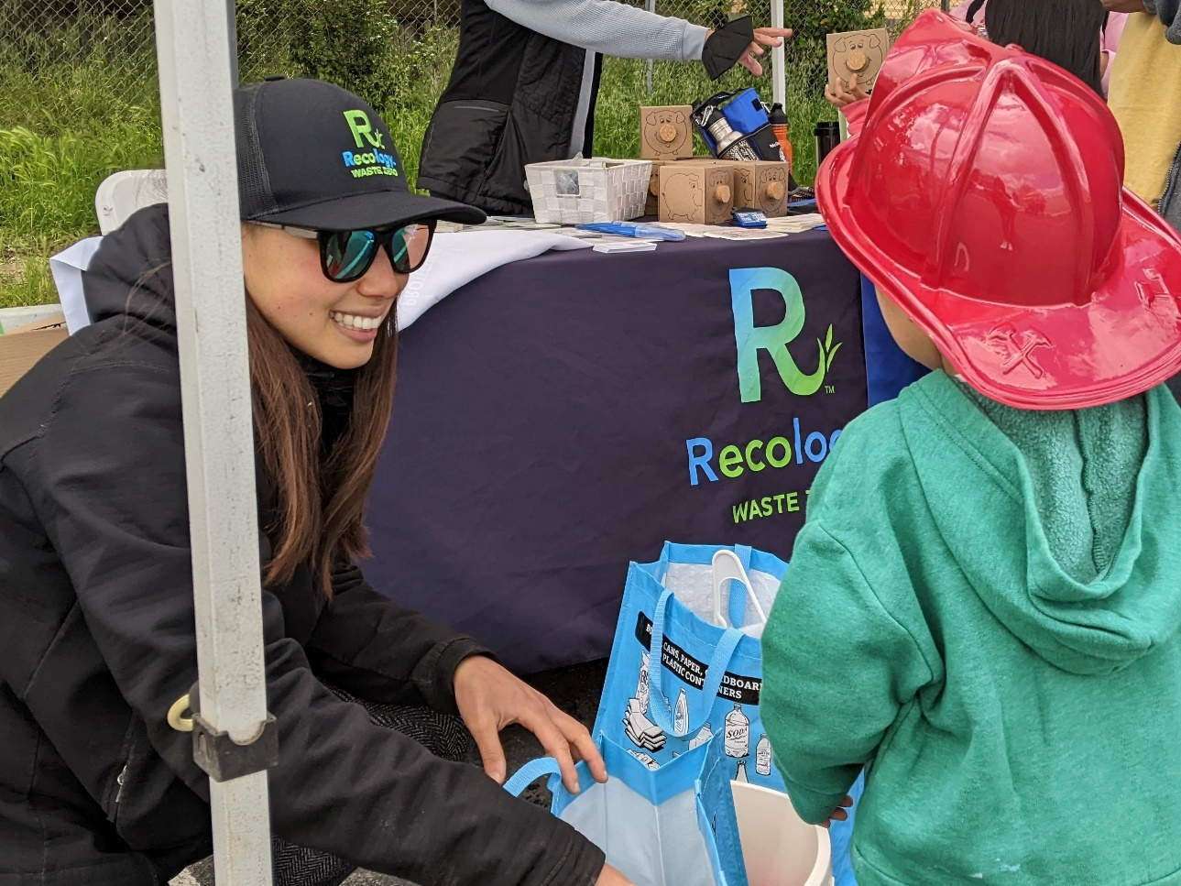
Public Education & Events
Newsletters delivered twice annually with Bolinas specific information and tips.
Recology Sonoma Marin | 2023
6
Notes:
Meilin is the Waste Zero Specialist for Bolinas, pictured here.

Slide 7
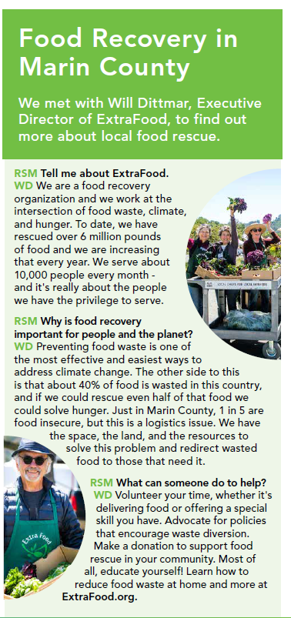
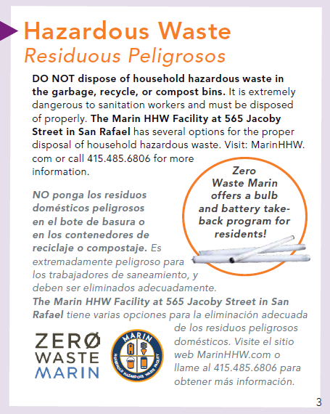
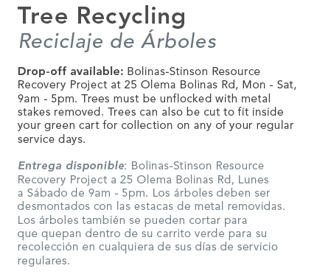
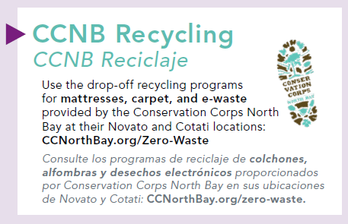
Waste Zero
Find the best and highest use of all resources collected
Increased landfill diversion in Bolinas from 50% in 2020 to 60% in 2023
Work with Zero Waste Marin, Marin County AB939 Local Task Force, and CalRecycle to assist the entire region in meeting recycling and composting requirements
Provide additional education and resources by collaborating with local organizations, including ExtraFood and Sustainable Exchange
Recology Sonoma Marin | 2023
7
Notes:
Our mission is to find the best and highest use of all resources that we collect.

Slide 8
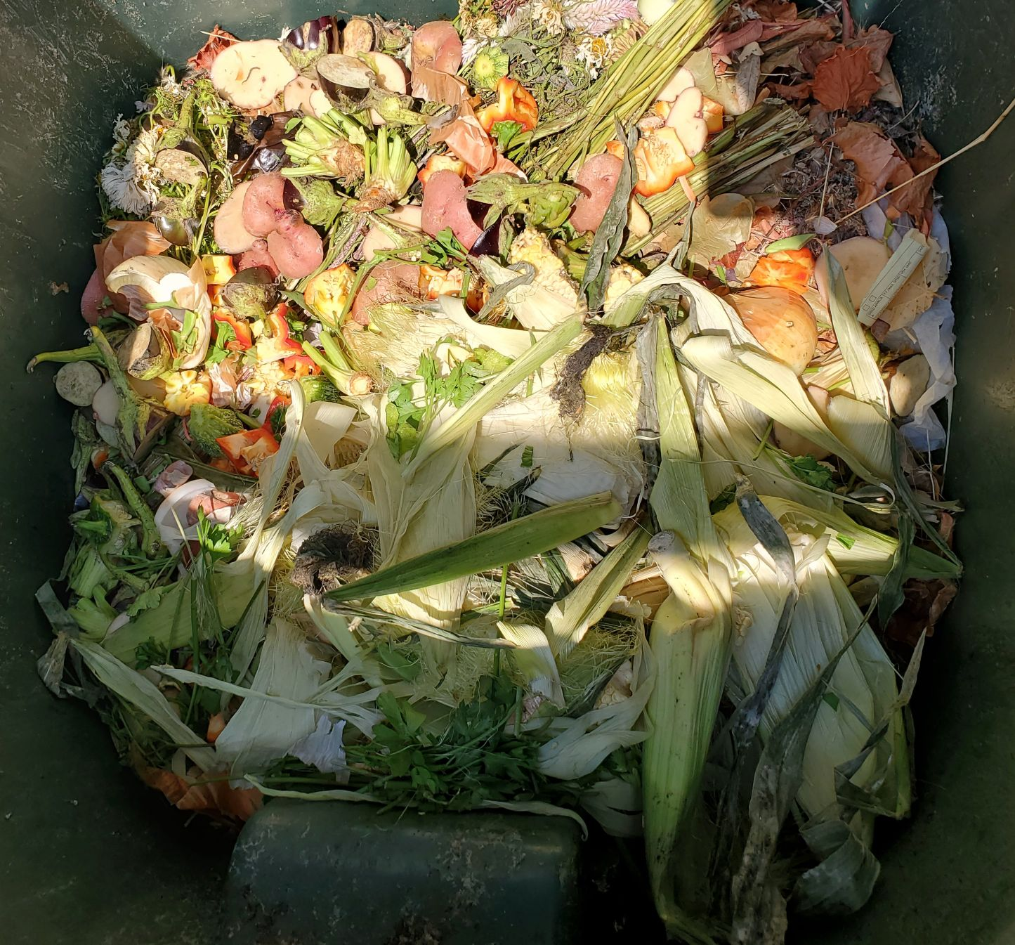
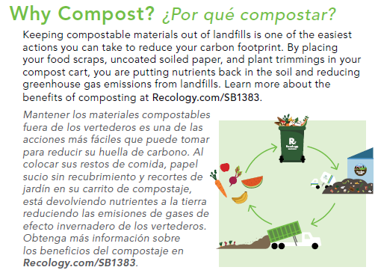
Commercial Compost
19 commercial compost programs in place in Bolinas
Including Bolinas-Stinson School
CA Mandatory Compost (AB1826) - went from 33% compliance in 2018 to 100% compliance in 2023
Recology Sonoma Marin | 2023
8

Slide 9
THANK YOU

