Slide 1
Item 5. County of Marin’s Short Term Rental Permit Program - Implications on Water Used and BCPUD Operations
5/21/2025
Regular Meeting of BCPUD Board of Directors

Slide 2
The county of Marin Recently Instituted a Short Term Rental Licensing Program.
Entire Chapter on this STR licensing program can be found here: ORDINANCE NO. ________

Slide 3
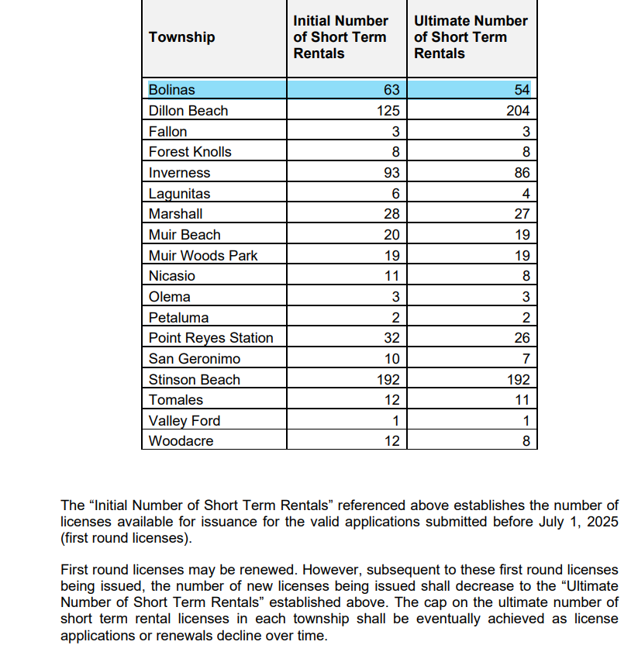
There are currently 63 spots “secured” for an STR permit in Bolinas.
There are currently 60 BCPUD customers registered as "securing" STR spots with the County; BCPUD staff found a total ~40 BCPUD customers with STRs listed on AirBnB, VRBO, etc.

Slide 4
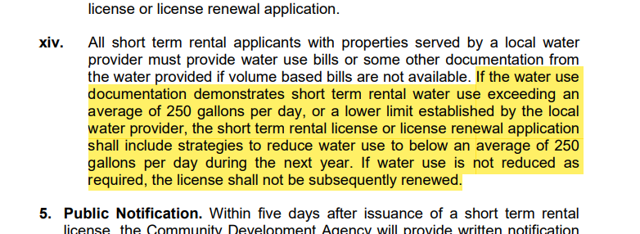
How does County’s STR Permitting Implicate Water Use and BCPUD Operations?
250 gallons/day works out to 33.4 Cu. Ft/day or ~3000 Cu. Ft/Quarter
A standard Limited Water Use Permit (LWUP) in Bolinas is 2700 Cu. Ft/Quarter

Slide 5
BCPUD is receiving notices in the mail from Marin County Planning Division:
BCPUD office is also starting to receive emails and phone calls from customers asking us to share their water use data, so that they can in turn share this info directly with the County
FURTHER DISCUSSION AND ACTION AT JUNE MEETING:
I will bring this item back in June and include some further analysis of customer water use data, including:
Do the 40 active STRs use less or more water than average residential customer?
How many of the 60 registered STRs already have an STR?
How often would water use for registered STR be above 2700 cu.ft/qt?
How often would water use for registered STR be above the ~3000 cu.ft/qt?
Any other analyses you would like staff to undertake to help in your decision process?
Then in June, you can decide if there is anything further you would like the District to do with regards to the County's STR permit program, besides sharing data with Customers.

