Slide 1
General Manager’s Update
April 16, 2025
Regular Board Meeting
Presented by Georgia Woods

Slide 2
Status of BCPUD’s Water Supply
Note March’s comprehensive Water Supply memo will soon be posted on our Website HERE.

Slide 3
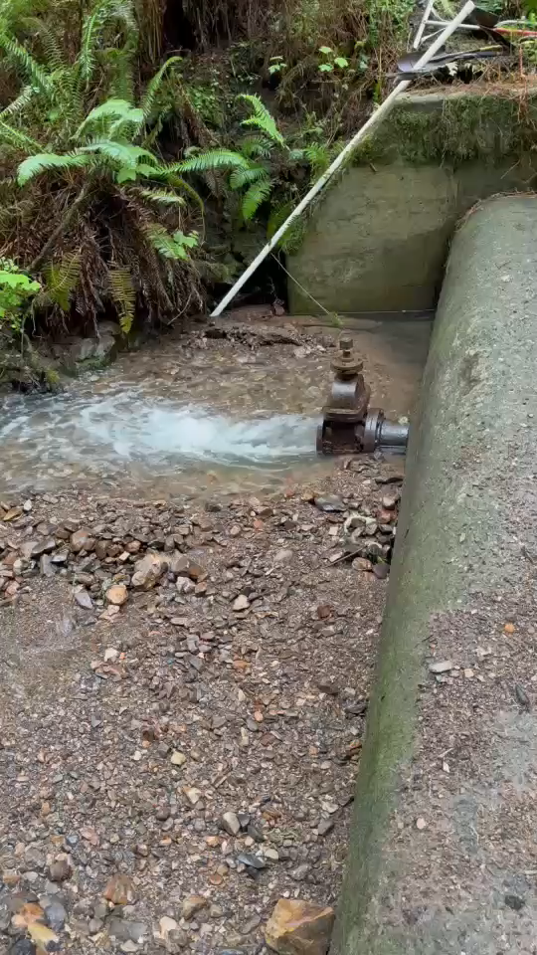
Upper impoundment was filled with rocks.
Reminder of what the Arroyo Hondo looked like in March
Lower impoundment was spilling
We were drawing from the lower impoundment.
on 3/17/2025

Slide 4
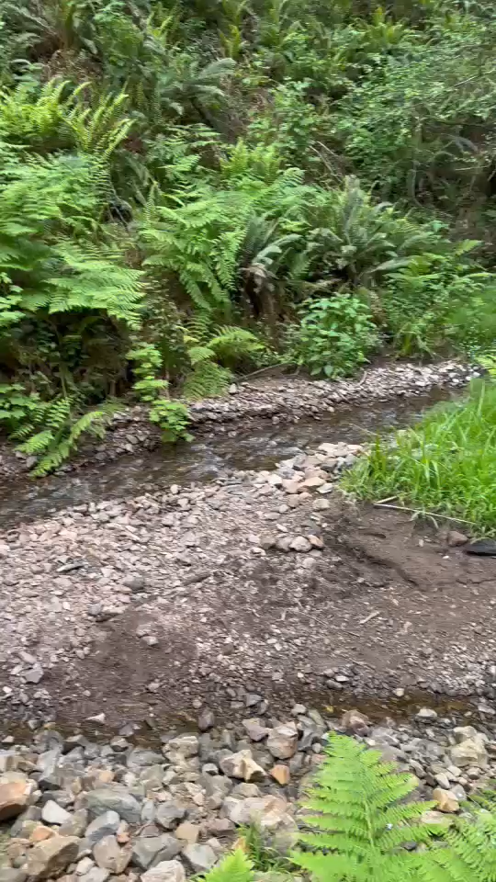
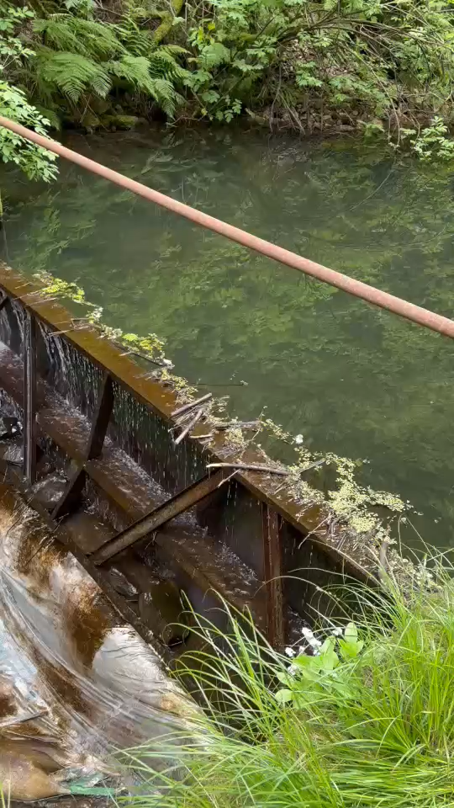
Upper impoundment: still filled!
What the Arroyo Hondo looks like today…
Lower impoundment: still spilling
We continue to draw from the lower impoundment.
on 4/16/2025

Slide 5
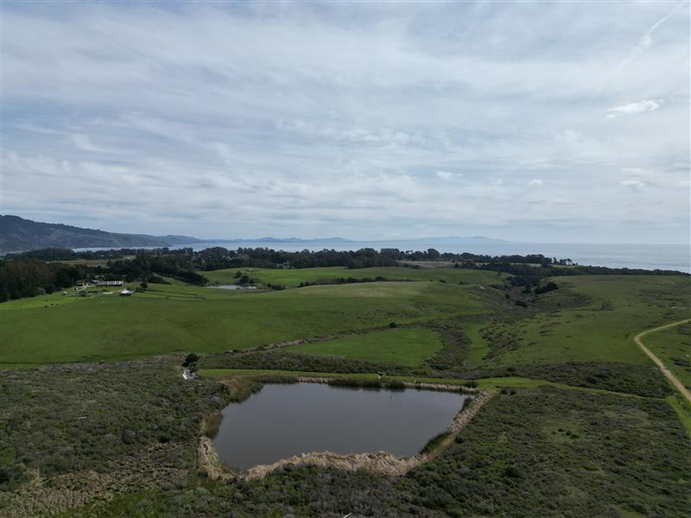
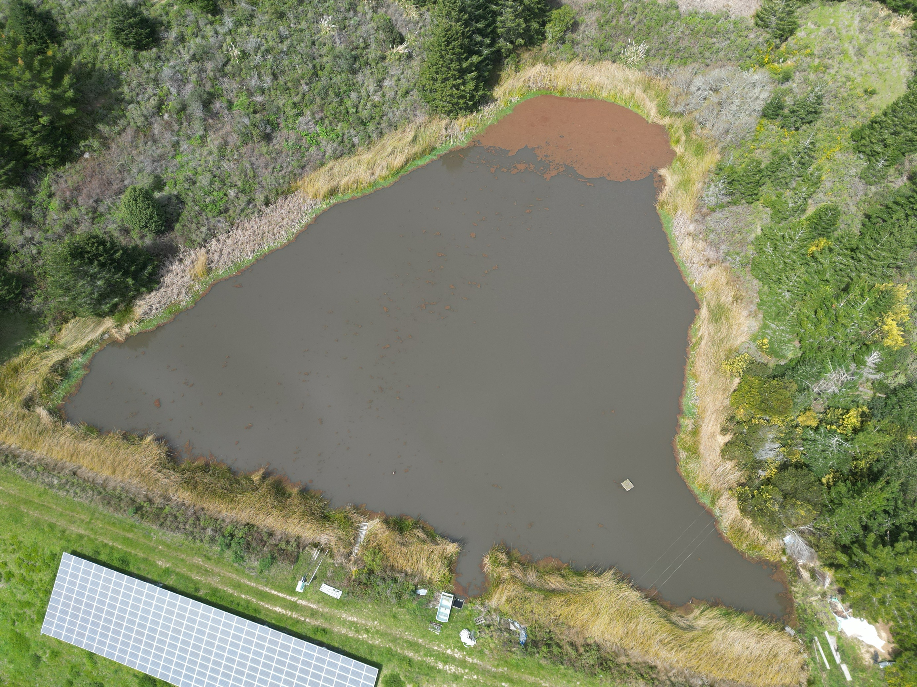
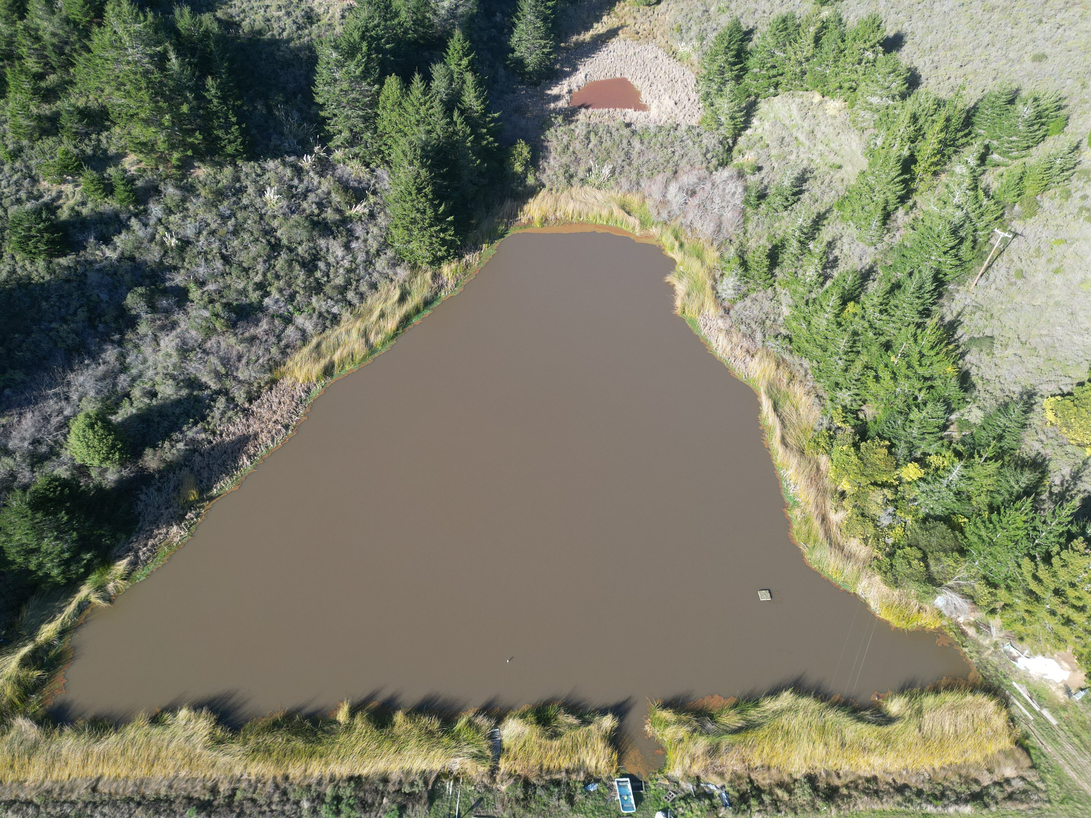
Both reservoirs are spilling...azolla is on the move...
Woodrat 2 on 3/19/2025
Woodrat 1 on 3/19/2025 (no aerial updates since last month)
Note Azolla is creeping back since 2/10

Slide 6
Winter 2025 Water Usage Trends
PRODUCTION​
In March 2025, water production in the district averaged 114 gallons per day (GPD)​ per connection
This is UP from February's production, which averaged 103 GPD per connection​
​
CONSUMPTION​​
Water consumption in March averaged 113 GPD per connection)​​
This is UP from February consumption, which averaged 109 GPD per connection).

Slide 7
Comparison to past two years
Average use per connection:
March 2023 – 48 GPD
March 2024 – 98 GPD
March 2025 – 113 GPD
15% increase per connection compared to last March

Slide 8
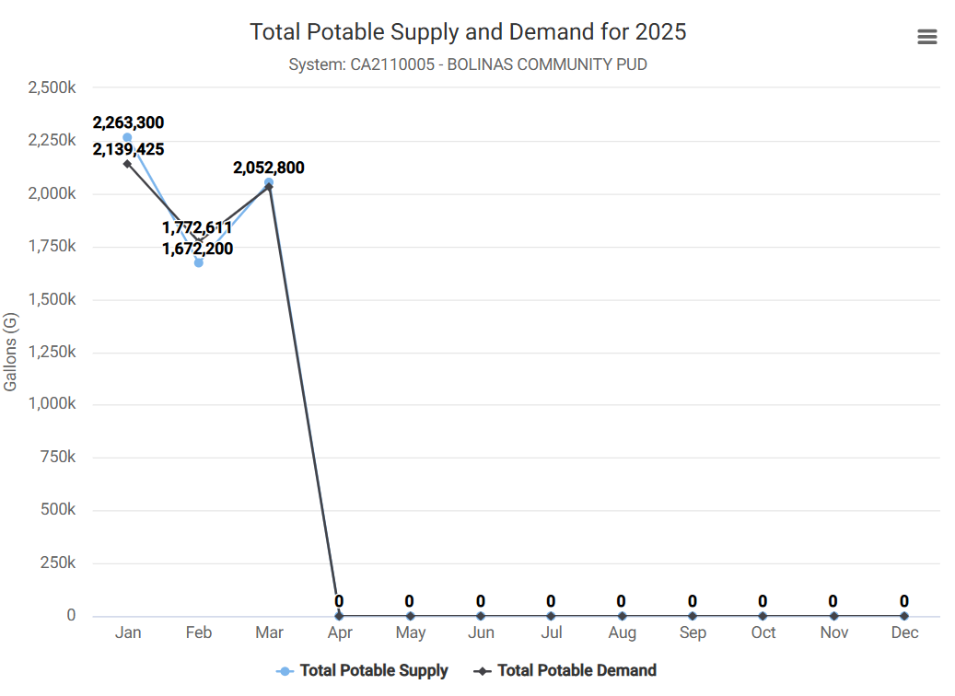
2025 Water Usage Trends

Slide 9
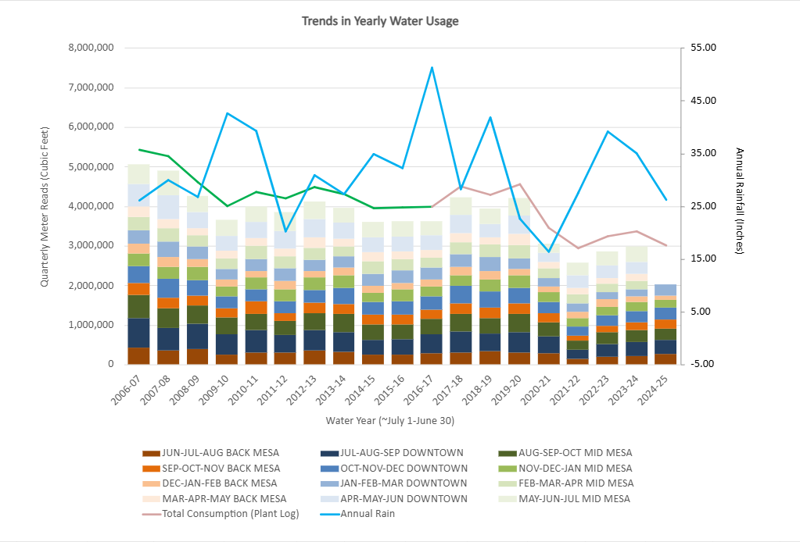
Annual Trends Since 2006
Quarterly Water Usage through March 2025
This graph shows “Cumulative Quarterly Water Usage”, as measured by “Regional Quarterly Water Meter Reads”
Remember: at the beginning of each month staff reads all meters within 1 of 3 given regions:
  1) BACK MESA
  2) DOWNTOWN
  3) MID MESA
Annual Rain Fall is plotted as a BLUE LINE
Town Consumption Estimates, based on the amount of water leaving the treatment plant daily is shown in PINK LINE.
GREEN LINE is an extension of pink line, which models consumption based on an absolute unaccounted for water loss of 437,856 CuFt (~10% loss)

Slide 10
Operations Updates

Slide 11
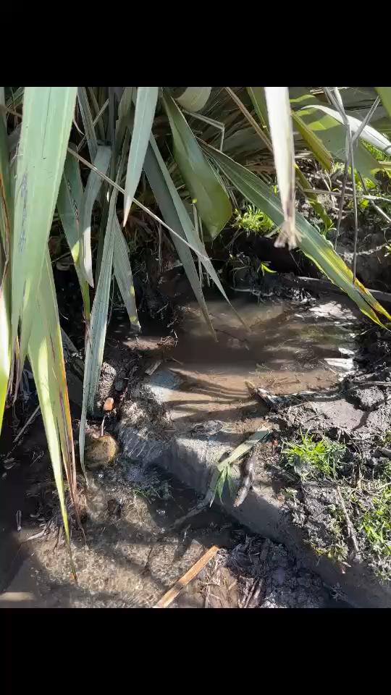
Operations Update (1 of 6): LEAKS
Smallish leak on Brighton Ave.
Repaired same day, in-house. Yay!
on 4/3/2025

Slide 12
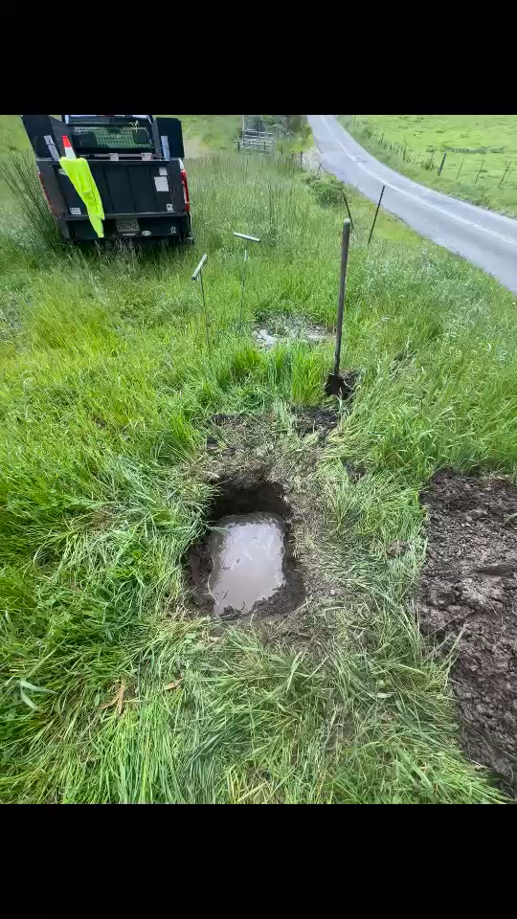
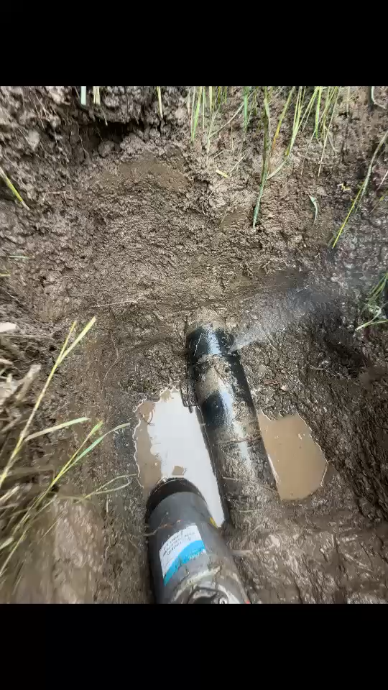
Operations Update (2 of 6): LEAKS
Leak on Booster Line out Mesa Road to Commonweal
It is very hard for us to repair these leaks
This booster line is an “odd” 6.7 inch diameter thin walled (not meant for water distribution) PEP pipe.
Water repair clamps have potential to crush the pipe
The leak is along a seam on weld of old Piazza repair.
We are trying to repair in house with a clamp but may need to call Piazza if unable to address ourselves.
on 4/16/2025

Slide 13
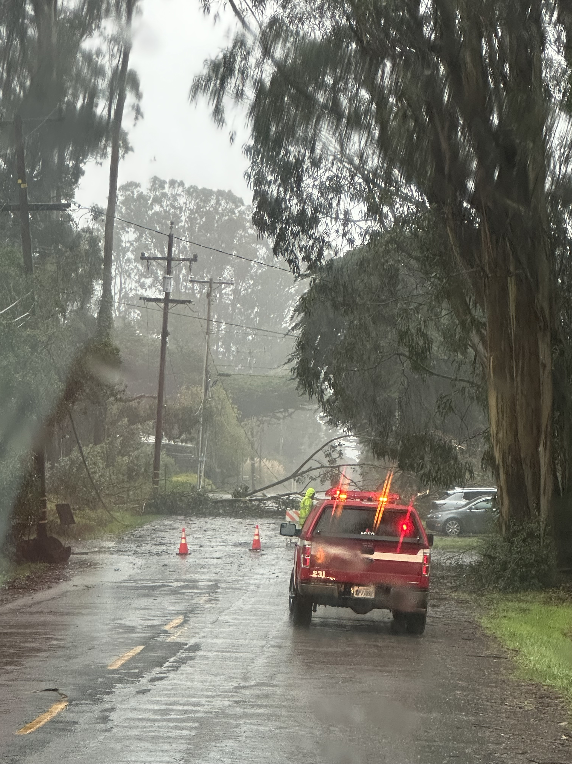
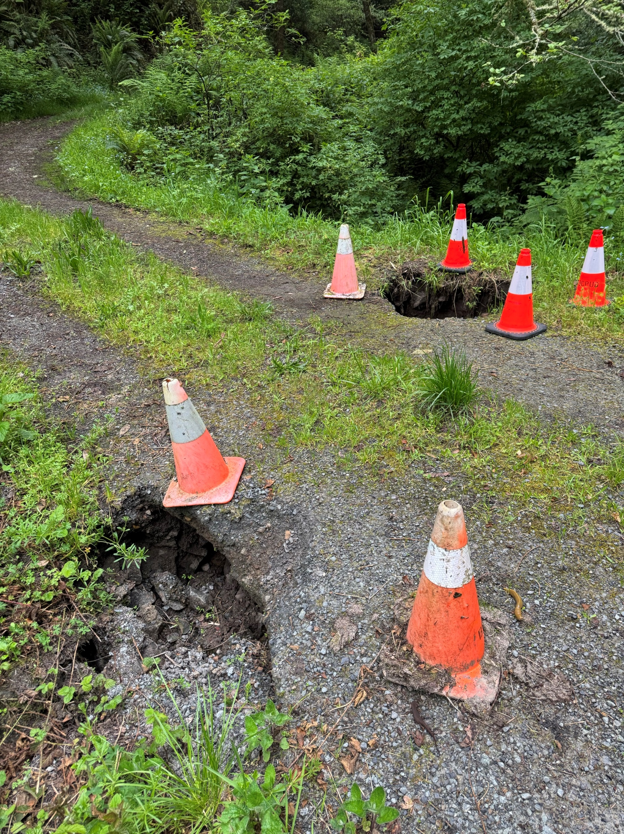
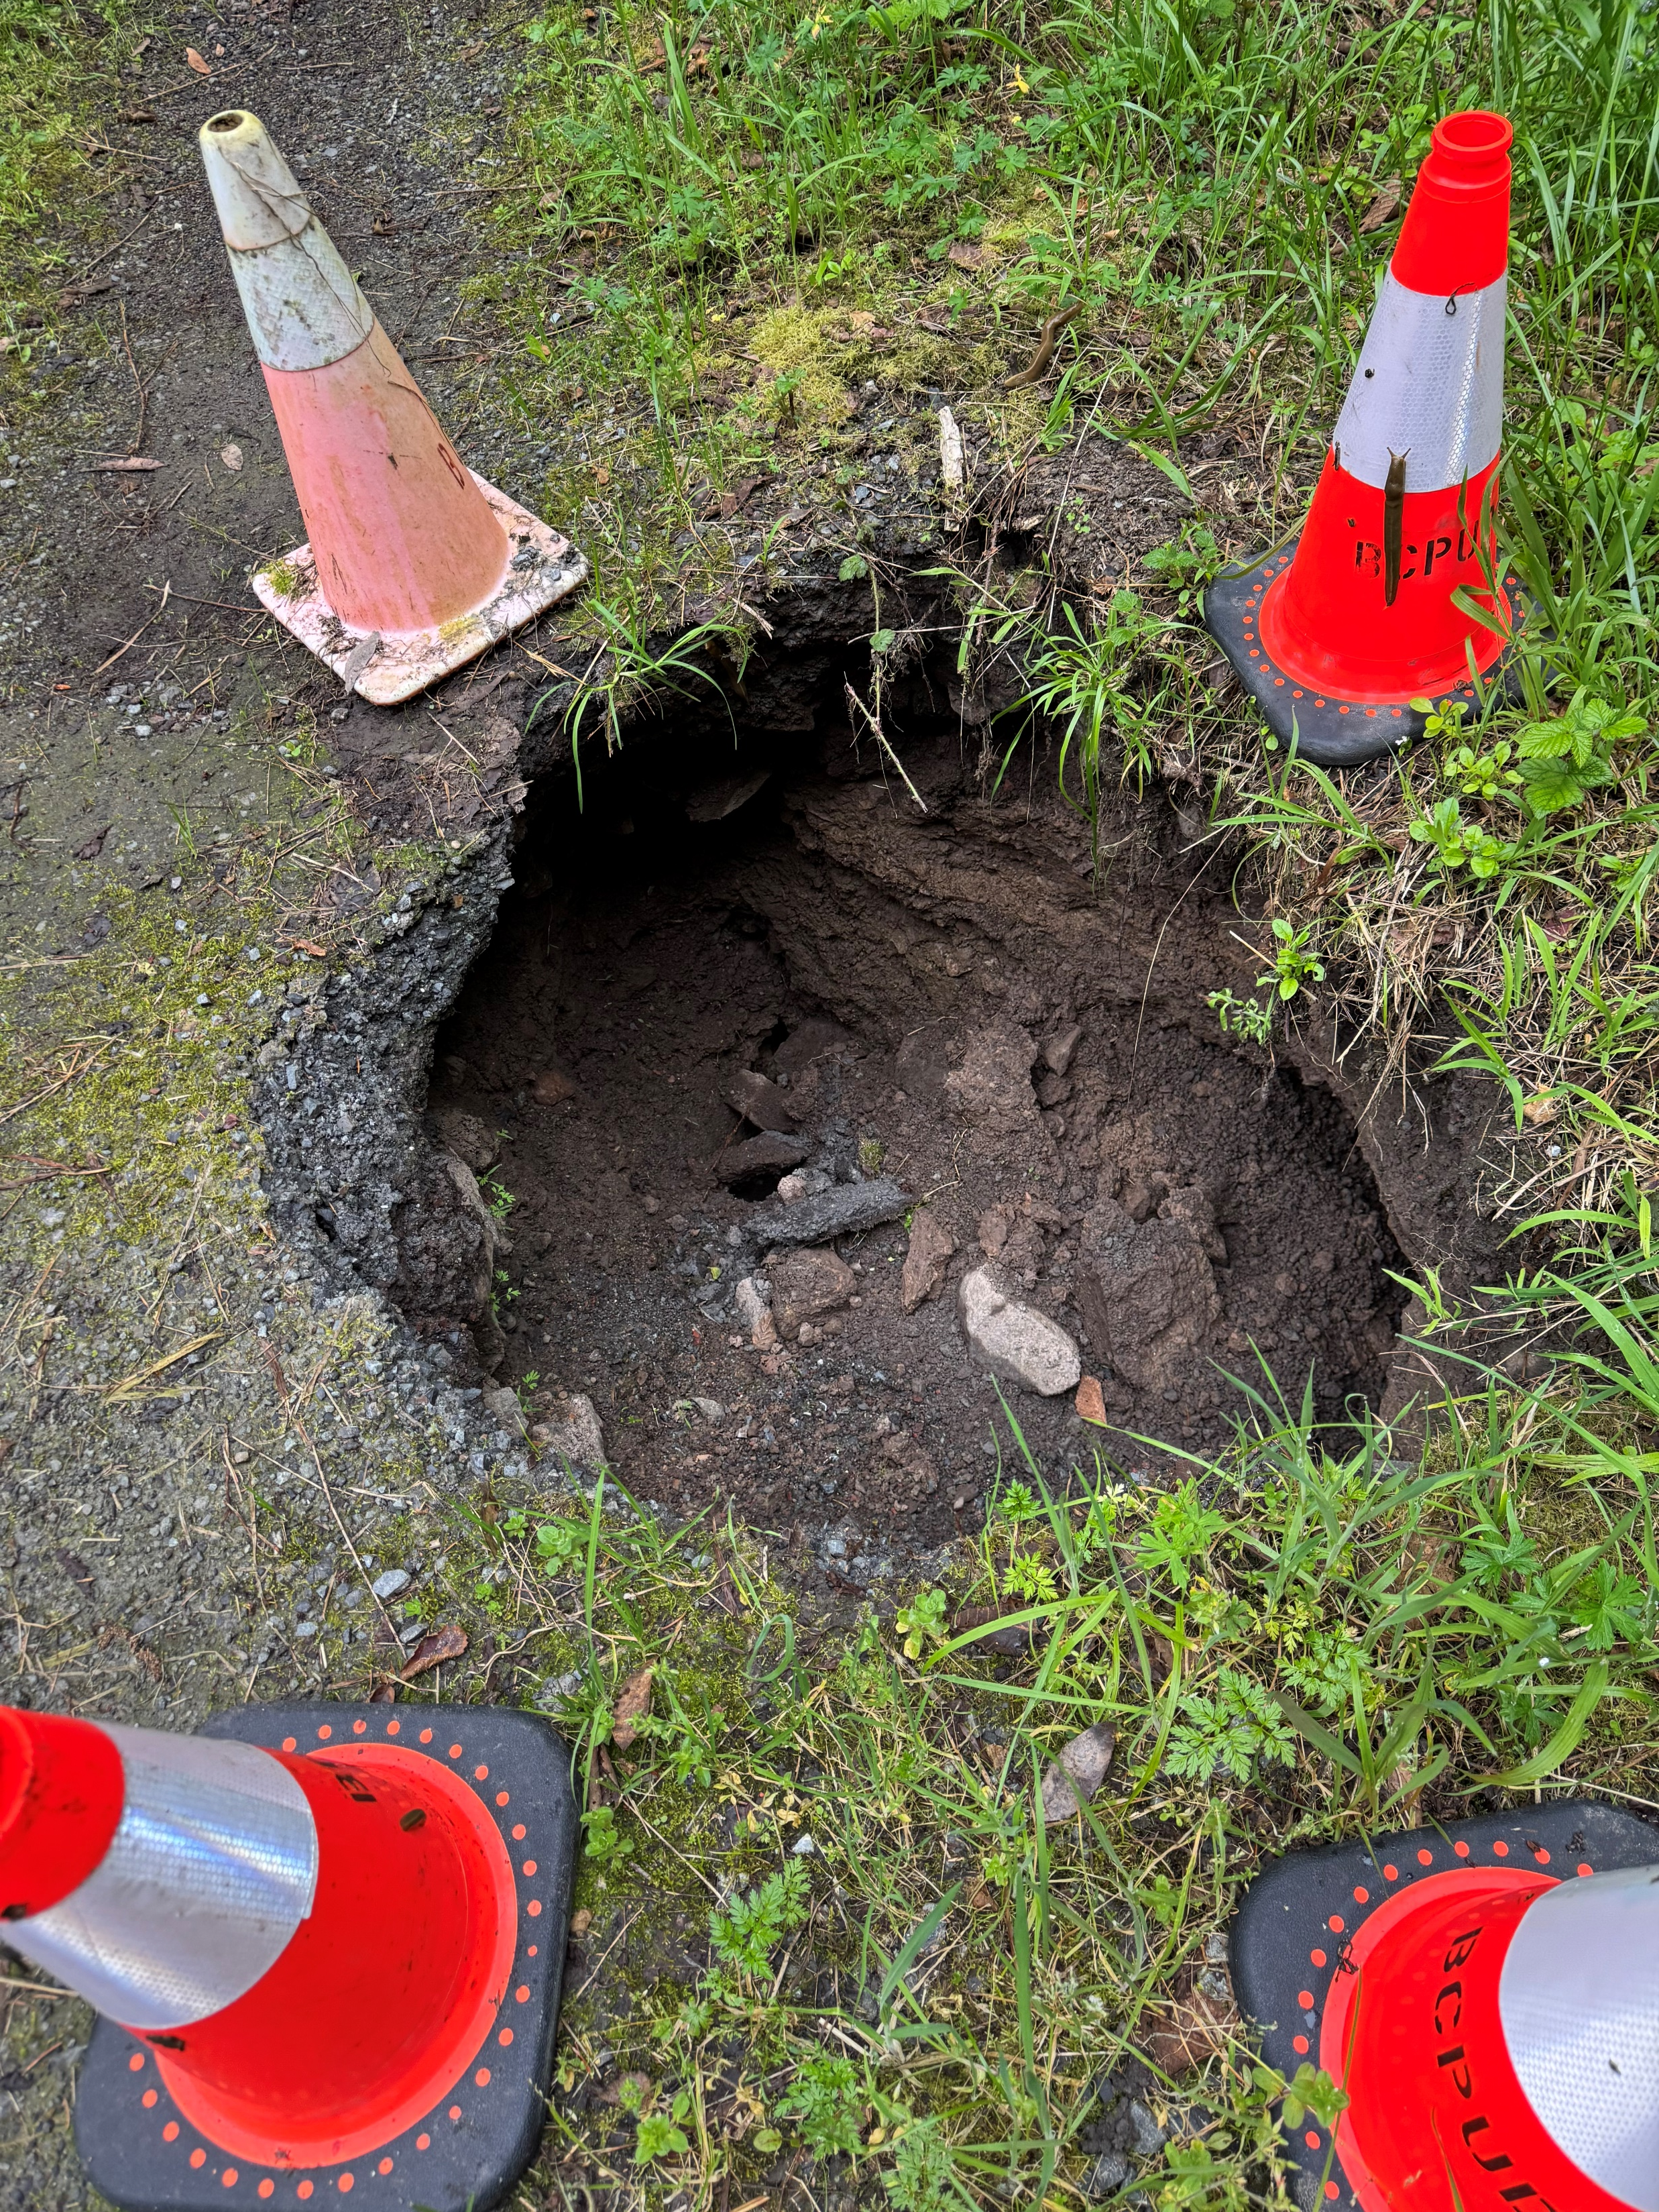
Operations Update (3 of 6): Storm Damage and Planned Repairs
on 2/4/2025
As you know we sustained some damage from last week's storm along the Arroyo Hondo Access Road
Damage to culvert and mud slides along road
on 4/16/2025

Slide 14
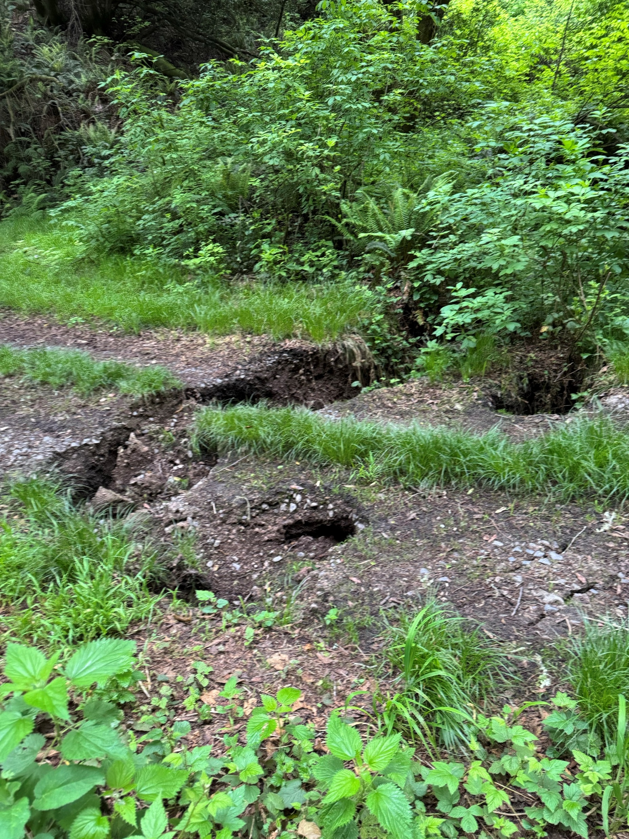
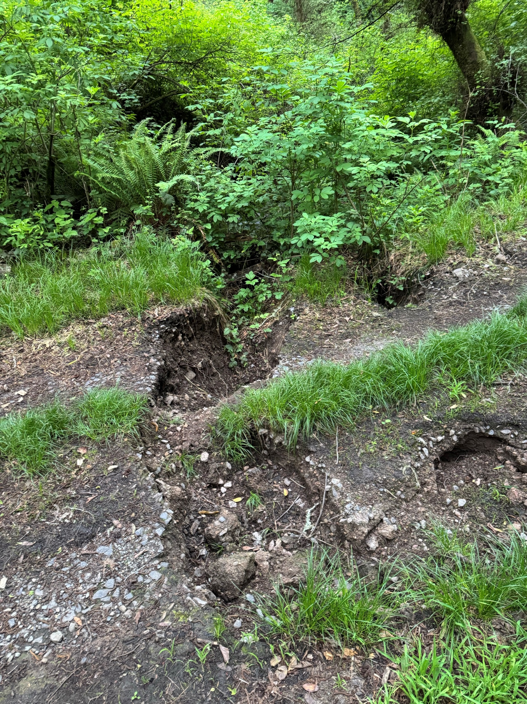
Operations Update (3 of 6): Storm Damage and Planned Repairs
on 2/4/2025
I will be meeting with Point Reyes National Seashore Park Service and consulting Engineer for site visit tomorrow to try to ID a plan to repair the road and replace culverts
on 4/16/ 2025

Slide 15
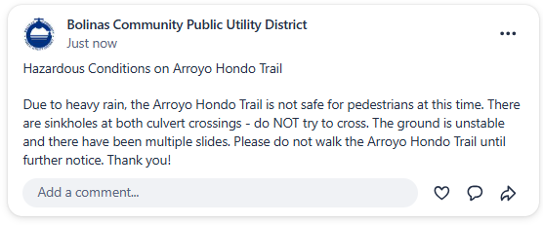
Please avoid hiking on the Arroyo Hondo trail until further notice!
I mentioned to the NPS the idea of posting a “Danger Sign” at the trail entrance. I will talk to them about this possibility tomorrow.

Slide 16
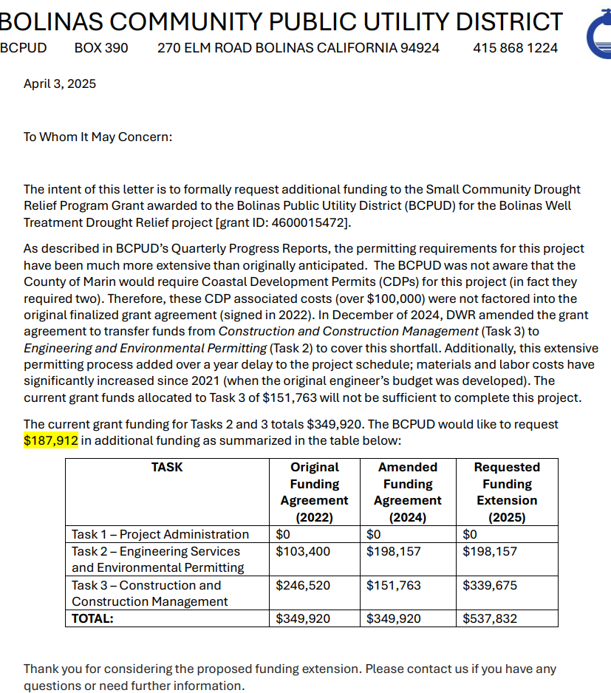
Operations Update (4 of 6): Well Projects
Well Projects are moving along through the construction phase
We have submitted our formal request letter for funding extension ( ~$190K) to DWR
We are in final stages of negotiating our easement agreement with BCLT that will be necessary for us to use and access the well at 31 Wharf
As soon as this easement is signed, we will be engaging Weeks Drilling to install the pump
We have a meeting with Habitat for Humanity next Monday, April 21, to continue to coordinate our respective projects

Slide 17
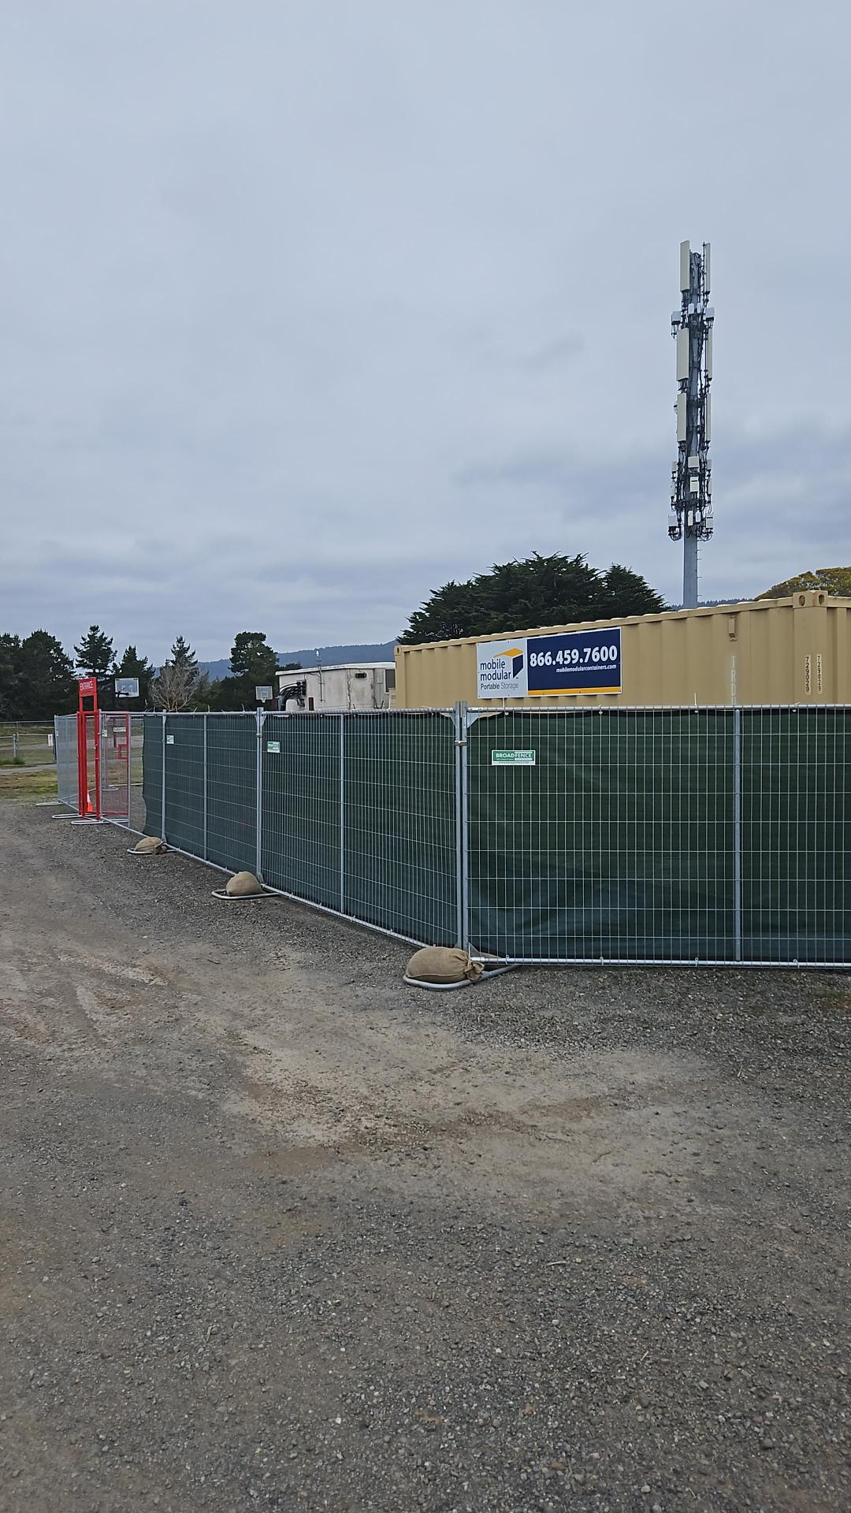
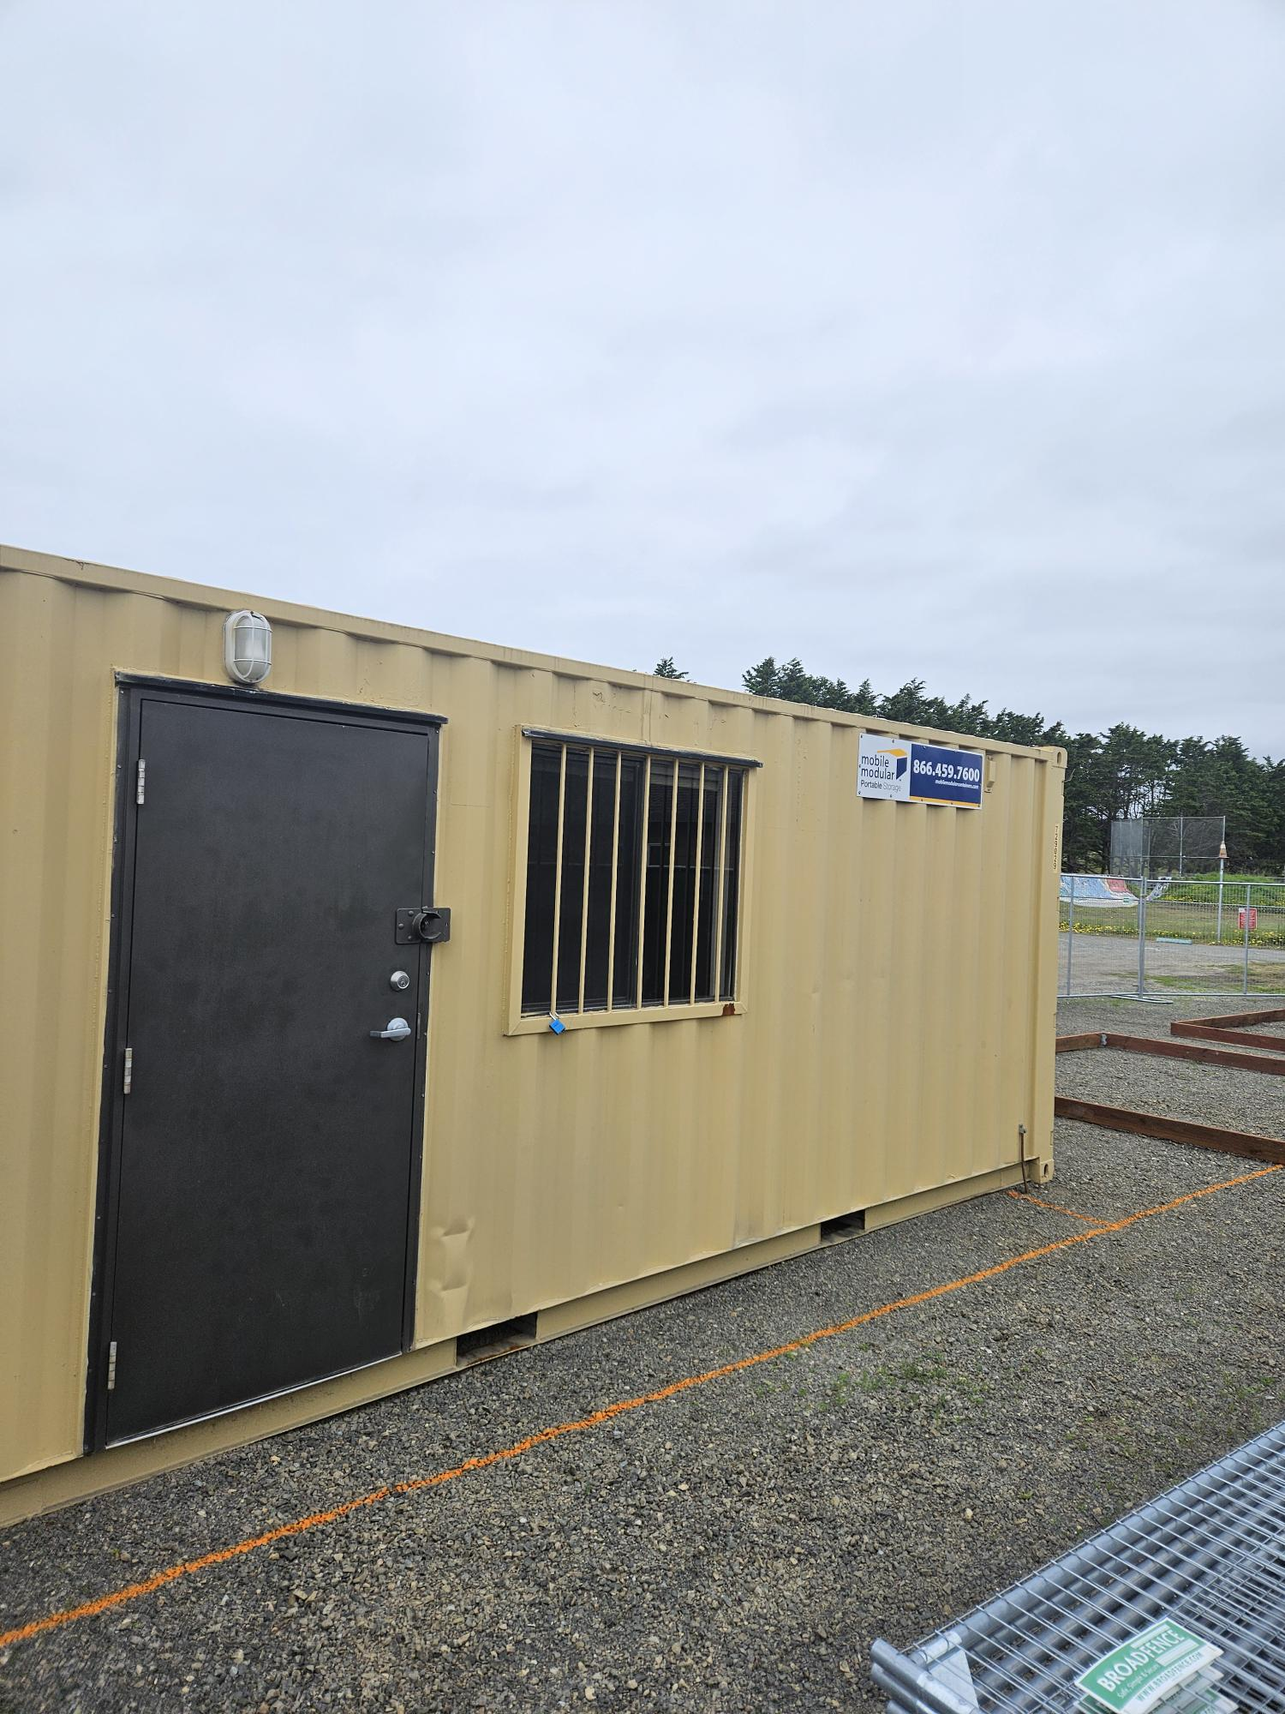
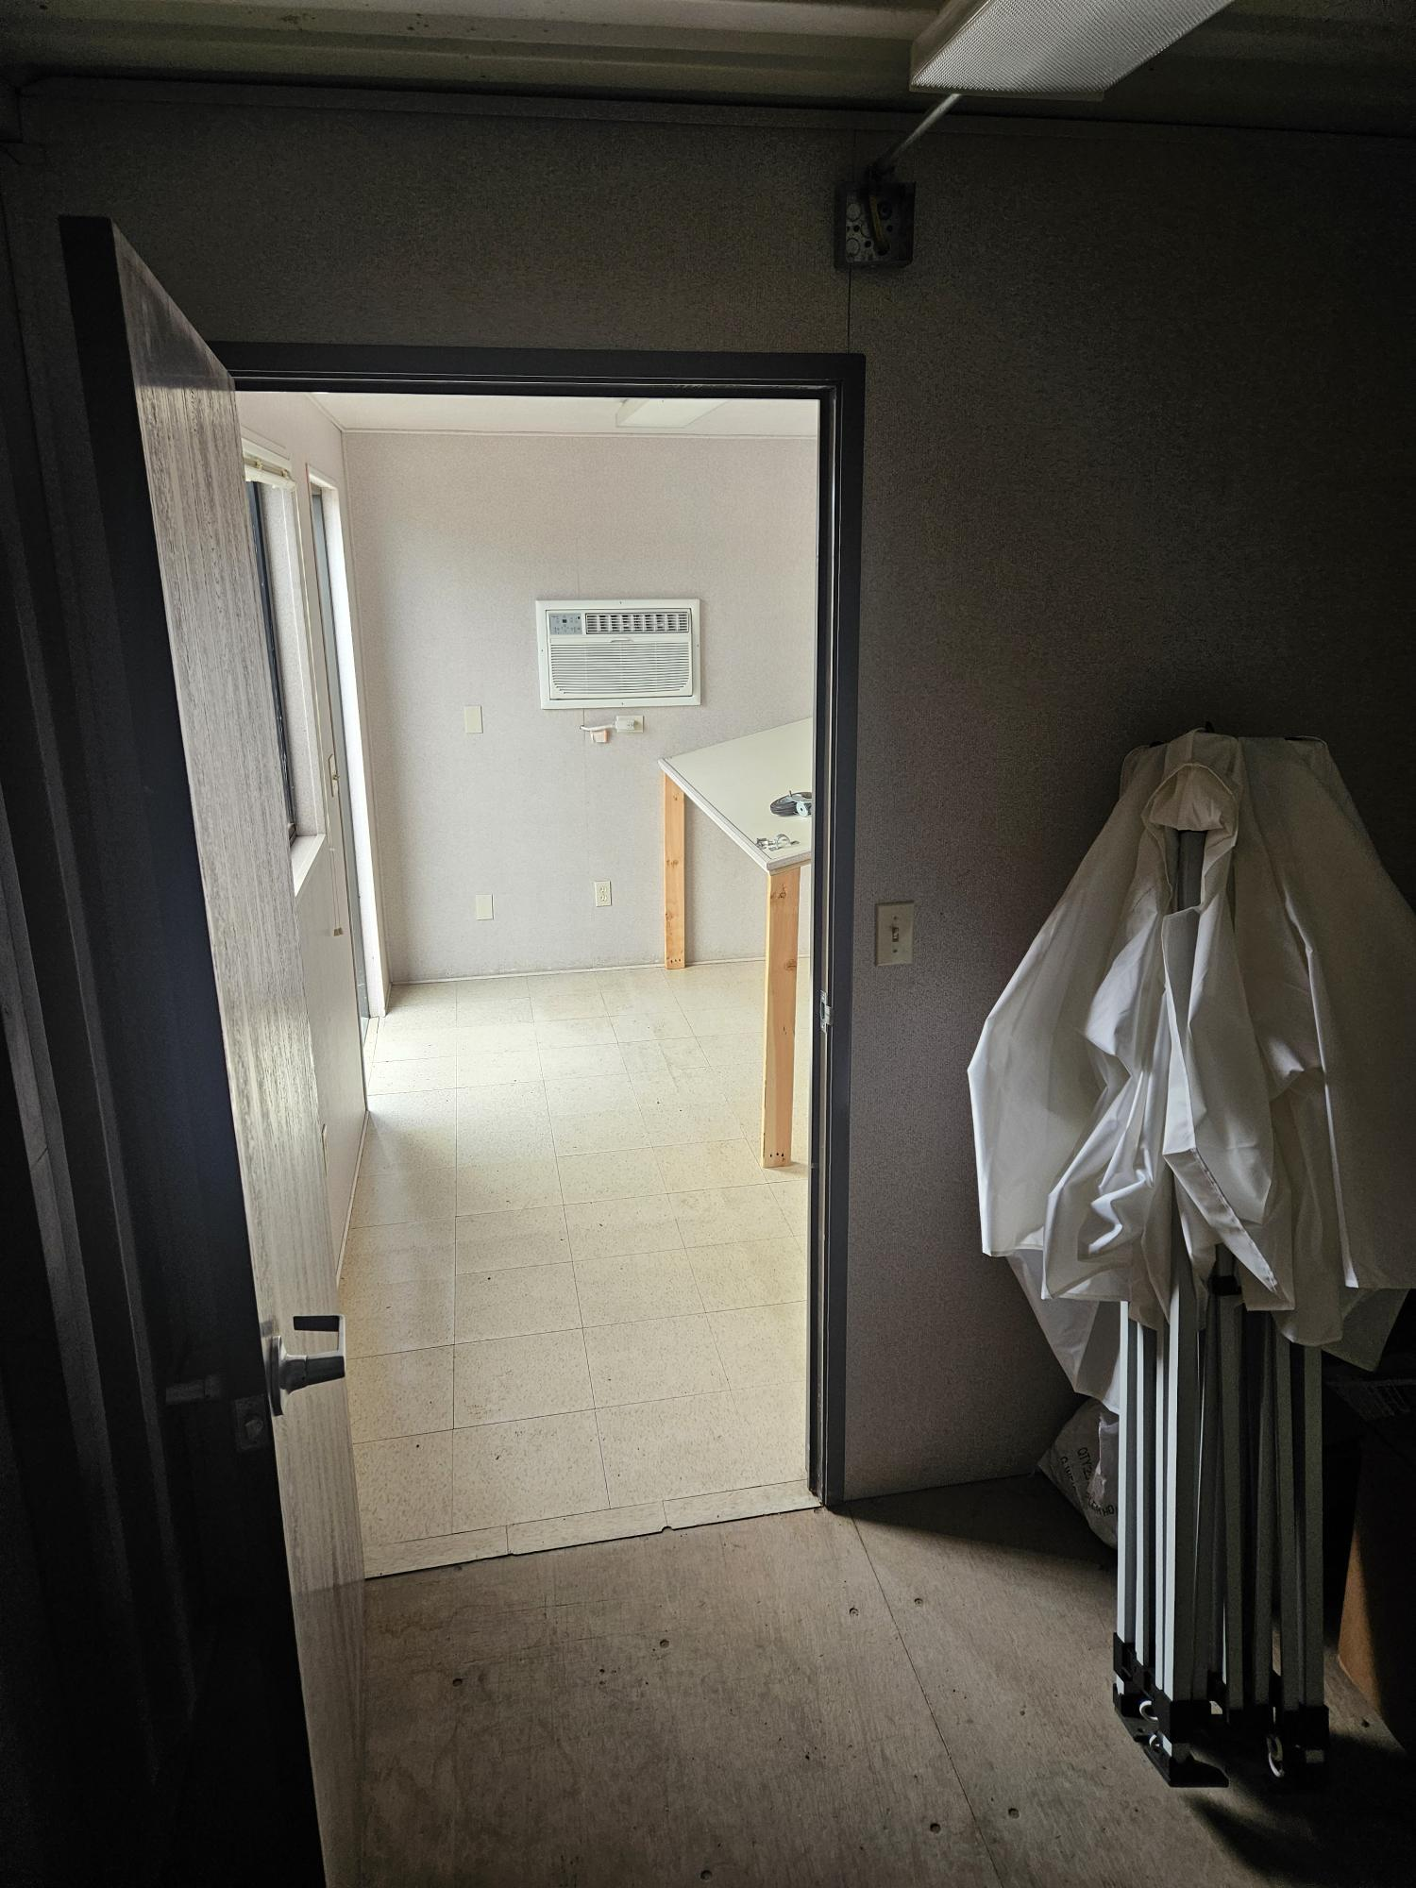
Operations Update (4 of 6): Well Projects

Slide 18
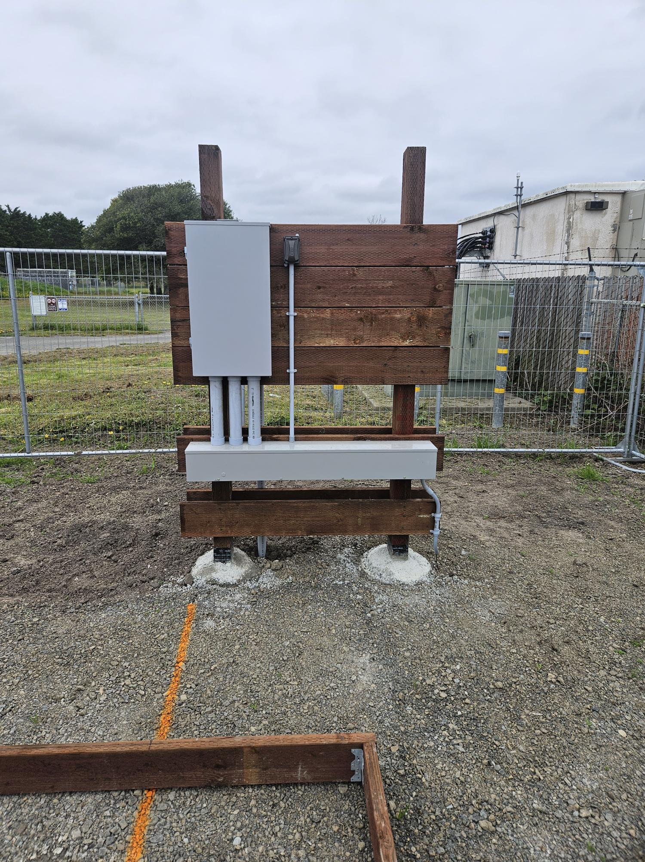
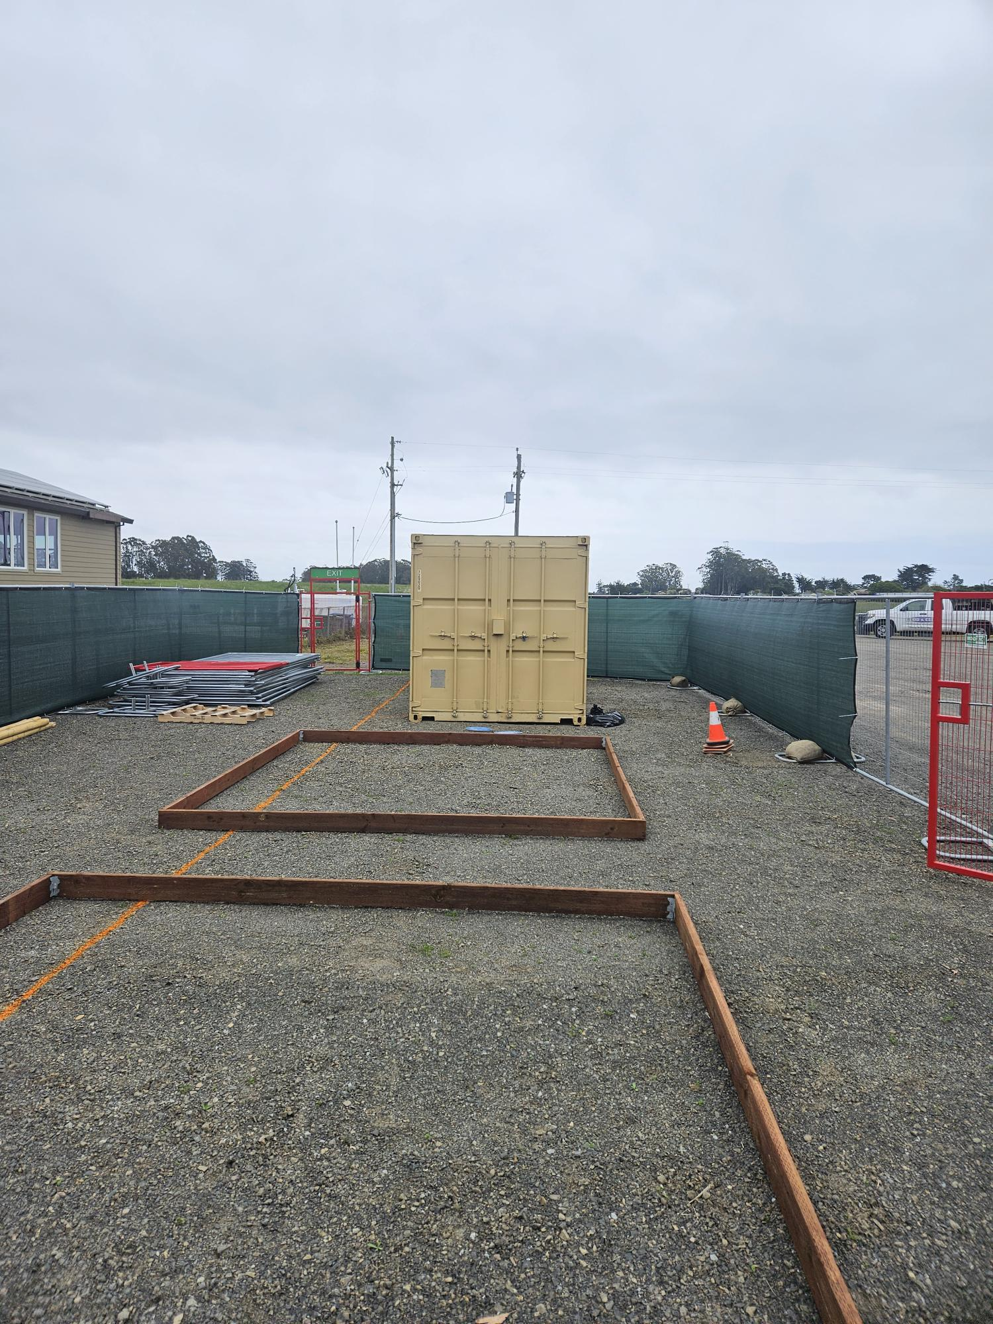
Operations Update (4 of 6): Well Projects

Slide 19
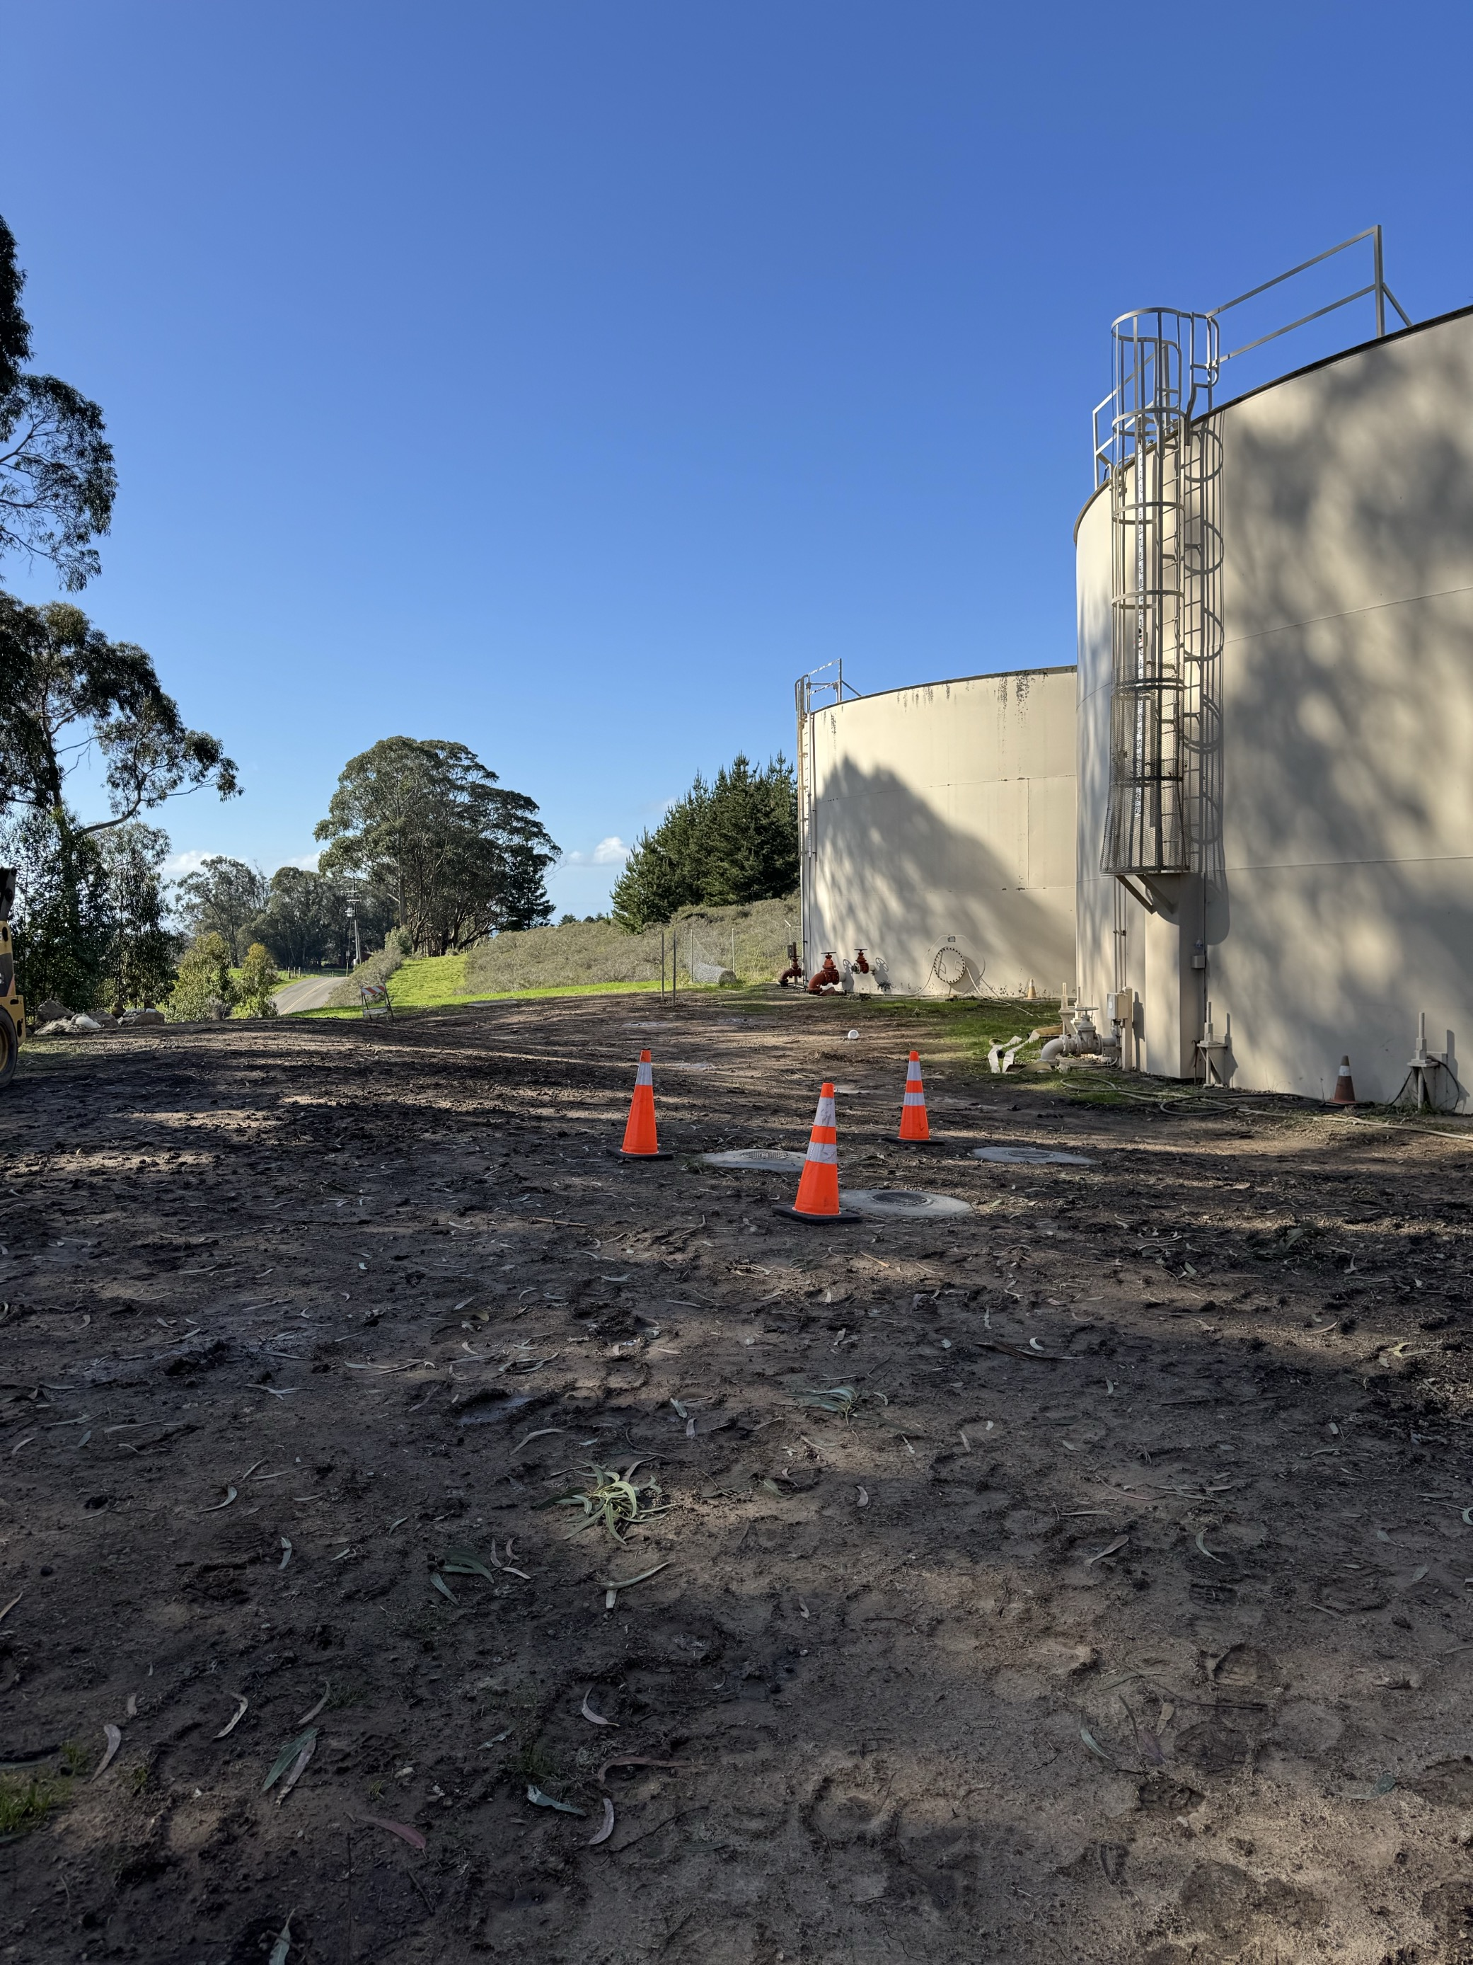
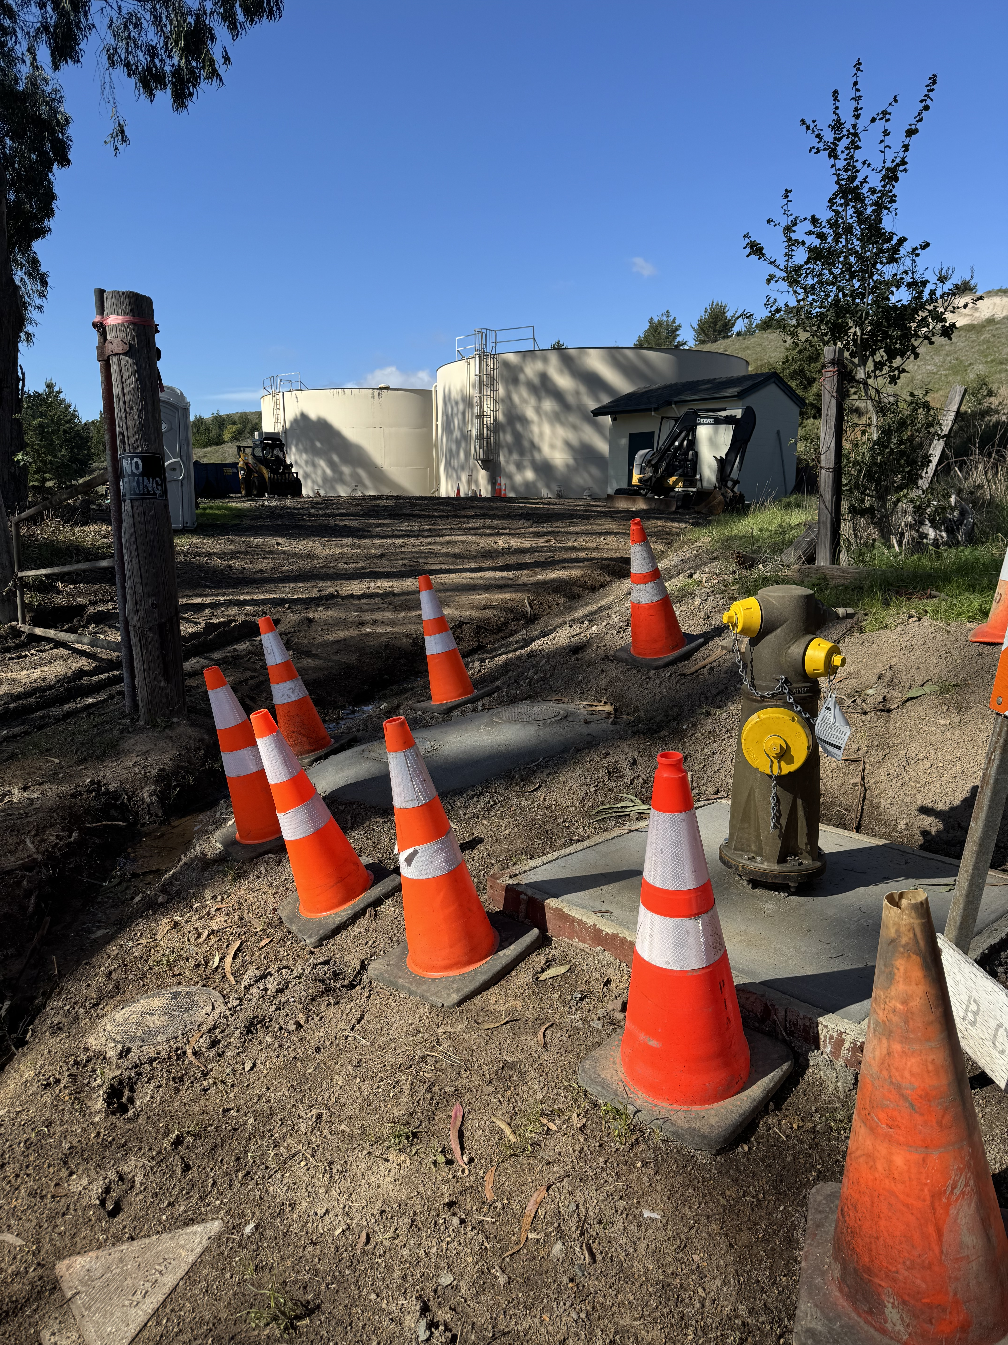
Operations Update (5 of 4): Tank-Site Pipeline Replacement project
There is still 1 more day of electrical work. We have negotiated the change order associated with this work. It will be an additional ~$2000.
After the work is finalized, I will present a special report summarizing total costs and closing out the project.

Slide 20
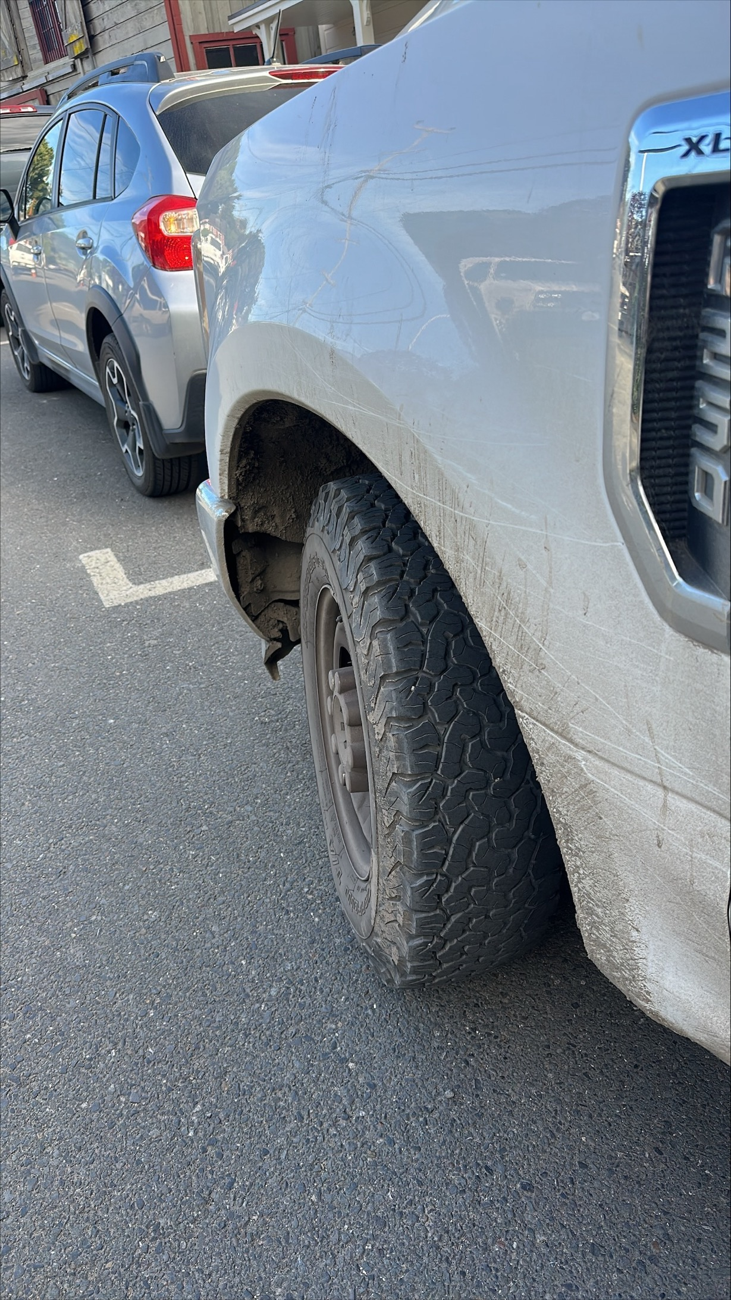
Operations Update (6 of 6): “Emergency” purchase of 4WD truck
We have 2 old “out of commission” trucks (circa 2008) that we are selling (1 sold for $500, trying to sell the other for $1000)
We have 2 newer trucks (2017) that we are using currently (but 1 just got brought in for $2500 repair this week)
We are down to 1 truck!
Staff is having to drive their personal vehicles!
The FY 2025-2026 budget factors the purchase of a new 4WD Truck.
Instead, we will be looking to IMMIDIATELY purchase that vehicle with a real loan from the LAIF reserve.
We will reimburse the LAIF when funds come in next year for this planned purchase.
Wobbling and damaged wheel on 4/10/2025 needing emergency repair

Slide 21
Miscellaneous Updates

Slide 22
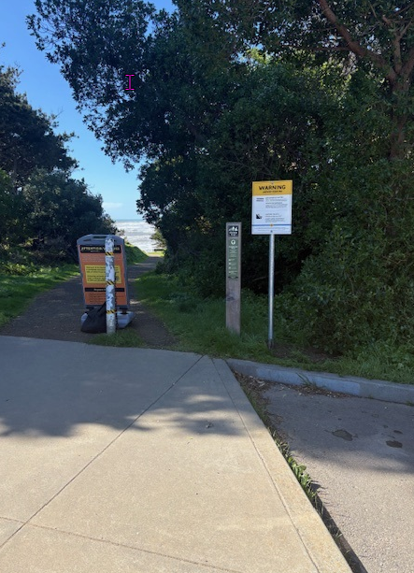
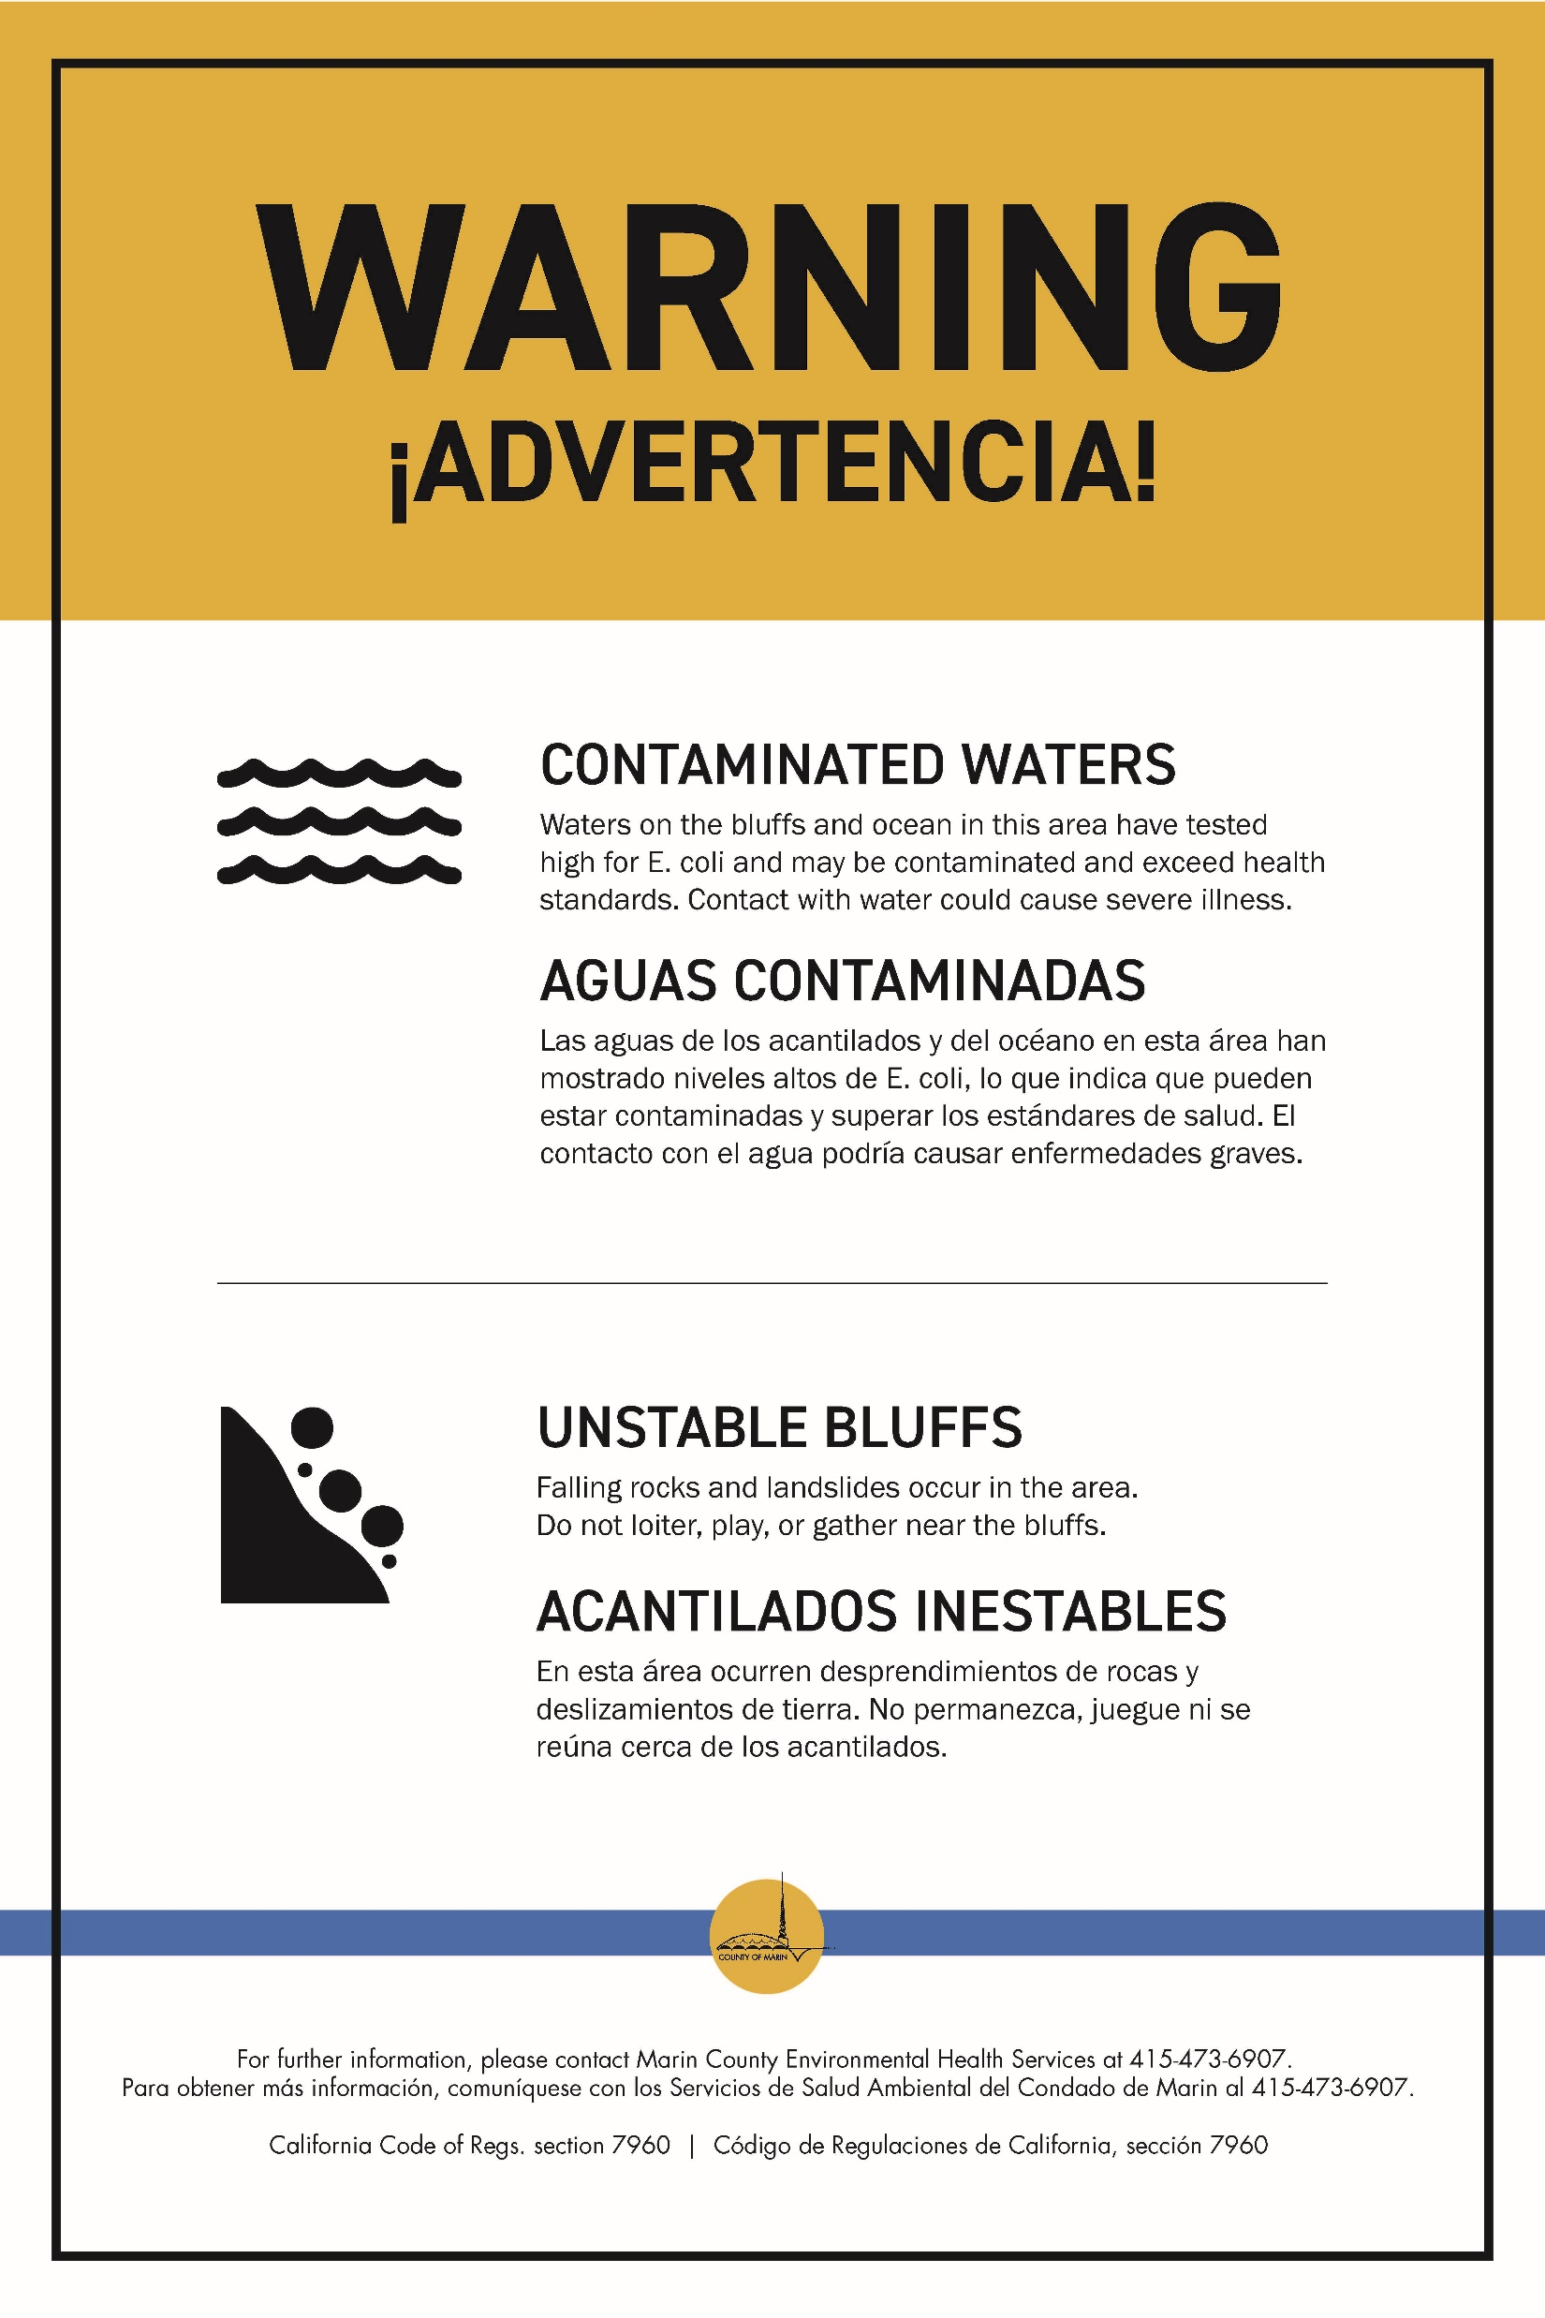
Miscellaneous Update (1 of 2): County Beach Warning Signs
County Staff alerted BCPUD that they would be posting Warning signs about contaminated waters at major beach access points.
This of course comes of the heels of the beach closure this past year.
BCPUD staff advised County Staff on the specific sites where community and visitors access the beach, but otherwise have not been involved in this effort.

Slide 23
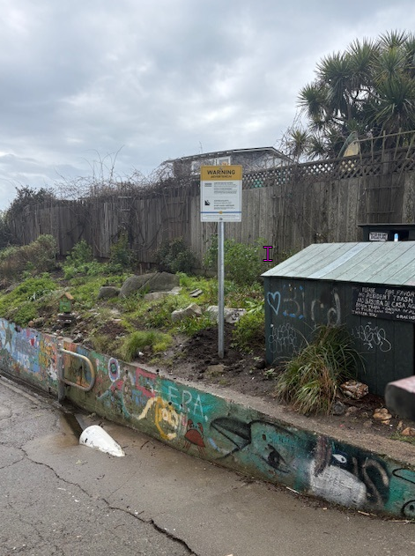
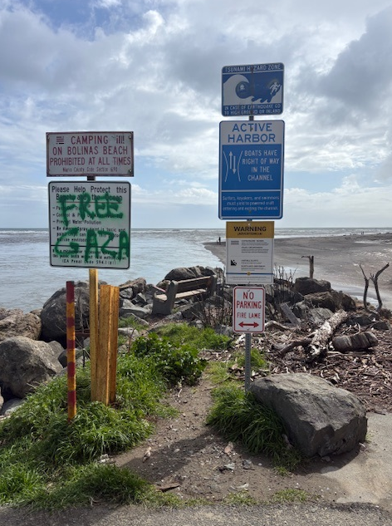
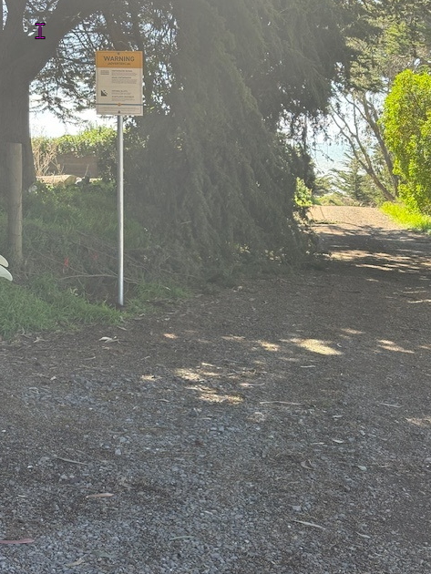
Miscellaneous Update (1 of 2): County Beach Warning Signs

Slide 24
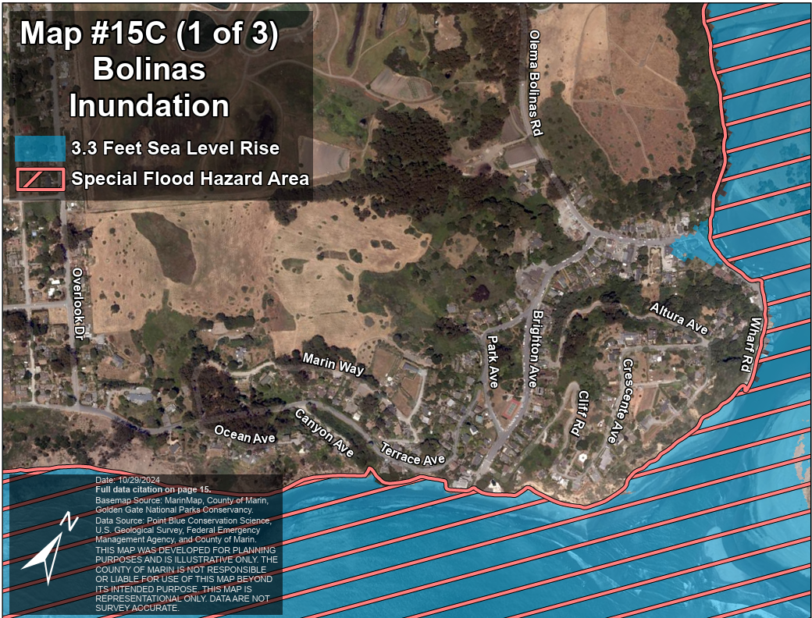
Miscellaneous Update (2 of 2): Stinson Water’s Ocean Protection Council Grant
We continue to work closely with Stinson Water on their OPC grant.
As a reminder to the Board and Public, this is a feasibility study to assess the potential for a “regional” solution to address wastewater needs in both communities. A primary aim of this study is to identify vulnerabilities of our wastewater infrastructure to sea level rise and to develop a proposal to mitigate and address those risks.
Recently, I have been working with the GM at Stinson Water to develop a request for proposal (RFP). I will share the RFP with the Board and Public once it is advertised in mid May.

