Slide 1
General Manager’s Update
June 18, 2025
Regular Board Meeting
Presented by Georgia Woods

Slide 2
Status of BCPUD’s Water Supply
Note May’s comprehensive Water Supply memo will soon be posted on our Website HERE.

Slide 3
Spring 2025 Water Usage Trends
PRODUCTION​
In May 2025, water production in the district averaged 163 gallons per day (GPD)​ per connection
This is UP from April's production, which averaged 128 GPD per connection​
​
CONSUMPTION​​
Water consumption in May averaged 159 GPD per connection
This is UP from April's consumption, which averaged 129 GPD per connection

Slide 4
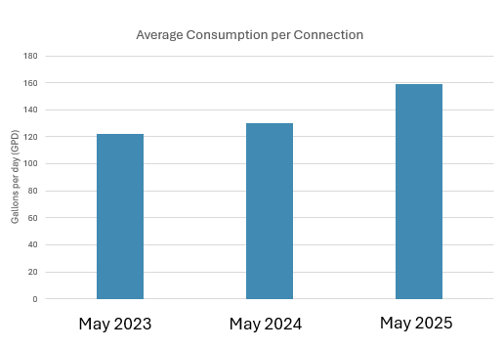
Comparison to past two years
Average use per connection:
May 2023 – 122 GPD
May 2024 – 130 GPD
May 2025 – 159 GPD
22% increase per connection compared to last May

Slide 5
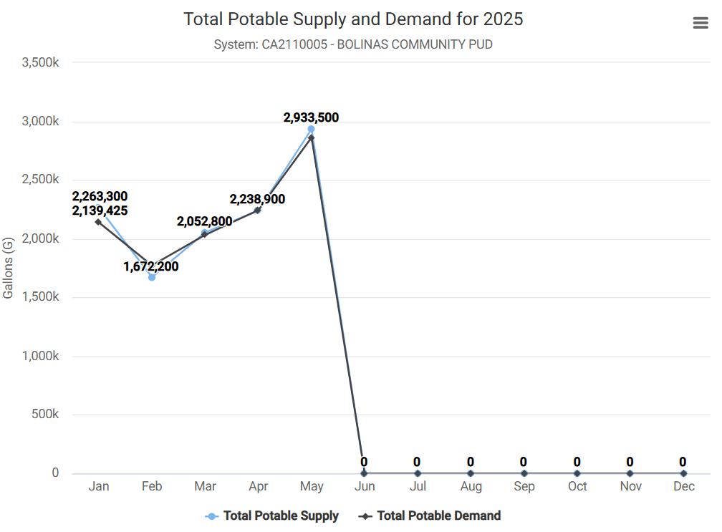
2025 Water Usage Trends

Slide 6
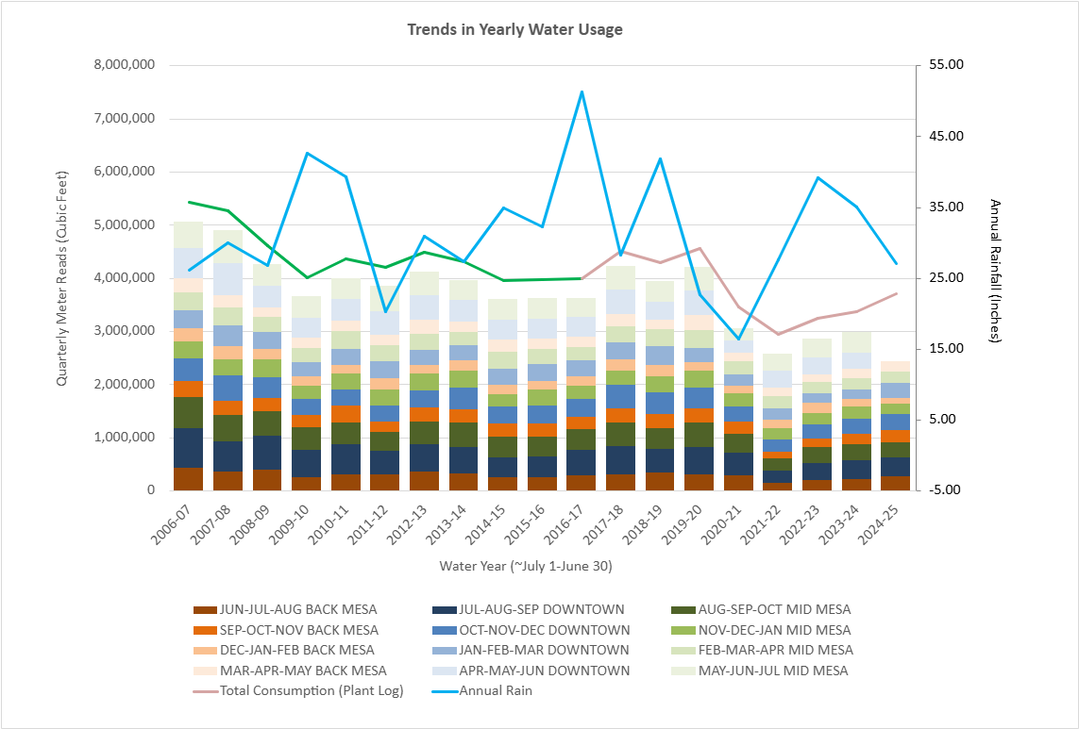
Annual Trends Since 2006
Quarterly Water Usage through May 2025
This graph shows “Cumulative Quarterly Water Usage”, as measured by “Regional Quarterly Water Meter Reads”
Remember: at the beginning of each month staff reads all meters within 1 of 3 given regions:
  1) BACK MESA
  2) DOWNTOWN
  3) MID MESA
Annual Rain Fall is plotted as a BLUE LINE
Town Consumption Estimates, based on the amount of water leaving the treatment plant daily is shown in PINK LINE.
GREEN LINE is an extension of pink line, which models consumption based on an absolute unaccounted for water loss of 437,856 CuFt (~10% loss)

Slide 7
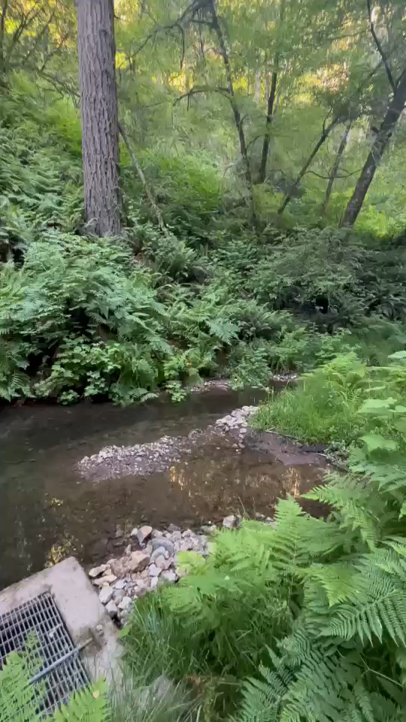
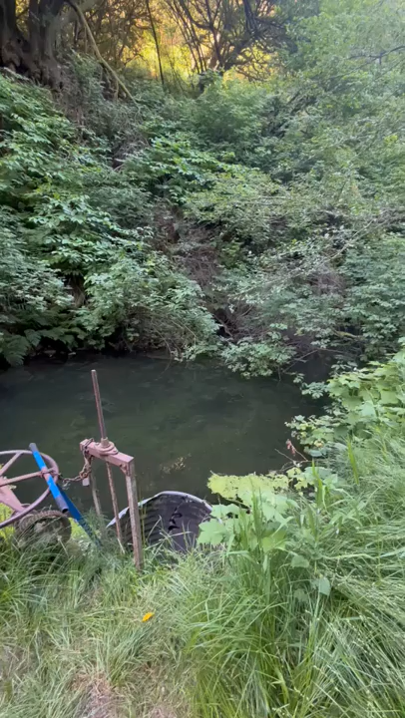
Upper impoundment was filled with rocks
Lower impoundment was spilling
Reminder of what the Arroyo Hondo looked like in May
We were drawing from the lower impoundment.
on 5/21/2025

Slide 8
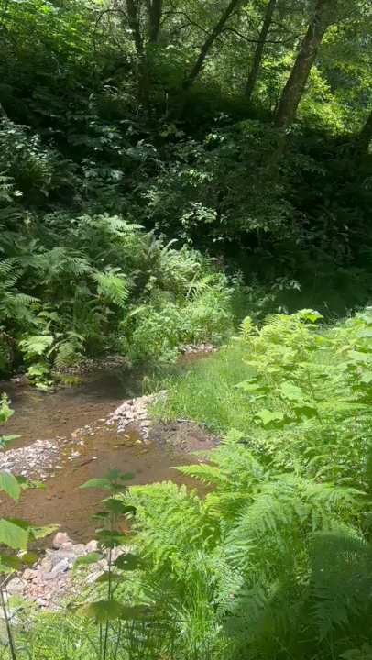
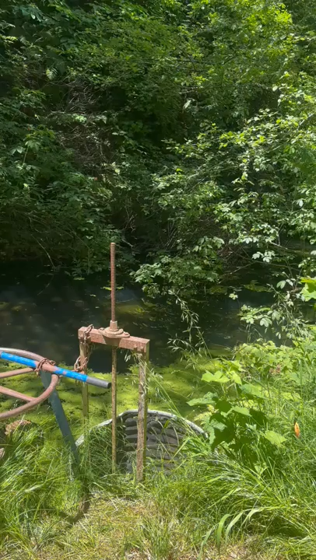
Upper impoundment: still filled!
What the Arroyo Hondo looks like today…
Lower impoundment: still spilling
We continue to draw from the lower impoundment very efficiently.
We were drawing at our plant max (118 gallons/min) and the lower was still spilling! Yay!
on 6/18/2025

Slide 9
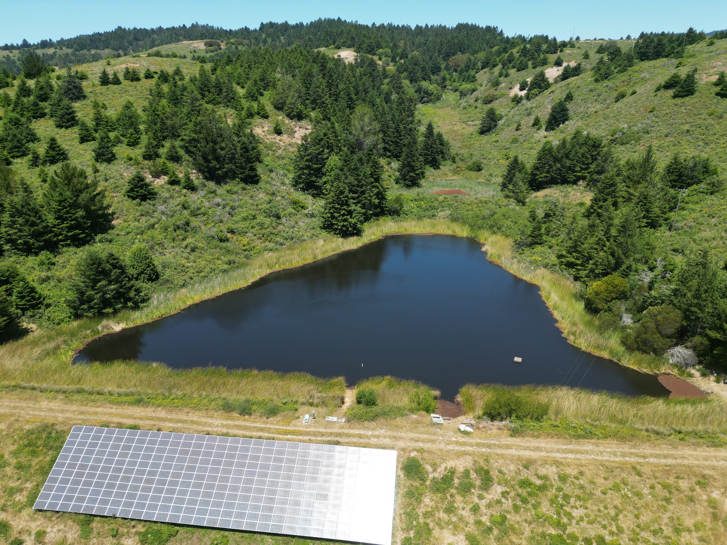
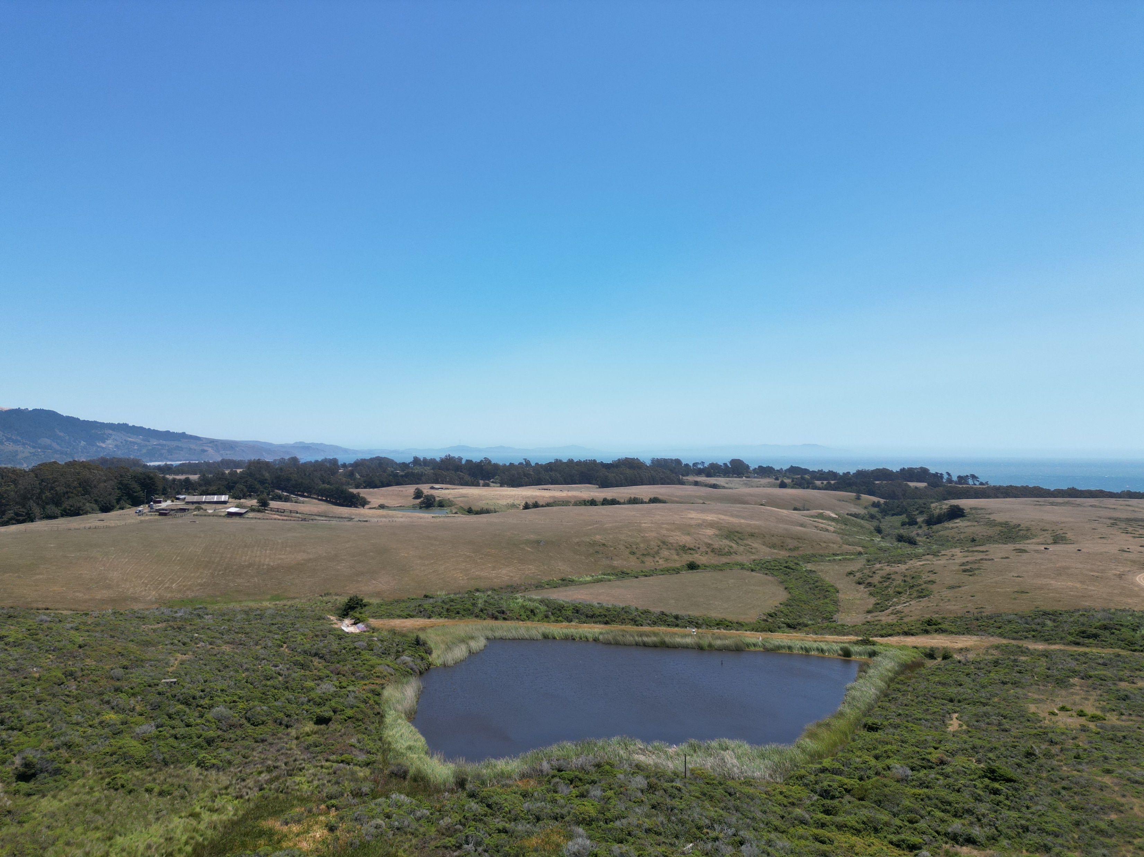
Woodrat 2 still spilling at a “Drip Rate” and Woodrat 1 no longer spilling.
Woodrat 2 on 6/18/2025
Woodrat 1 on 6/18/2025

Slide 10
Operations Updates

Slide 11
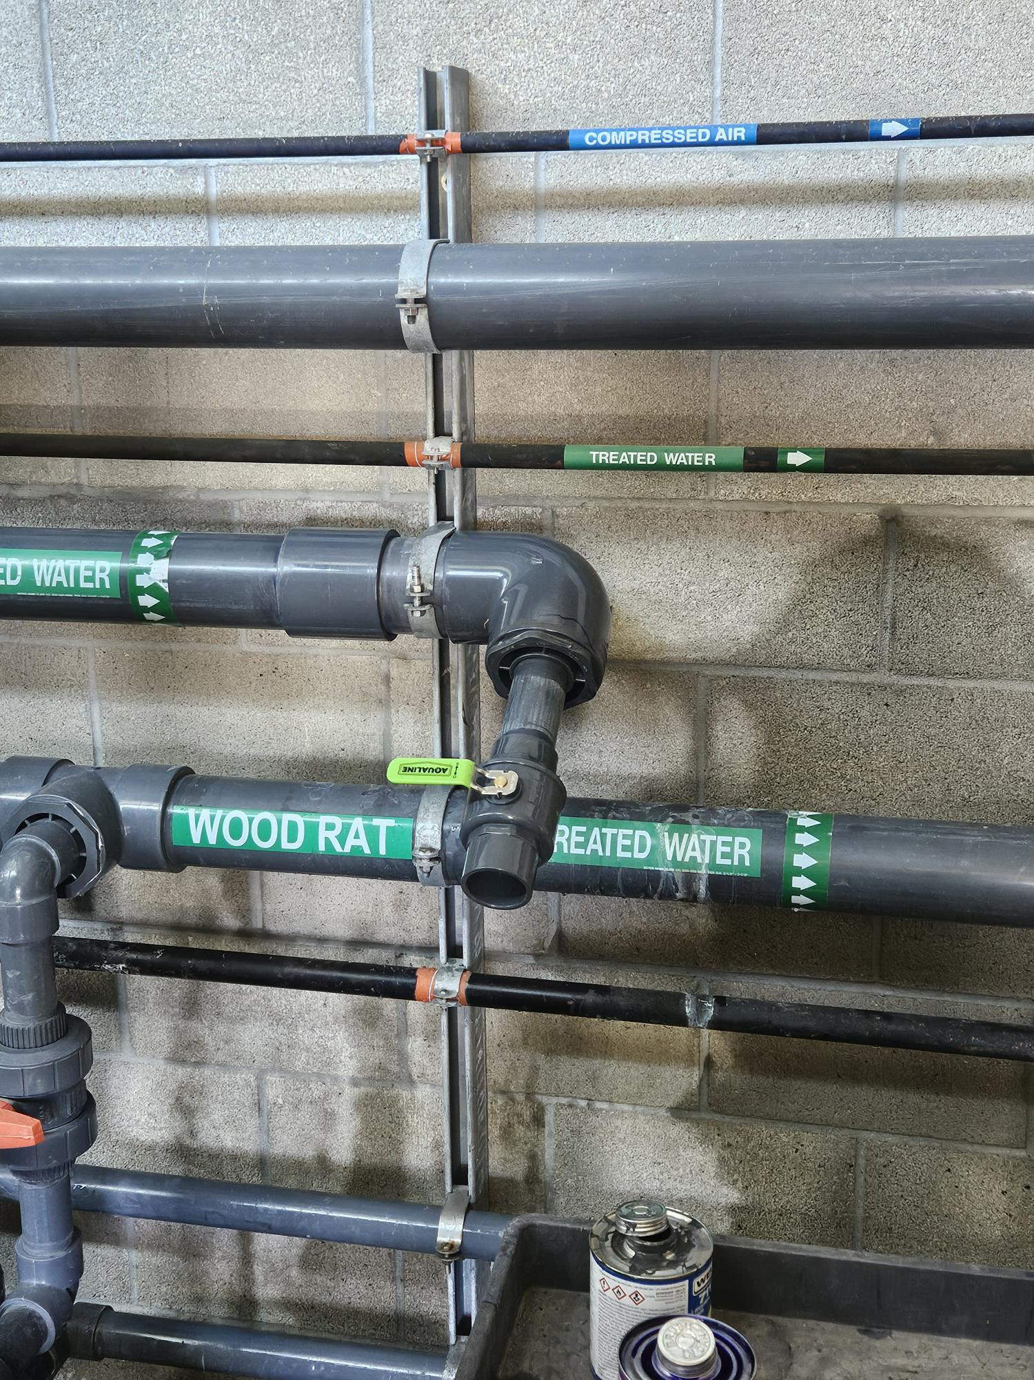
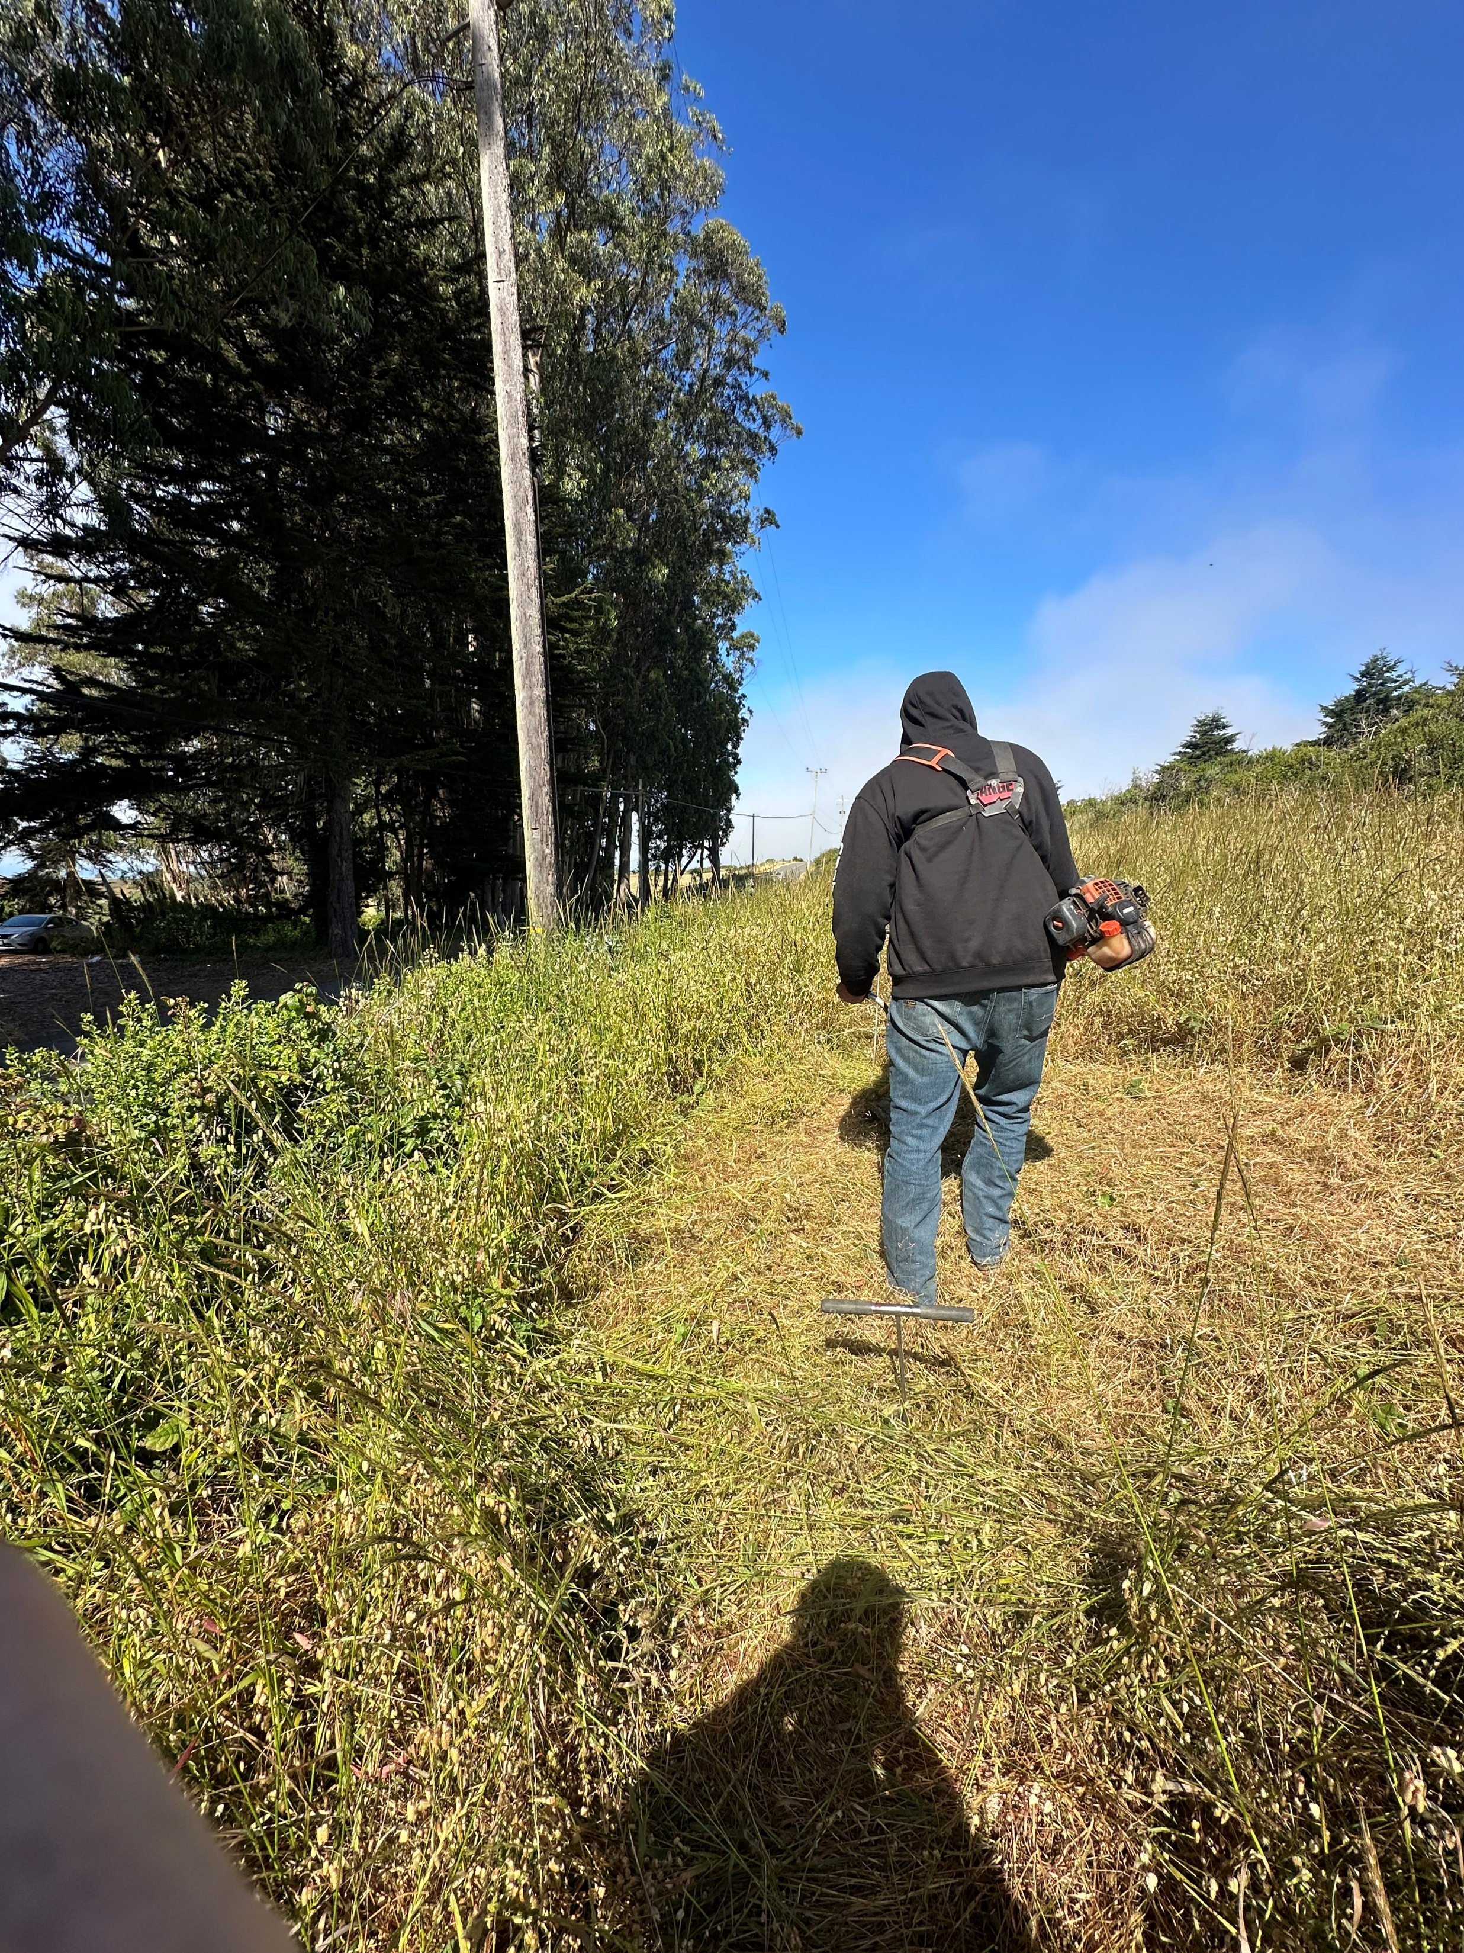
Operations Update (1 of 5): LEAKS
Only minor leaks this past month!
  One on the booster line (will be repaired tomorrow)
  One on “circulation wall” at the plant (repaired Monday)
on 6/18/2025

Slide 12
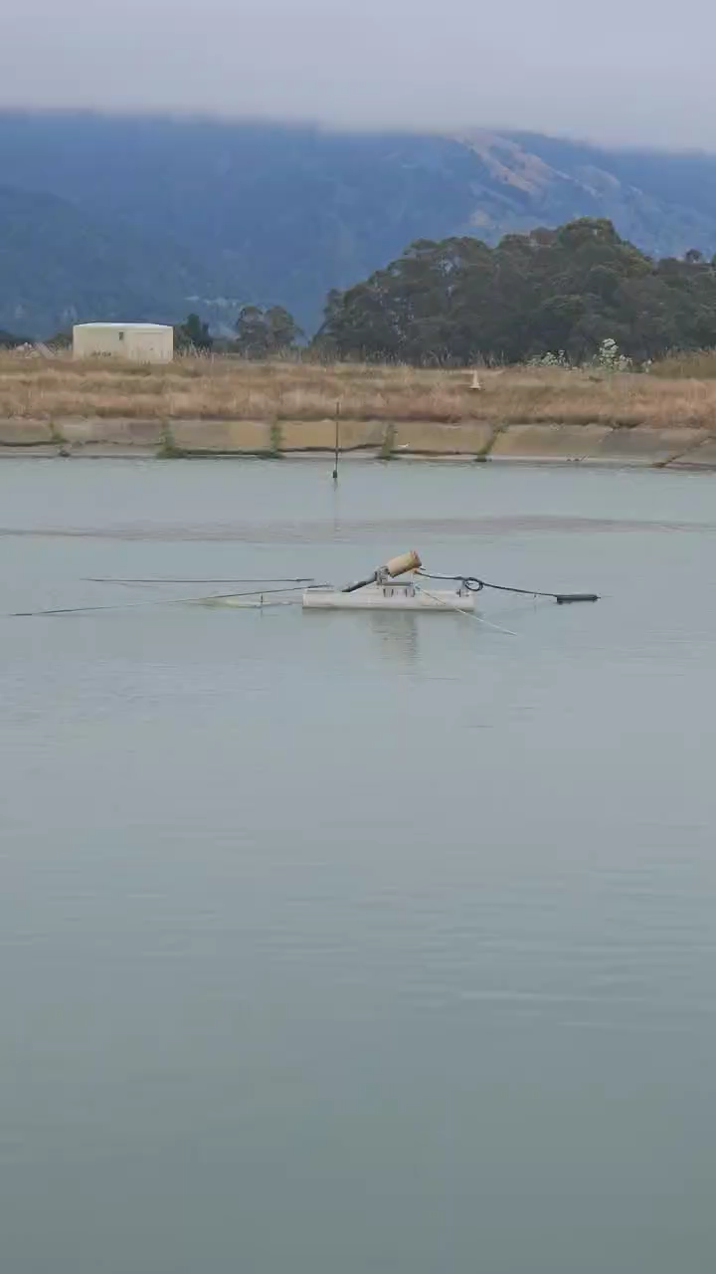
Operations Update (2 of 5): Aerator on 1B
Aerator was not working this last month or so.
Timer was bad and causing electrical interference.
Timer was automated and designed to save power (though we didn’t actually use it).
Mesa Electric repaired Aerator on Pond 1B by removing timer.
BODs are looking good!
on 6/18/2025

Slide 13
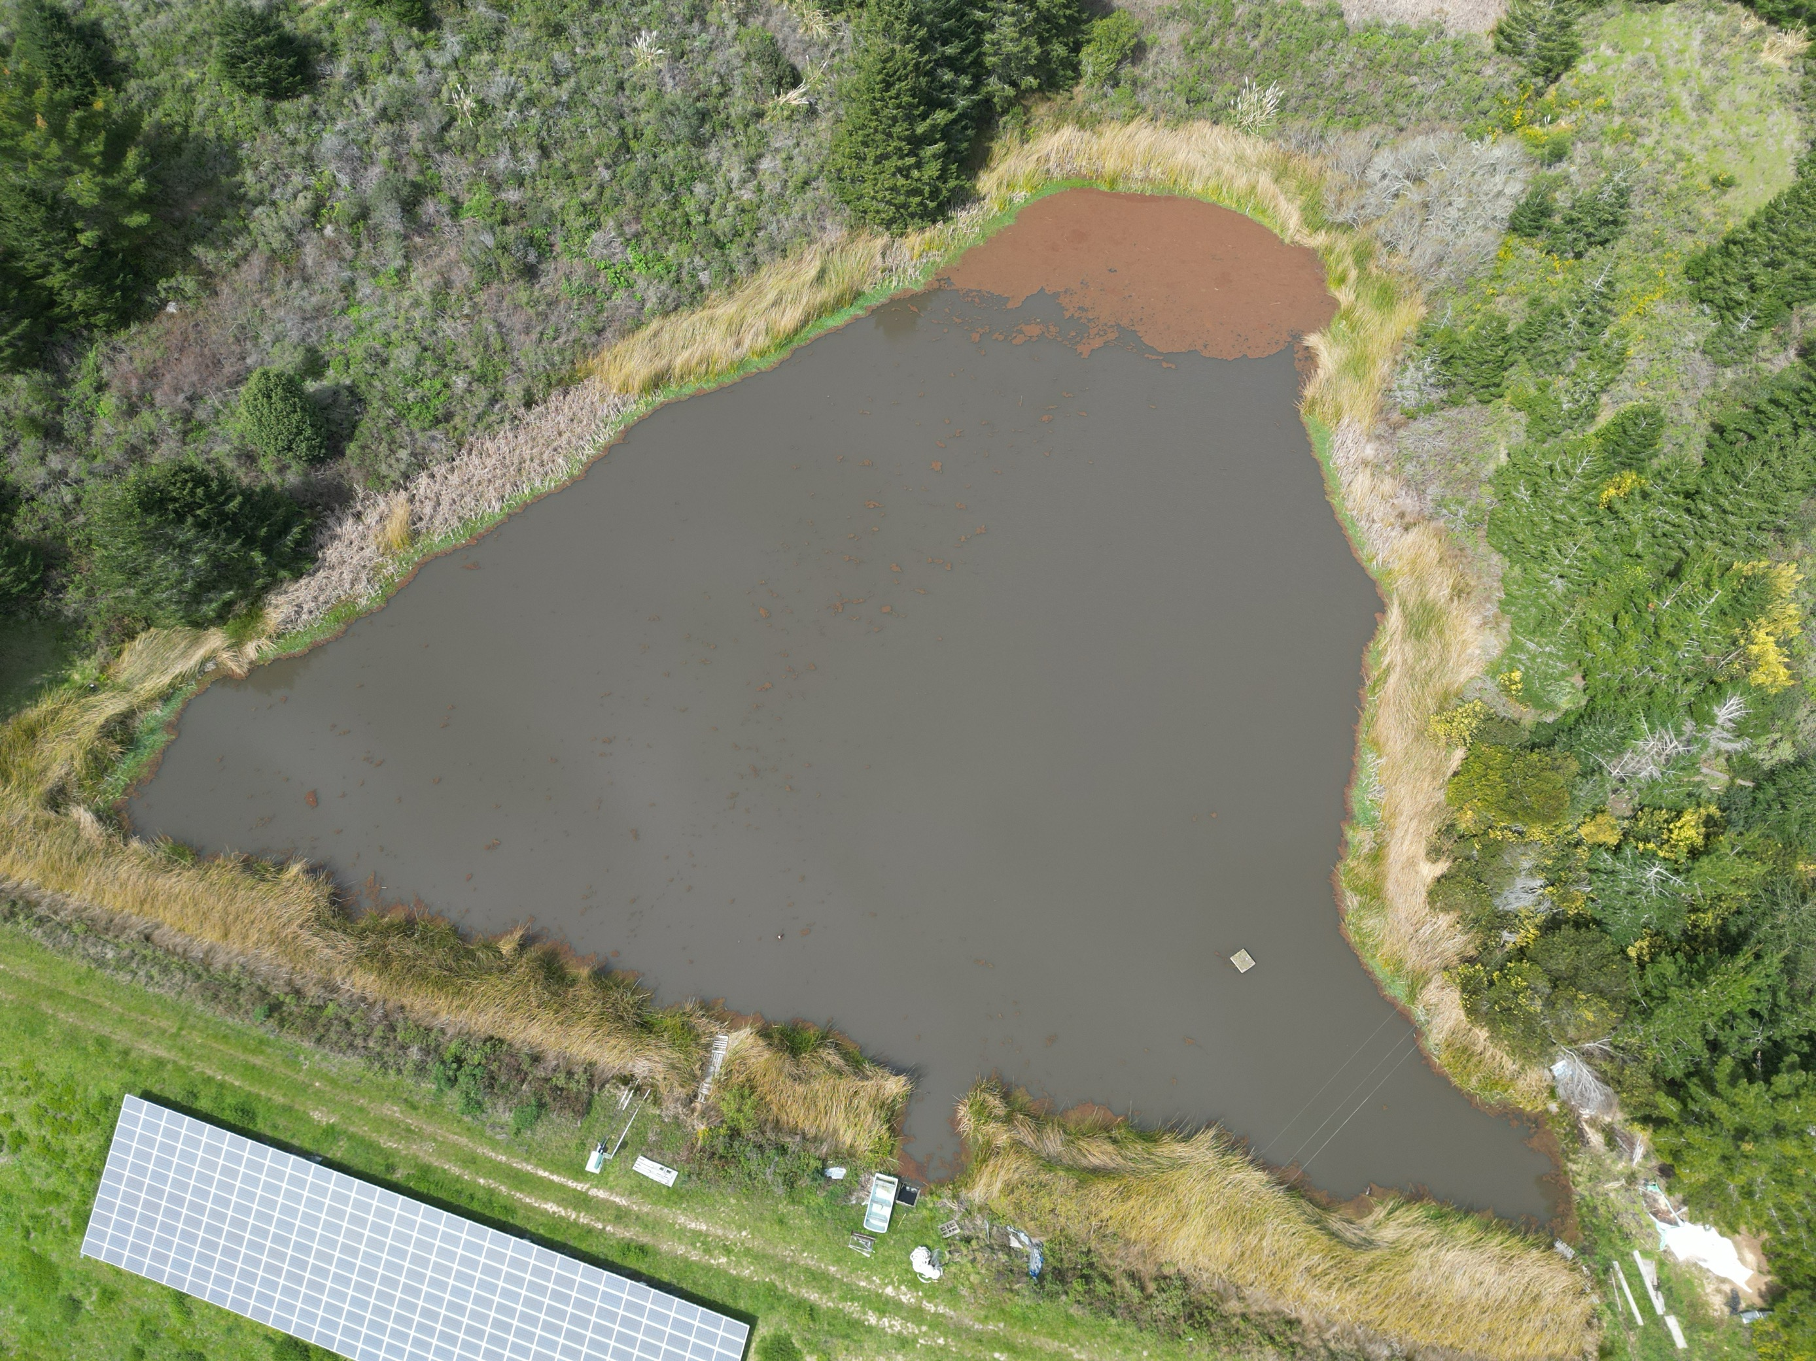
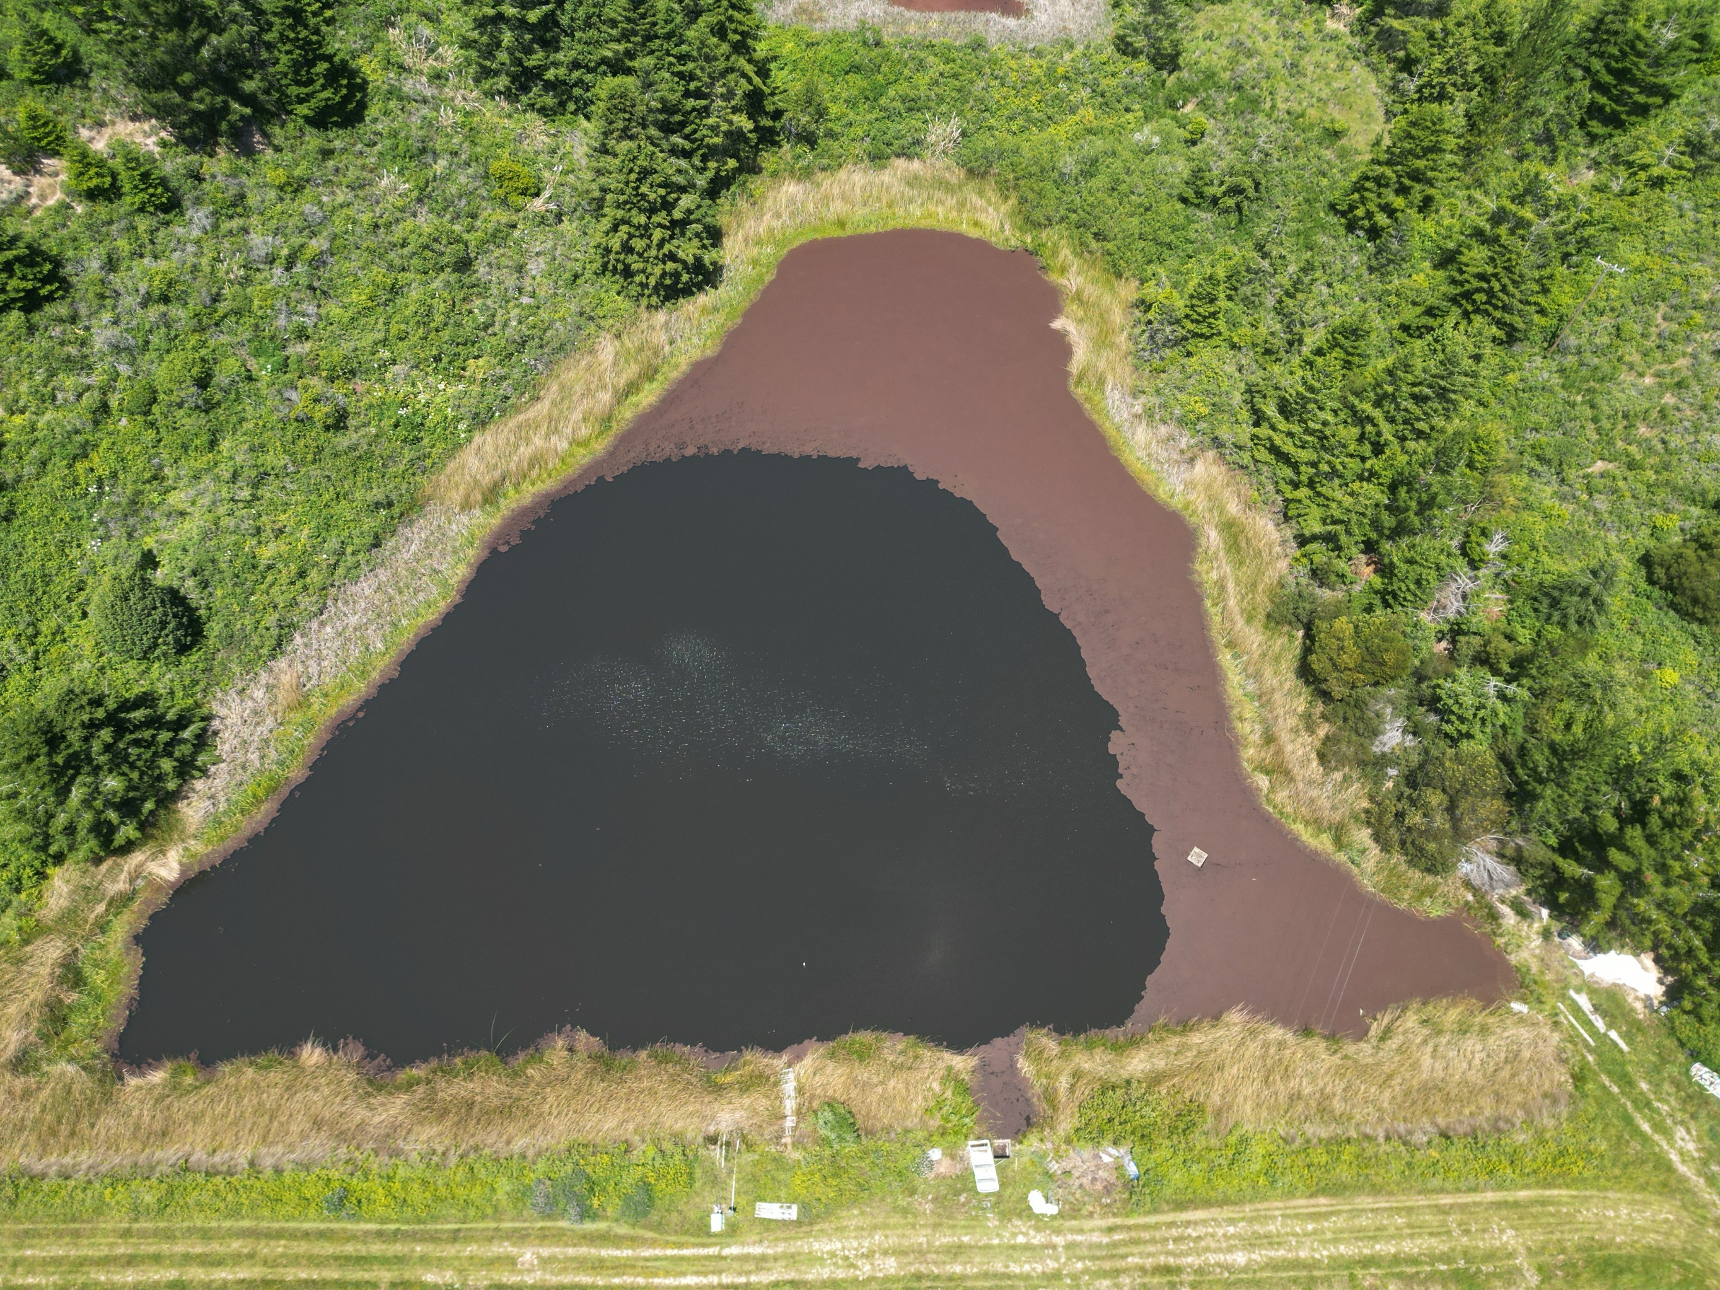

Operations Update (3 of 5): Azolla status on WR 1
Woodrat 1 on 3/19/2025
Woodrat 1 on 5/19/2025
Woodrat 1 on 6/18/2025
Aquatic Resource Management (ARM) did 3 days of removal in July 2024 ($7,440).
ARM did 2 days (14 hrs) of removal in January 2025 ($5,640).
Going forward, we were hoping to get them out 3 times a year (1 day/visit) for total of ~24 hrs and $9K/year.
ARM said not really feasible to do this due to mobilization—need to do 2 days per visit.
ARM removed azolla on 06/04-06/05 ($6,240).
So total for the FY 2024/2025 was $19,3220! (though probably closer to $13,000/ 12 mo.).
In the FY 2024/2025 we only used WR1 Reservoir for 5 days in Oct to supplement Arroyo Hondo source.

Slide 14
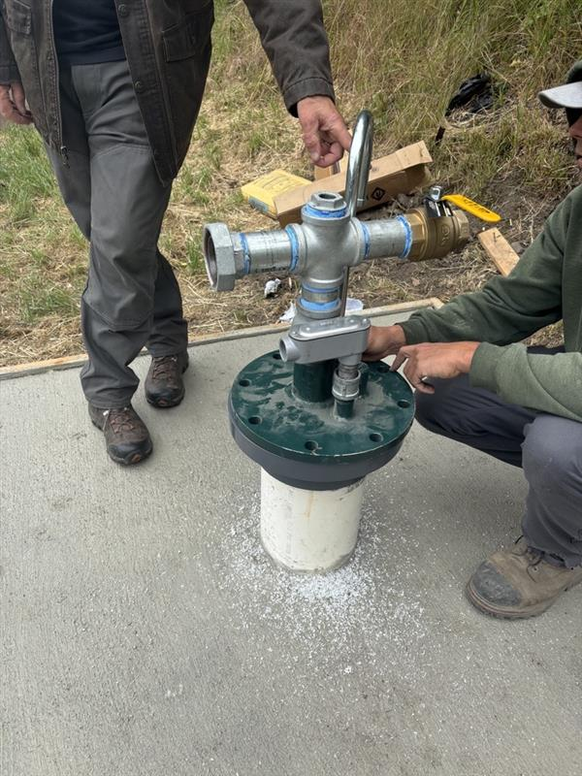
Operations Update (4 of 5): Well Projects
Well Projects are moving along through the construction phase!
Weeks Drilling installed the pump at 31 Wharf
We continued to prep the treatment site at Mesa Park for the RR Well
We continue to have meetings with BCLT and Habitat for Humanity to coordinate design of the Well Project and the Housing Project.

Slide 15
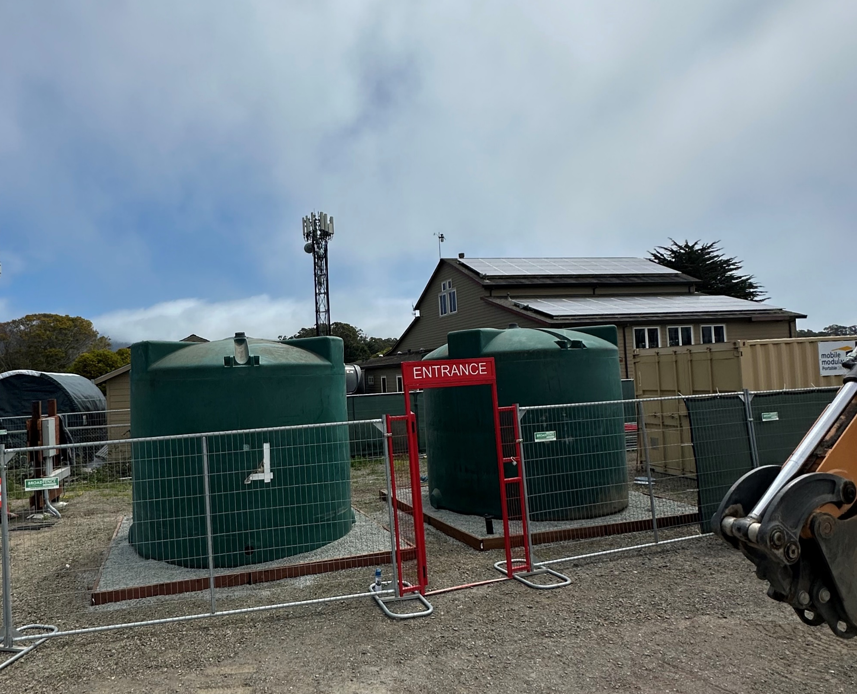
Water tanks installed on Mesa Park site platforms with fencing

Slide 16
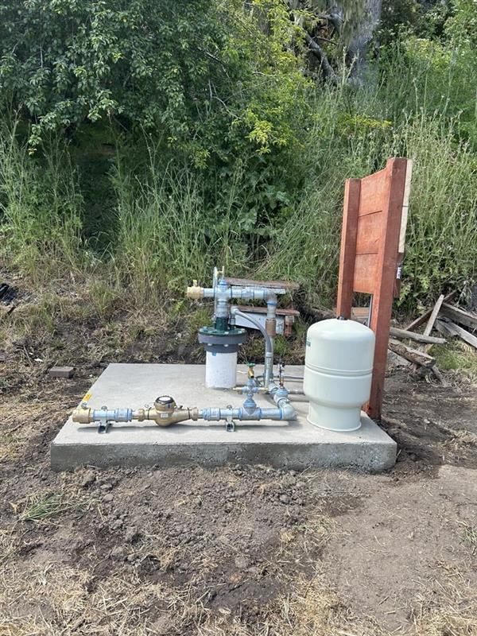
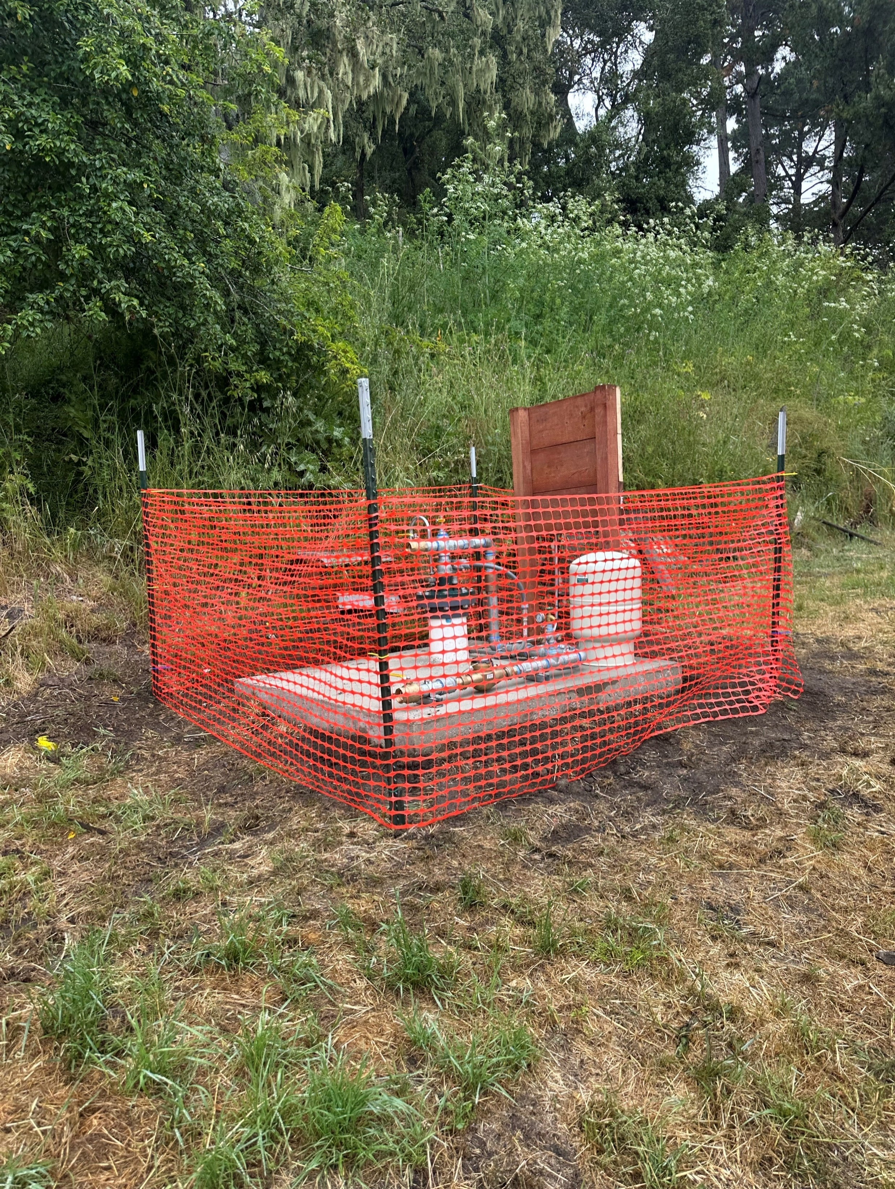
Well pump installed at 31 Wharf site
Well pump with temporary fencing

Slide 17
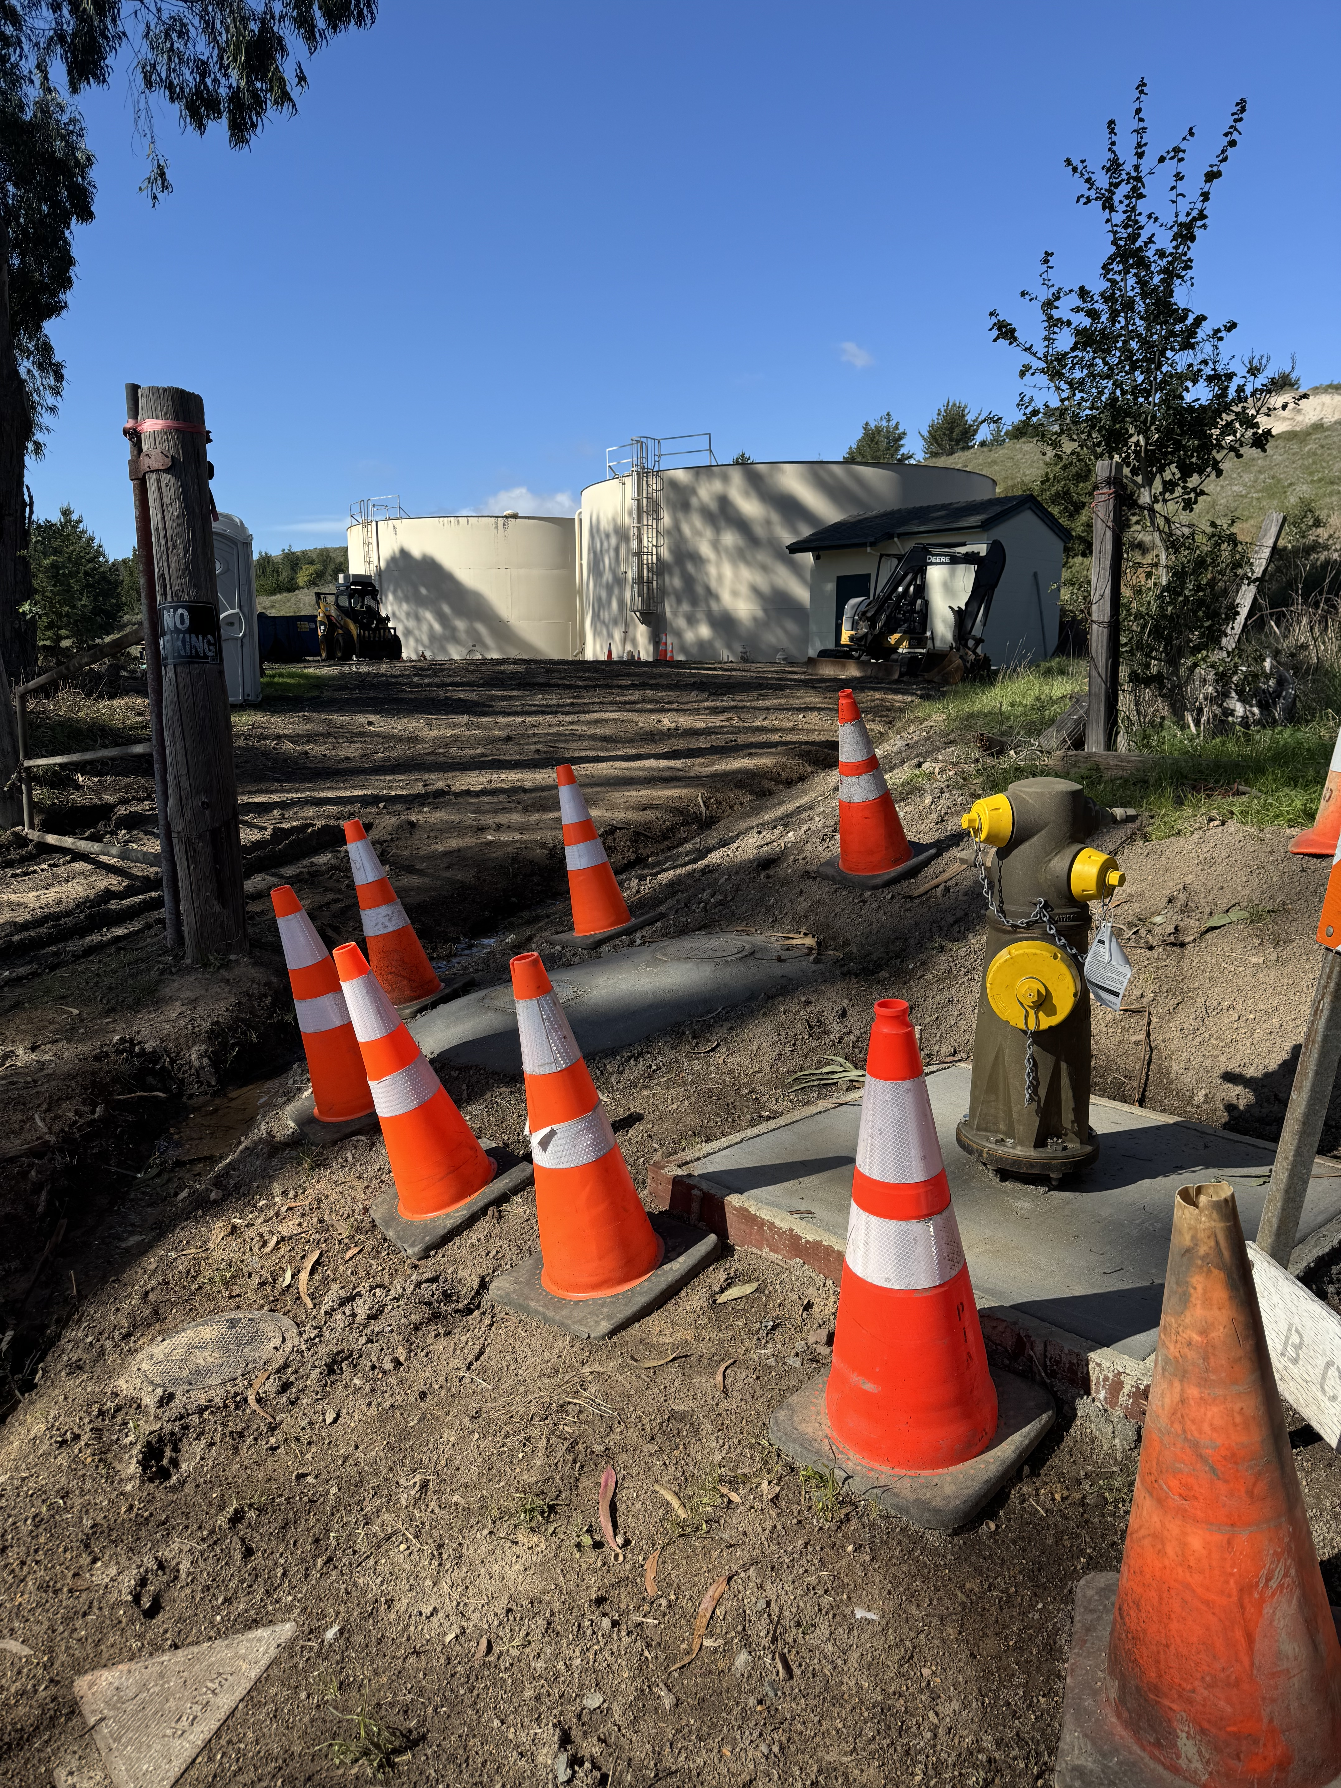
Operations Update (5 of 5): Tank-Site Pipeline Replacement project
We met with Engineer on May 30 to wrap up the project.
Unfortunately, there is still electrical work that needs to be “cleaned-up” so we can read digital display in the booster pump house.
After all work is finalized, I will present a special report summarizing total costs and closing out the project. Am very much hoping we can resolve this before the end of the FY 2024/2025.

Slide 18
Miscellaneous Updates

Slide 19
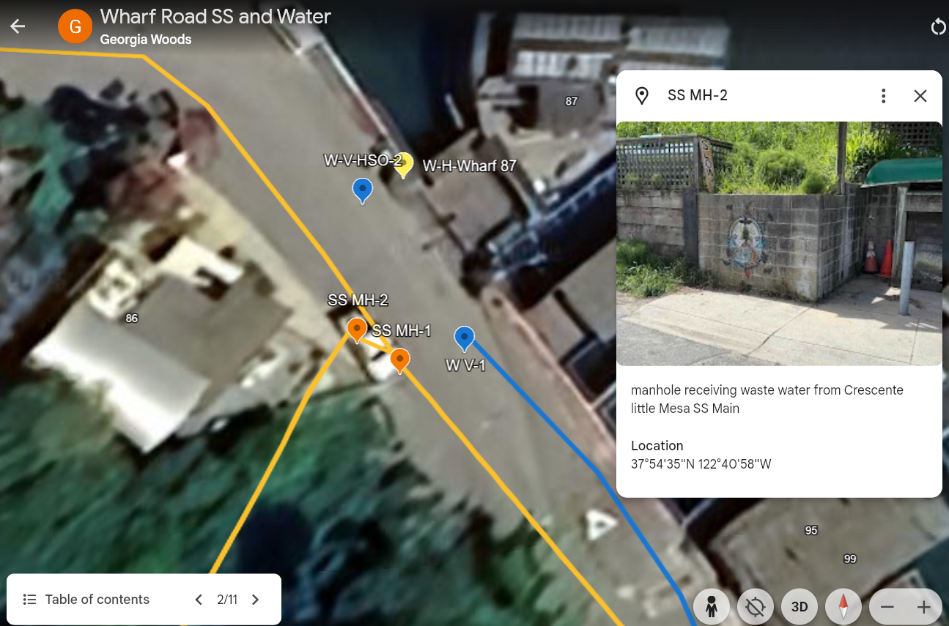
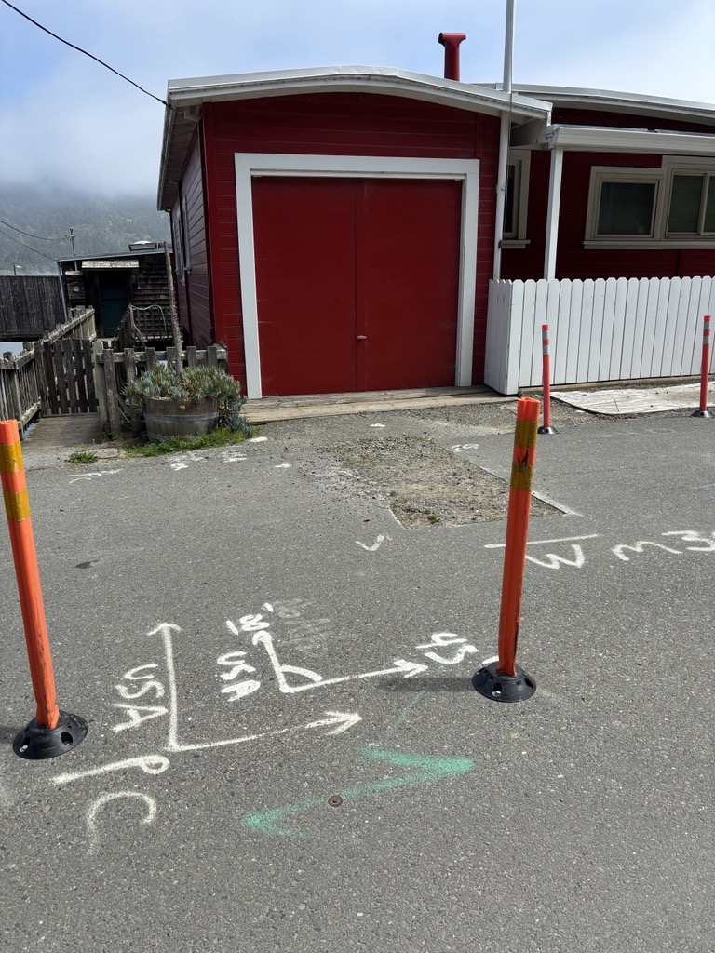
Miscellaneous Update (1 of 3): County Repair of Wharf Road
On June 2, Director Walker and I met with DPW Engineers to discuss their project to repair the road at #95 Wharf.
The current plan is as follows:
  County to undertake "temporary protective measure" between September and October (no planned drilling; no water/sewer shutdowns)
  County to seek grant funds for more comprehensive project that will involve drilling
  FY 25/26 BCPUD to seek engineering proposal for slip-lining and relocating water main inland
  ~FY 26/27 BCPUD moves water main and slip-lines sewer
After 26/27, County has tentative plans to pursue a FEMA funded project to more comprehensively repair the road for the long-term.

Slide 20
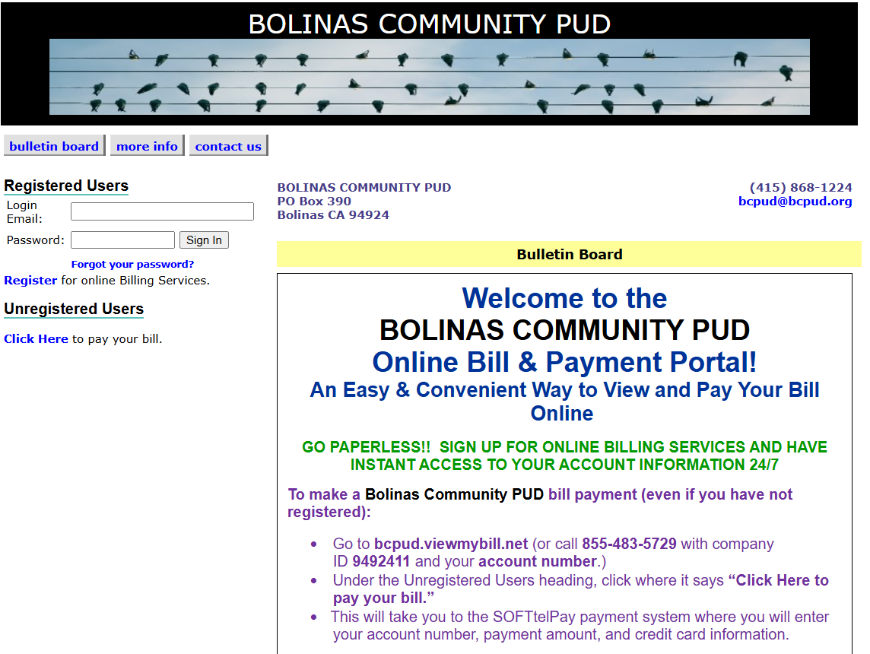
Miscellaneous Update (2 of 3): Automated Billing
A handful of eligible BCPUD staff and Board members (6 people total) have signed up for e-billing and paid their water bill online! The payments have been received in BCPUD’s bank account. The process has been straightforward and Annie is excited to launch the online payment option to the public.
Feedback from participating Board members?
  Do you want to direct Staff to launch the program and solicit customers to sign up for online billing in July's outgoing bills and through other public outreach…
  OR do you want this item to be agendized at July meeting and e-billing to be launched in August or September?

Slide 21
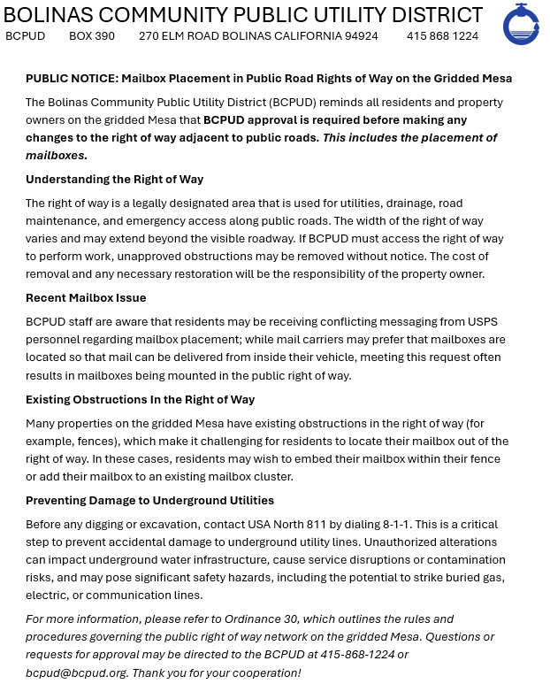
Miscellaneous Update (3 of 3):
Update in our communications to the public regarding encroachment into the right of way and directing public to not install mailboxes in the ROW
As the Board directed at last month's meeting, BCPUD staff prepared another outgoing message regarding the ROW and emphasized mailboxes this time.

