Slide 1
General Manager’s Update
January 15, 2025
Regular Board Meeting
Presented by Georgia Woods

Slide 2
Status of BCPUD’s Water Supply
Note December’s comprehensive Water Supply memo will soon be posted on our Website HERE.

Slide 3
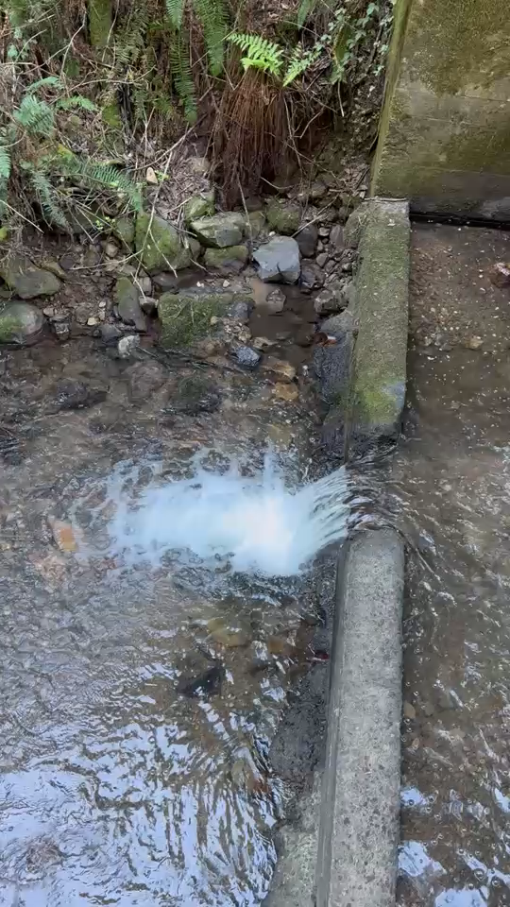
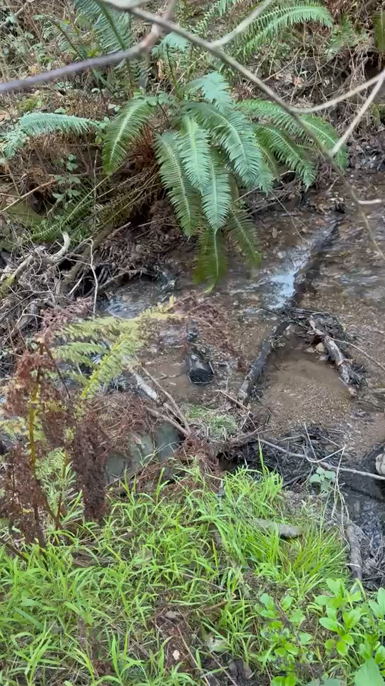
Upper impoundment
Lower impoundment
Arroyo Hondo:
on 1/8/2025
on 1//2025

Slide 4
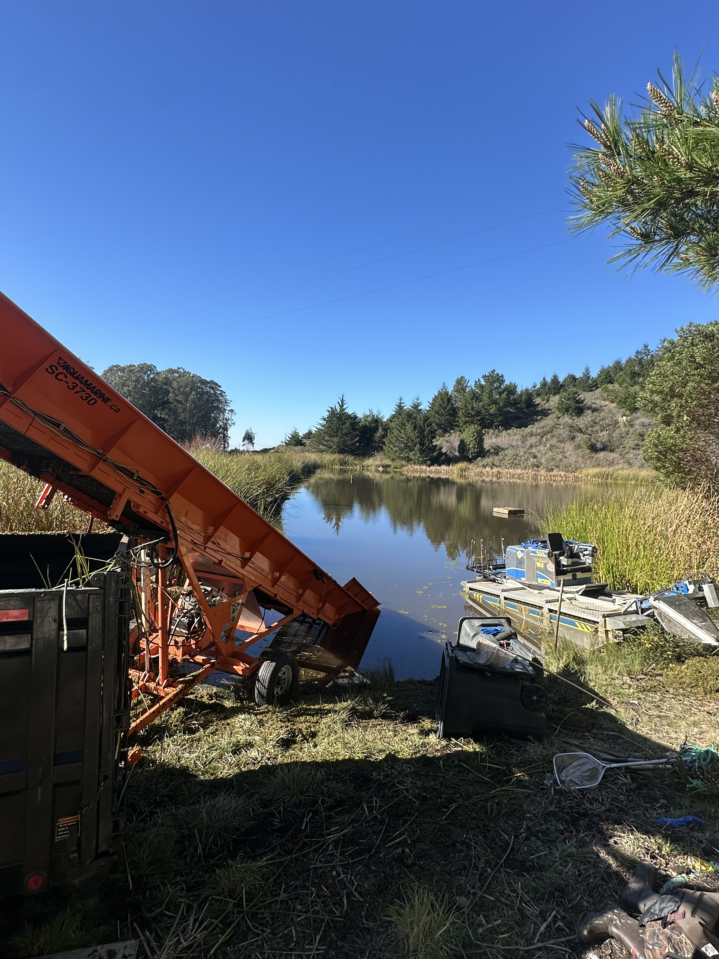
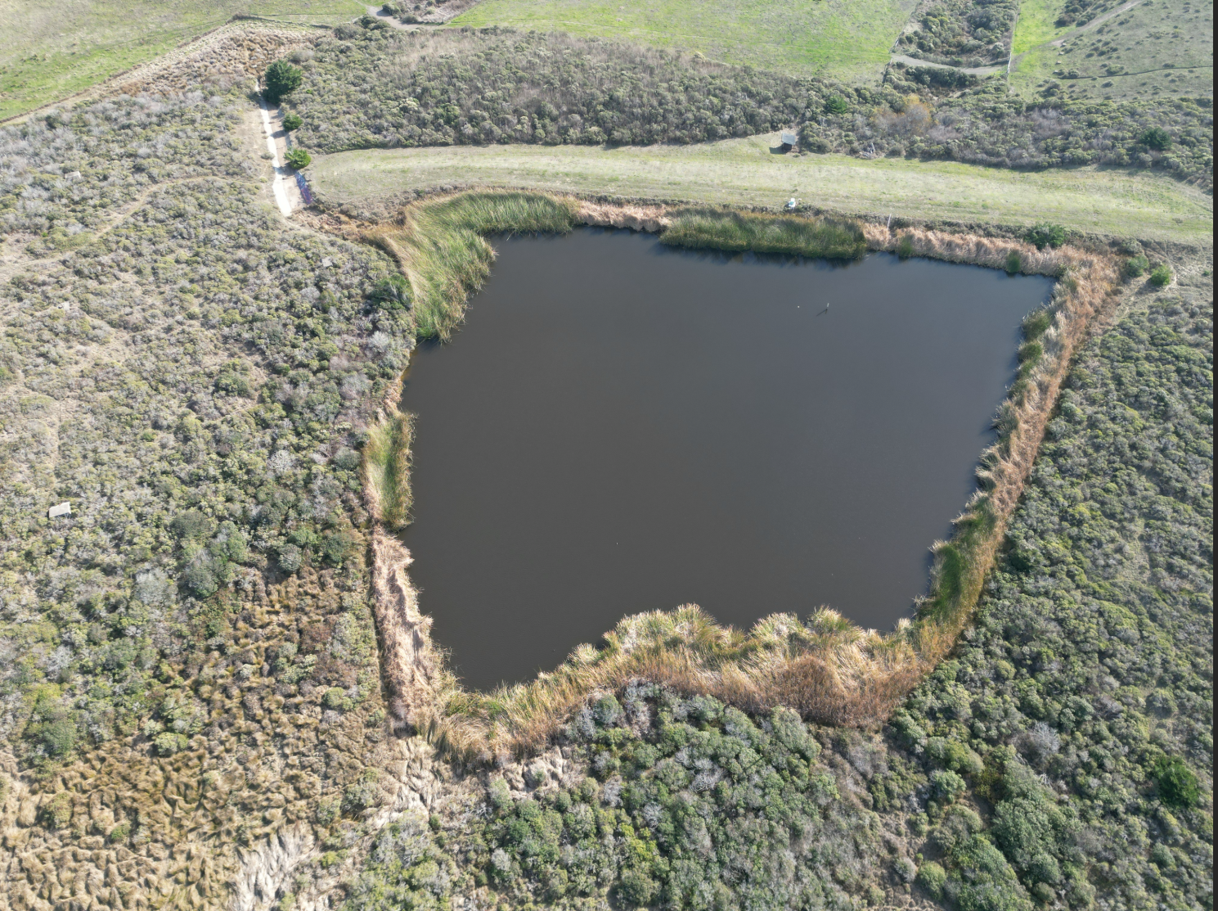
Woodrat 1 on 1/15/2025
The Reservoirs:
Woodrat 2
on 12/3/2024
Azolla was removed yesterday and today

Slide 5
Winter 2024 Water Usage Trends
PRODUCTION​
In December 2024, water production in the district averaged 93 gallons per day (GPD)​ per connection
This is DOWN from November's production, which averaged 155 GPD per connection​
​
CONSUMPTION​​
Water consumption in December averaged 117 GPD per connection
This is DOWN from November consumption, which averaged 151 GPD per connection.

Slide 6
Comparison to past two years
Average use per connection:
Dec 2022 – 107 GPD
Dec 2023 – 105 GPD
Dec 2024 – 117 GPD
11% increase per connection compared to last December (leaks undoubtably contributed to higher consumption numbers)

Slide 7
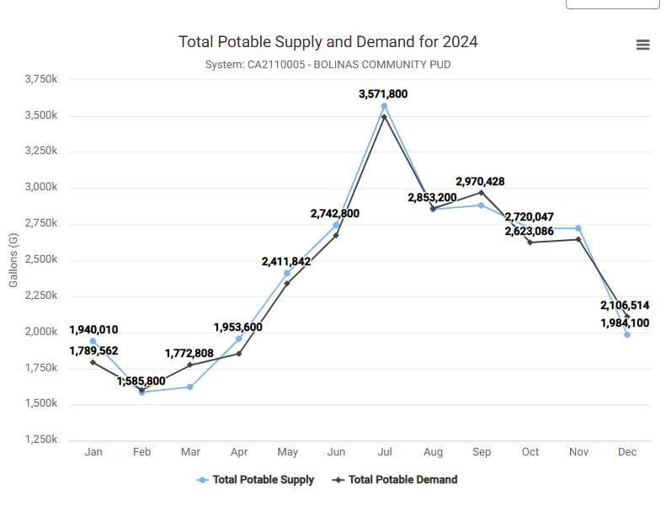
2024 Water Usage Trends

Slide 8
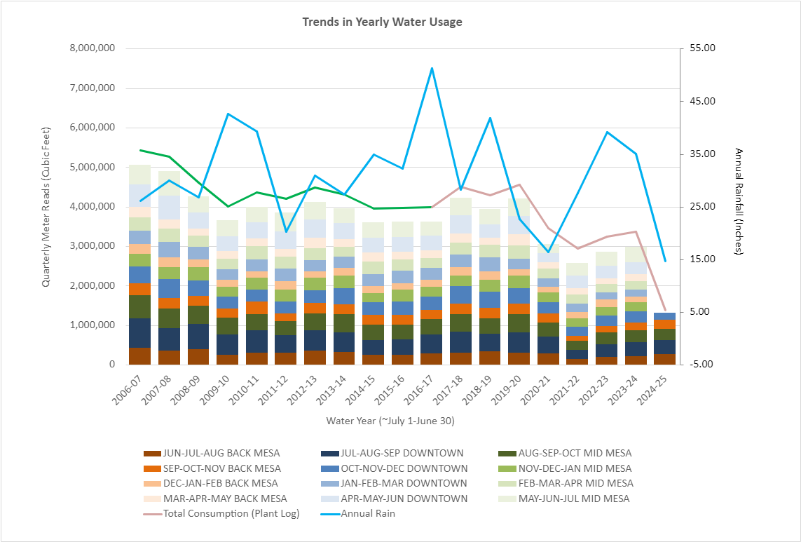
Annual Trends Since 2006 Quarterly Water Usage through Dec 2024
This graph shows “Cumulative Quarterly Water Usage”, as measured by “Regional Quarterly Water Meter Reads”
Remember: at the beginning of each month staff reads all meters within 1 of 3 given regions:
1) BACK MESA
2) DOWNTOWN
3) MID MESA
Annual Rain Fall is plotted as a BLUE LINE
Town Consumption Estimates, based on the amount of water leaving the treatment plant daily is shown in PINK LINE.
GREEN LINE is an extension of pink line, which models consumption based on an absolute unaccounted for water loss of 437,856 CuFt (~10% loss)

Slide 9
Operations Updates

Slide 10
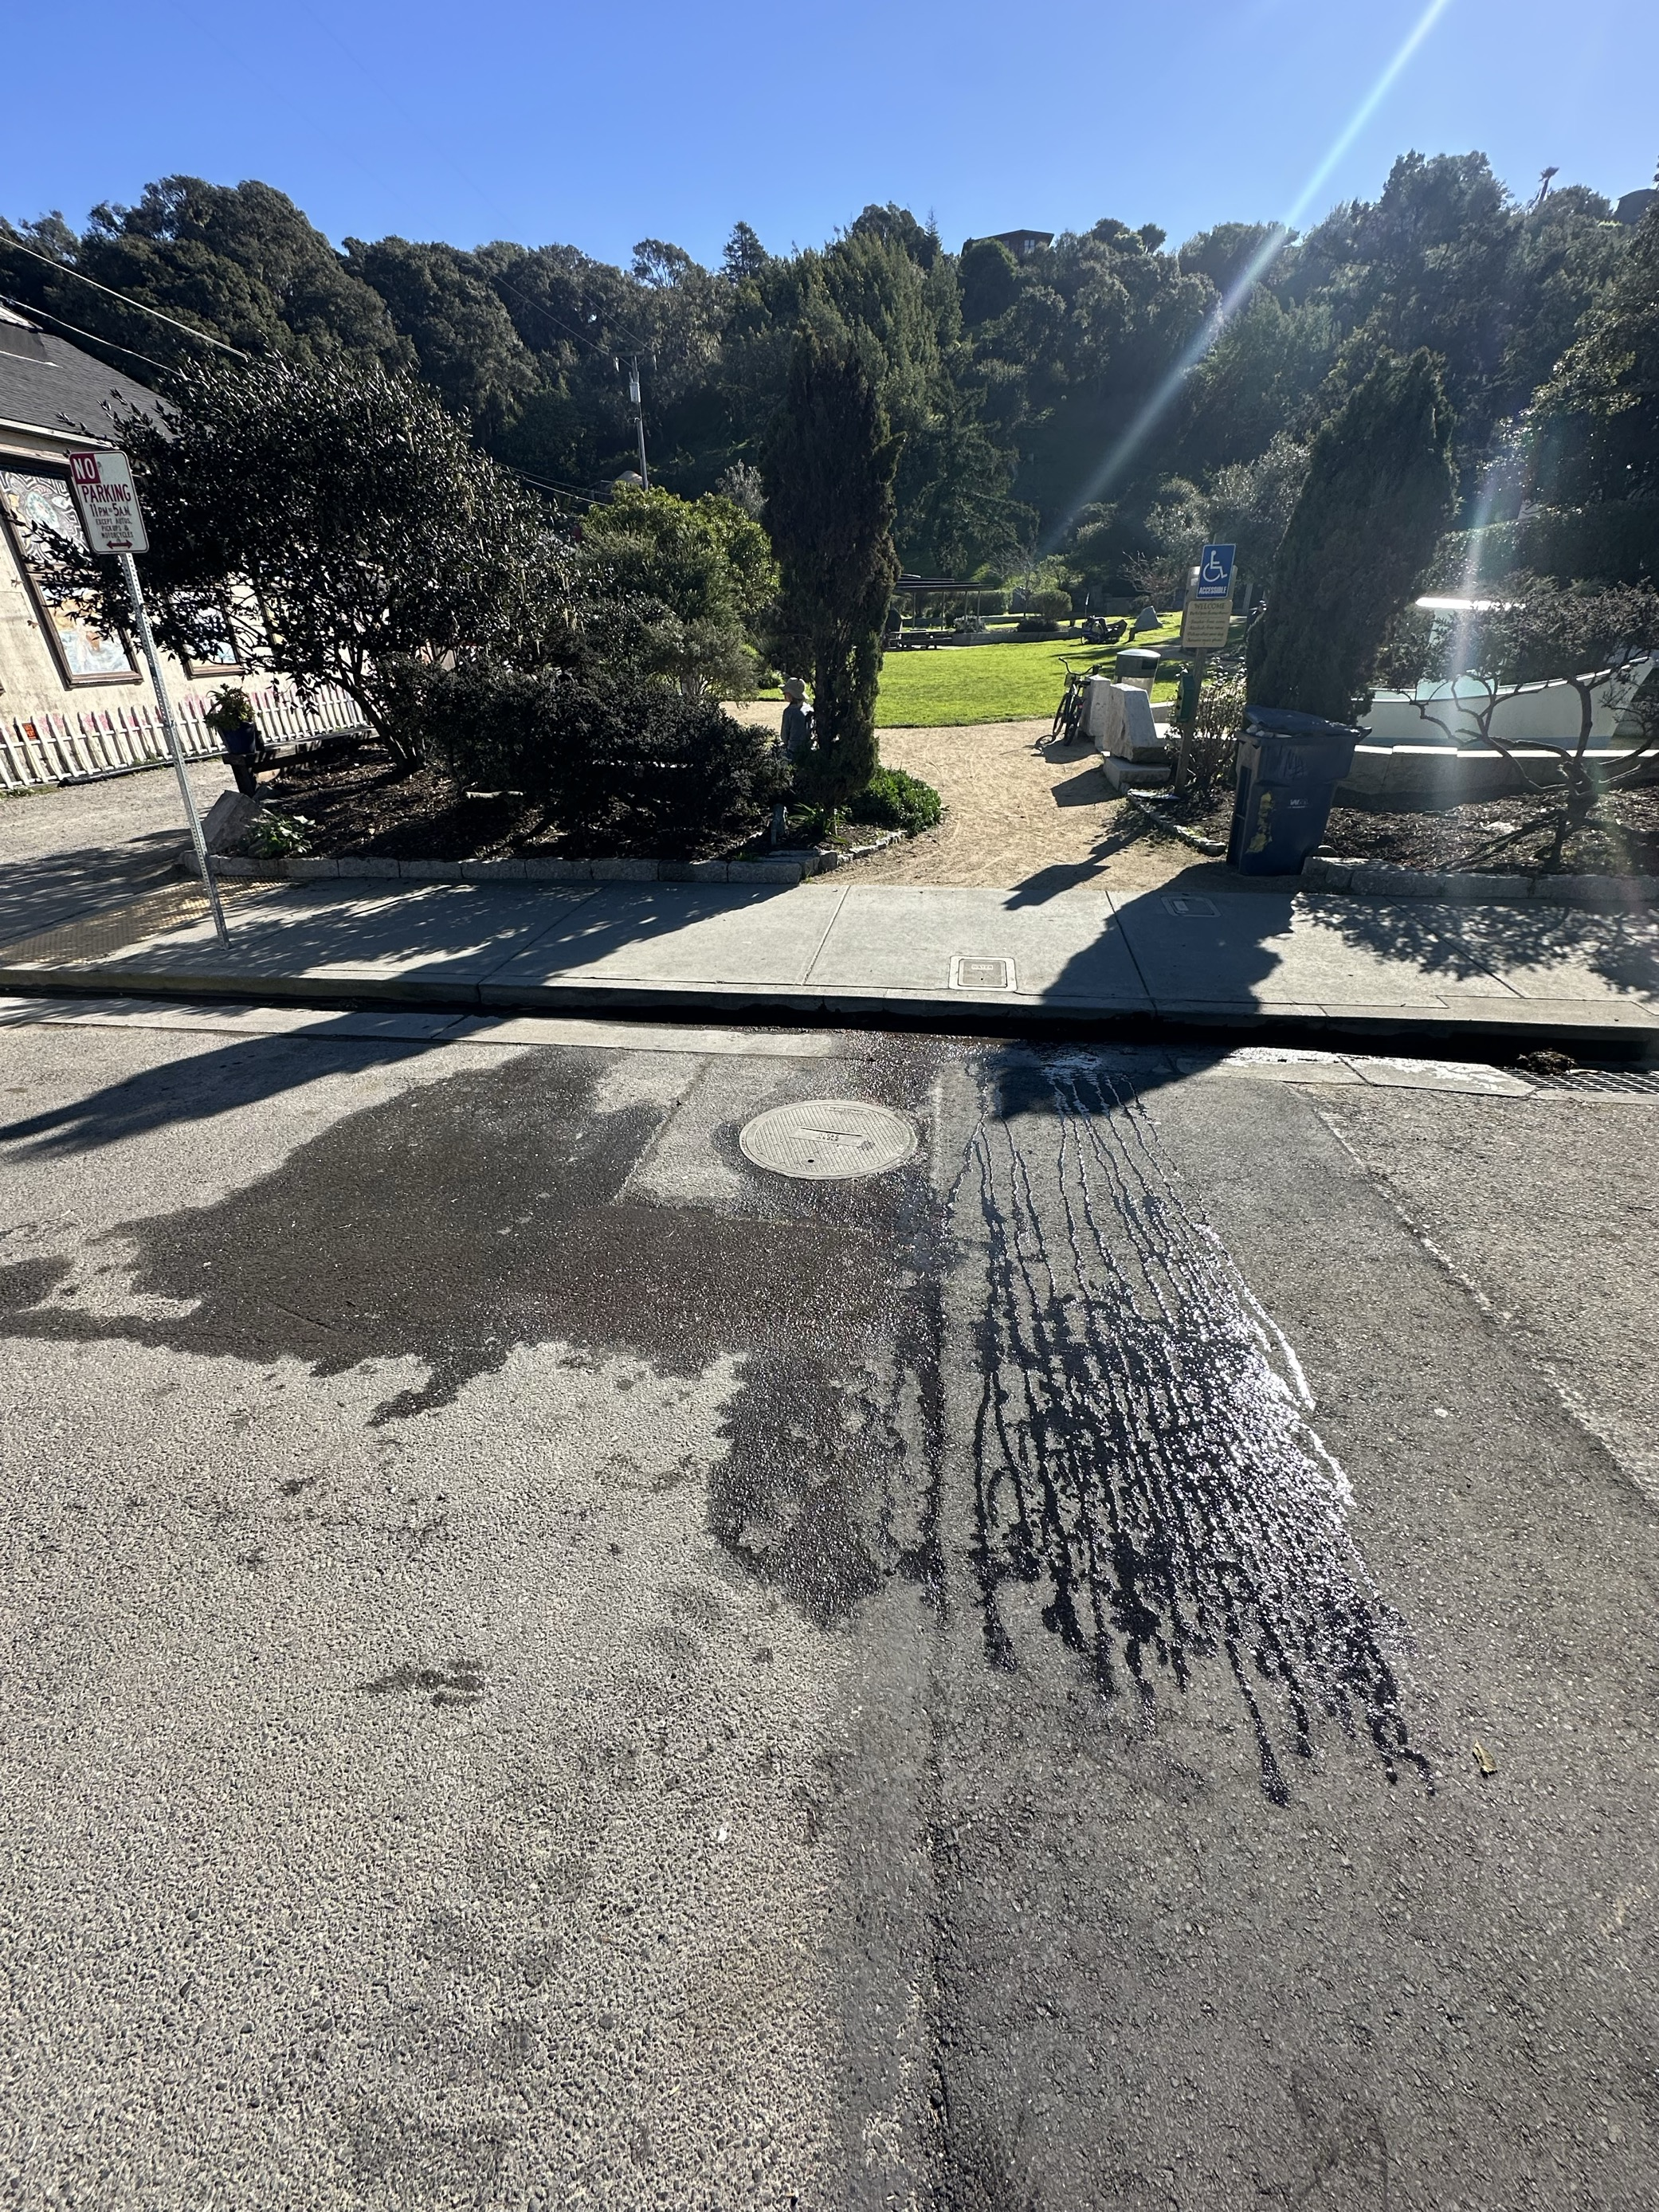
Operations Update (1a of 4): LEAKS!!!
Piazza came out to attend to Paving projects associated with our emergency leaks on County Road: 2 on Wharf Rd; 1 on Brighton Ave and 1 one on Mesa Rd.
Unfortunately, the patch in front of the Downtown Park has started to leak again!

Slide 11
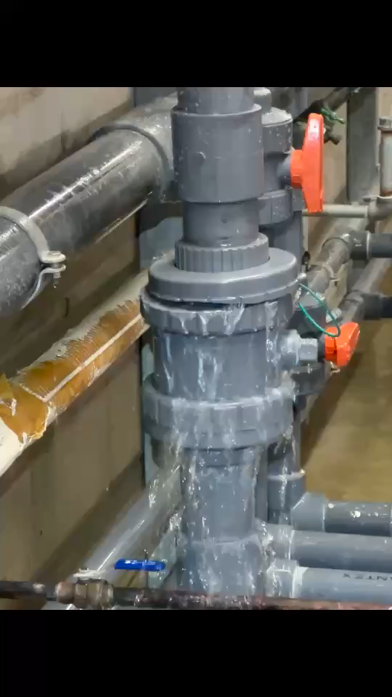
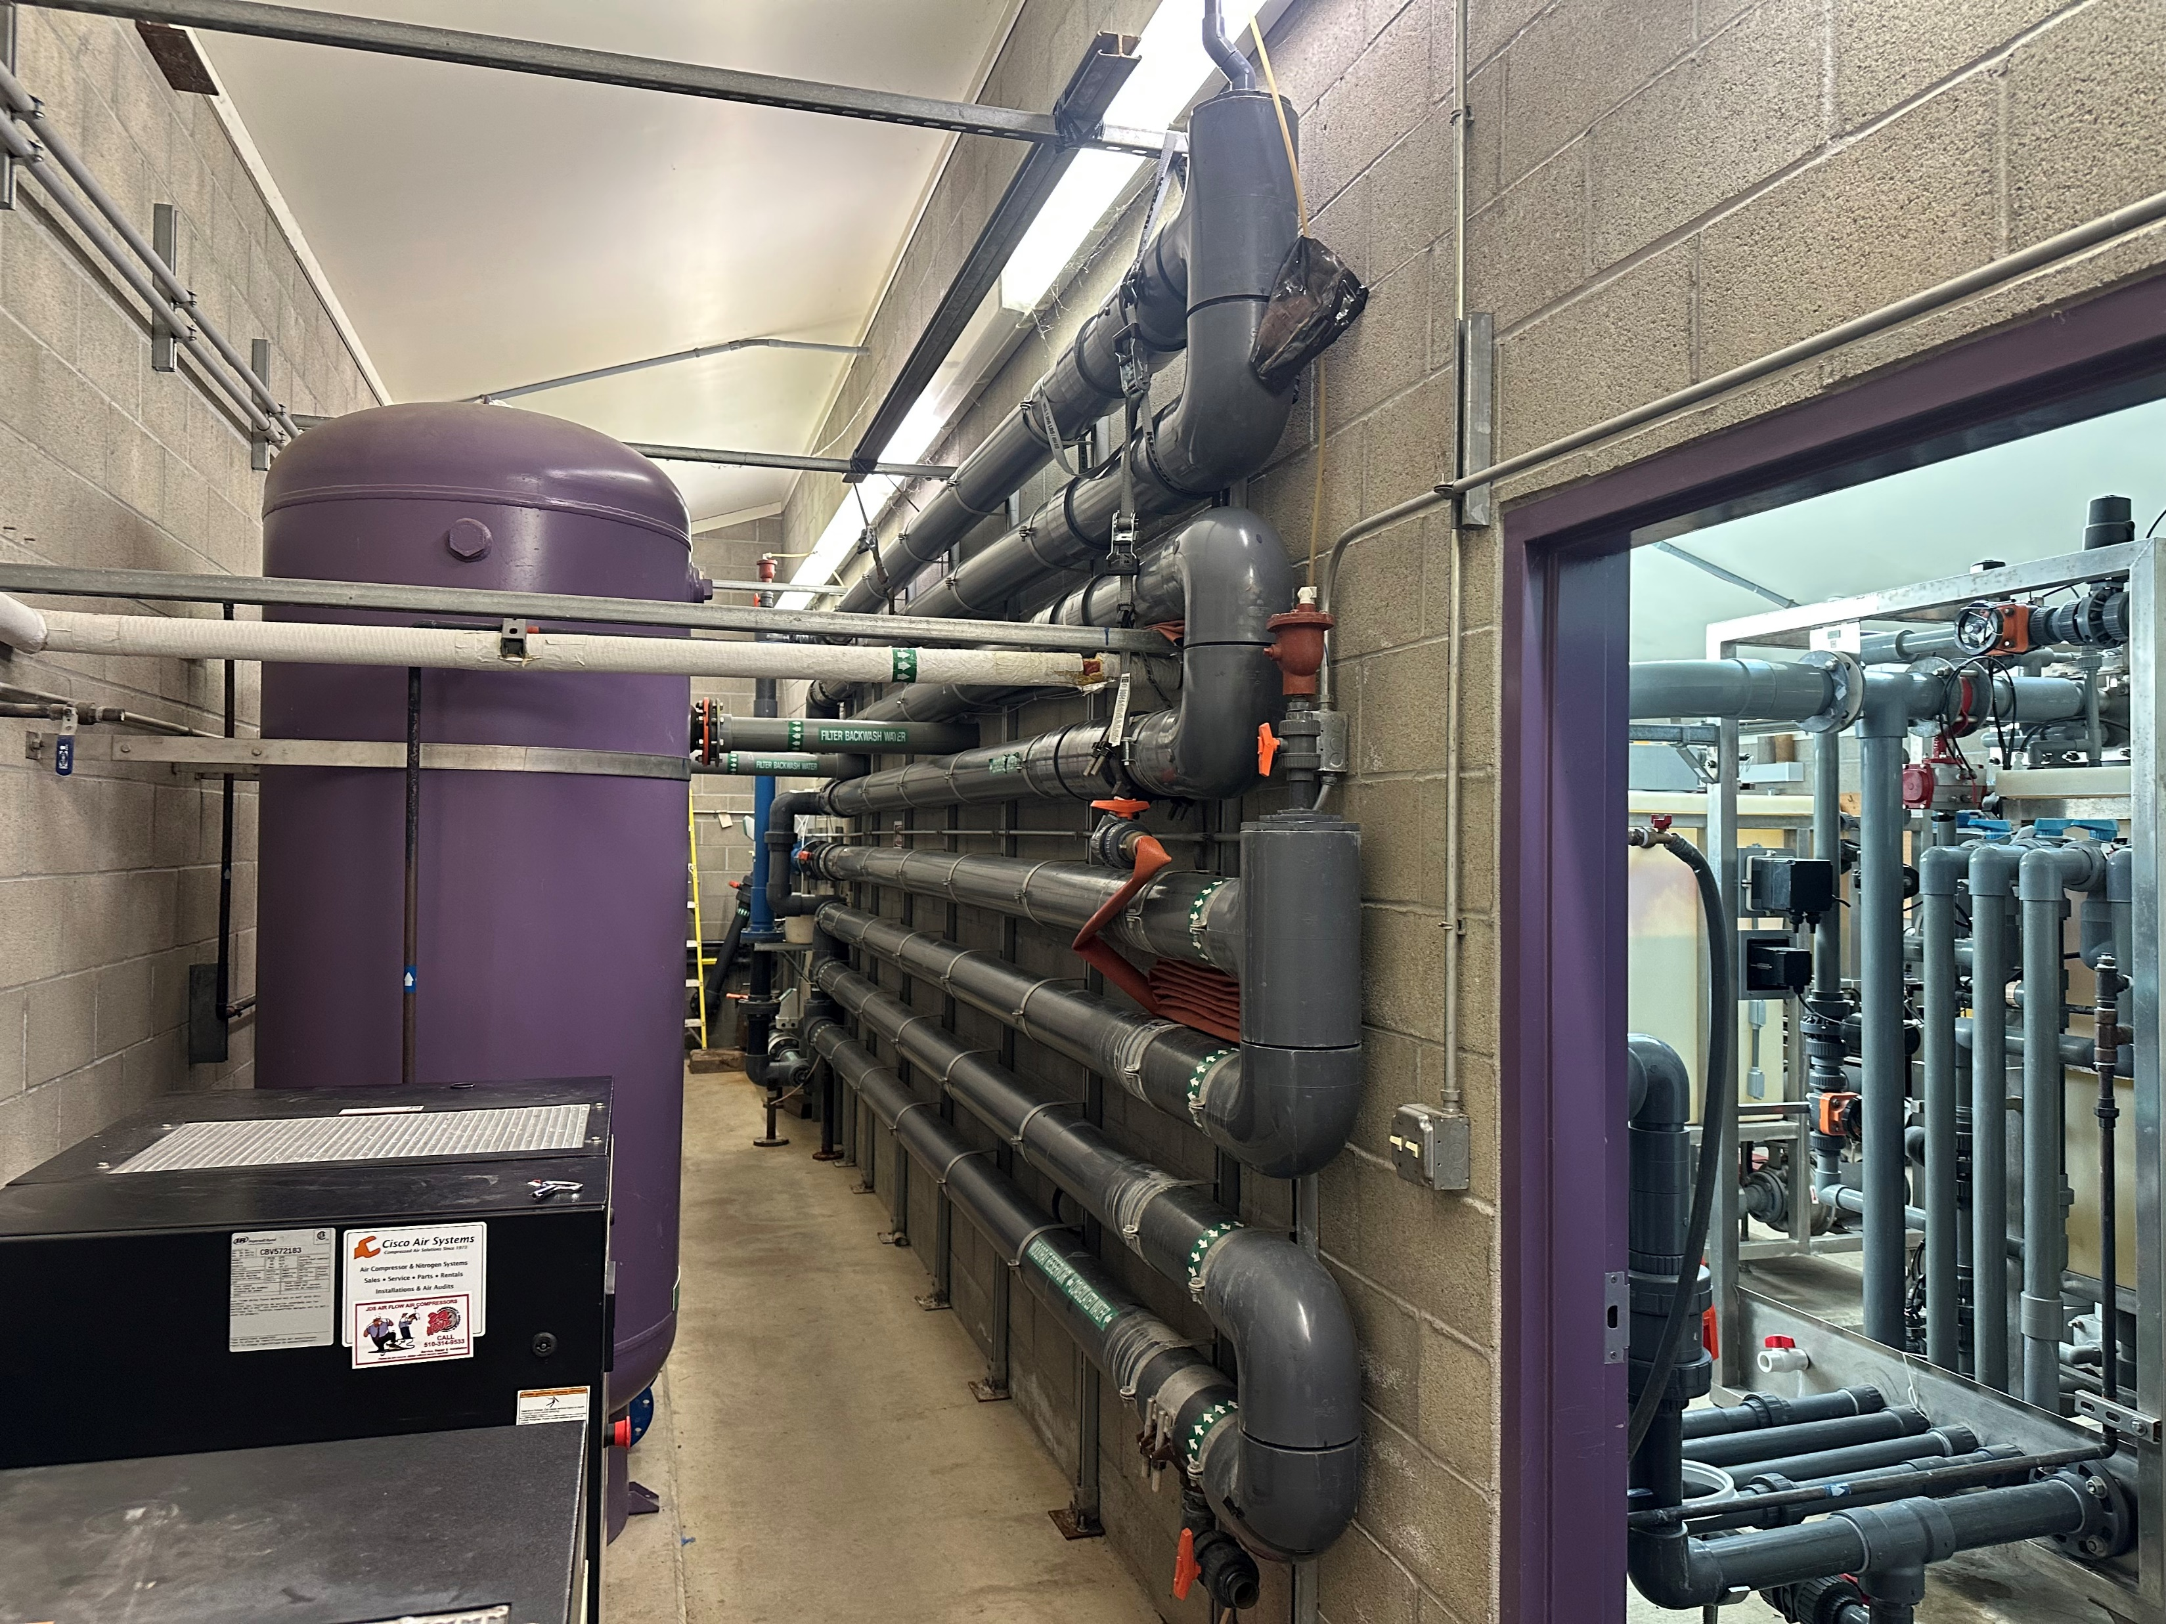
Operations Update (1b of 4): LEAKS!!!
AND…more leaks at the plant
This is just further evidence that we need to redesign and rebuild the circuitous "co-ag" piping on the wall.

Slide 12
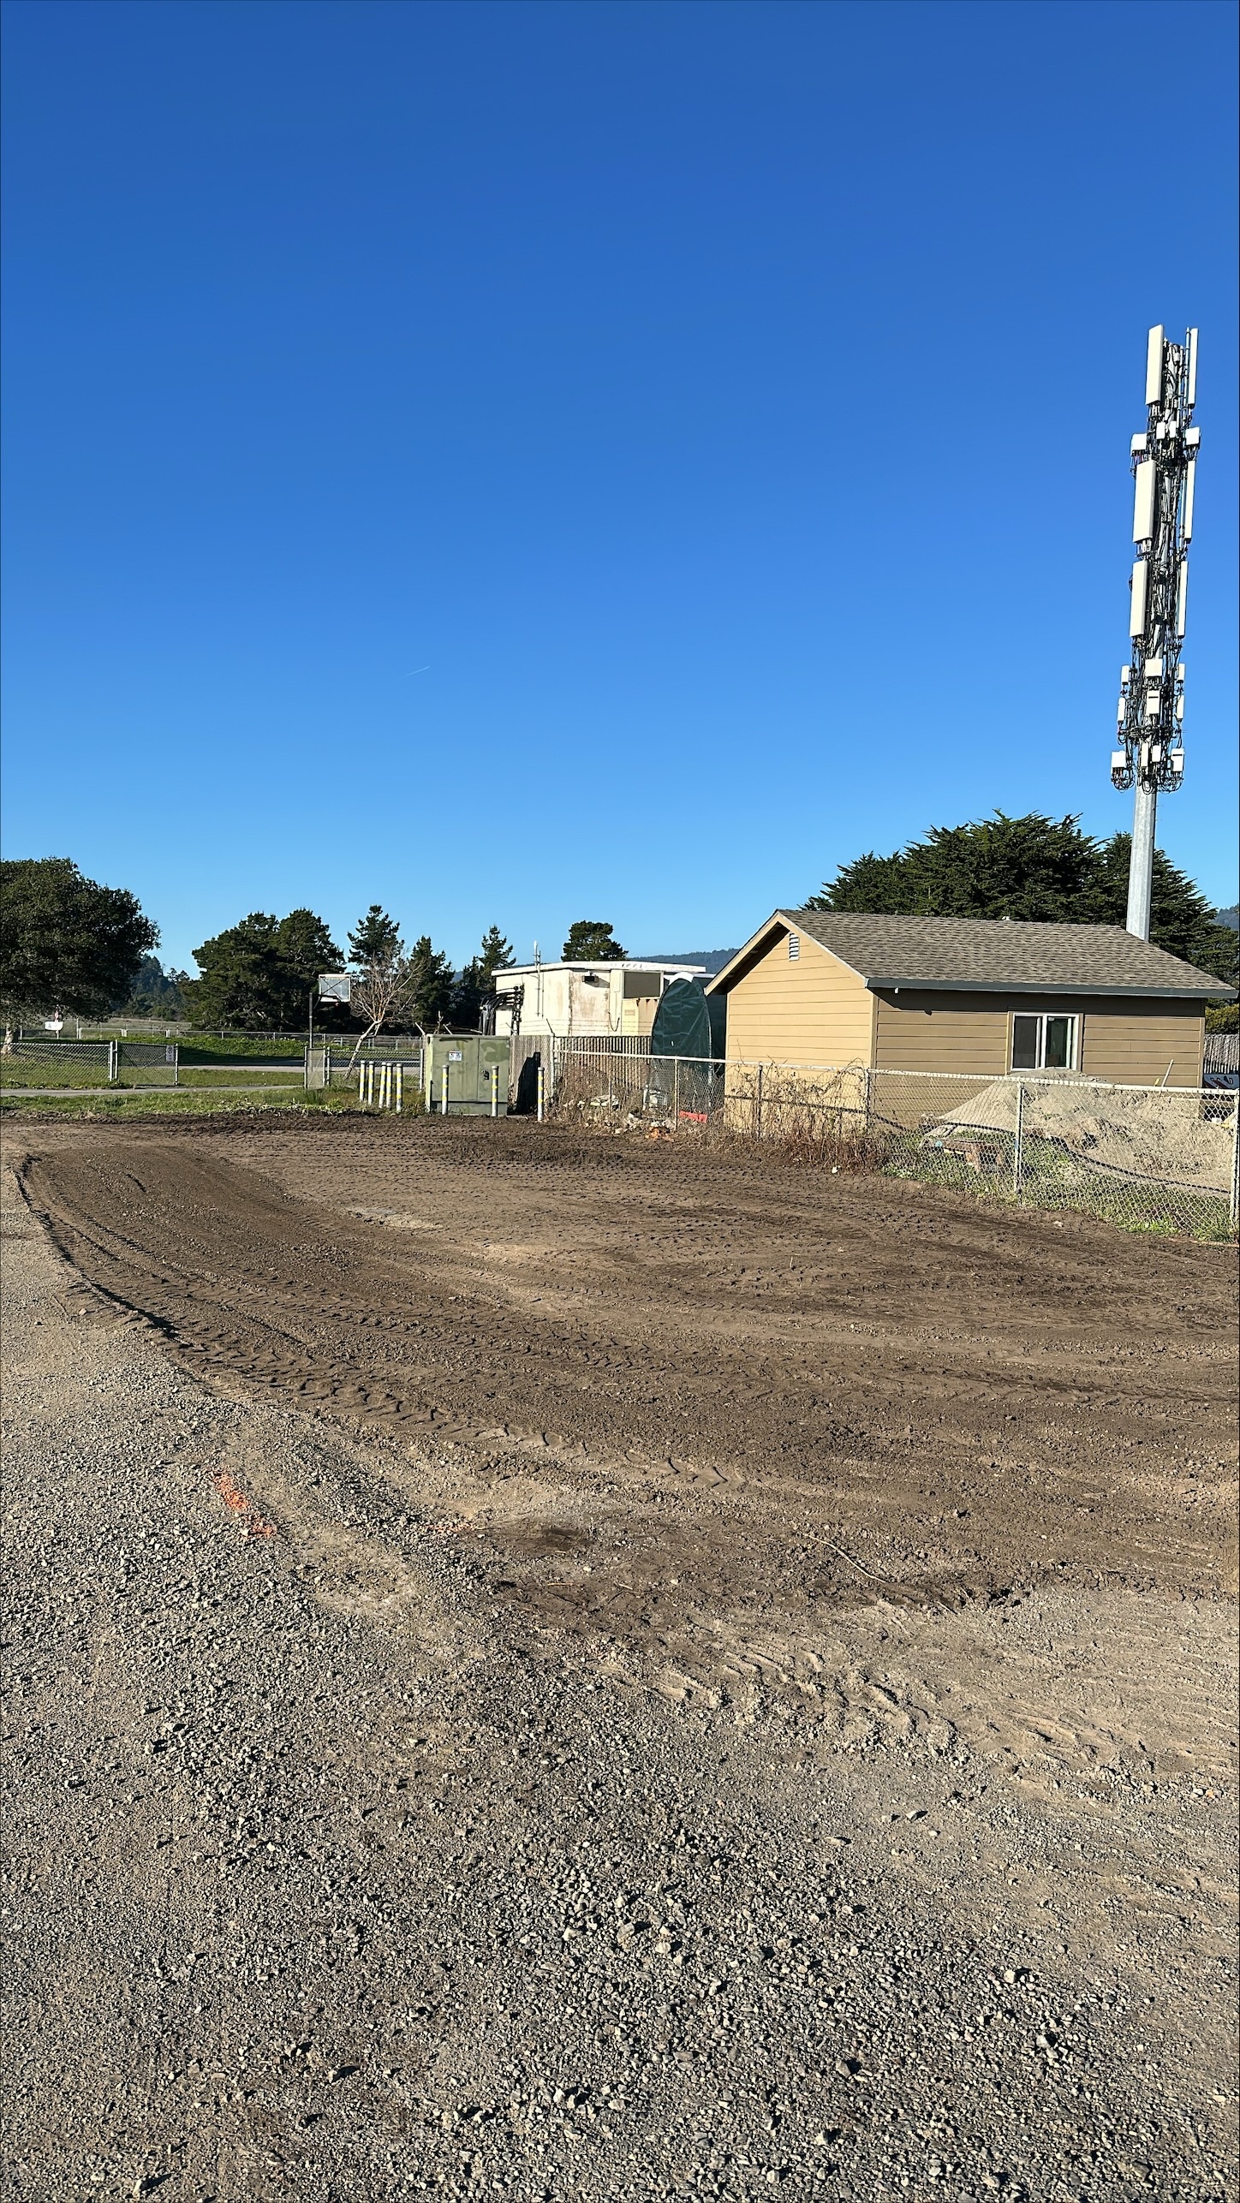
Operations Update (2 of 4): Well Projects
Well projects are moving along
We have begun prepping Mesa Park work site for installation of the small Water Treatment facility for the Resource Recovery Well
Our Engineer has updated our schedule for the projects
We will still be looking to request additional funds from DWR (grant funder) of >$100K to cover our construction shortfall

Slide 13
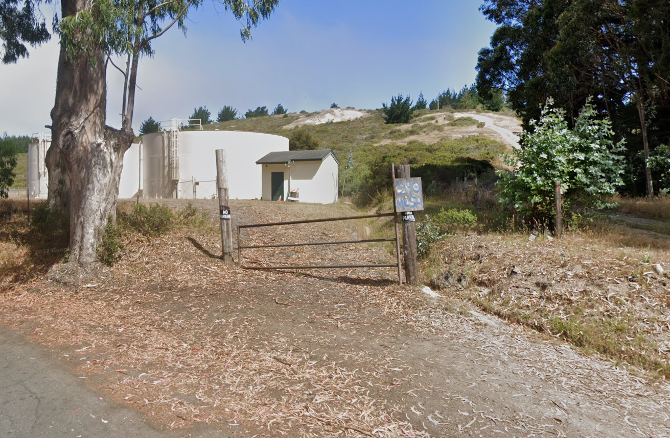
Operations Update (3 of 4): Tank-Site Pipeline Replacement project
We’ve had delays due to: storm➔ holiday ➔ leaks for Piazza ➔Paving for Piazza.
We expect work to resume soon and to last about 2 more weeks
We expect the project to be completed by the end of January.

Slide 14
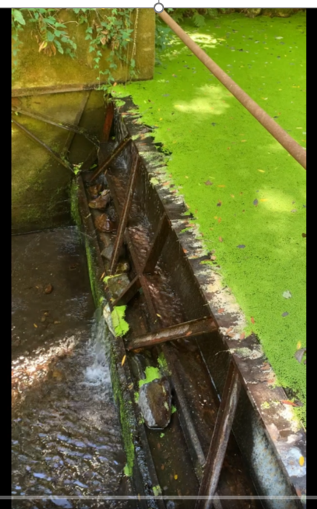
Operations Update (4 of 4): Radial Gate Repair
Update on Status:
I have still not heard anything regarding our application for a Special Use Permit from the National Park Service, submitted in early December (despite the fact that they told me they would "fast track" our request, and my nudging).
At this point I am going to suggest that we delay until next Fall when creek flows are low, and we will have everything (including permit) in line to proceed.

Slide 15
Miscellaneous Updates

Slide 16

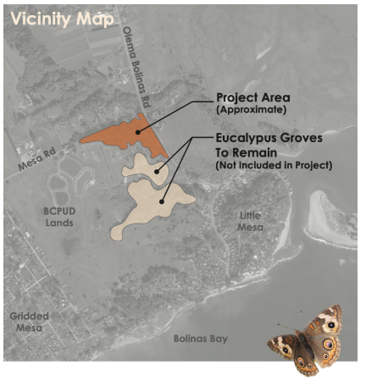
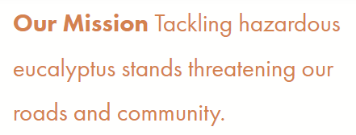
Miscellaneous updates (1 of 1):
As you know, BEP submitted a Coastal Development Permit application to allow the removal of trees (primarily within BCPUD property, below the Sewer Ponds)
They are in the process of addressing "incompleteness items" called out by the CDA planner reviewing their application. We've begun working more closely with BEP to coordinate our message, as BCPUD is a co-applicant on this project.
BEP has scheduled a meeting with Rodoni and CDA Tuesday, January 30th to help move this project forward.
I would like the status of the BEP to be resolved before I resume the Bike Path Rehab project, so that I know which trees the path rehab project may or may not have to contend with when we submit our CDP application.

