Slide 1
General Manager’s Update
February 10, 2025
Regular Board Meeting
Presented by Georgia Woods

Slide 2
Status of BCPUD’s Water Supply
Note January’s comprehensive Water Supply memo will soon be posted on our Website HERE.

Slide 3
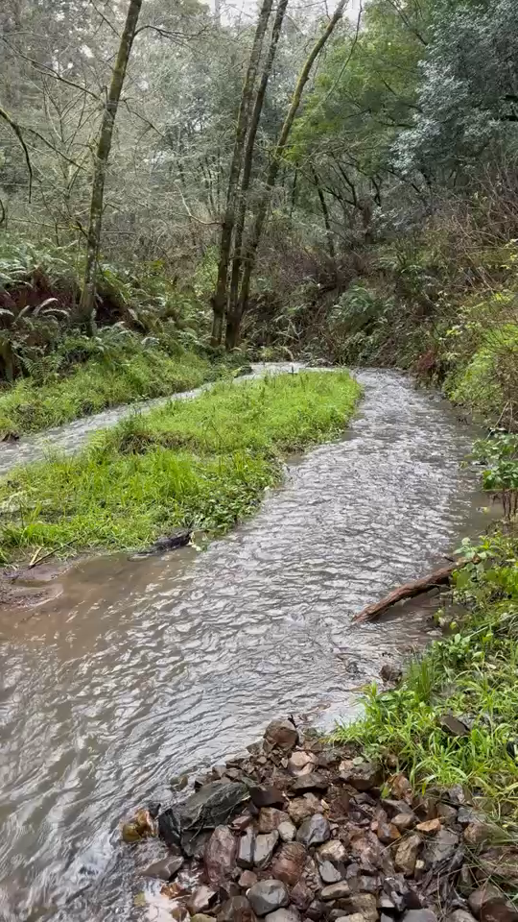
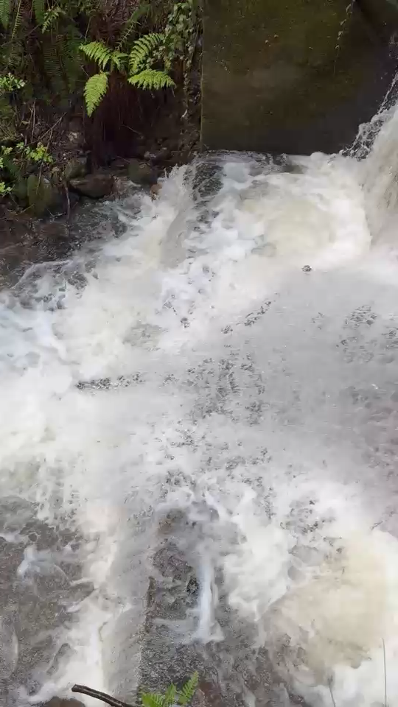
Upper impoundment: filled!
Lower impoundment
Arroyo Hondo:
on 2/6/2025
on 2/7/2025

Slide 4
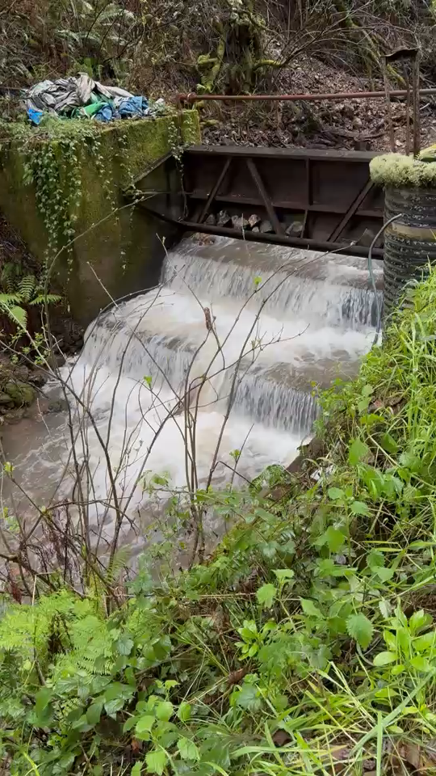
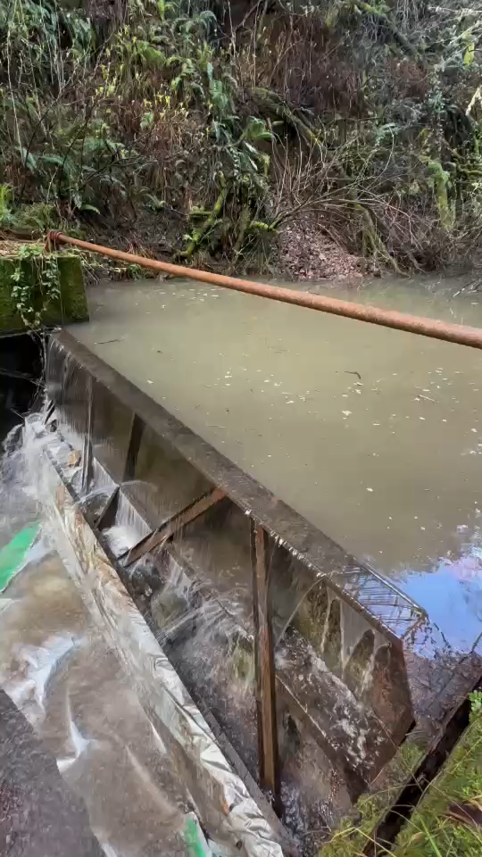
Lower Dam
The upper impoundment has been filled with debris. We have moved to the lower dam and lowered the radial gate. We started drawing from the lower dam last Friday.
on 2/7/2025
on 2/7/2025

Slide 5
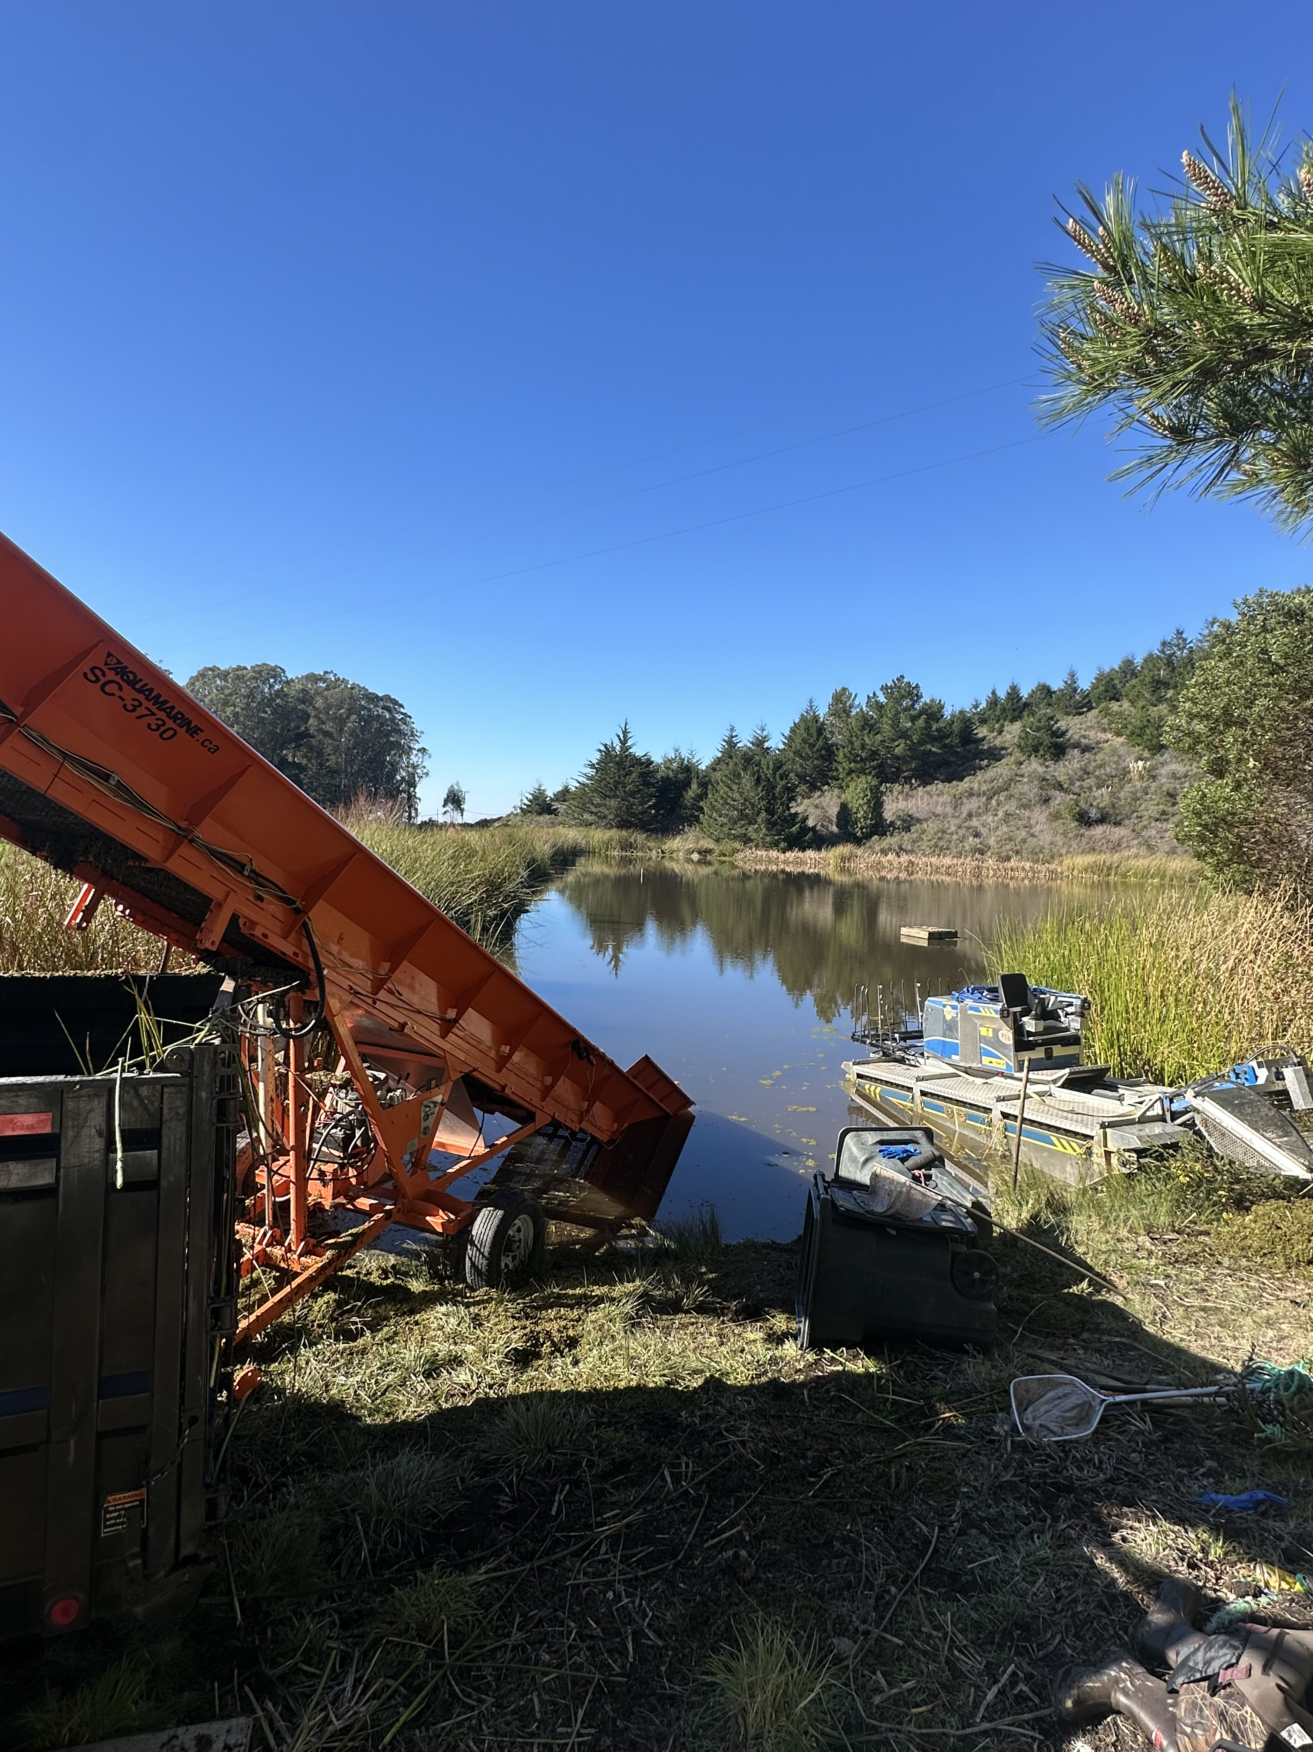
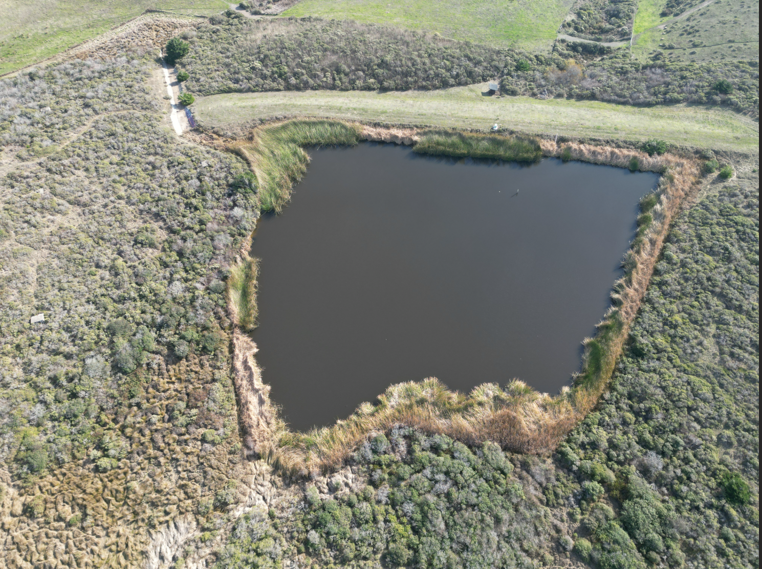
Woodrat 1 on 1/15/2025
The Reservoirs:
Woodrat 2
on 12/3/2024
Azolla was removed 1/15 and 1/16, costing $5,460.00; for total $12,900 for FY 2024/2025

Slide 6

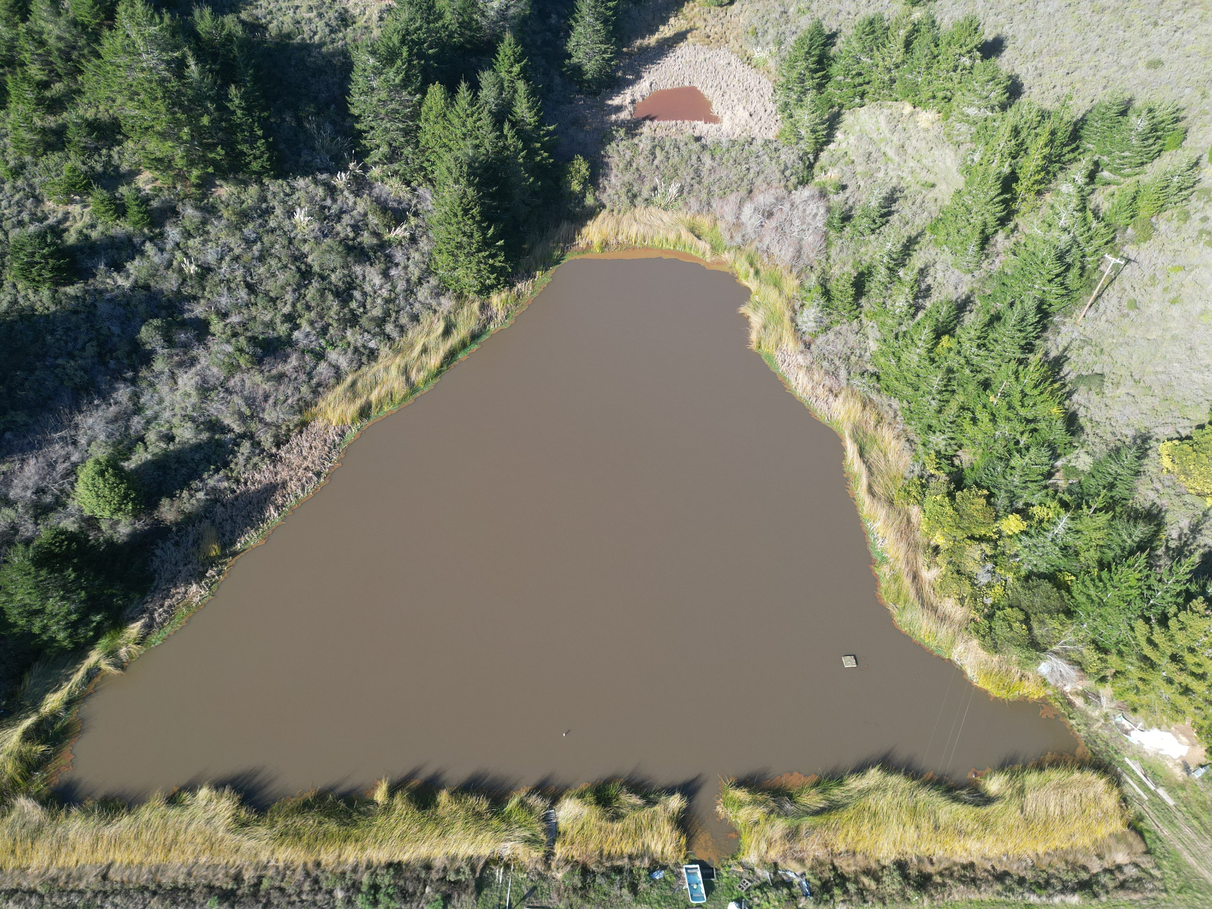
Azolla, needed a second day of removal...

Slide 7
Winter 2024-25 Water Usage Trends
PRODUCTION​
In January 2025, water production in the district averaged 197 gallons per day (GPD)​ per connection
This is UP from December's production, which averaged 93 GPD per connection​
​
CONSUMPTION​​
Water consumption in January averaged 119 GPD (per connection)​​
This is (roughly) EQUAL to December consumption, which averaged 117 GPD per connection.

Slide 8
Comparison to past two years
Average use per connection:
Jan 2023 – 93 GPD
Jan 2024 – 99 GPD
Jan 2025 – 119 GPD
20% increase per connection compared to last January

Slide 9
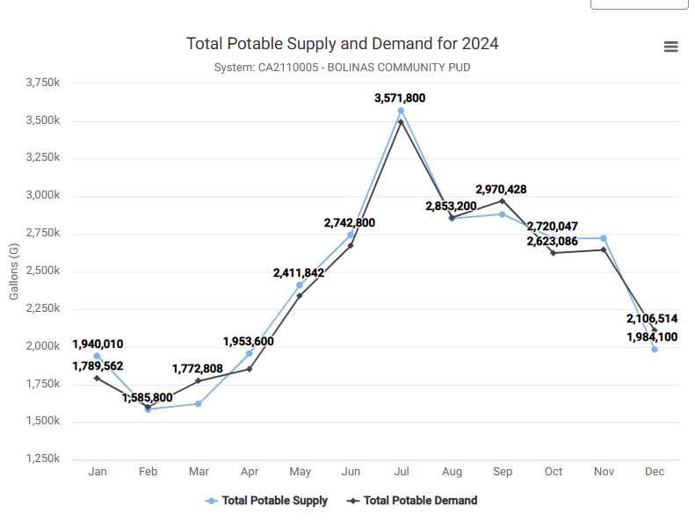
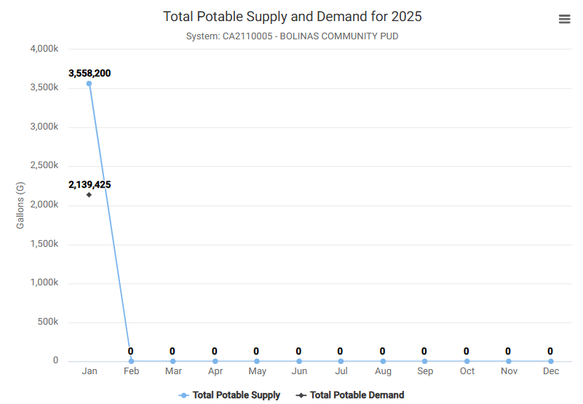
2024-25 Water Usage Trends

Slide 10
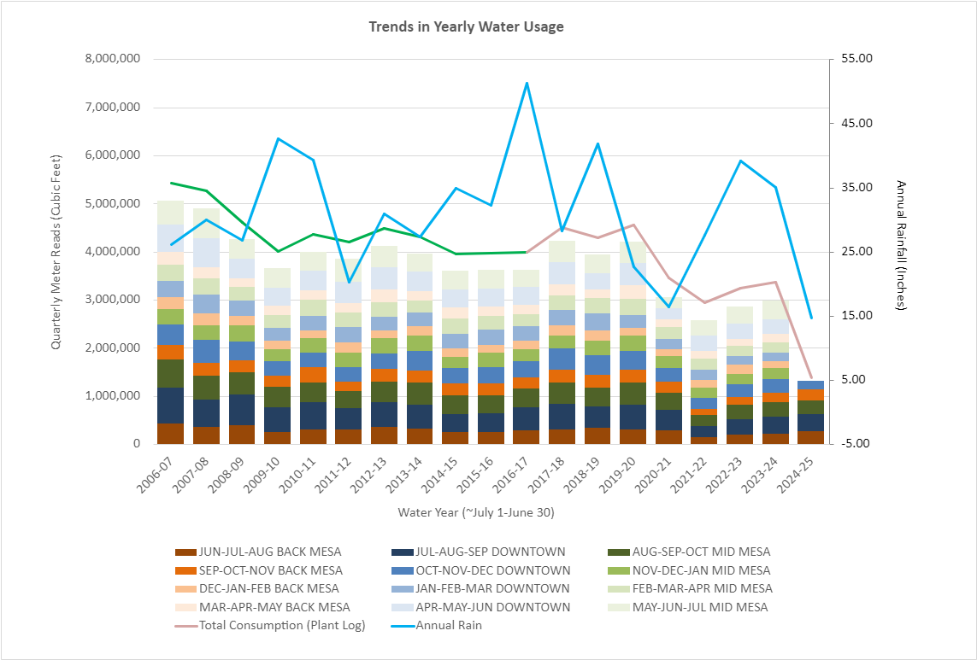
Annual Trends Since 2006—We've not yet input data from January's meter reads! Quarterly Water Usage through Dec 2024
This graph shows “Cumulative Quarterly Water Usage”, as measured by “Regional Quarterly Water Meter Reads”
Remember: at the beginning of each month staff reads all meters within 1 of 3 given regions:
1) BACK MESA
2) DOWNTOWN
3) MID MESA
Annual Rain Fall is plotted as a BLUE LINE
Town Consumption Estimates, based on the amount of water leaving the treatment plant daily is shown in PINK LINE.
GREEN LINE is an extension of pink line, which models consumption based on an absolute unaccounted for water loss of 437,856 CuFt (~10% loss)

Slide 11
Meetings Attended

Slide 12
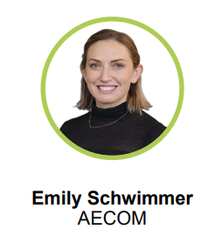
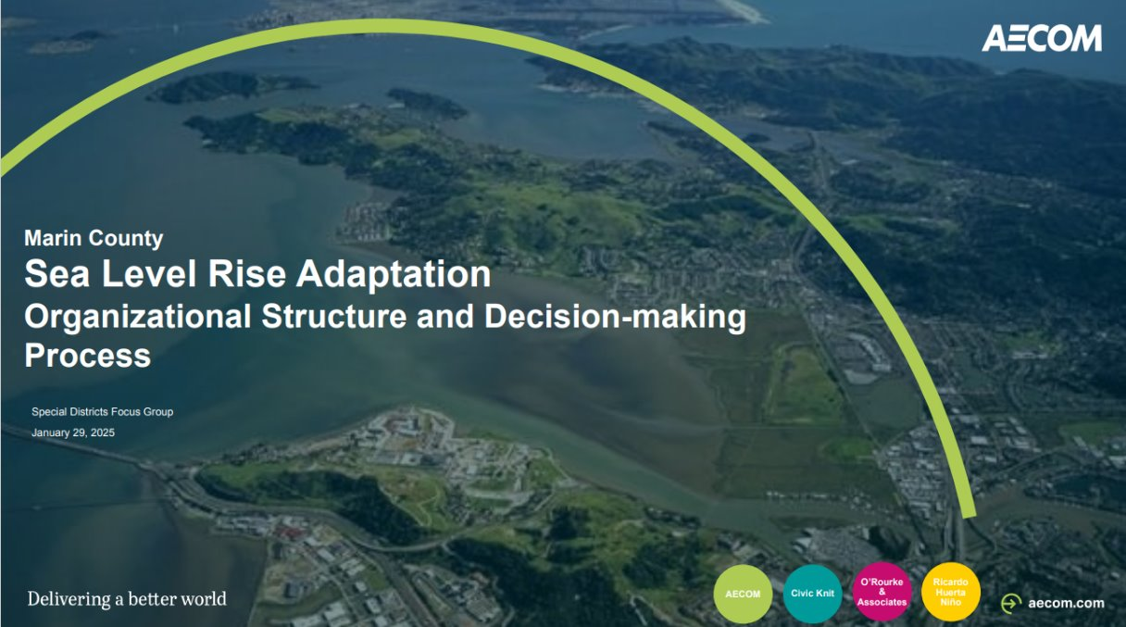
Meetings Attended (1 of 1): Sea Level Rise!
Attended Marin County's Sea Level Rise Adaptation planning meeting
This work is being conducted by AECOM
AECOM is a consulting firm hired by the County of Marin to help a County Wide effort to address Sea Level Rise
The purpose of this specific meeting was to get stakeholder input from the heads of Special Utility Districts in West Marin
Director Alexander-Green was also in attendance

Slide 13
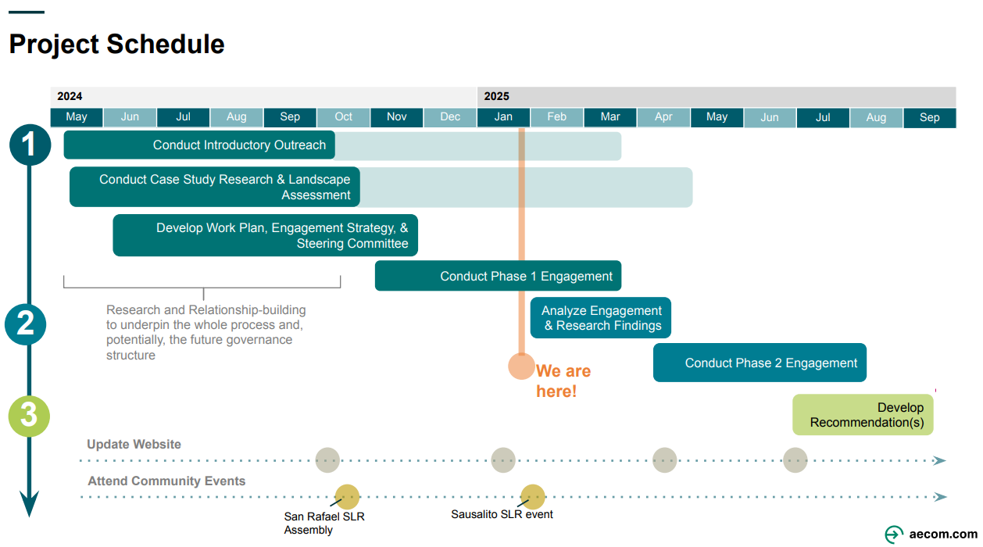

Slide 14
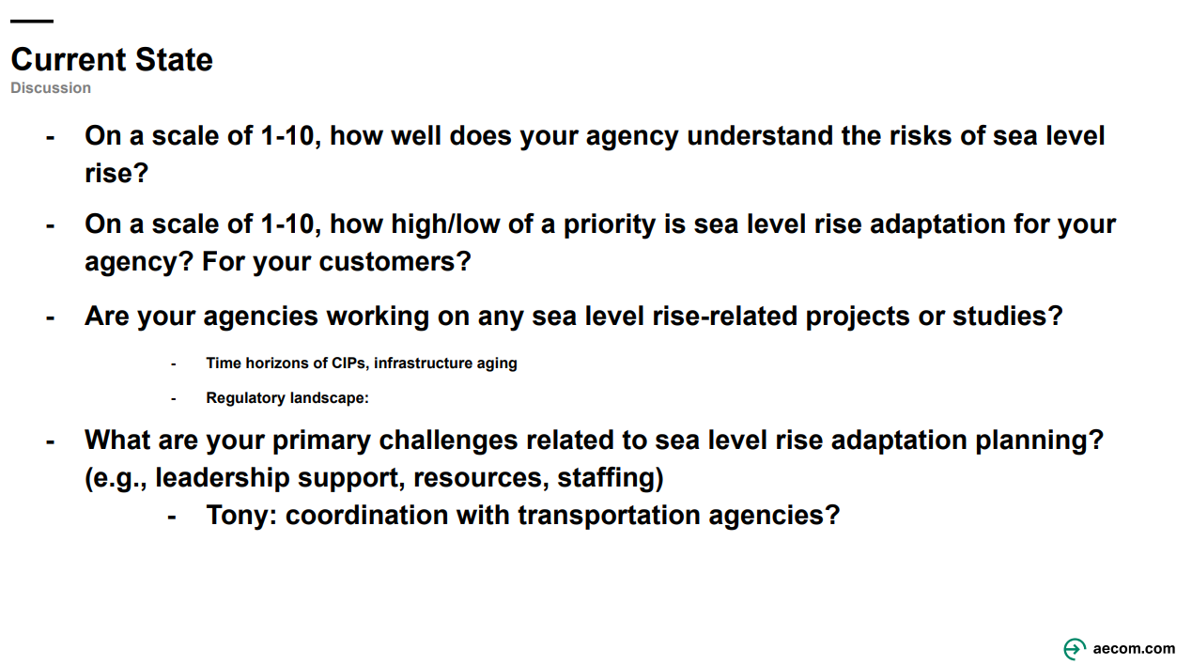

Slide 15
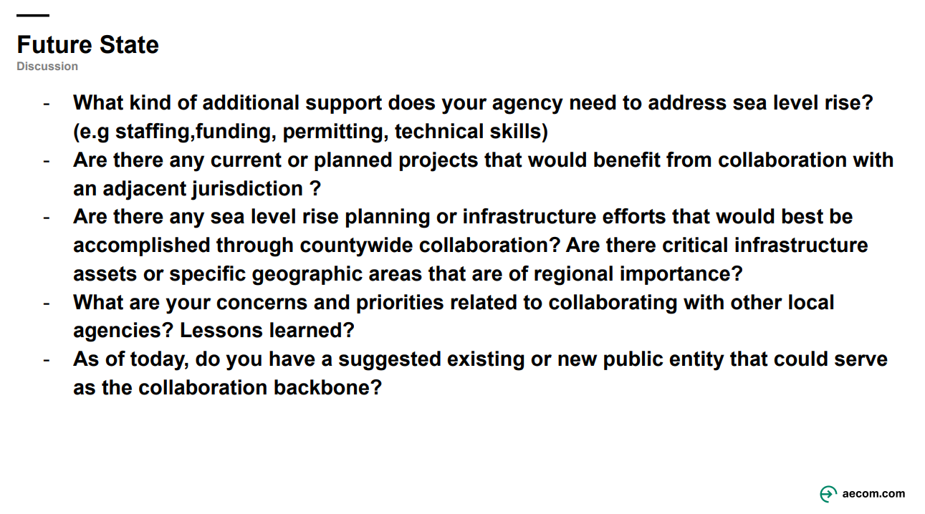

Slide 16
Operations Updates

Slide 17
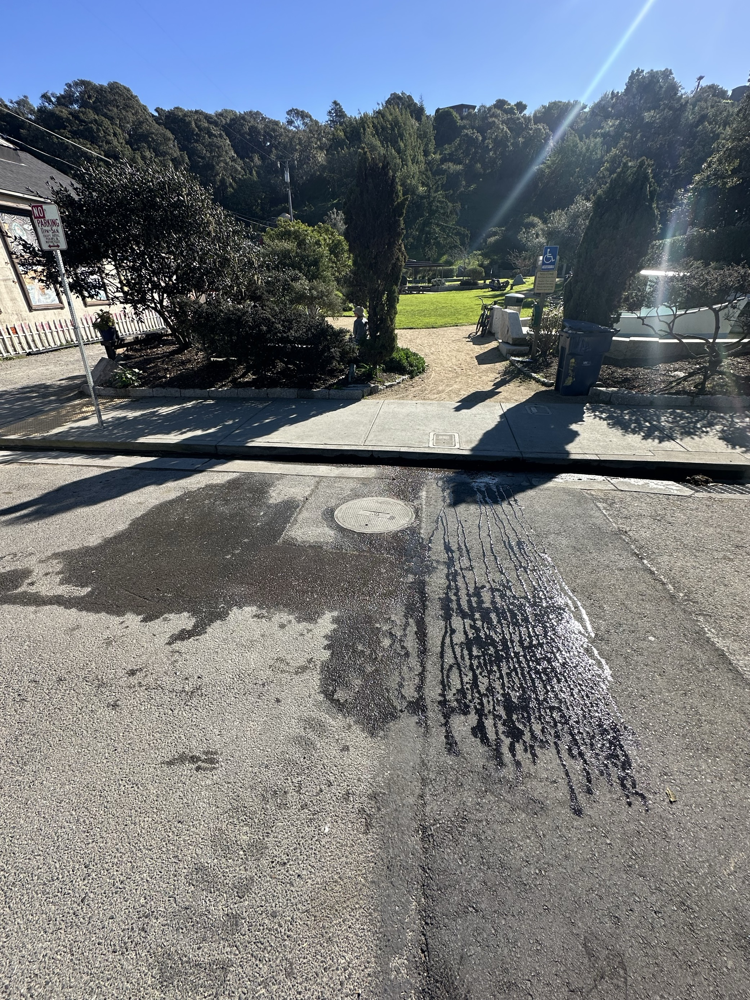
Operations Update (1 of 4): LEAKS
Hopefully getting to this next week after this week's forecasted rains.
We are planning to get Piazza out here next week.
We will also be using this repair as a test case to see if we can strategize ways to bring down our paving costs.

Slide 18
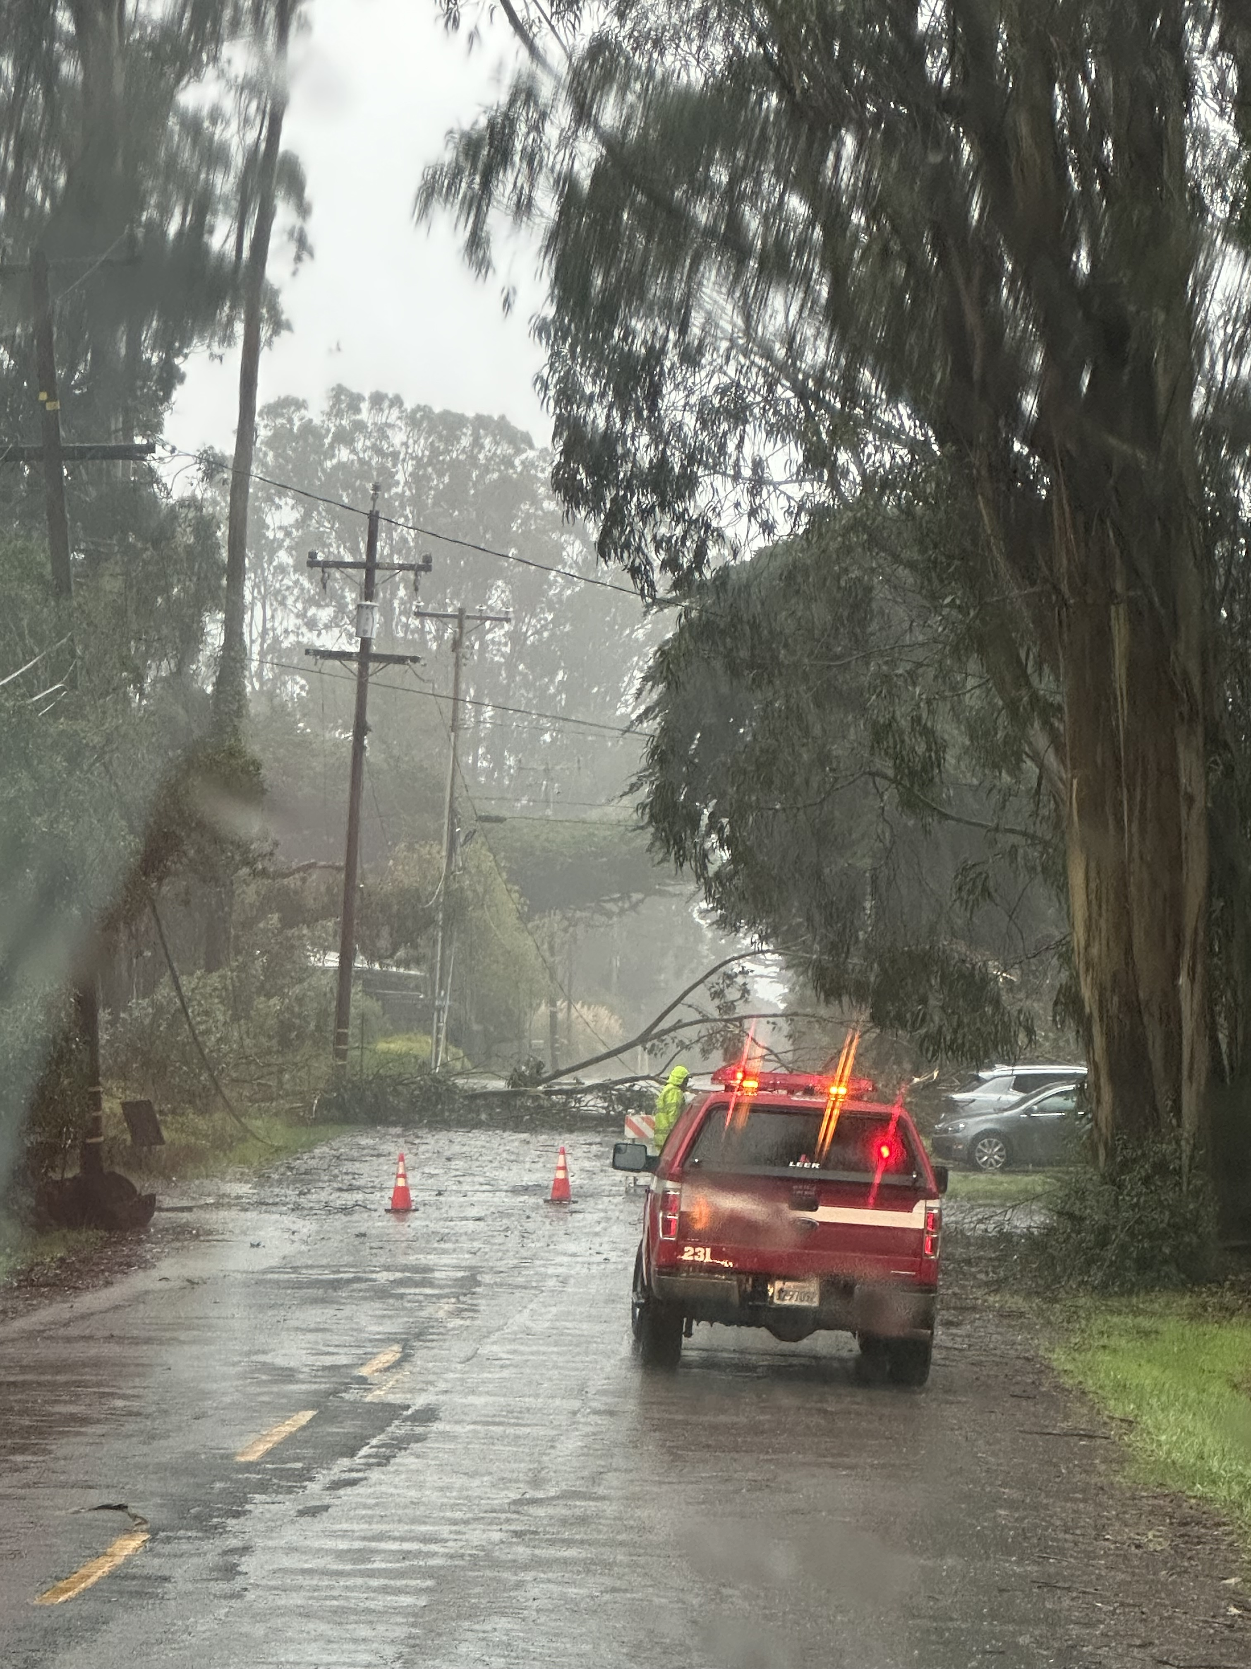
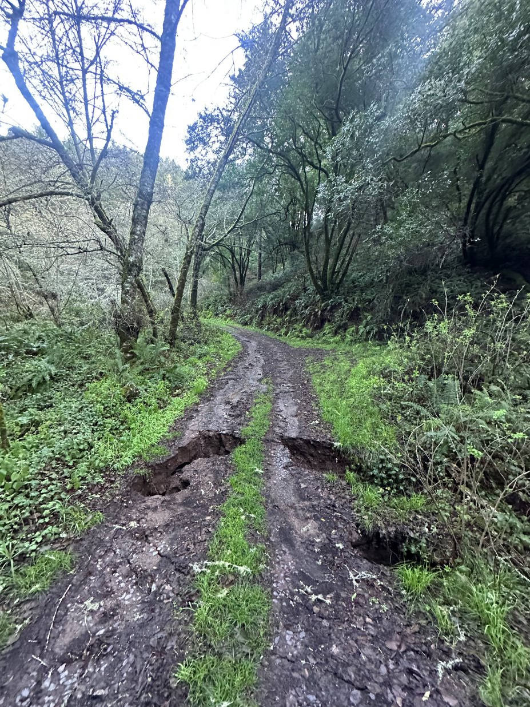
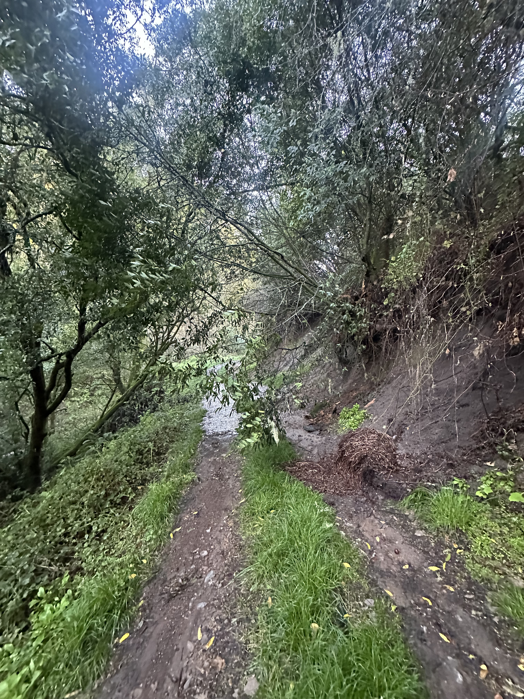
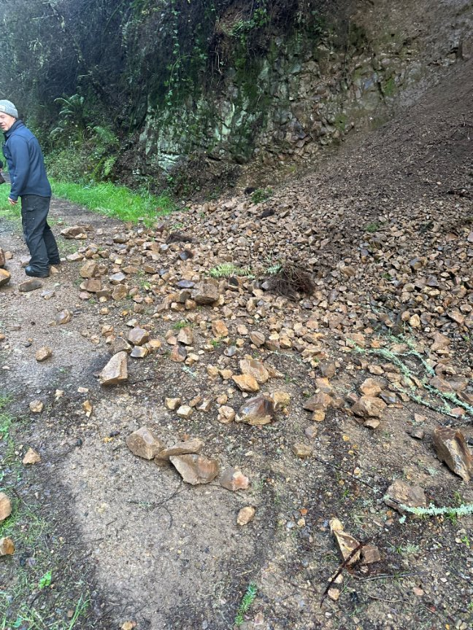
Operations Update (2 of 4): Storm Damage and Planned Repairs
on 2/4/2025
We sustained some damage from last week's storm along the Arroyo Hondo Access Road
Damage to culvert and slides
on 2/7-2/10, 2025

Slide 19
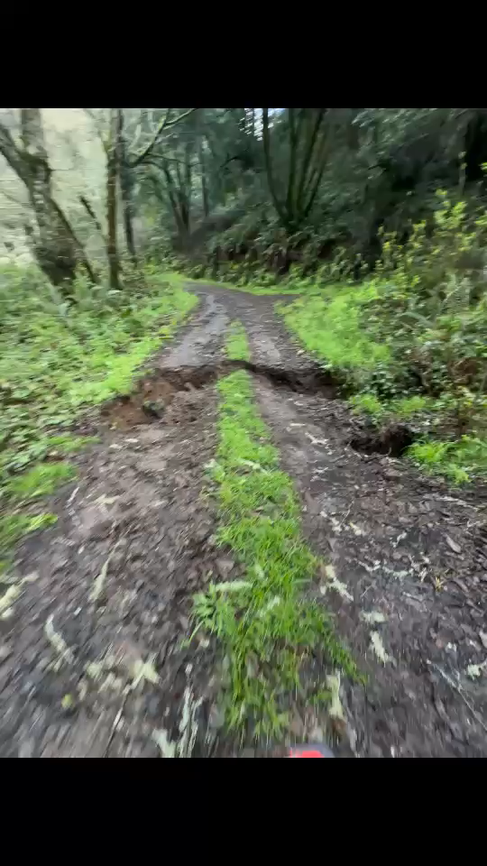
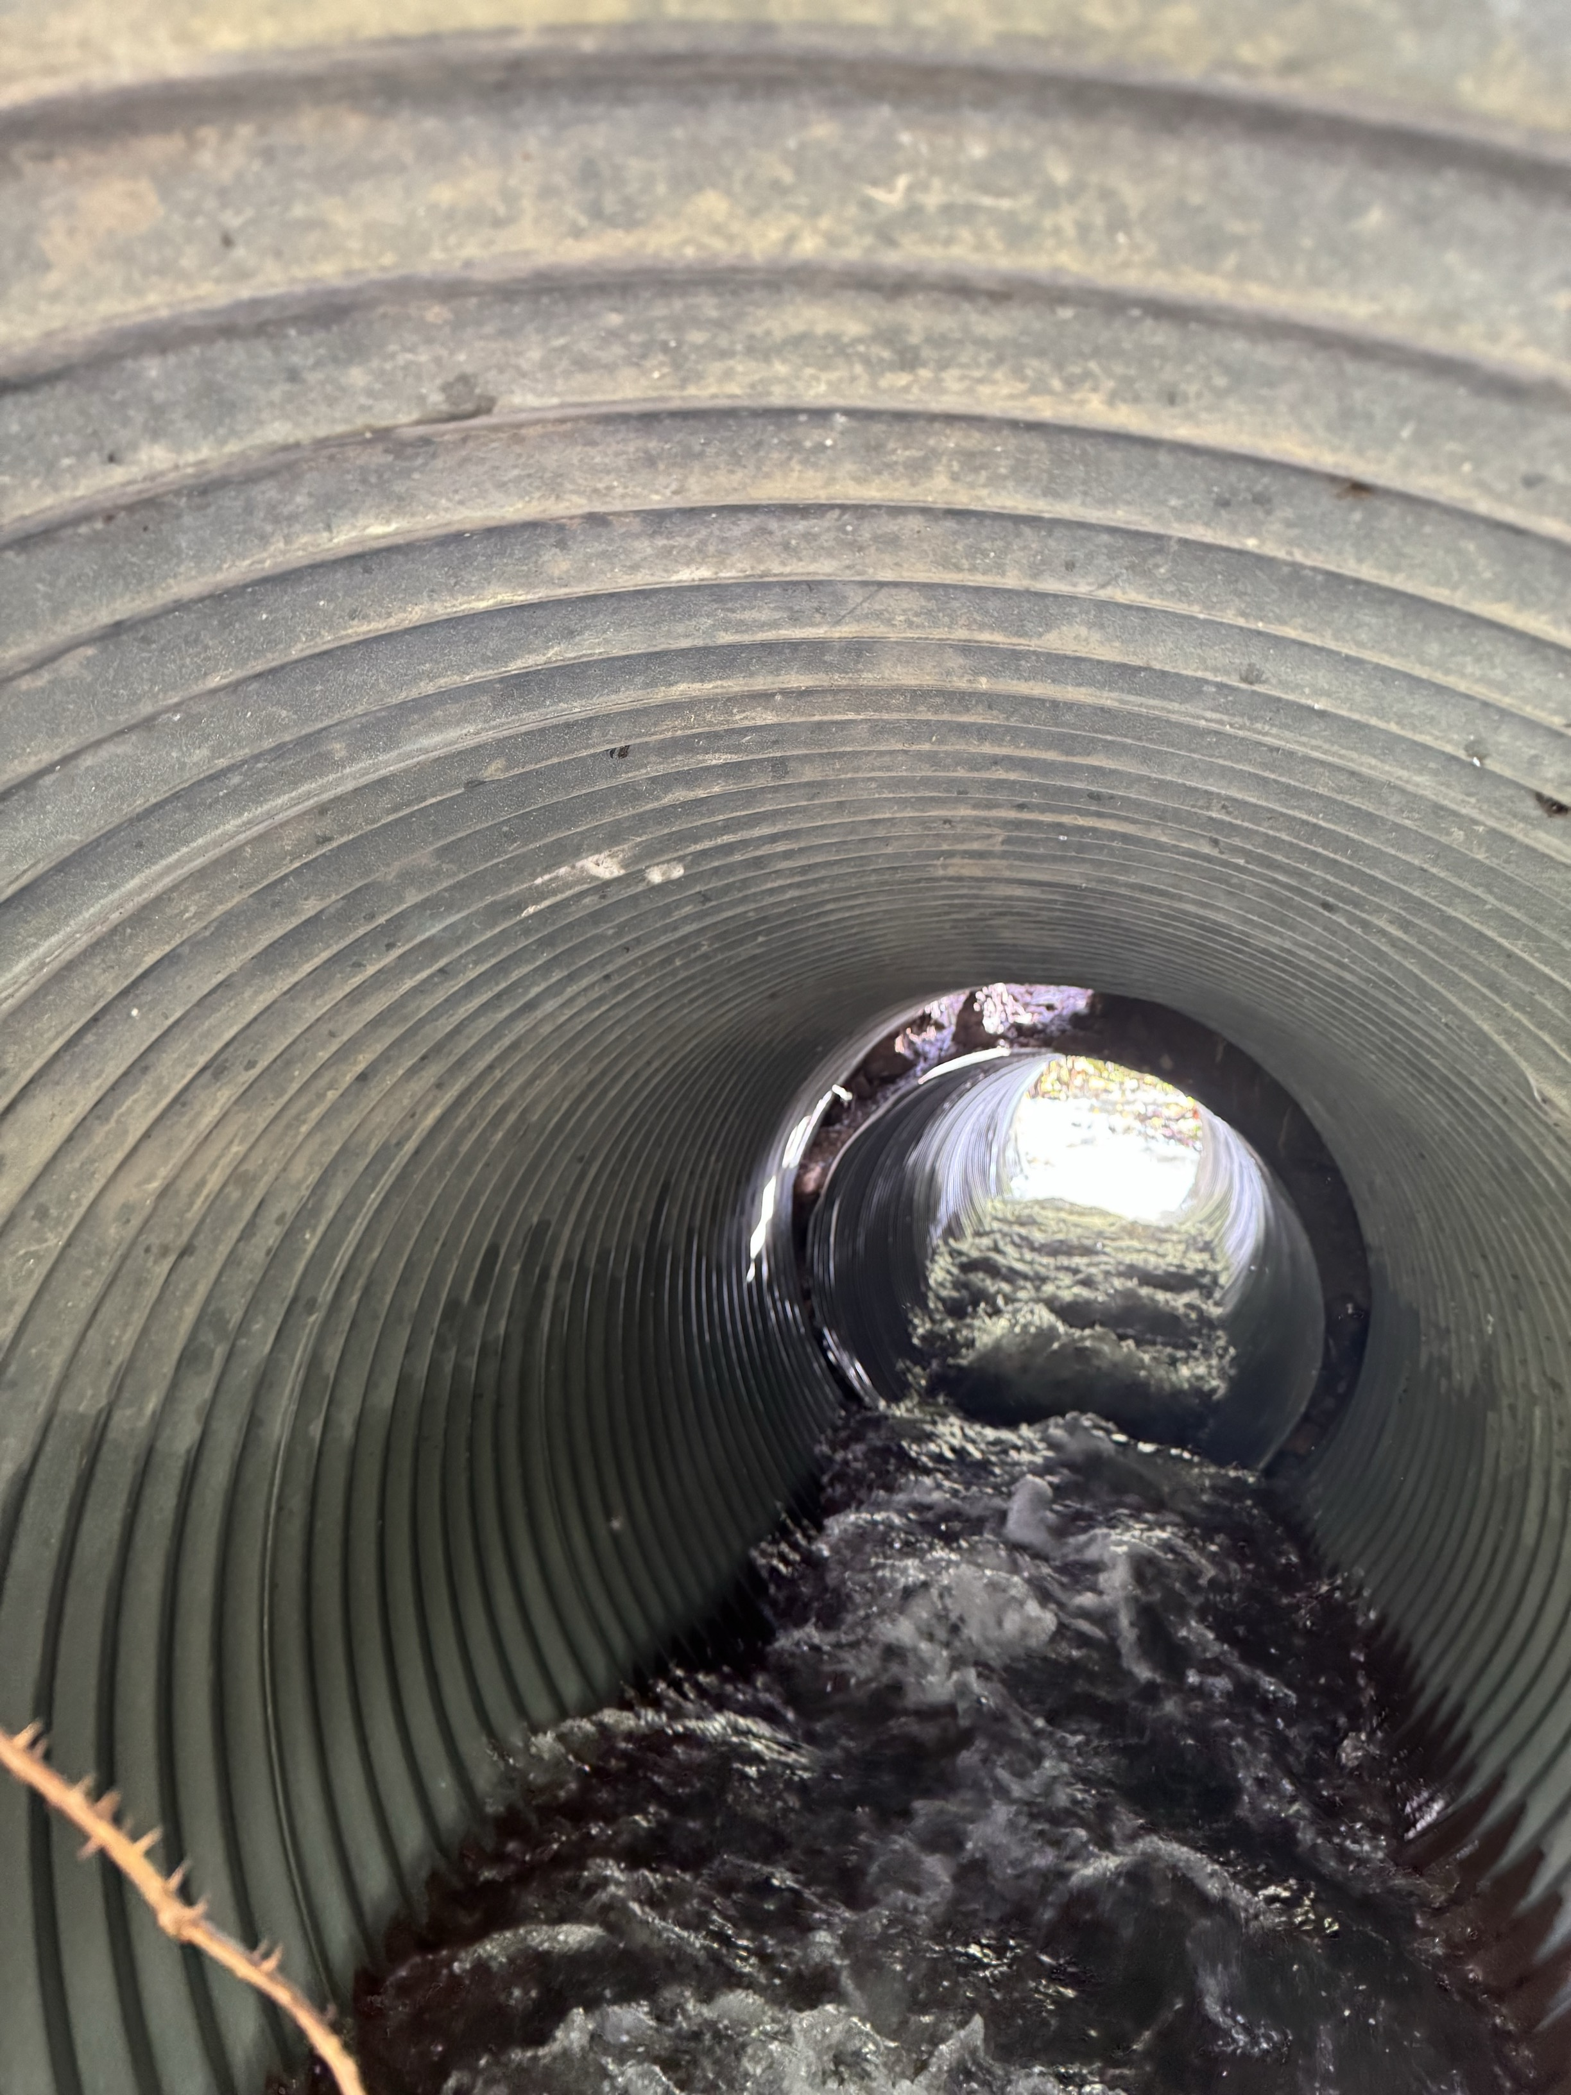
Operations Update (2 of 4): Storm Damage and repairs
We will be looking to replace one of the culverts at the "Double Barrel" crossing.
There is also another culvert that has sustained damaged and may need to be repaired, especially after this next round of rains.
We are currently working with the National Park Service to get approval for this emergency work order.
Don Murch will be helping with the repair. We are currently estimating the repair at $6000.
We are also looking for potential reimbursement via Marin County Office of Emergency Management.
on 2/7-2/10/2025

Slide 20
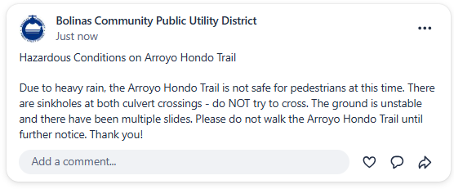
Please avoid hiking on the Arroyo Hondo trail until further notice!

Slide 21
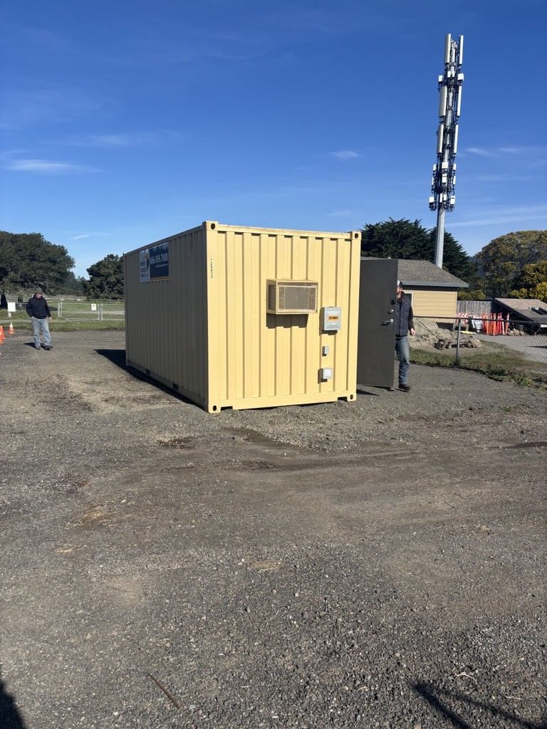
Operations Update (3 of 4): Well Projects
Well Projects are moving along
We have the Storage box at Mesa Park for the Resource Recovery Well
We did a walk through for electrical work with Mesa Electric for both Well projects
We still need to prepare a revised budget and request additional funds from DWR (grant funder) of >$100K to cover our construction shortfall

Slide 22
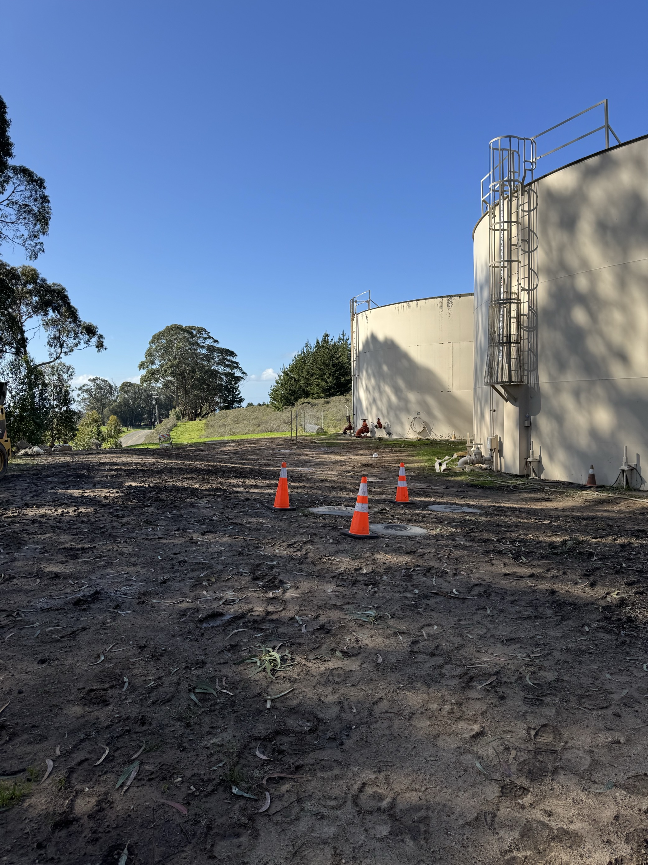
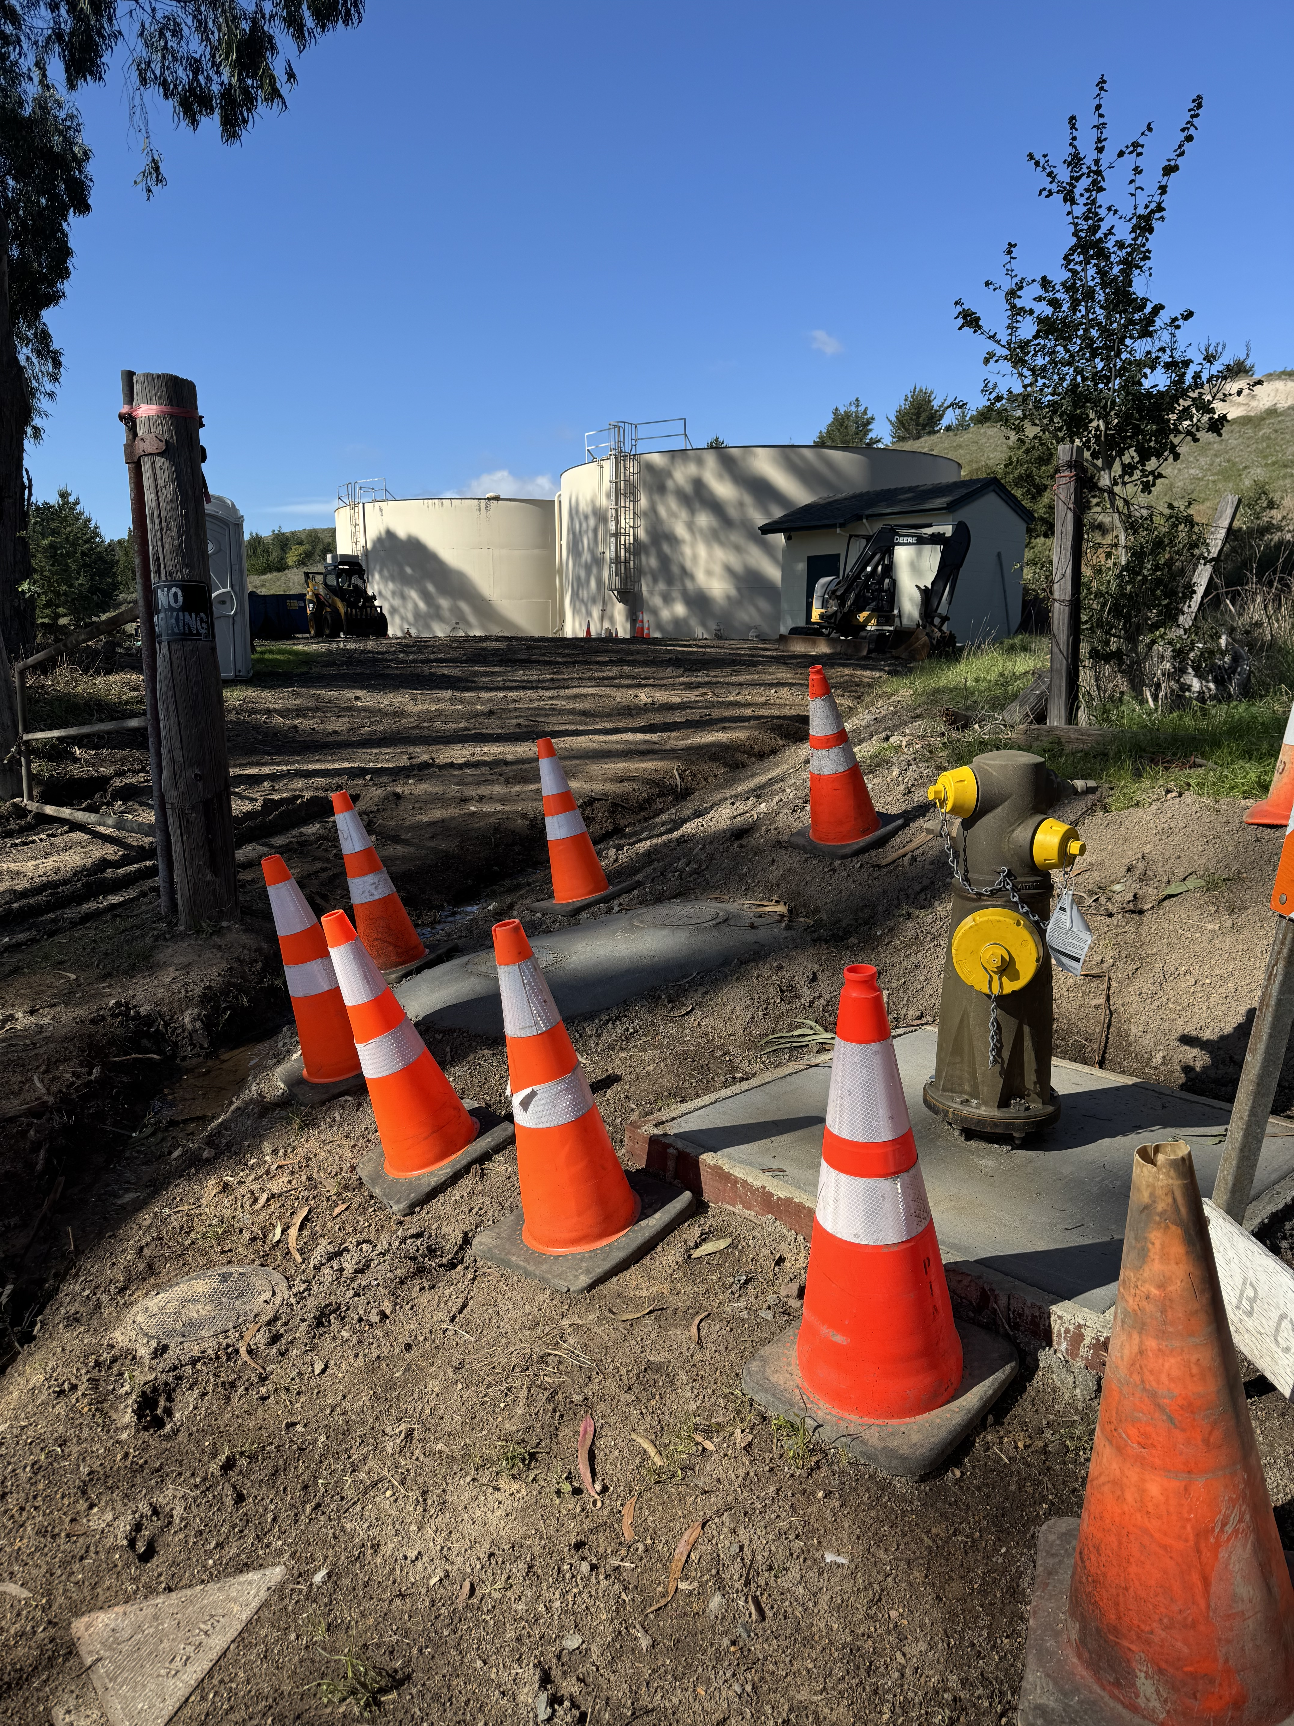
Operations Update (4 of 4): Tank-Site Pipeline Replacement project
Piazza is almost done!
There is about 1 more day of electrical work.
After the work is finalized, I will present a special report summarizing total costs and closing out the project.

Slide 23
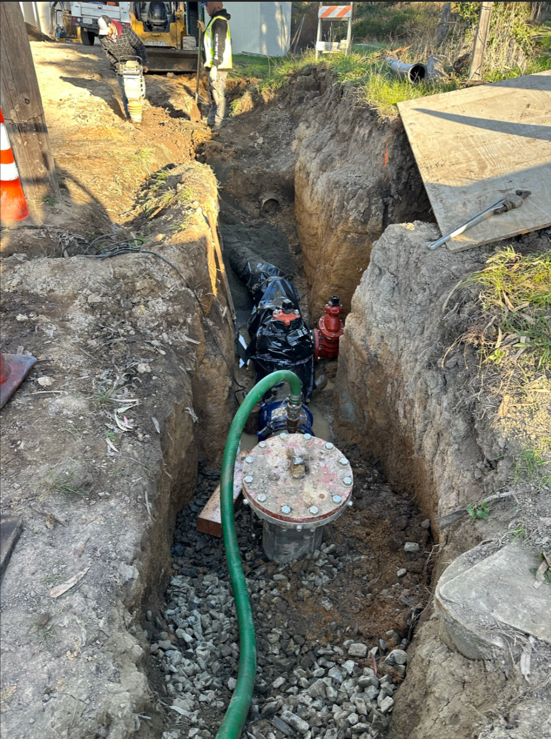
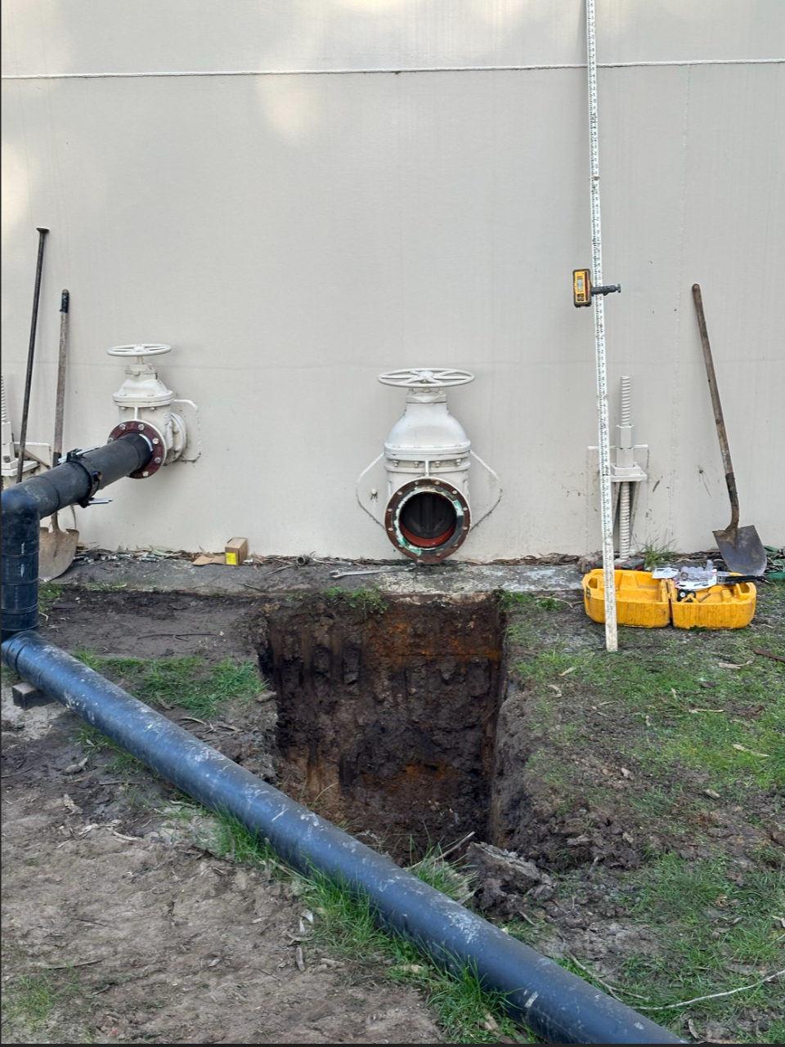
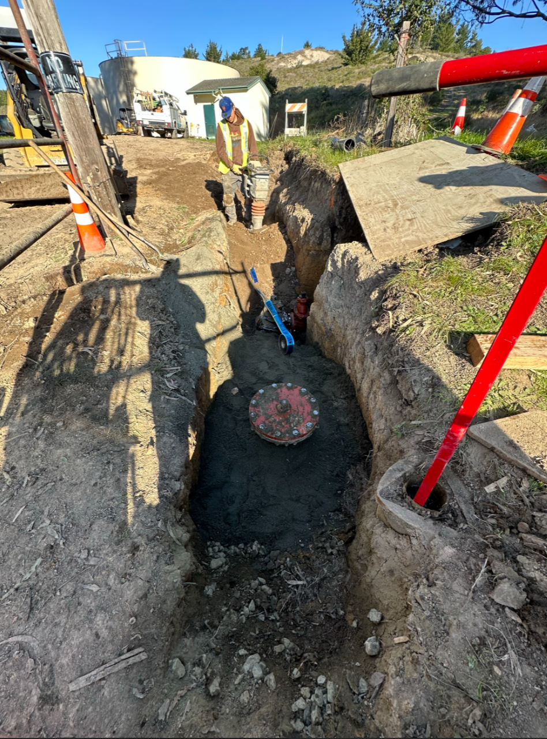
Tank site construction photos...

Slide 24
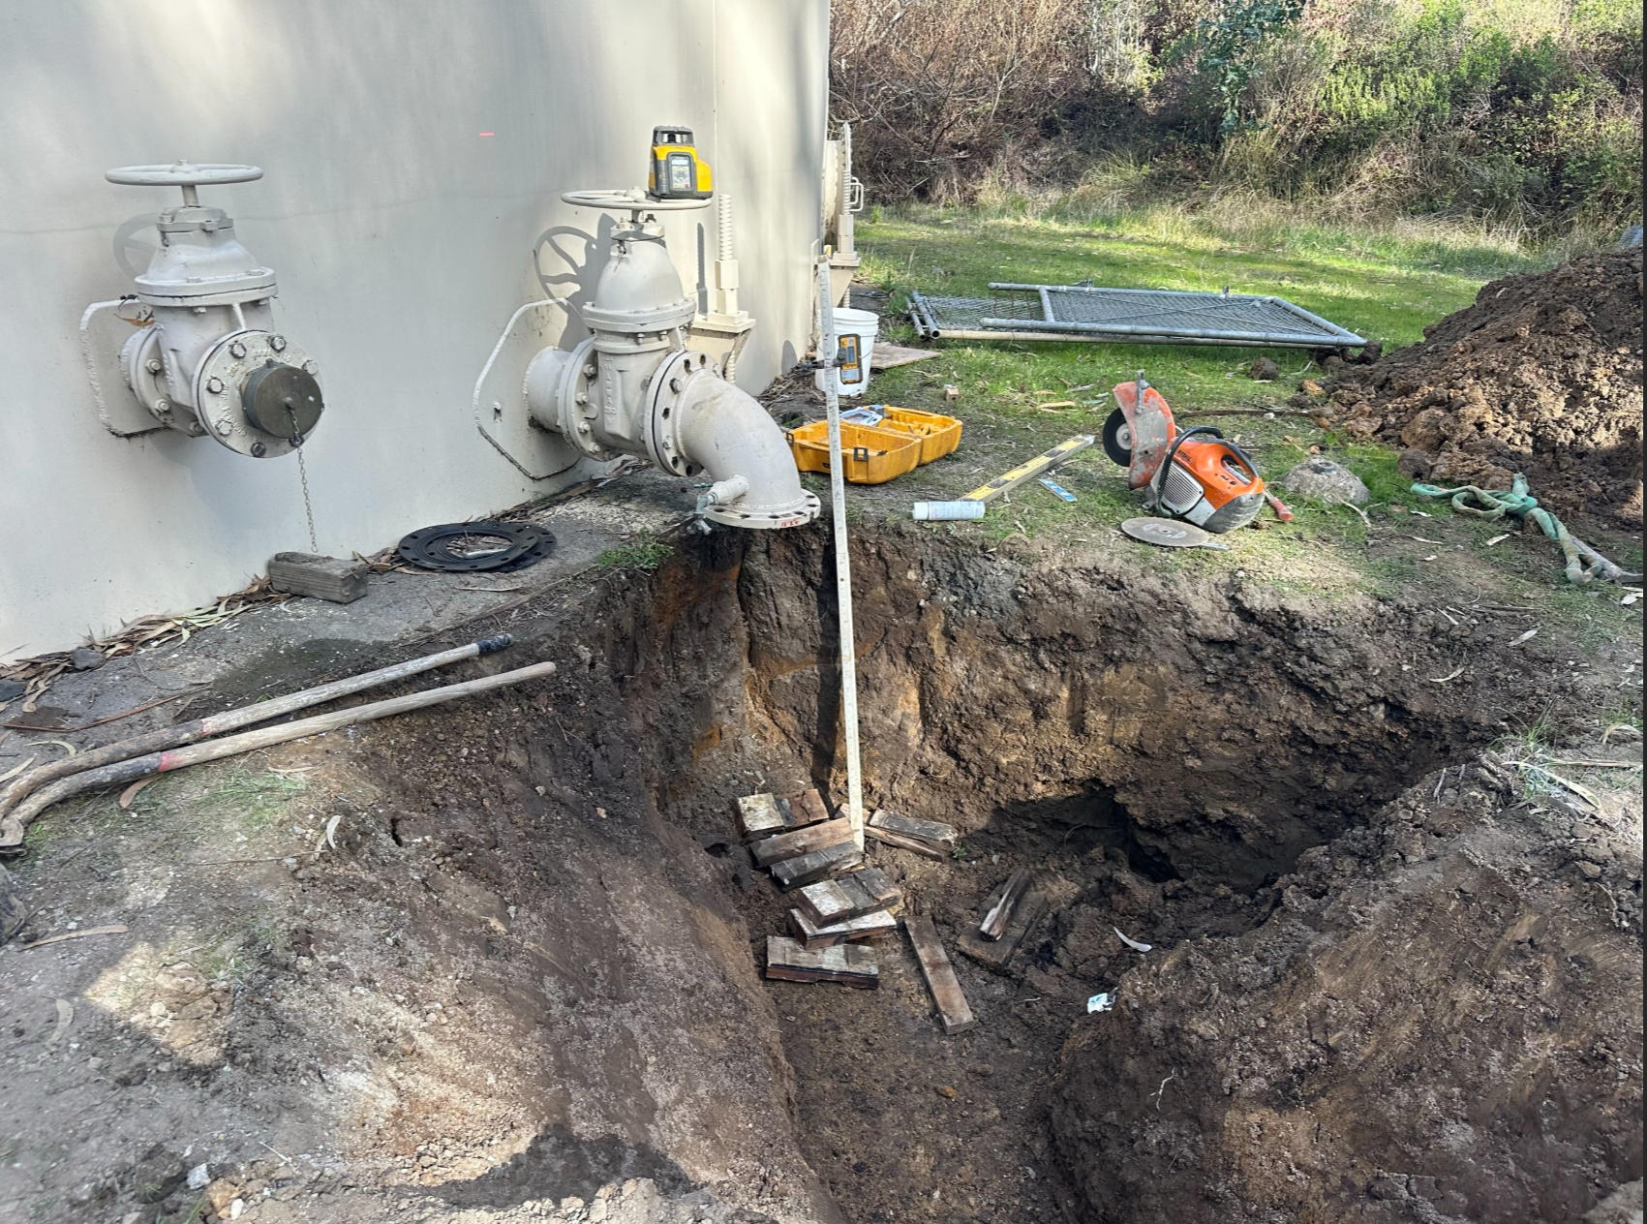
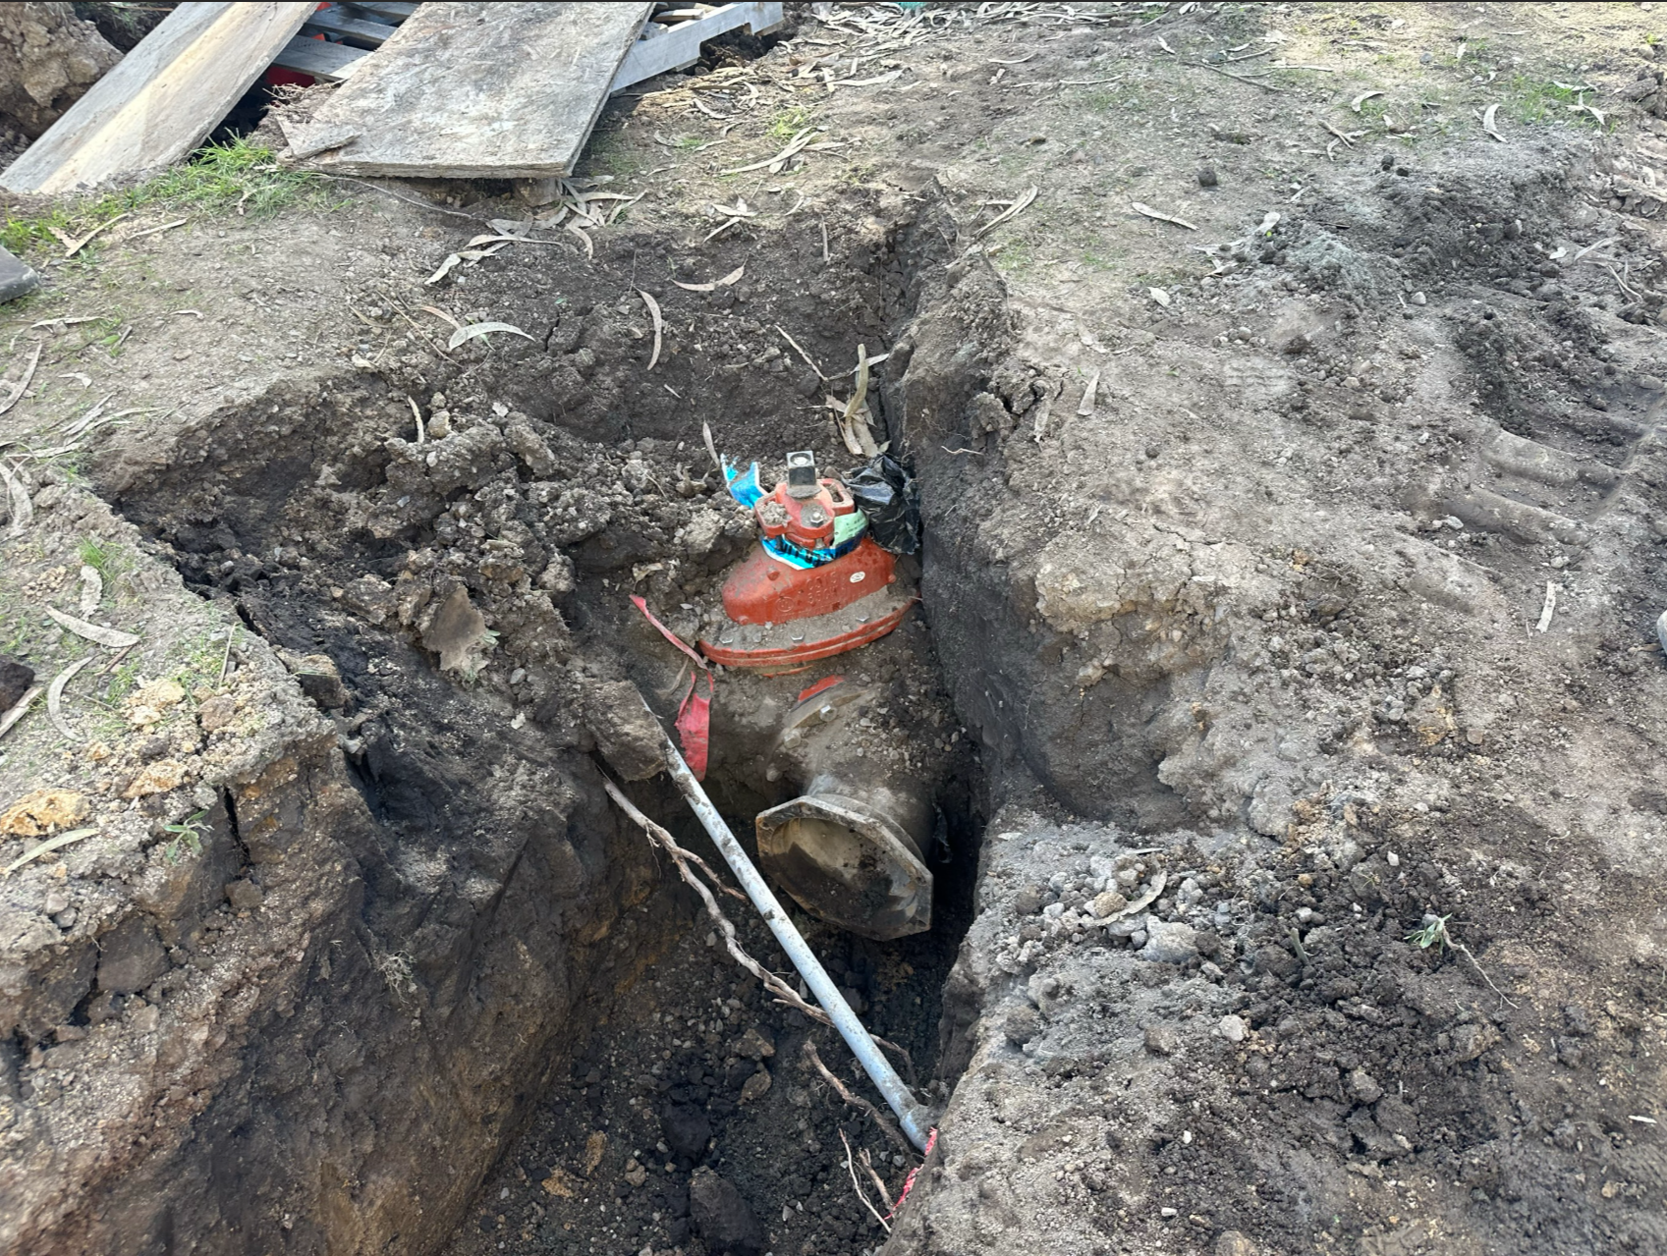
Tank site construction photos...

Slide 25
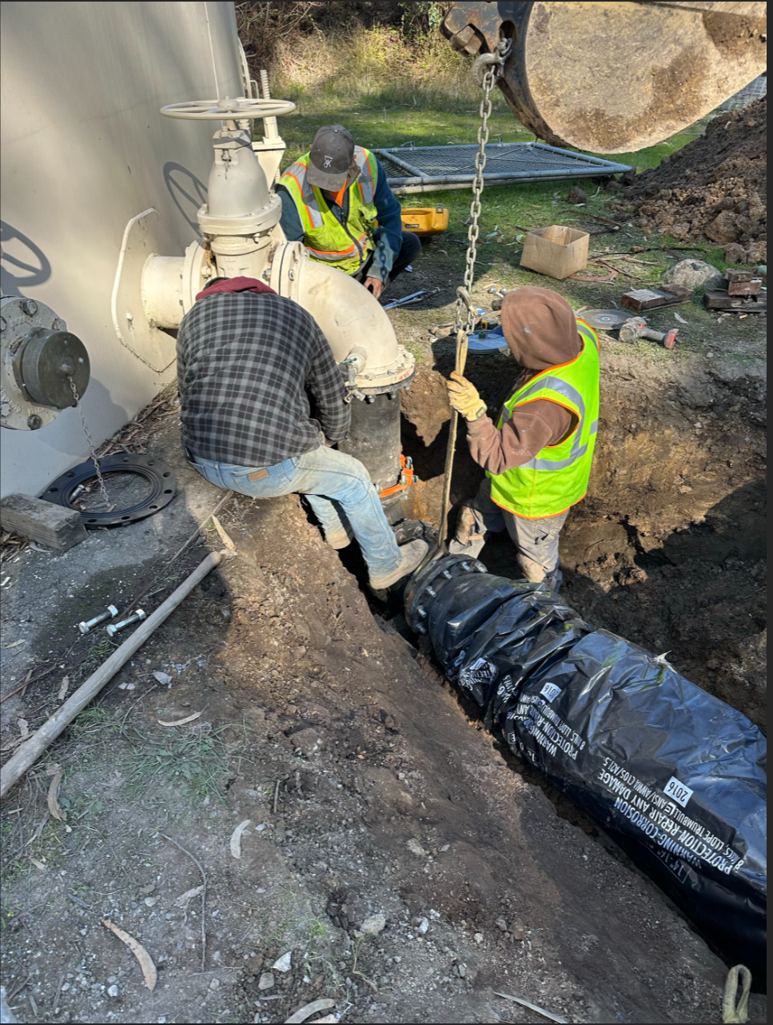
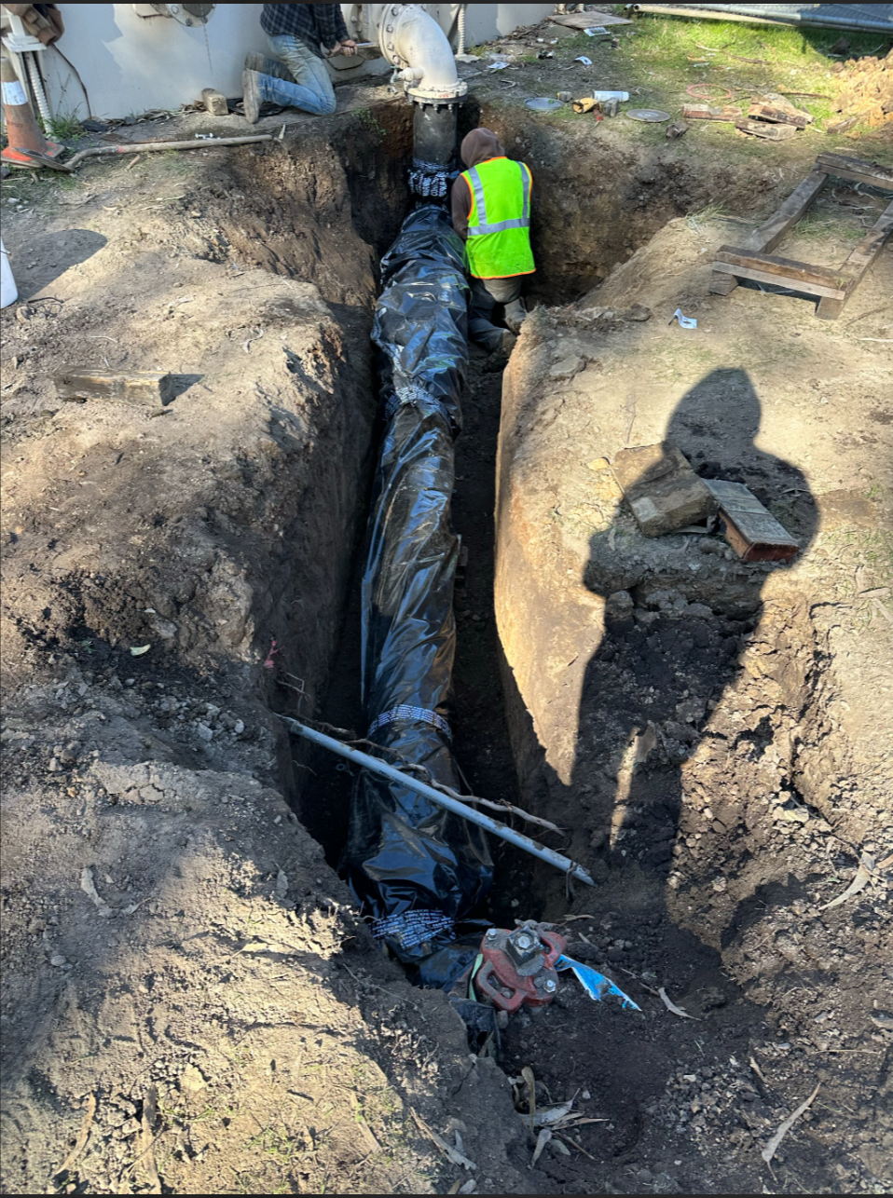
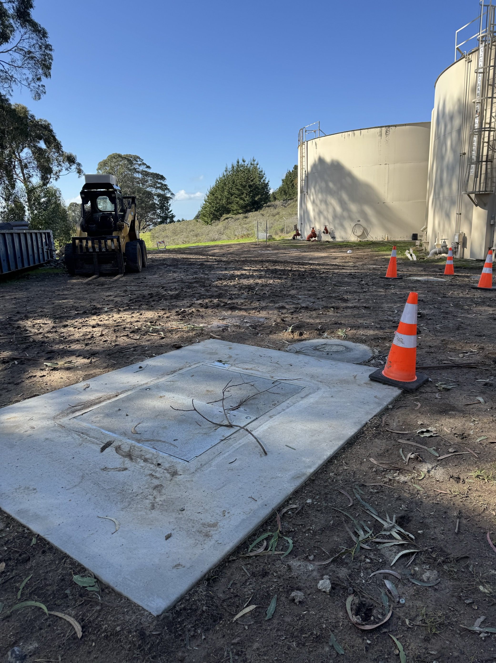
Tank site construction photos...

Slide 26
Governance Updates

Slide 27
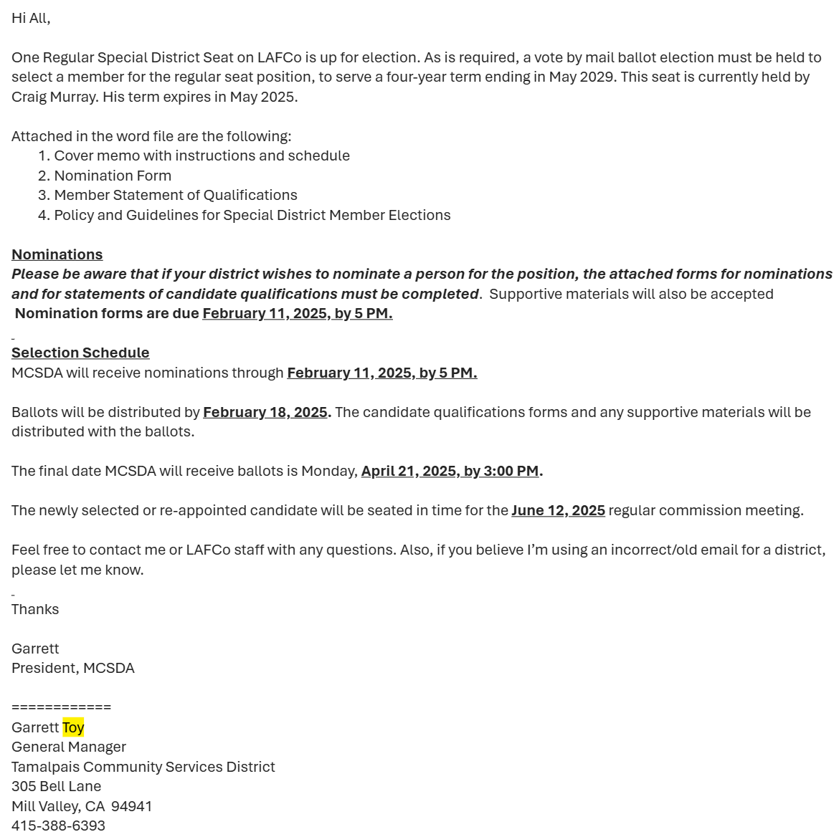

Governance Update (1 of 1): LAFCO Representative
Do any BCPUD Directors have any interest in being nominated to serve as a Local Agency Formation Commission (LAFCO) representative?
If so, the deadline for nominating you is tomorrow!
LAFCO oversees the formation and organization of local government agencies. LAFCOs aim to:
Encourage orderly formation and development of local governmental agencies.
Preserve agricultural and open-space lands.
Discourage urban sprawl
Each of California's 58 counties has its own LAFCO, which reviews proposals for the creation, expansion, or reorganization of cities and special districts to ensure efficient and logical service delivery

Slide 28
Miscellaneous Updates

Slide 29
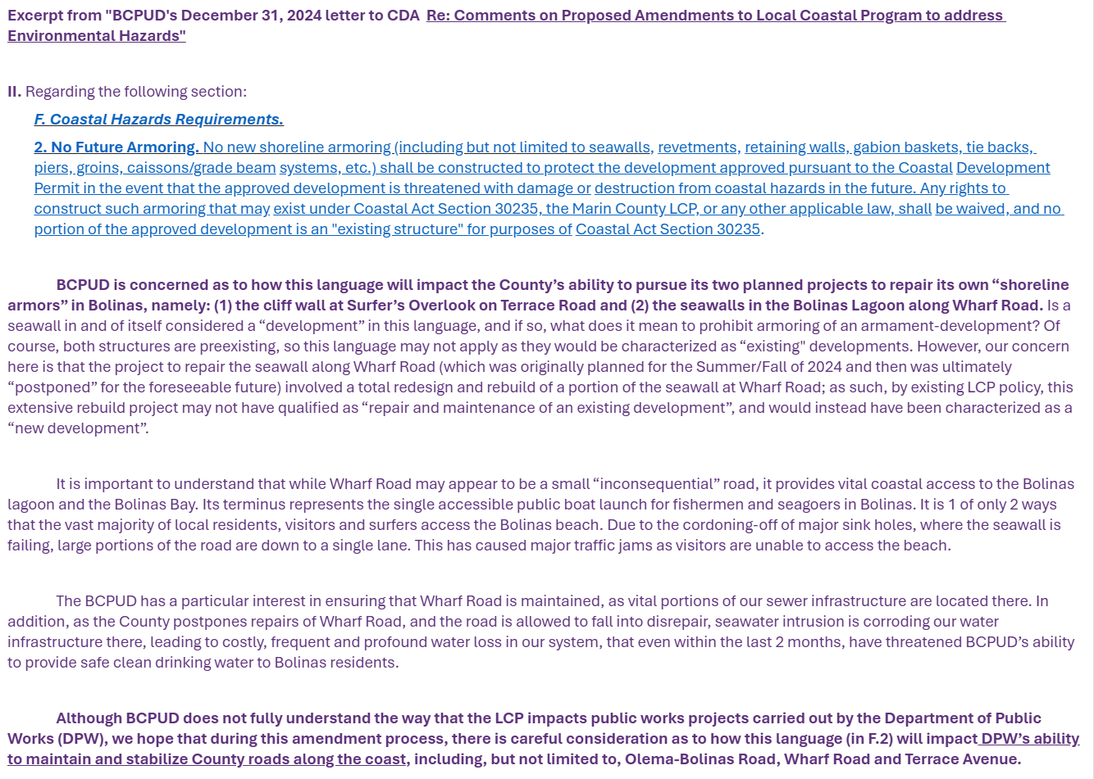

Miscellaneous Update (1 of 1): Marin County's Public Works Projects in Bolinas:
I'll be going to the County Office to meet with Principal Civil Engineer, Robin Bartlett, at the County this Thursday:
I'll be looking to discuss status updates on 2 projects:
Wharf Road & Sea Wall
Surfer's Overlook
I have brought to their attention an issue we raised in BCPUD's letter to CDA regarding proposed amendments to the Local Coastal Program; I'll also be looking to discuss this issue with them further.

