Slide 1
General Manager’s Update
March 19, 2025
Regular Board Meeting
Presented by Georgia Woods

Slide 2
Status of BCPUD’s Water Supply
Note February’s comprehensive Water Supply memo will soon be posted on our Website HERE.

Slide 3
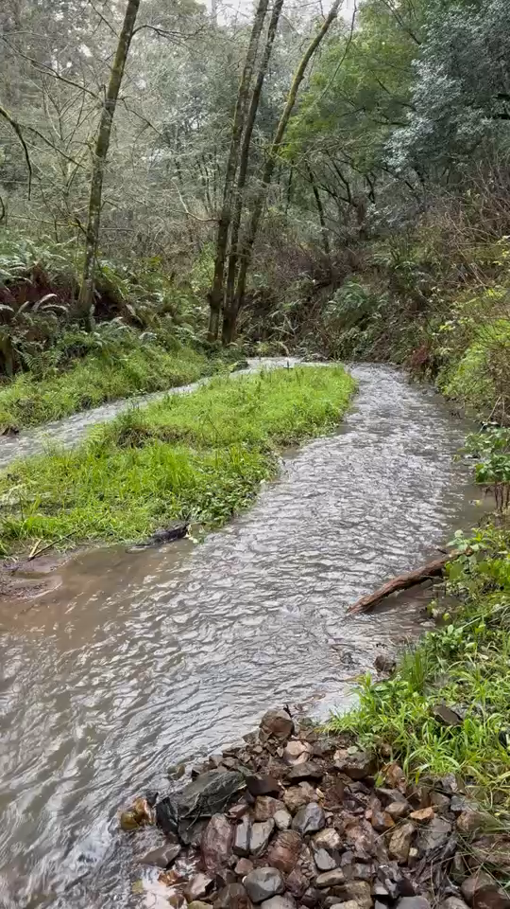
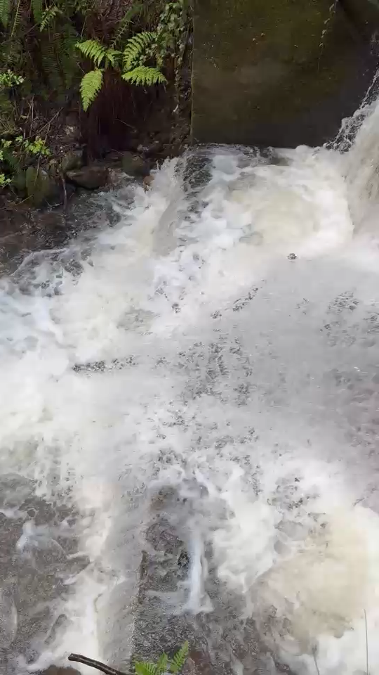
Upper impoundment: filled!
Lower impoundment
Reminder: Arroyo Hondo in February
on 2/6/2025
on 2/7/2025

Slide 4
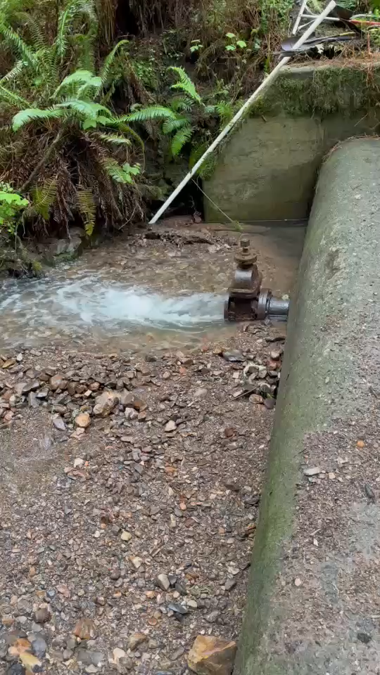
Upper impoundment: still filled!
Arroyo Hondo in March
Lower impoundment: still spilling
We continue to draw from the lower impoundment.
on 3/17/2025

Slide 5
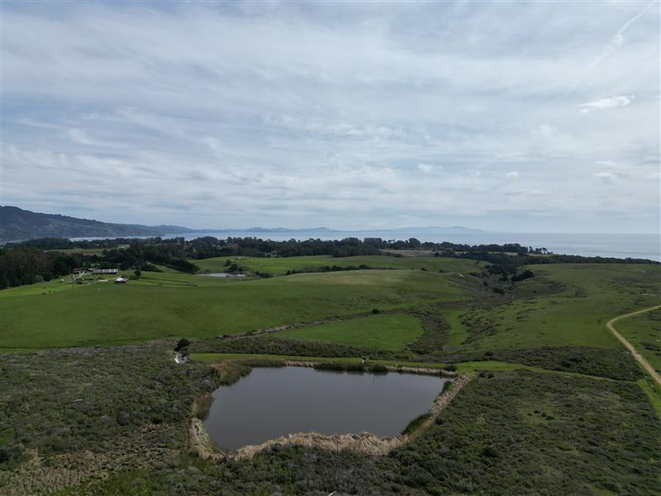
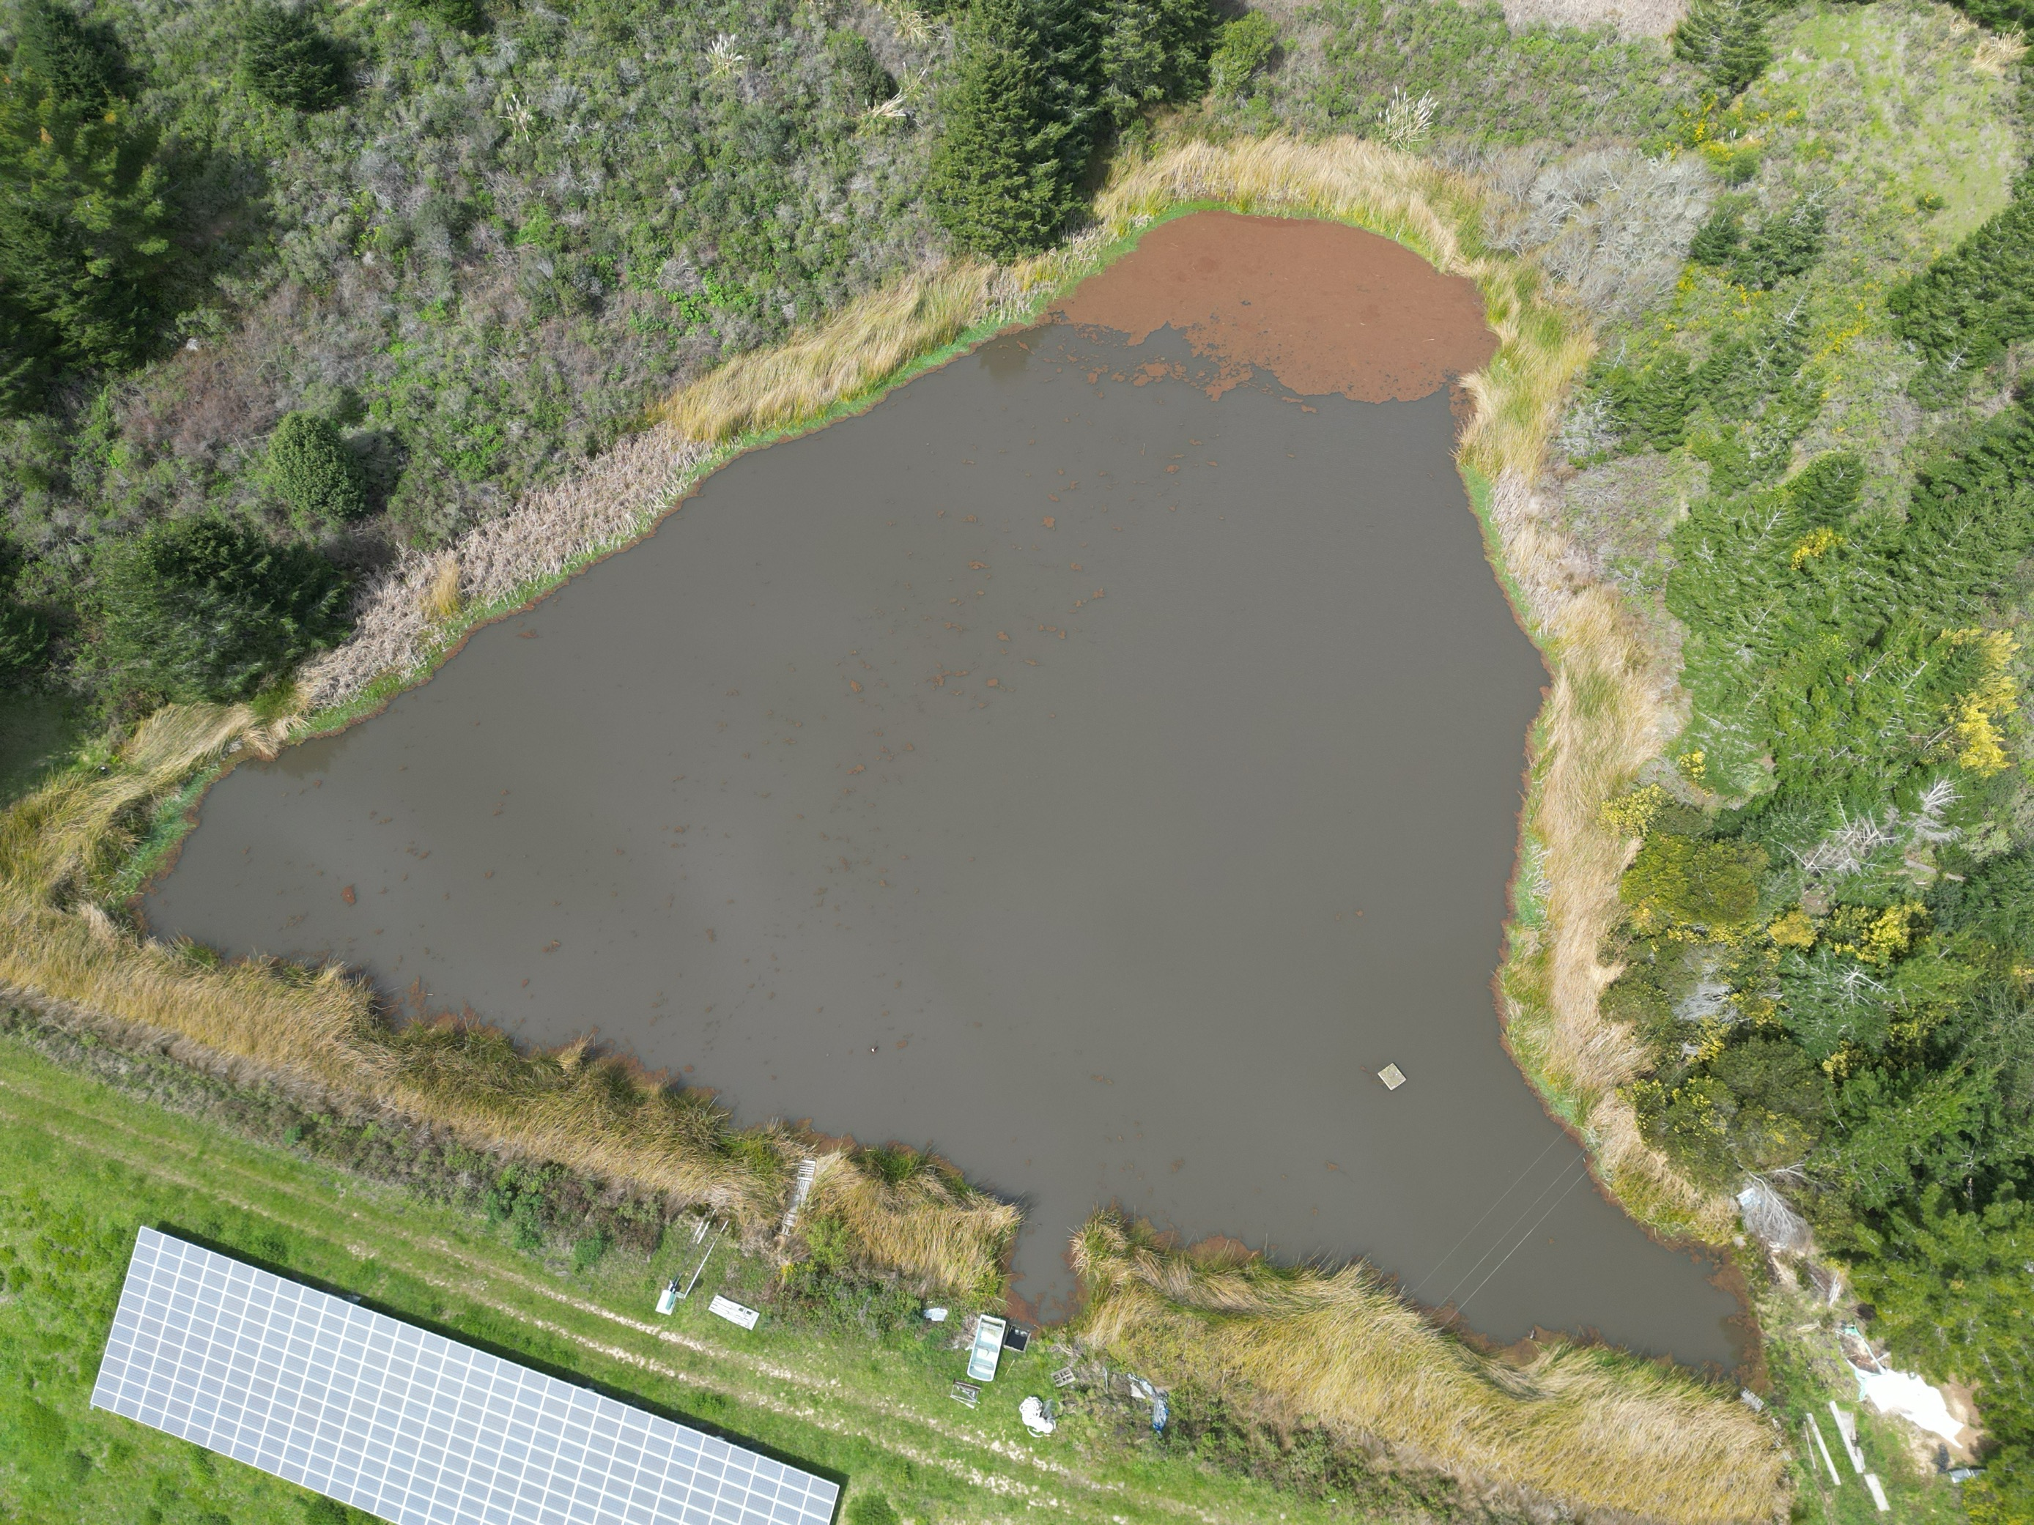
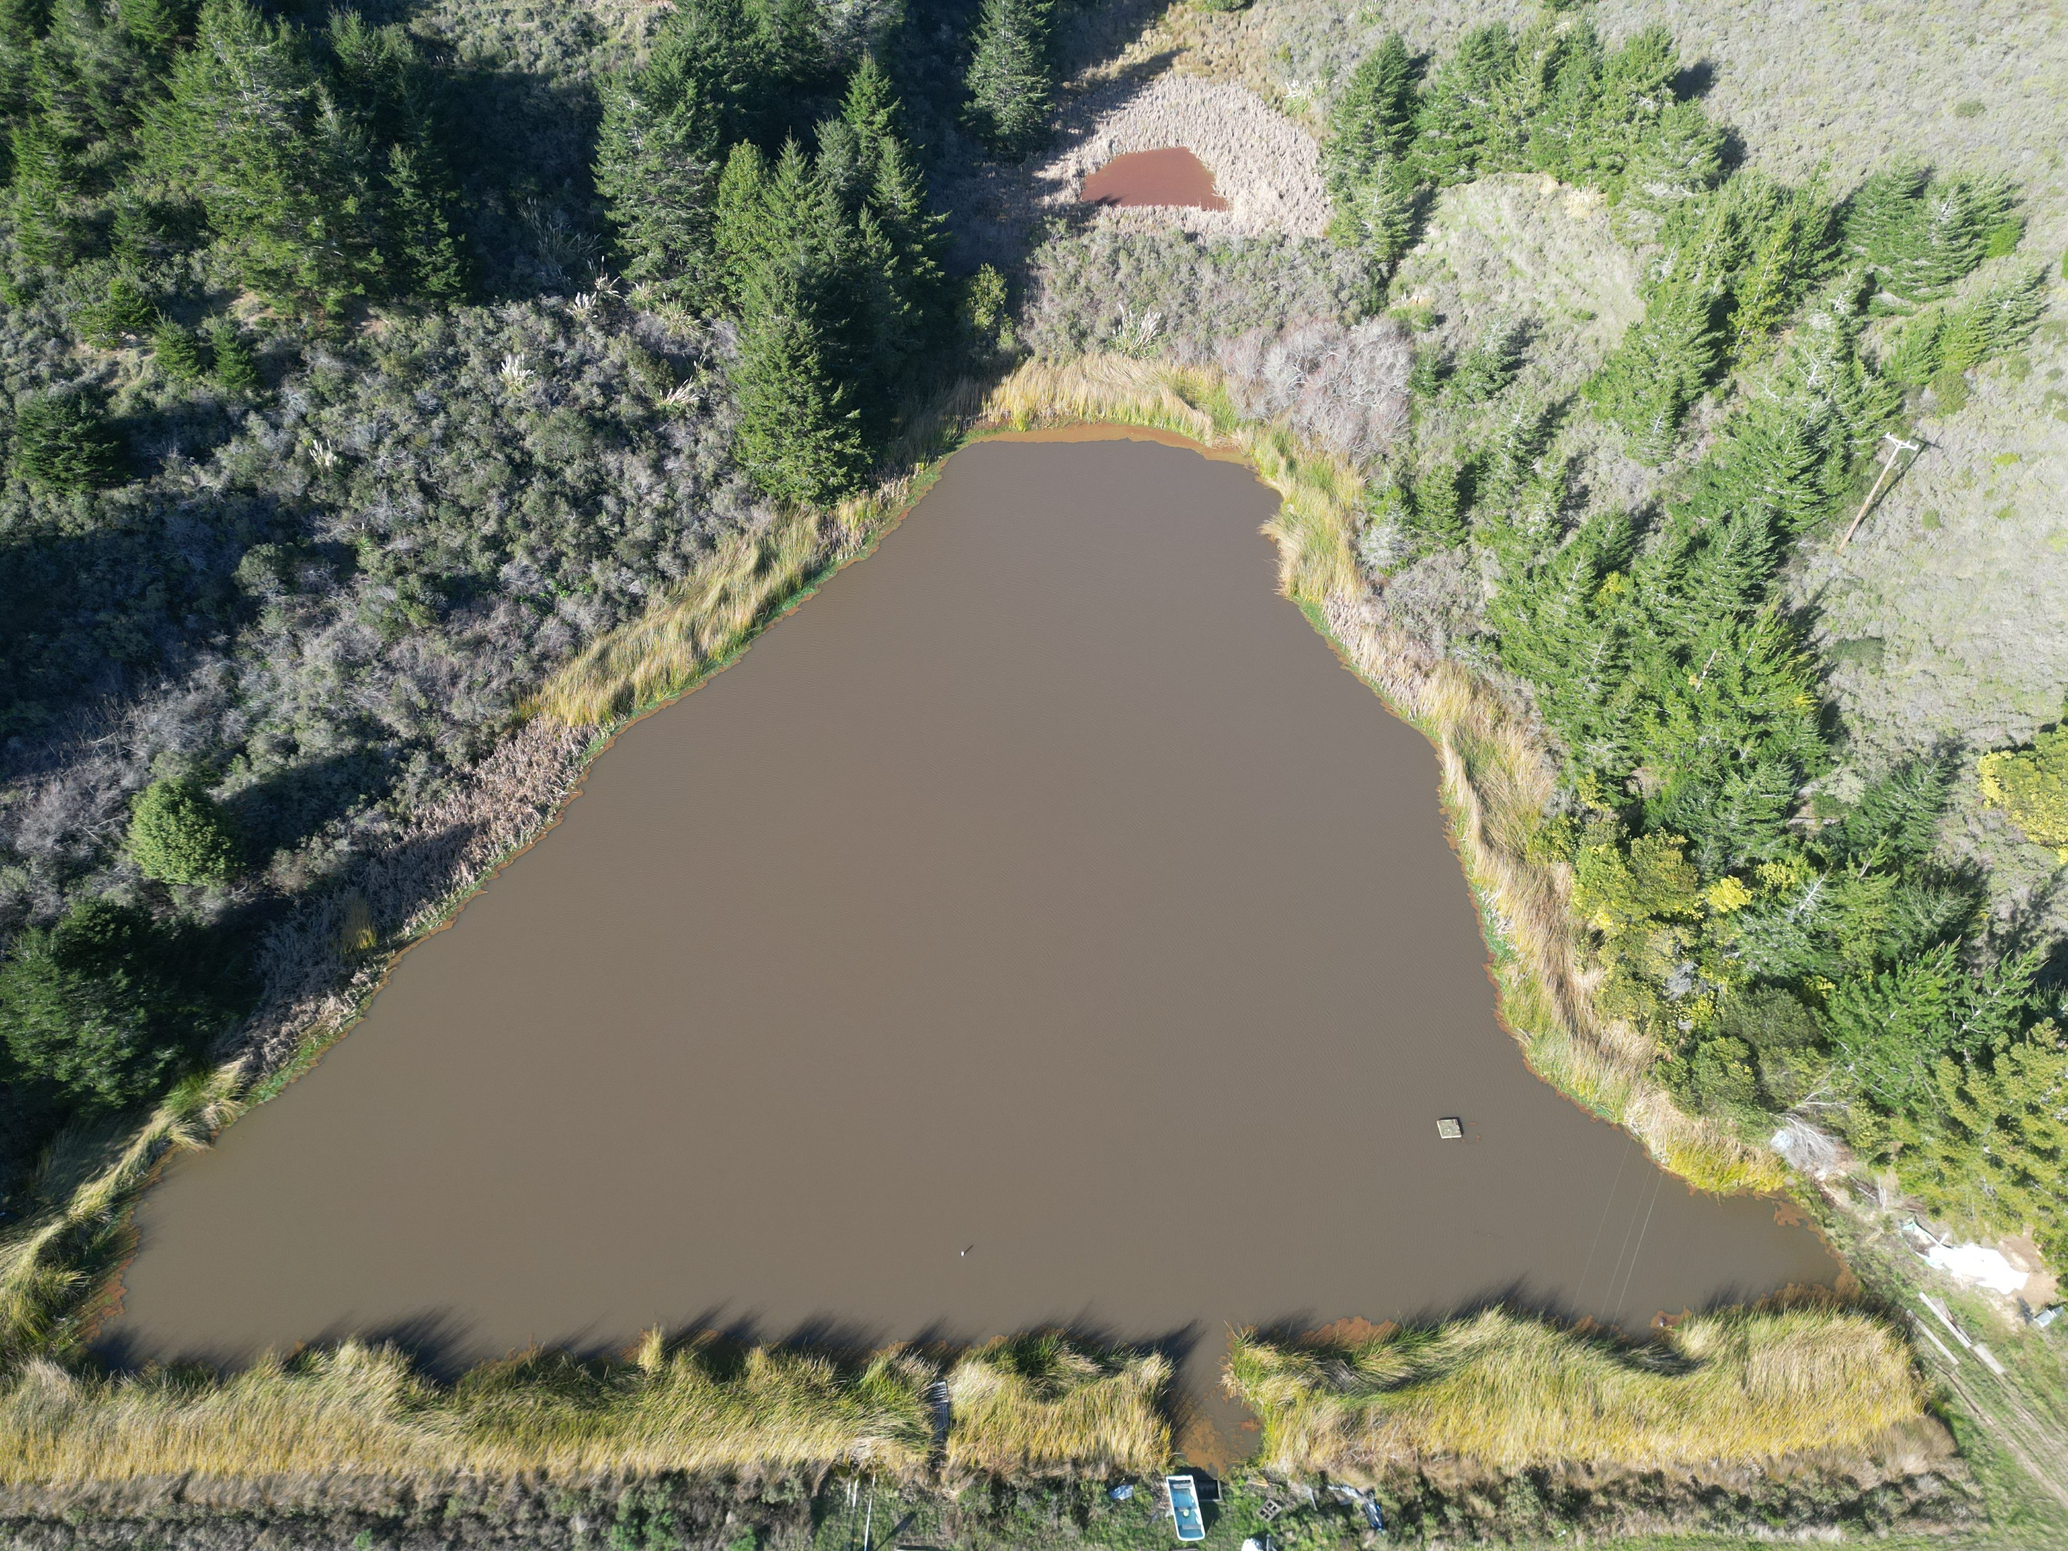
Both reservoirs are spilling...azolla is on the move...
Woodrat 2 on 3/19/2025
Woodrat 1 on 3/19/2025
Note Azolla is creeping back since 2/10

Slide 6
Winter 2025 Water Usage Trends
PRODUCTION​
In February 2025, water production in the district averaged 103 gallons per day (GPD)​ per connection
This is DOWN from January's production, which averaged 125 GPD per connection​
​
CONSUMPTION​​
Water consumption in February averaged 109 GPD per connection)​​
This is DOWN from January consumption, which averaged 119 GPD per connection).

Slide 7
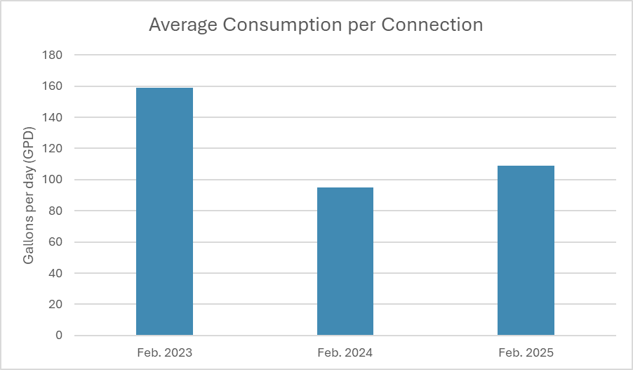
Comparison to past two years
Average use per connection:
Feb 2023 – 159 GPD (big leak that year)
Feb 2024 – 95 GPD
Feb 2025 – 109 GPD
14% increase per connection compared to last February

Slide 8
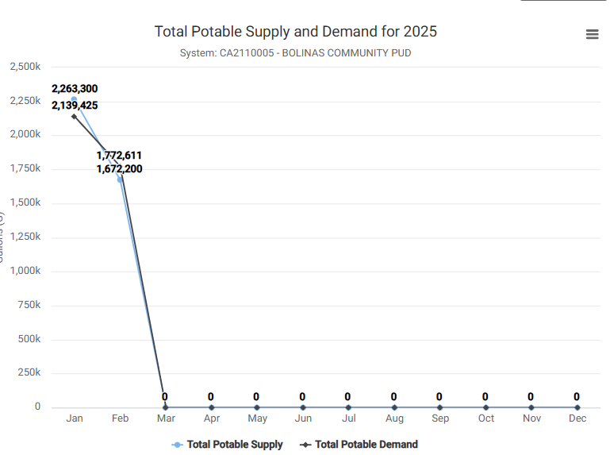
2025 Water Usage Trends

Slide 9
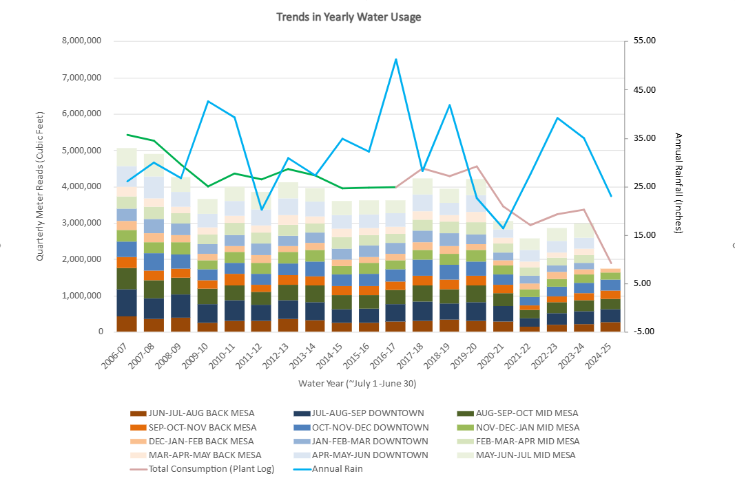
Annual Trends Since 2006 Quarterly Water Usage through Feb 2025
This graph shows “Cumulative Quarterly Water Usage”, as measured by “Regional Quarterly Water Meter Reads”
Remember: at the beginning of each month staff reads all meters within 1 of 3 given regions:
1) BACK MESA
2) DOWNTOWN
3) MID MESA
Annual Rain Fall is plotted as a BLUE LINE
Town Consumption Estimates, based on the amount of water leaving the treatment plant daily is shown in PINK LINE.
GREEN LINE is an extension of pink line, which models consumption based on an absolute unaccounted for water loss of 437,856 CuFt (~10% loss)

Slide 10
Meetings Attended

Slide 11
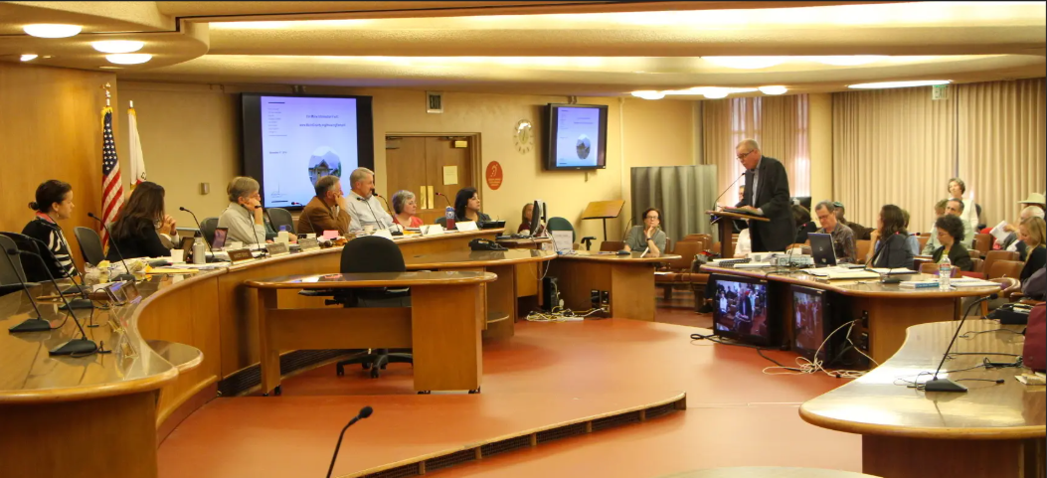
County Planning Commission Meeting (1 of 4): Ammendment to the Local Coastal Program Environmental Hazards Sections
I attended Marin County's Planning Commission Meeting on March 10 as ammendment (environmental hazards) to the LCP were being discussed
This work was extended to a meeting on Monday March 24.
I will be mailing an updated letter tomorrow morning to be shared Commissioners and Belle will be attending this meeting on the 24th to deliver public comment.
I will be meeting with newly appointed Commissioner Leila Monroe this week to discuss this issue
Congratulation Leila and Thank you!
West Marin gets new planning commissioner - Point Reyes Light

Slide 12
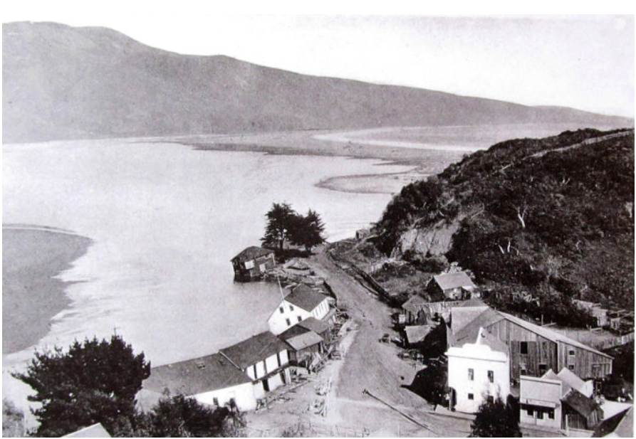
Meetings Attended (2 of 4): Wharf Road Repair
I (along with Director Walker) met with engineers at DPW this week to discuss their planned repair of Wharf Road
I'll be meeting with our own engineer soon to discuss what if anything we should do to proactively protect our water and sewer infrastructure prior to the commencement of County's work
I'll continue to provide updates regarding this work, especially as the schedule and details solidify

Slide 13
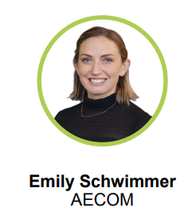
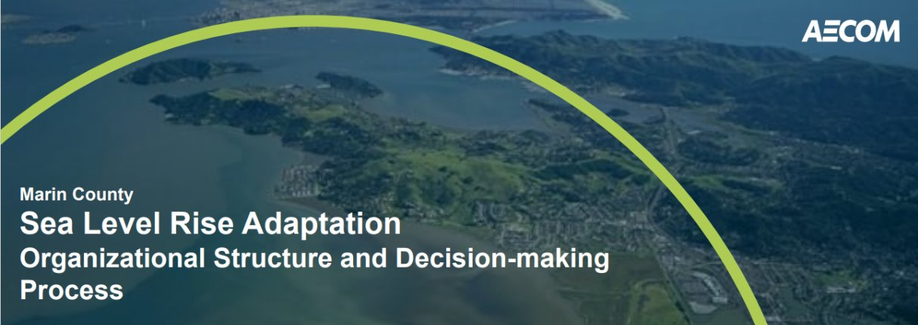
Meetings Attended (3 of 4): Sea Level Rise!
Attended another Marin County's Sea Level Rise Adaptation planning meeting, this time in-person at Stinson Beach Community Center
This work is being conducted by AECOM
AECOM is a consulting firm hired by the County of Marin to help a County Wide effort to address Sea Level Rise
The purpose of this specific meeting was to get stakeholder input from community members and agencies in Southern West Marin (Bolinas and Stinson)

Slide 14
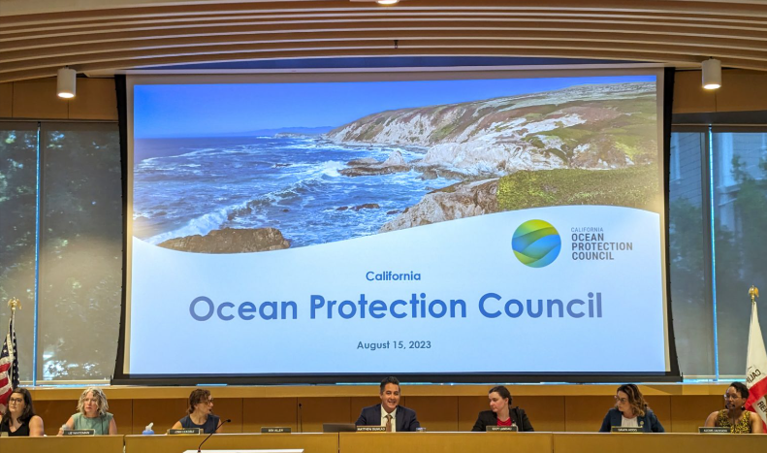
Ocean Protection Council (4 of 4):
As you know, this winter BCPUD had been actively working with Stinson Water to help them revise their OPC grant proposal
The grant proposes a "regional feasability study" that will evaluate and recommend potential upgrades to wastewater infrastructure and facilities in both Stinson and Bolinas in the face of sea level rise
On March 3, Stinson Water's OPC grant proposal was awarded an additional $300K (Totalling $1.5M)
In the coming weeks I will be working with Stinson Water to draft our Request For Proposal

Slide 15
Operations Updates

Slide 16
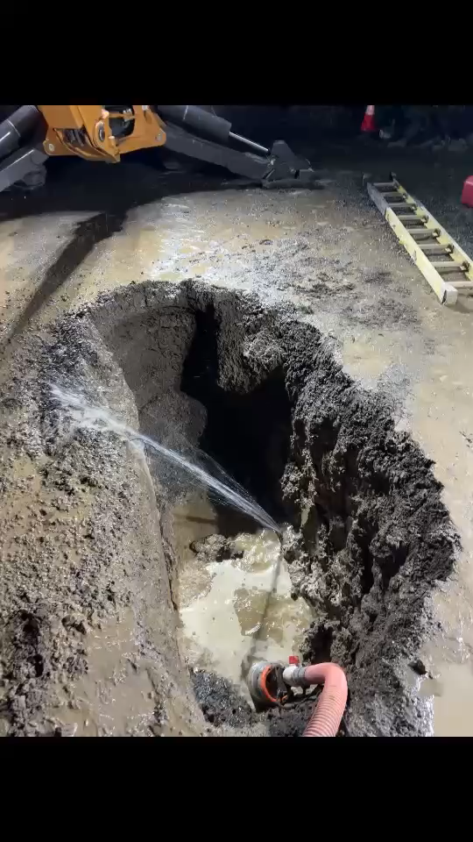
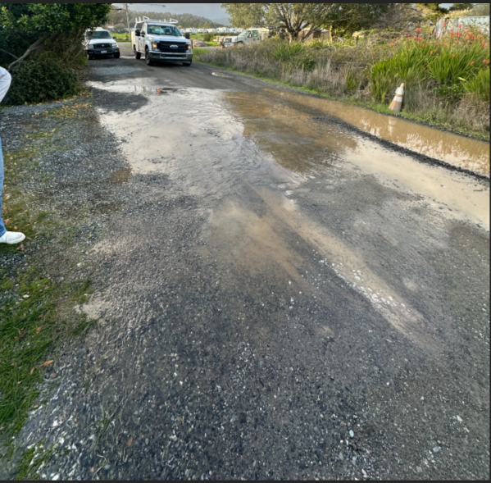
Operations Update (1 of 4): LEAKS
Large leak on the 500 block of Birch Road last week.
Operators repaired the leak that evening!

Slide 17
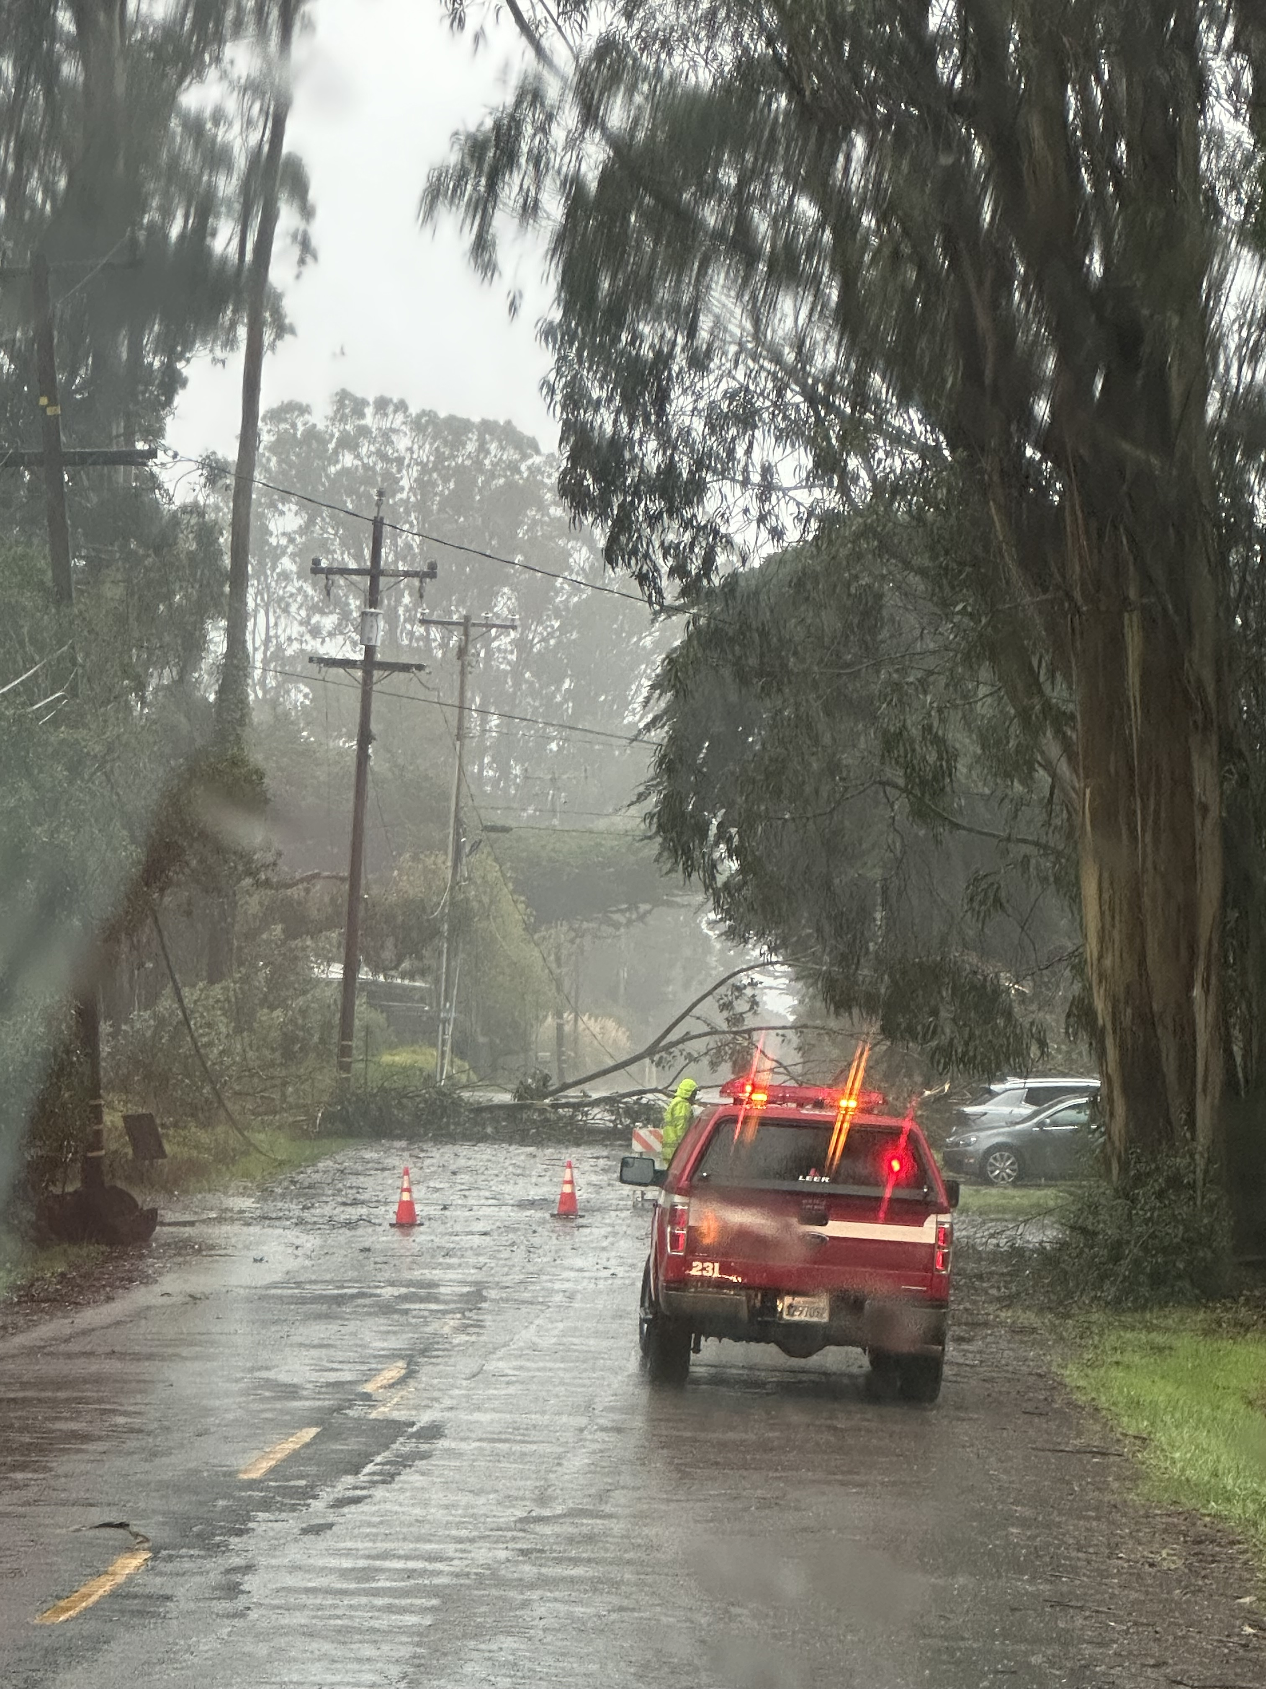
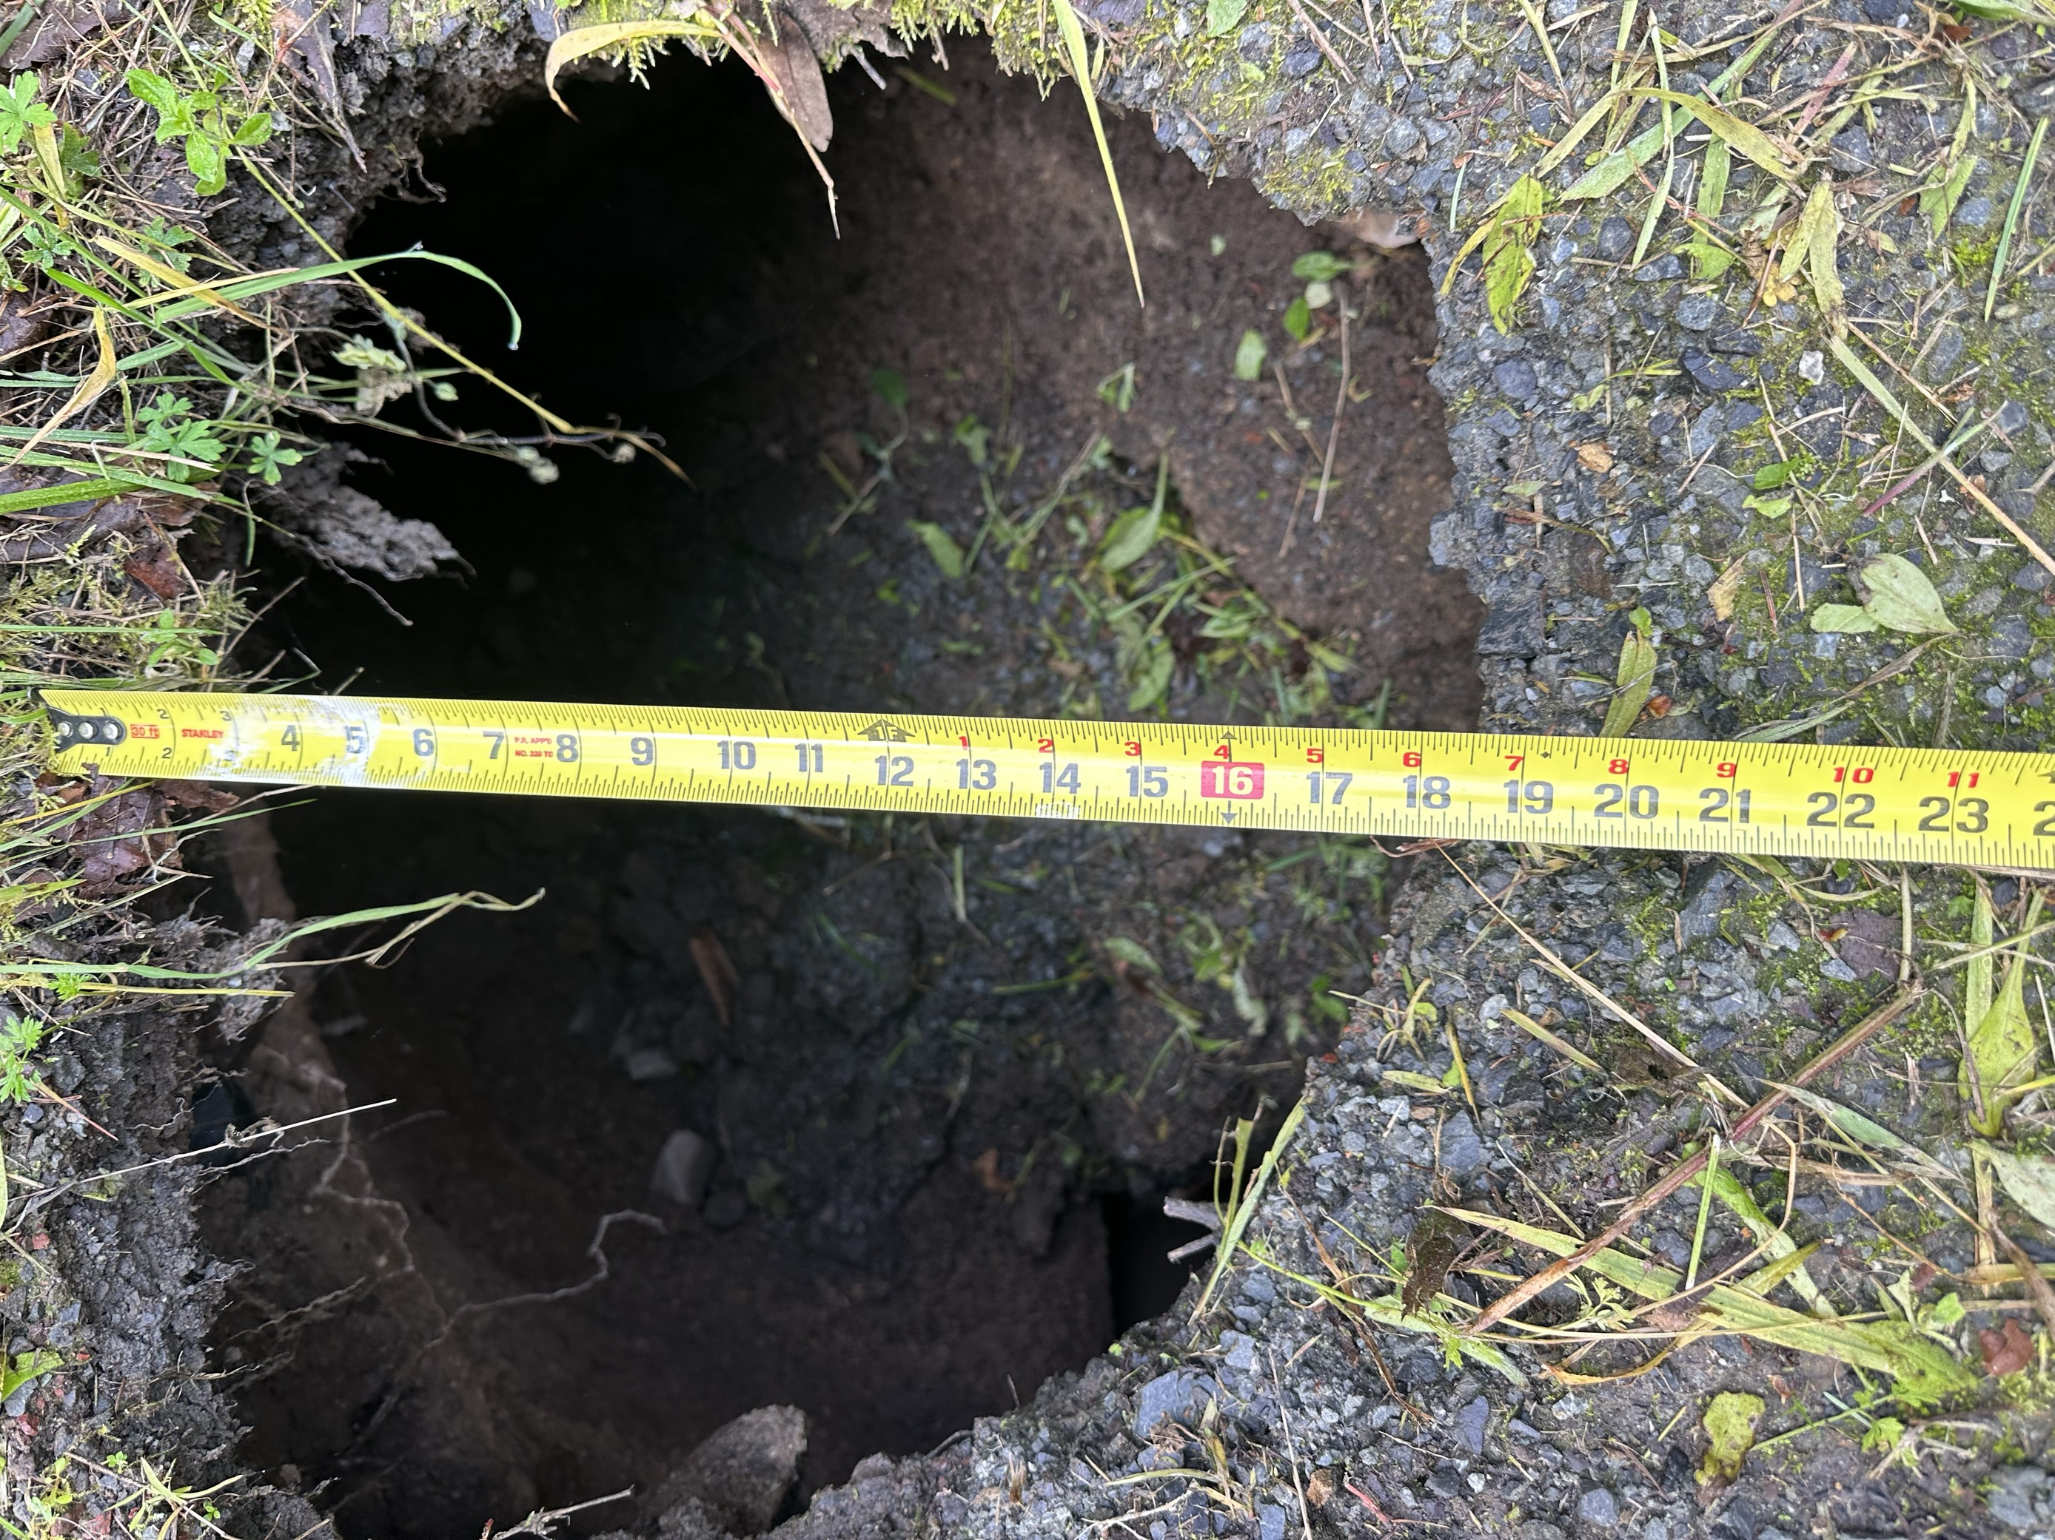
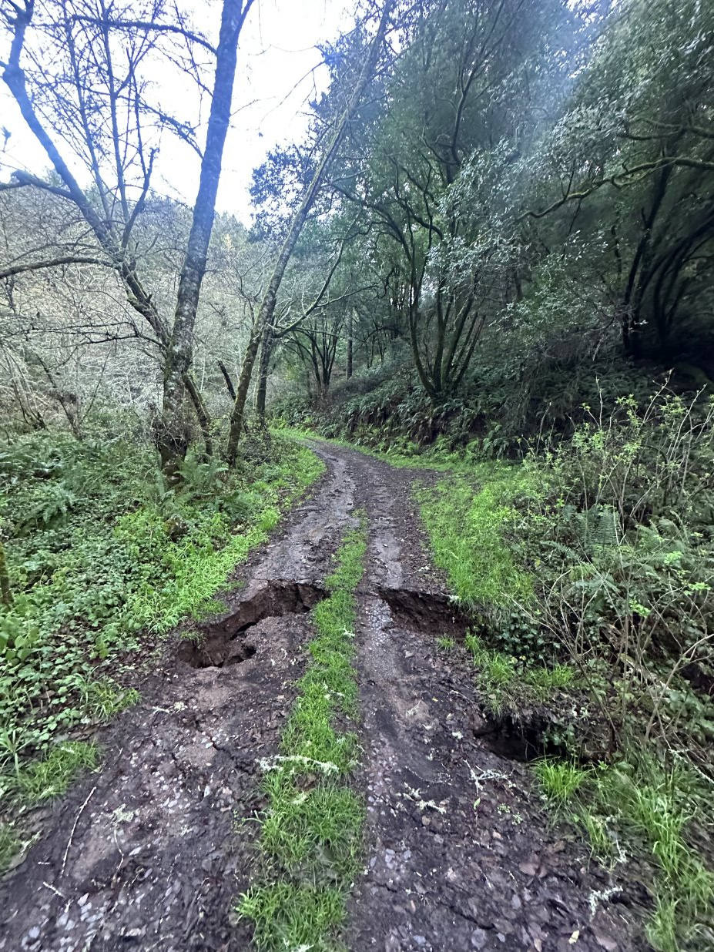
Operations Update (2 of 4): Storm Damage and Planned Repairs
on 2/4/2025
We sustained some damage from last week's storm along the Arroyo Hondo Access Road
Damage to culvert and slides
on 3/10, 2025
on 2/7-2/10, 2025

Slide 18
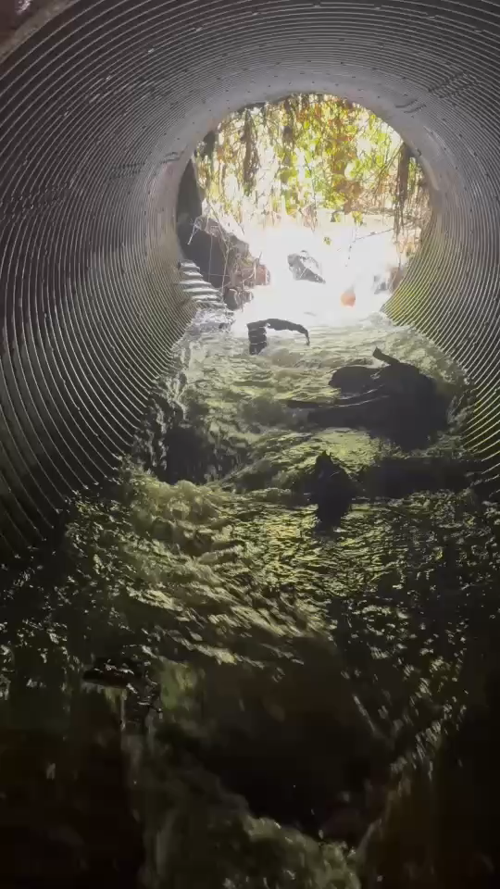
Operations Update (2 of 4): Storm Damage and repairs
We will be looking to repair 2 sections of the Arroyo Hondo Access Road:
The culvert that has split at the creek crossing closer to Mesa Road
The culvert which has split at the "Double Barrel" crossing
I got the name of an engineer that I will be contacting to develop a solution to repair this damage
We will continue to work with the National Park Service to get approval for this emergency work order
on 3/14/2025

Slide 19
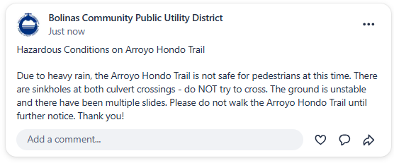
Please avoid hiking on the Arroyo Hondo trail until further notice!

Slide 20
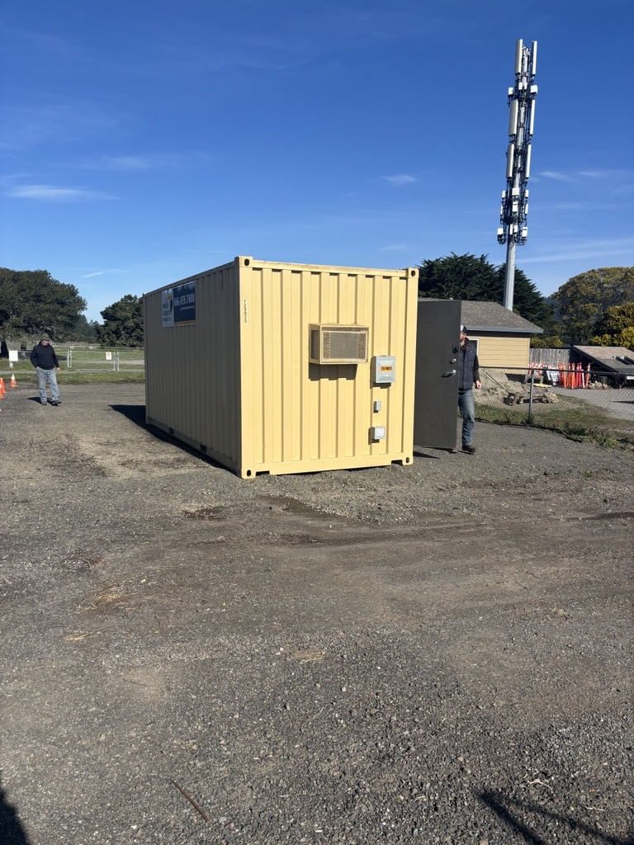
Operations Update (3 of 4): Well Projects
Well Projects are moving along through the construction phase
We continue to work on our easement agreement with BCLT that will be necessary for us to use and access the well at 31 Wharf
I will be meeting with the Grant Manager at DWR on Friday to formally request additional funds to cover our budget "shortfalls" (currently estimated ~$190K)
We continue to communicate with Habitat for Humanity to coordinate our respective projects
I've had meetings with the Weeks Drilling and project engineers for planning the installation of the pump at 31 Wharf

Slide 21
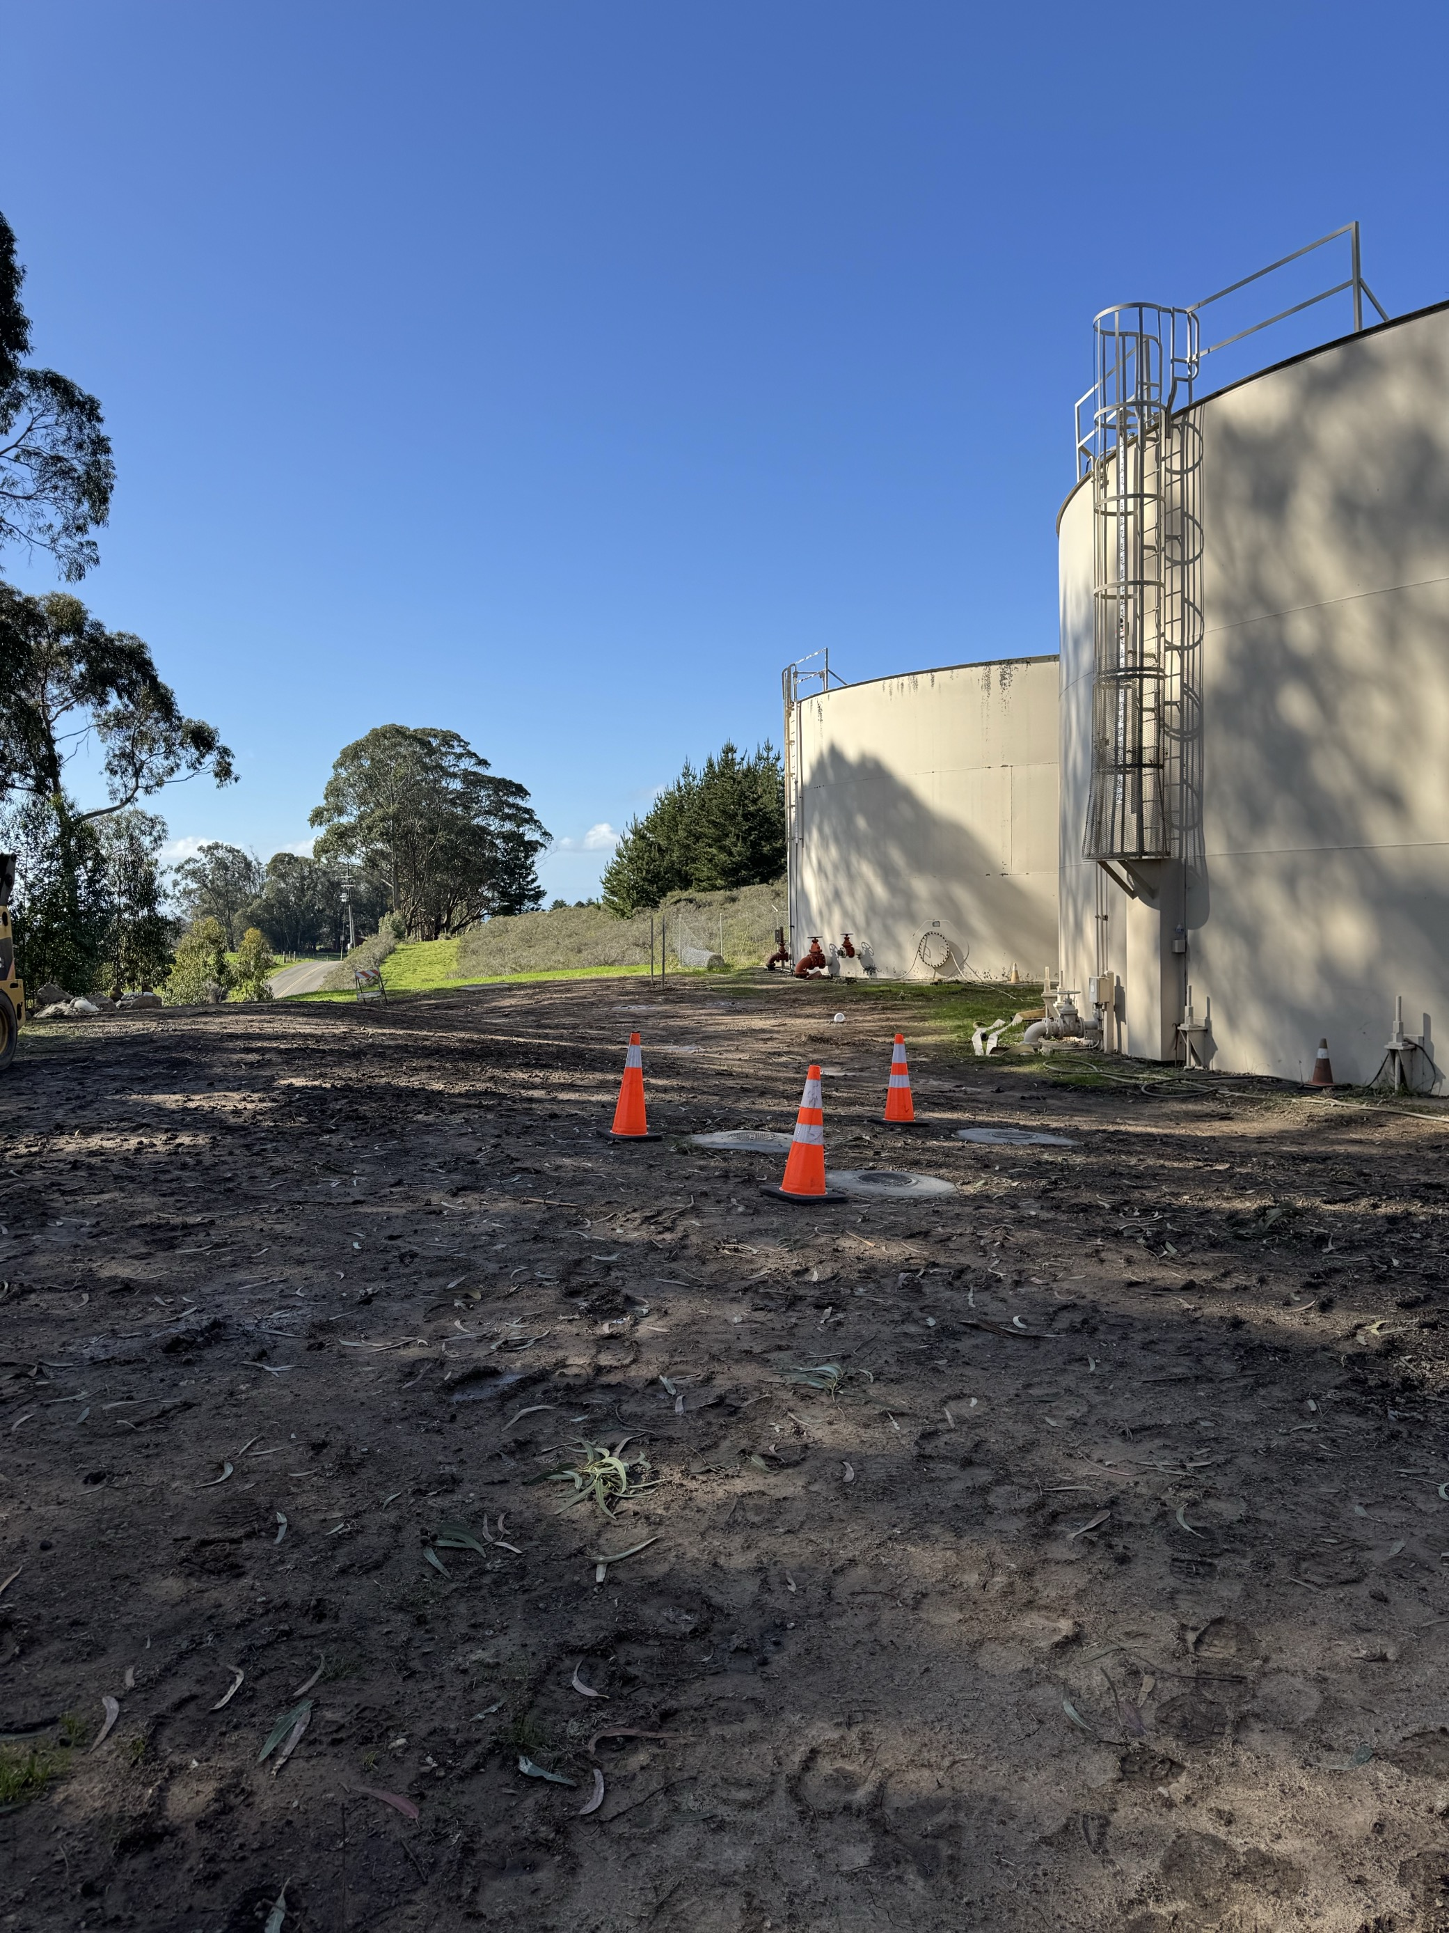
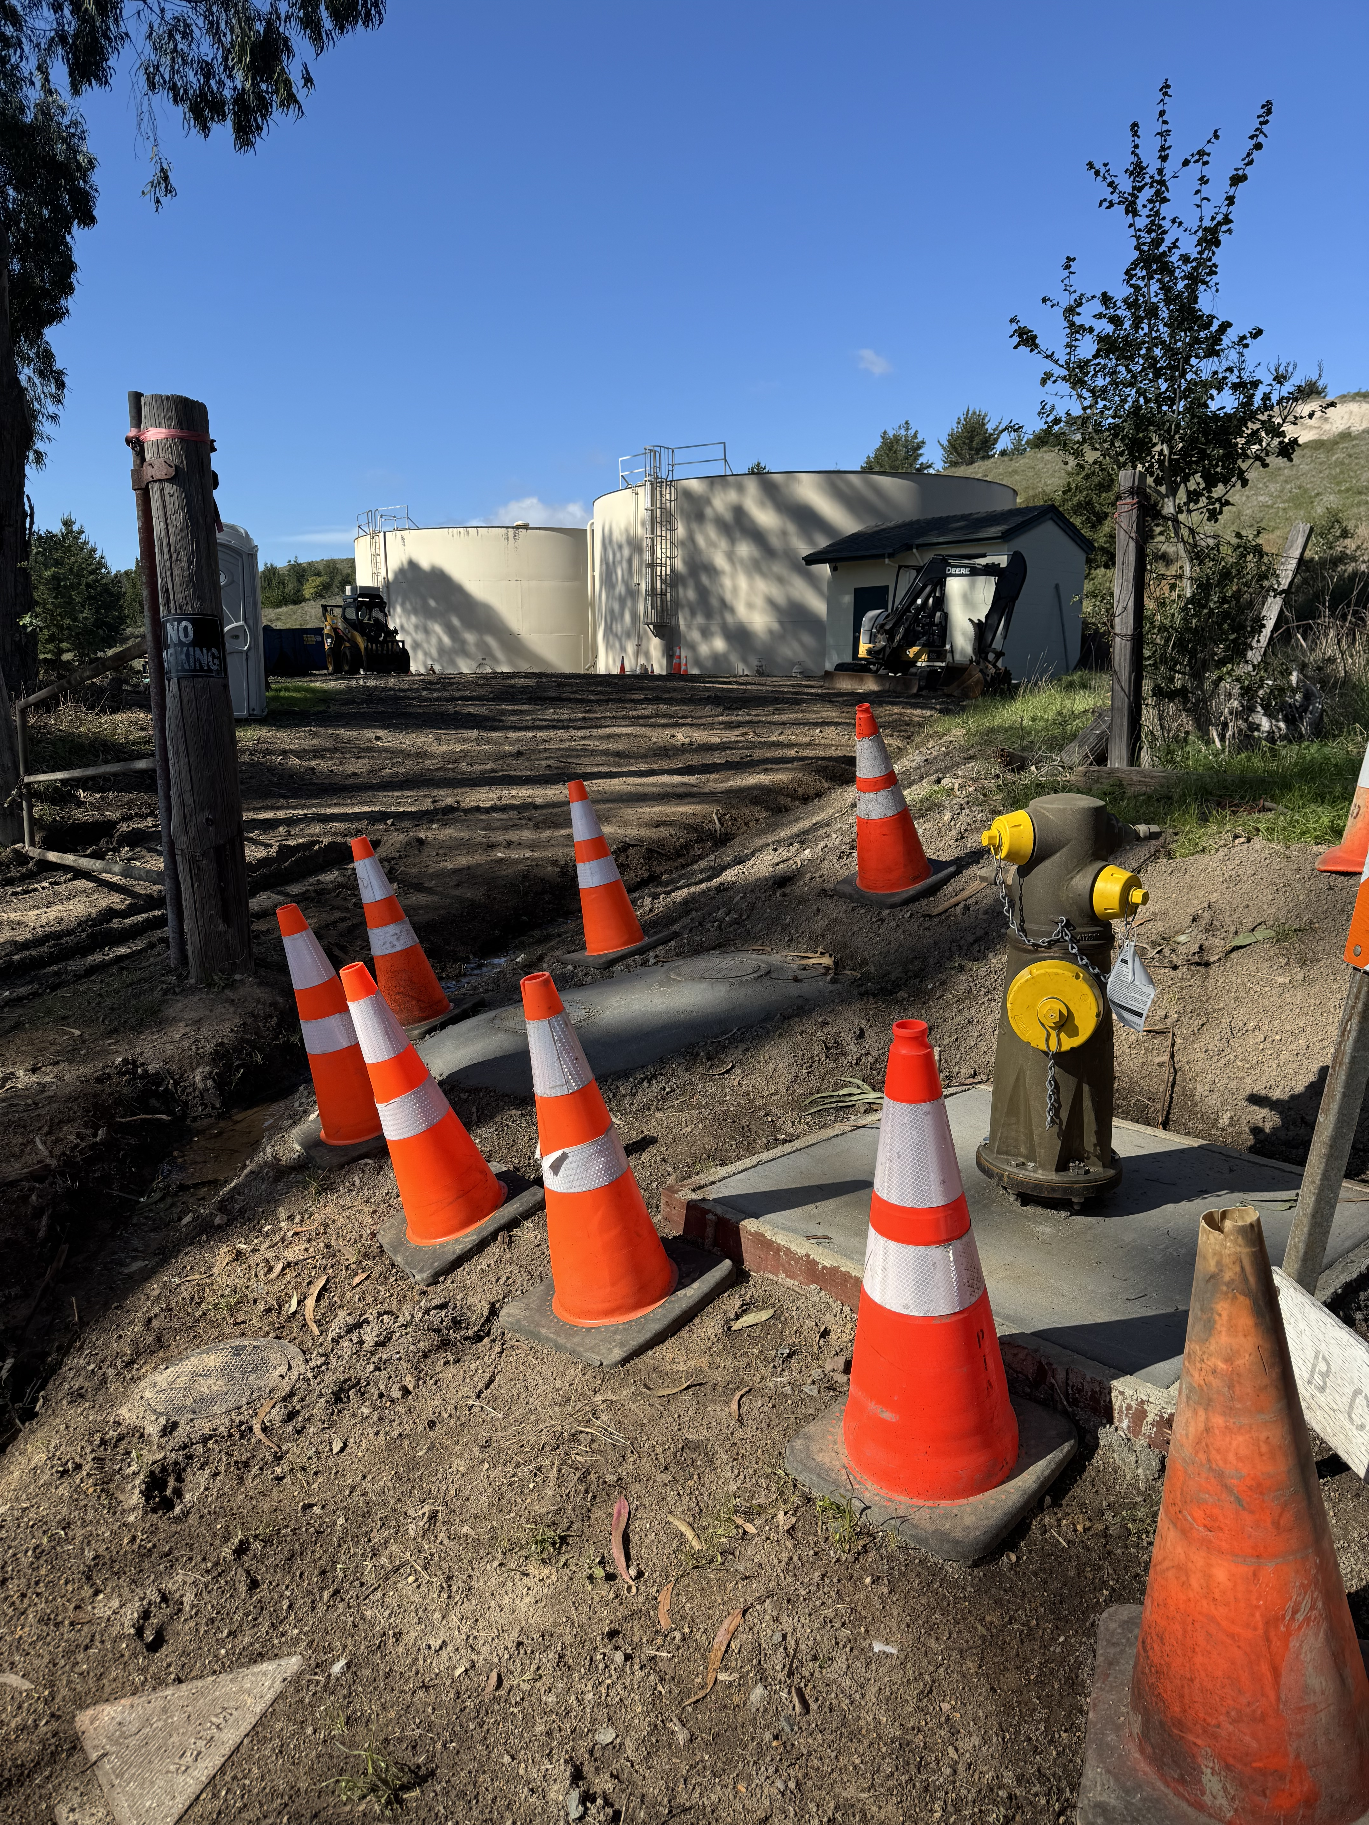
Operations Update (4 of 4): Tank-Site Pipeline Replacement project
There is still 1 more day of electrical work. We are negotiating the change order associated with this work.
After the work is finalized, I will present a special report summarizing total costs and closing out the project.

