Slide 1
Item 12. General Manager’s Update
January 21, 2026
Regular Board Meeting
Presented by Georgia Woods

Slide 2
Status of BCPUD’s Water Supply
Note November's comprehensive Water Supply memo will soon be posted on our Website HERE.

Slide 3
Winter 2025 Water Usage Trends
PRODUCTION​​
In December 2025, water production in the district averaged 111 gallons per day (GPD)​ per connection​
This is DOWN from November’s production, which averaged 129 GPD per connection​​
​​
CONSUMPTION​​​
Water consumption in December averaged 113 GPD per connection
This is DOWN from November consumption, which averaged 124 GPD per connection

Slide 4
Comparison to past two years
Average use per connection:
December 2023 – 102 GPD
December 2024 – 117 GPD
December 2025 – 113 GPD
3% decrease per connection compared to last December
December 2023
December 2024
December 2025

Slide 5
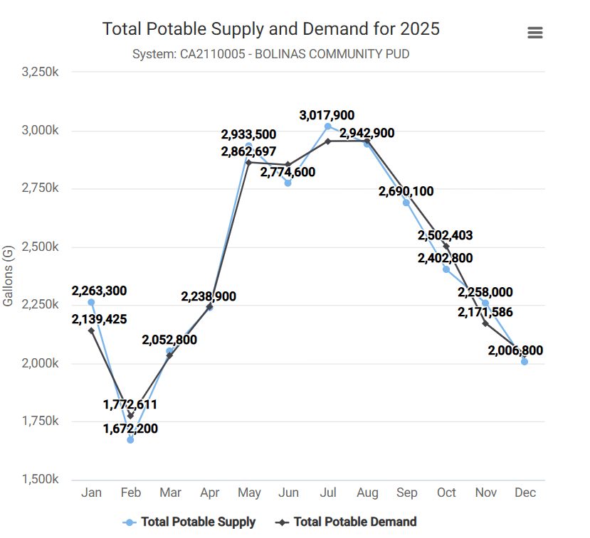
2025 Water Usage Trends

Slide 6
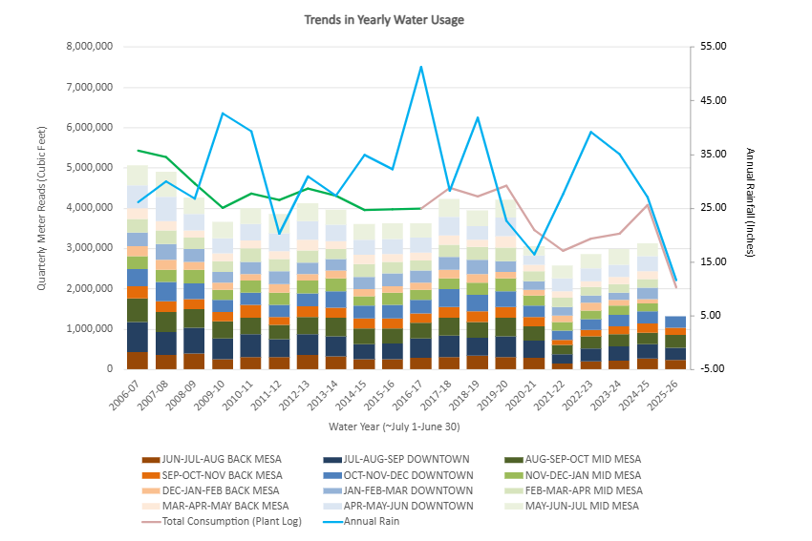
Annual Trends Since 2006
Quarterly Water Usage through December 2025
This graph shows “Cumulative Quarterly Water Usage”, as measured by “Regional Quarterly Water Meter Reads”
Remember: at the beginning of each month staff reads all meters within 1 of 3 given regions:
  1) BACK MESA
  2) DOWNTOWN
  3) MID MESA
Annual Rain Fall is plotted as a BLUE LINE
Town Consumption Estimates, based on the amount of water leaving the treatment plant daily is shown in PINK LINE.
GREEN LINE is an extension of pink line, which models consumption based on an absolute unaccounted for water loss of 437,856 CuFt (~10% loss)

Slide 7
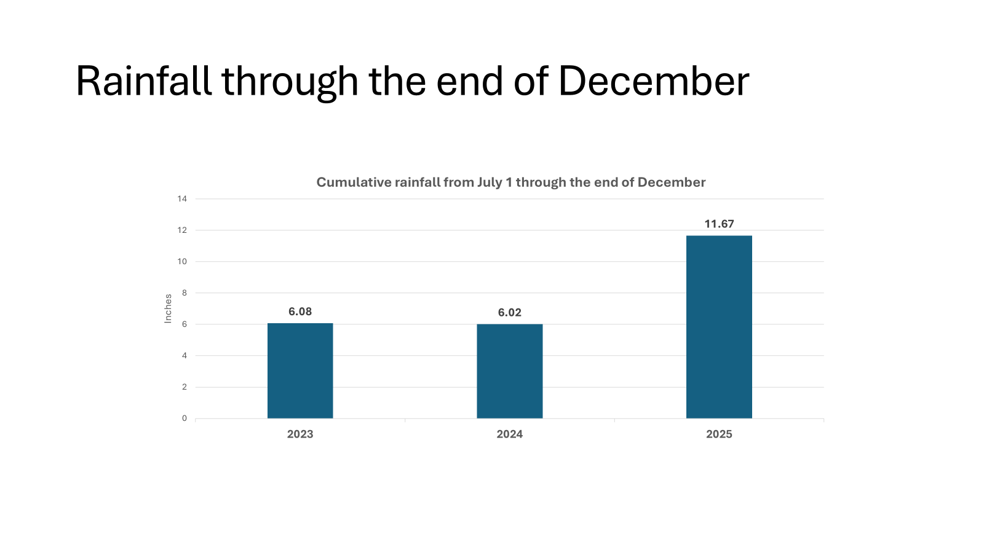
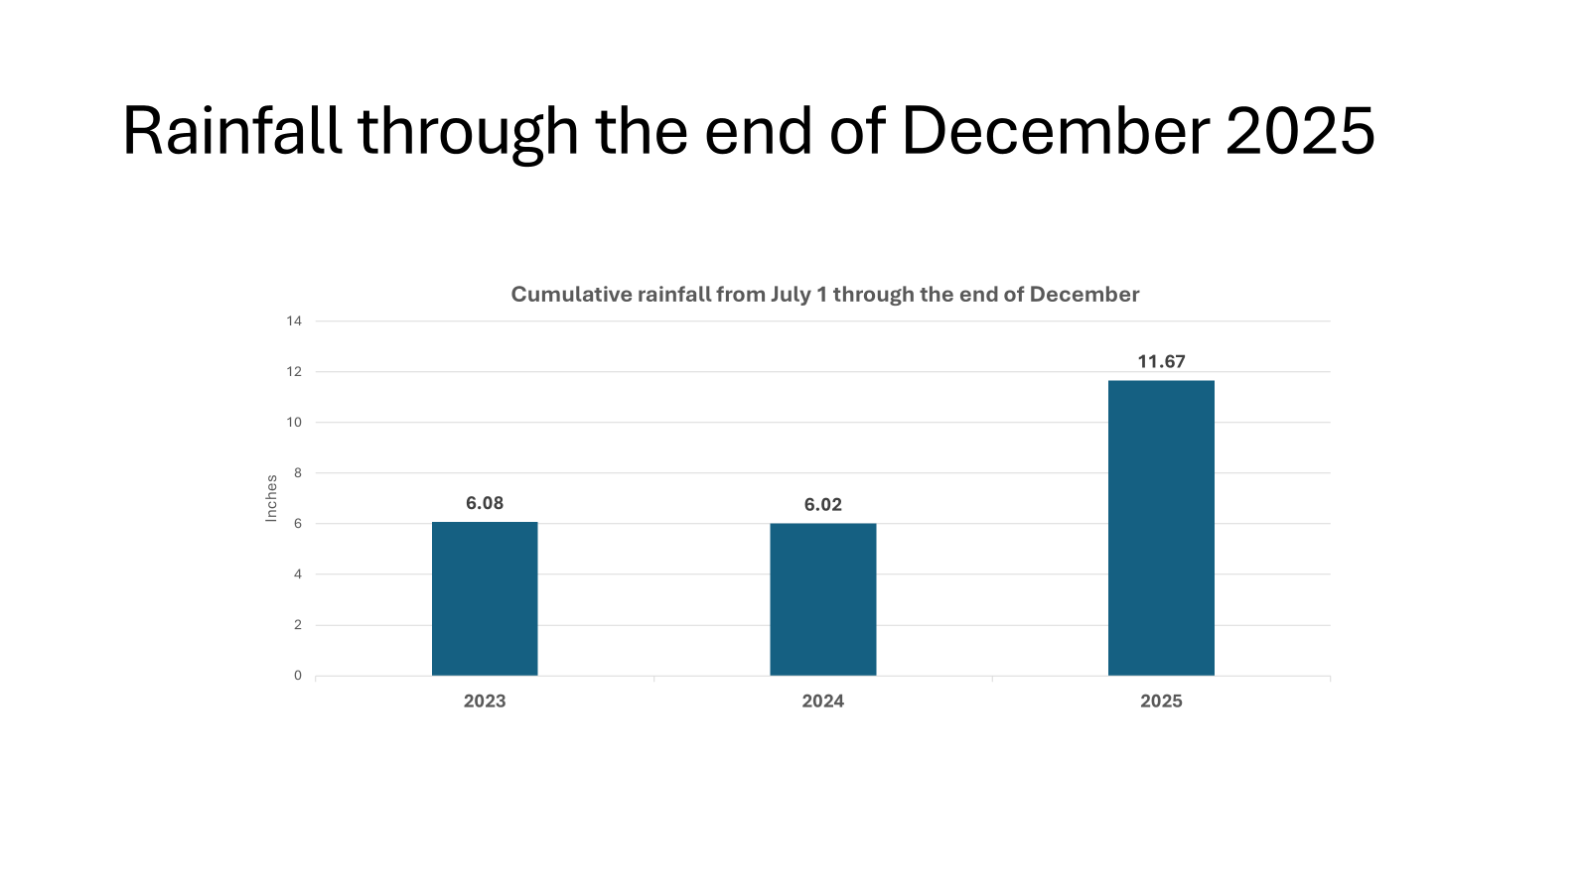
Annual Trends Since 2006
Quarterly Water Usage through December 2025
This graph shows “Cumulative Quarterly Water Usage”, as measured by “Regional Quarterly Water Meter Reads”
Remember: at the beginning of each month staff reads all meters within 1 of 3 given regions:
  1) BACK MESA
  2) DOWNTOWN
  3) MID MESA
Annual Rain Fall is plotted as a BLUE LINE
Town Consumption Estimates, based on the amount of water leaving the treatment plant daily is shown in PINK LINE.
GREEN LINE is an extension of pink line, which models consumption based on an absolute unaccounted for water loss of 437,856 CuFt (~10% loss)

Slide 8
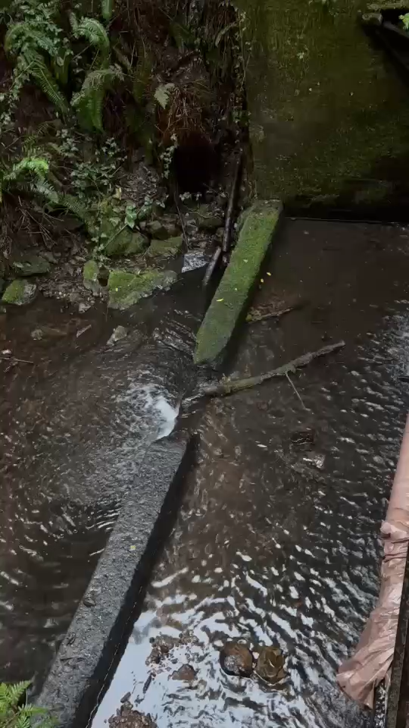
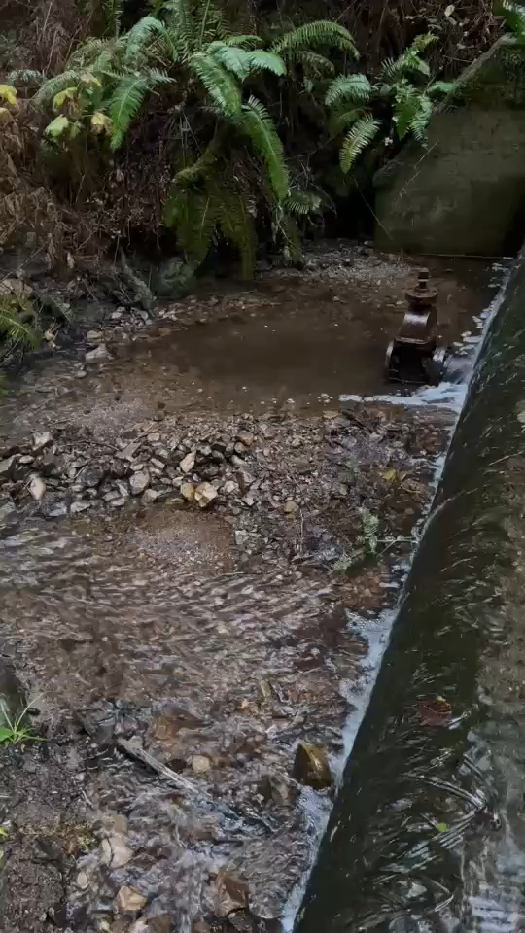
Reminder of what the Arroyo Hondo looked like in December
Lower
Upper
We were drawing from the upper impoundment.
on 12/17/2025
on 12/17/2025

Slide 9
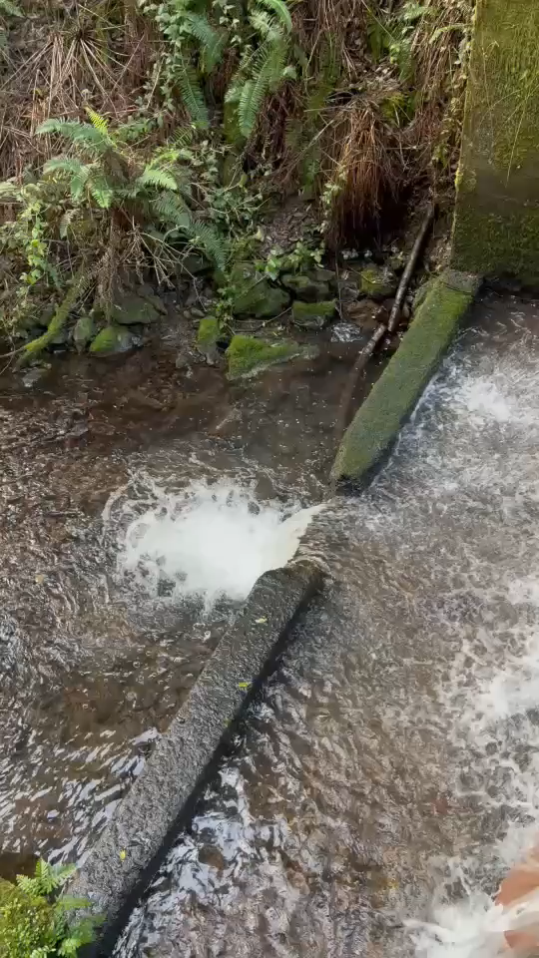
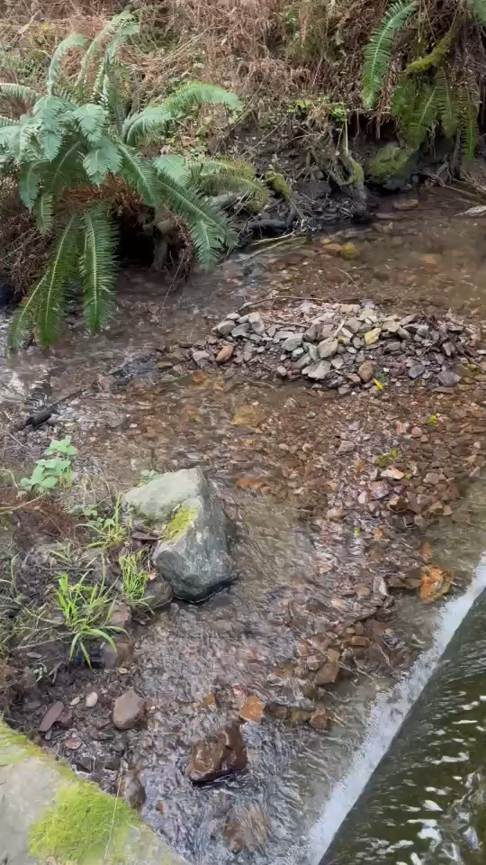
What the Arroyo Hondo looks like now…
Lower
Upper
We are still drawing from the upper impoundment. The Radial Gate is in place.
Today we were drawing at our plant at 60 gpm and the creek continues to flow over the lip while we draw (same as last month).
Under current conditions, 90 gpm is the max draw; but currently we’ve not had to go above 60 gpm due to low customer demand.
on 1/20/2026
on 1/20/2026

Slide 10
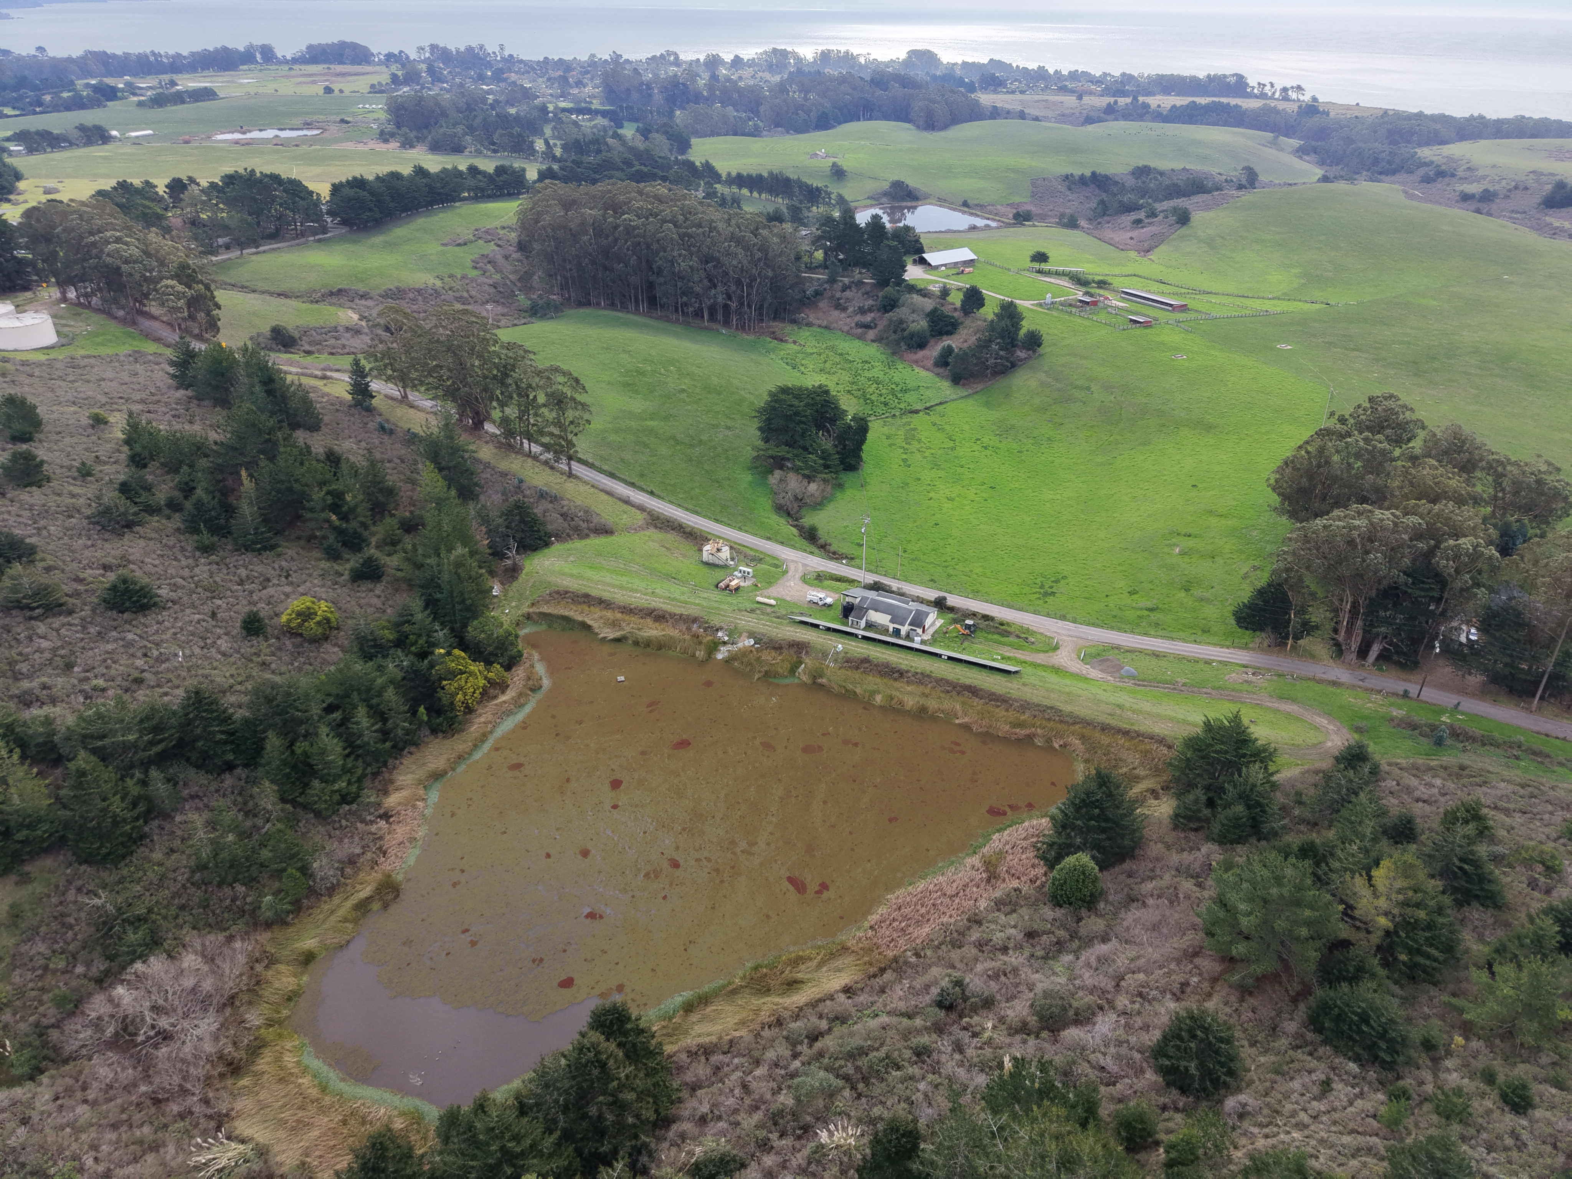
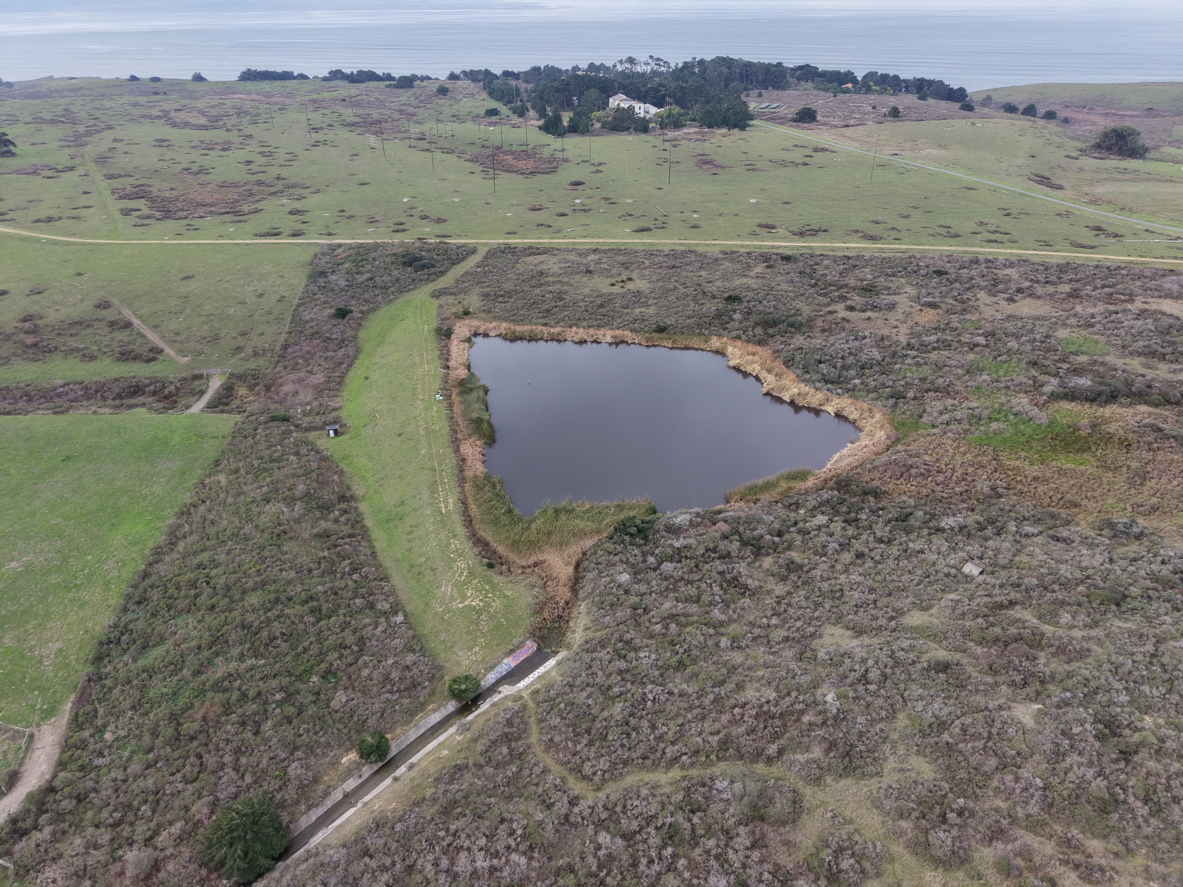
Woodrat 1 and Woodrat 2 are not spilling…azolla exploded…
Woodrat 1 on 1/21/2026
Woodrat 2 on 1/21/2026

Slide 11
Meetings Attended

Slide 12

Meetings Attended (1 of 1):
Bolinas' potential for Electrical Independence
I met with Isabelle Winstead and Bob Krause (Spark Communities) this month.
This was a continuation of our discussion with Isabelle last fall.
Here's a review of that meeting—please check it out when you get a chance!
  Meeting Materials
  No commitment from BCPUD—but I told them that we can put them in touch with community "thought leaders" who can help spearhead this exploration effort—Any ideas?

Slide 13
Operations Updates

Slide 14
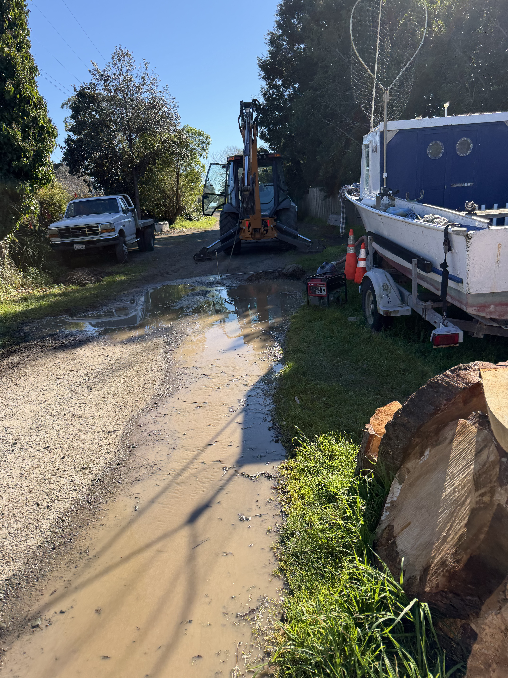
Operations Update (1 of 4): LEAKS
Leaks have been minimal this past month. Yay!
  Small leak on Fern Rd.
  It's that time of year that leaks are difficult to detect due to a lot of standing water though.

Slide 15
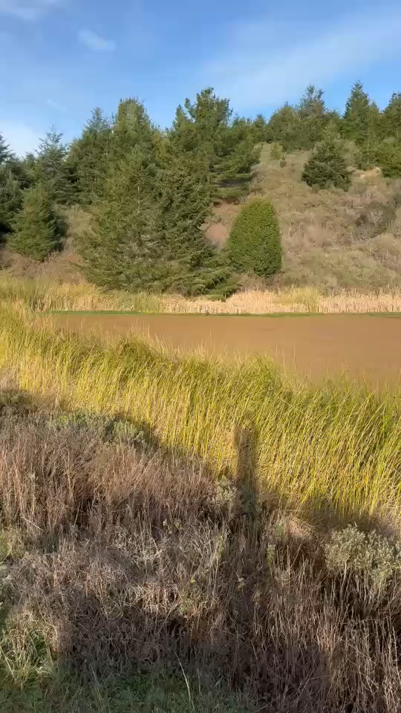
Operations Update (2 of 4): Azolla
Azolla needs to be cleared—again!
July 23-25, 2024 - $7440
Jan 14-15, 2025 - $5460 (14 hours)
June 4-5, 2025 - $6240 (16 hours)

Slide 16
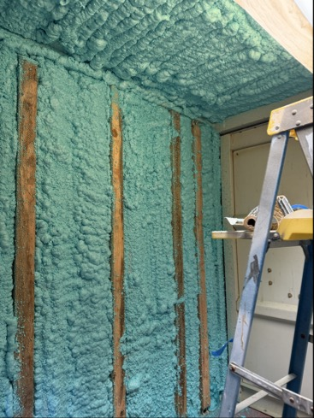
Operations Update (3 of 4): Wells Project Update
We are continuing to move forward with both well-projects.
Including getting rid of mobile equipment that needs to be removed from the Resource Recovery Site (see next slide)
Prepping of insulation in the shipping container treatment facility at Mesa Park

Slide 17
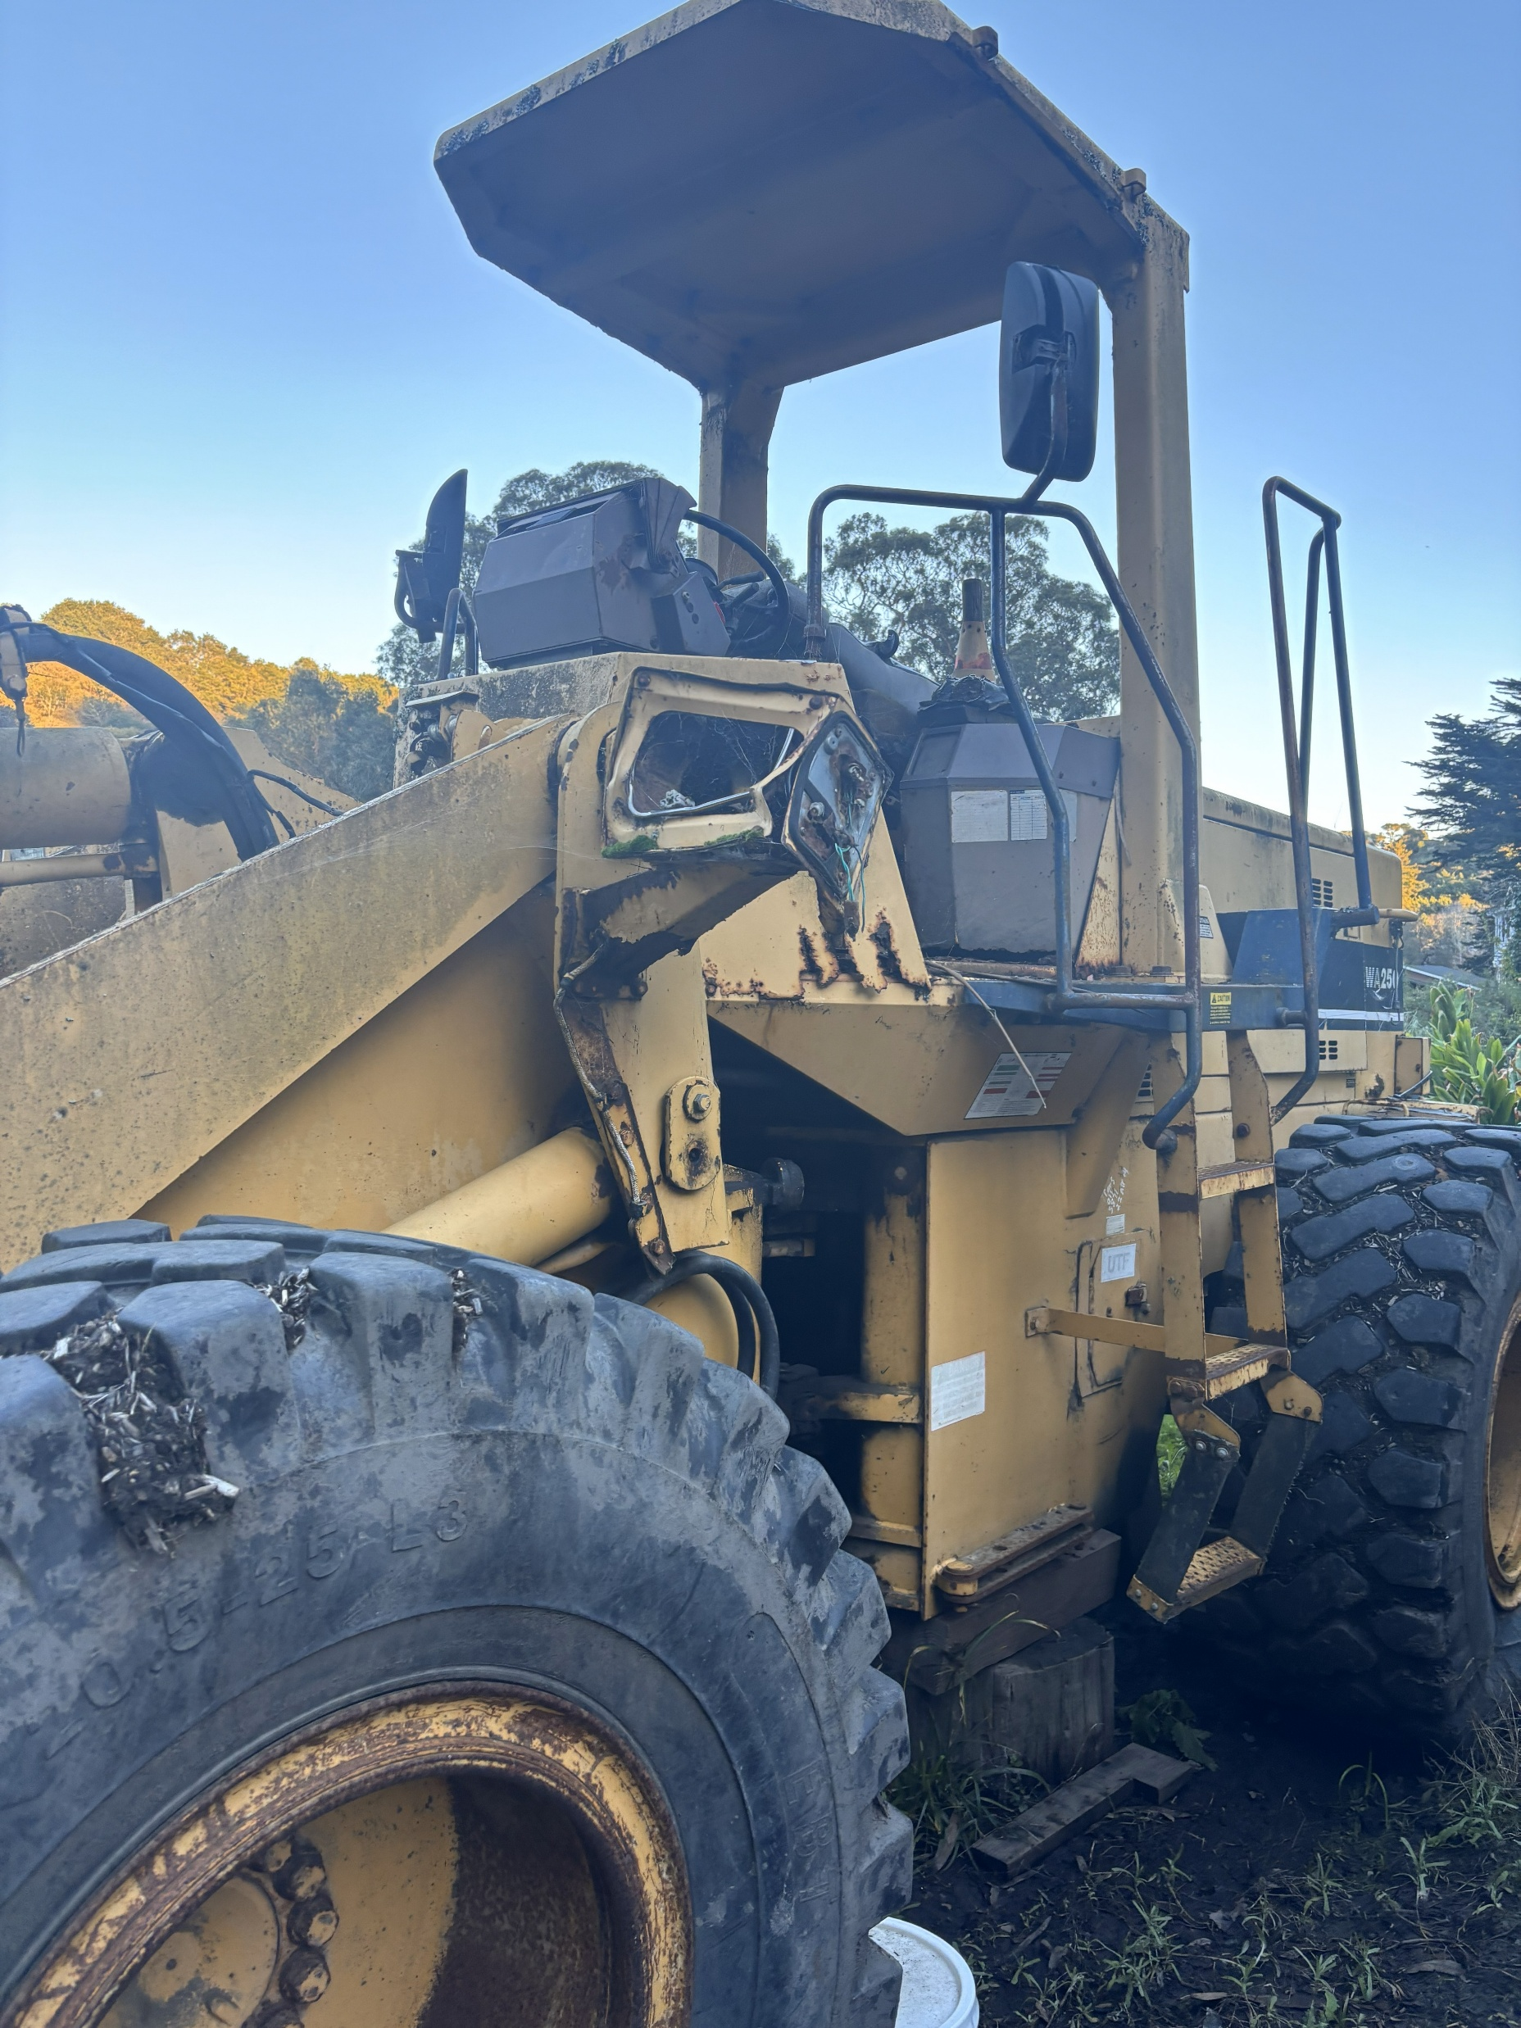
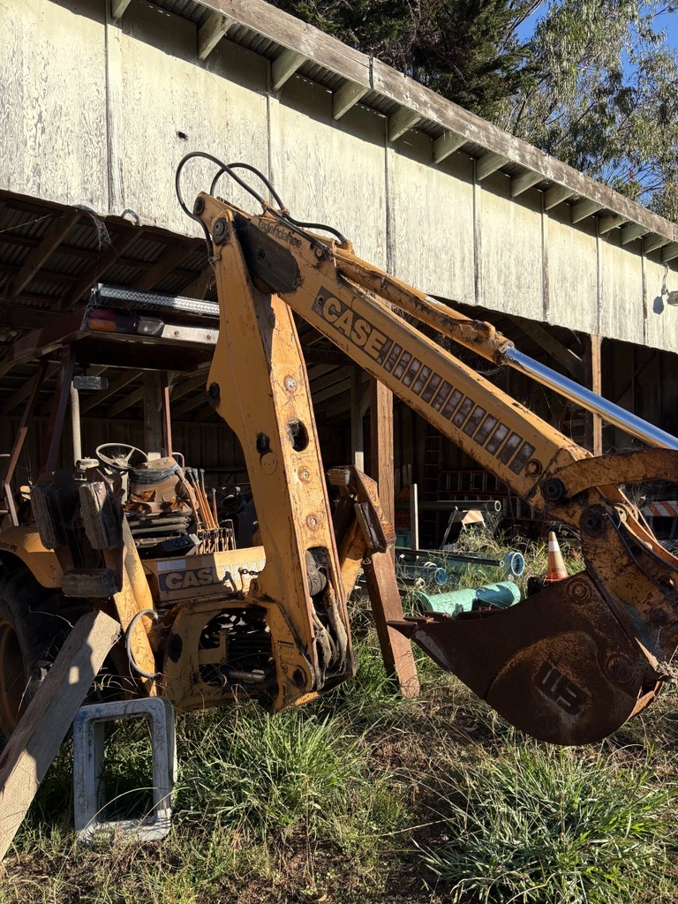
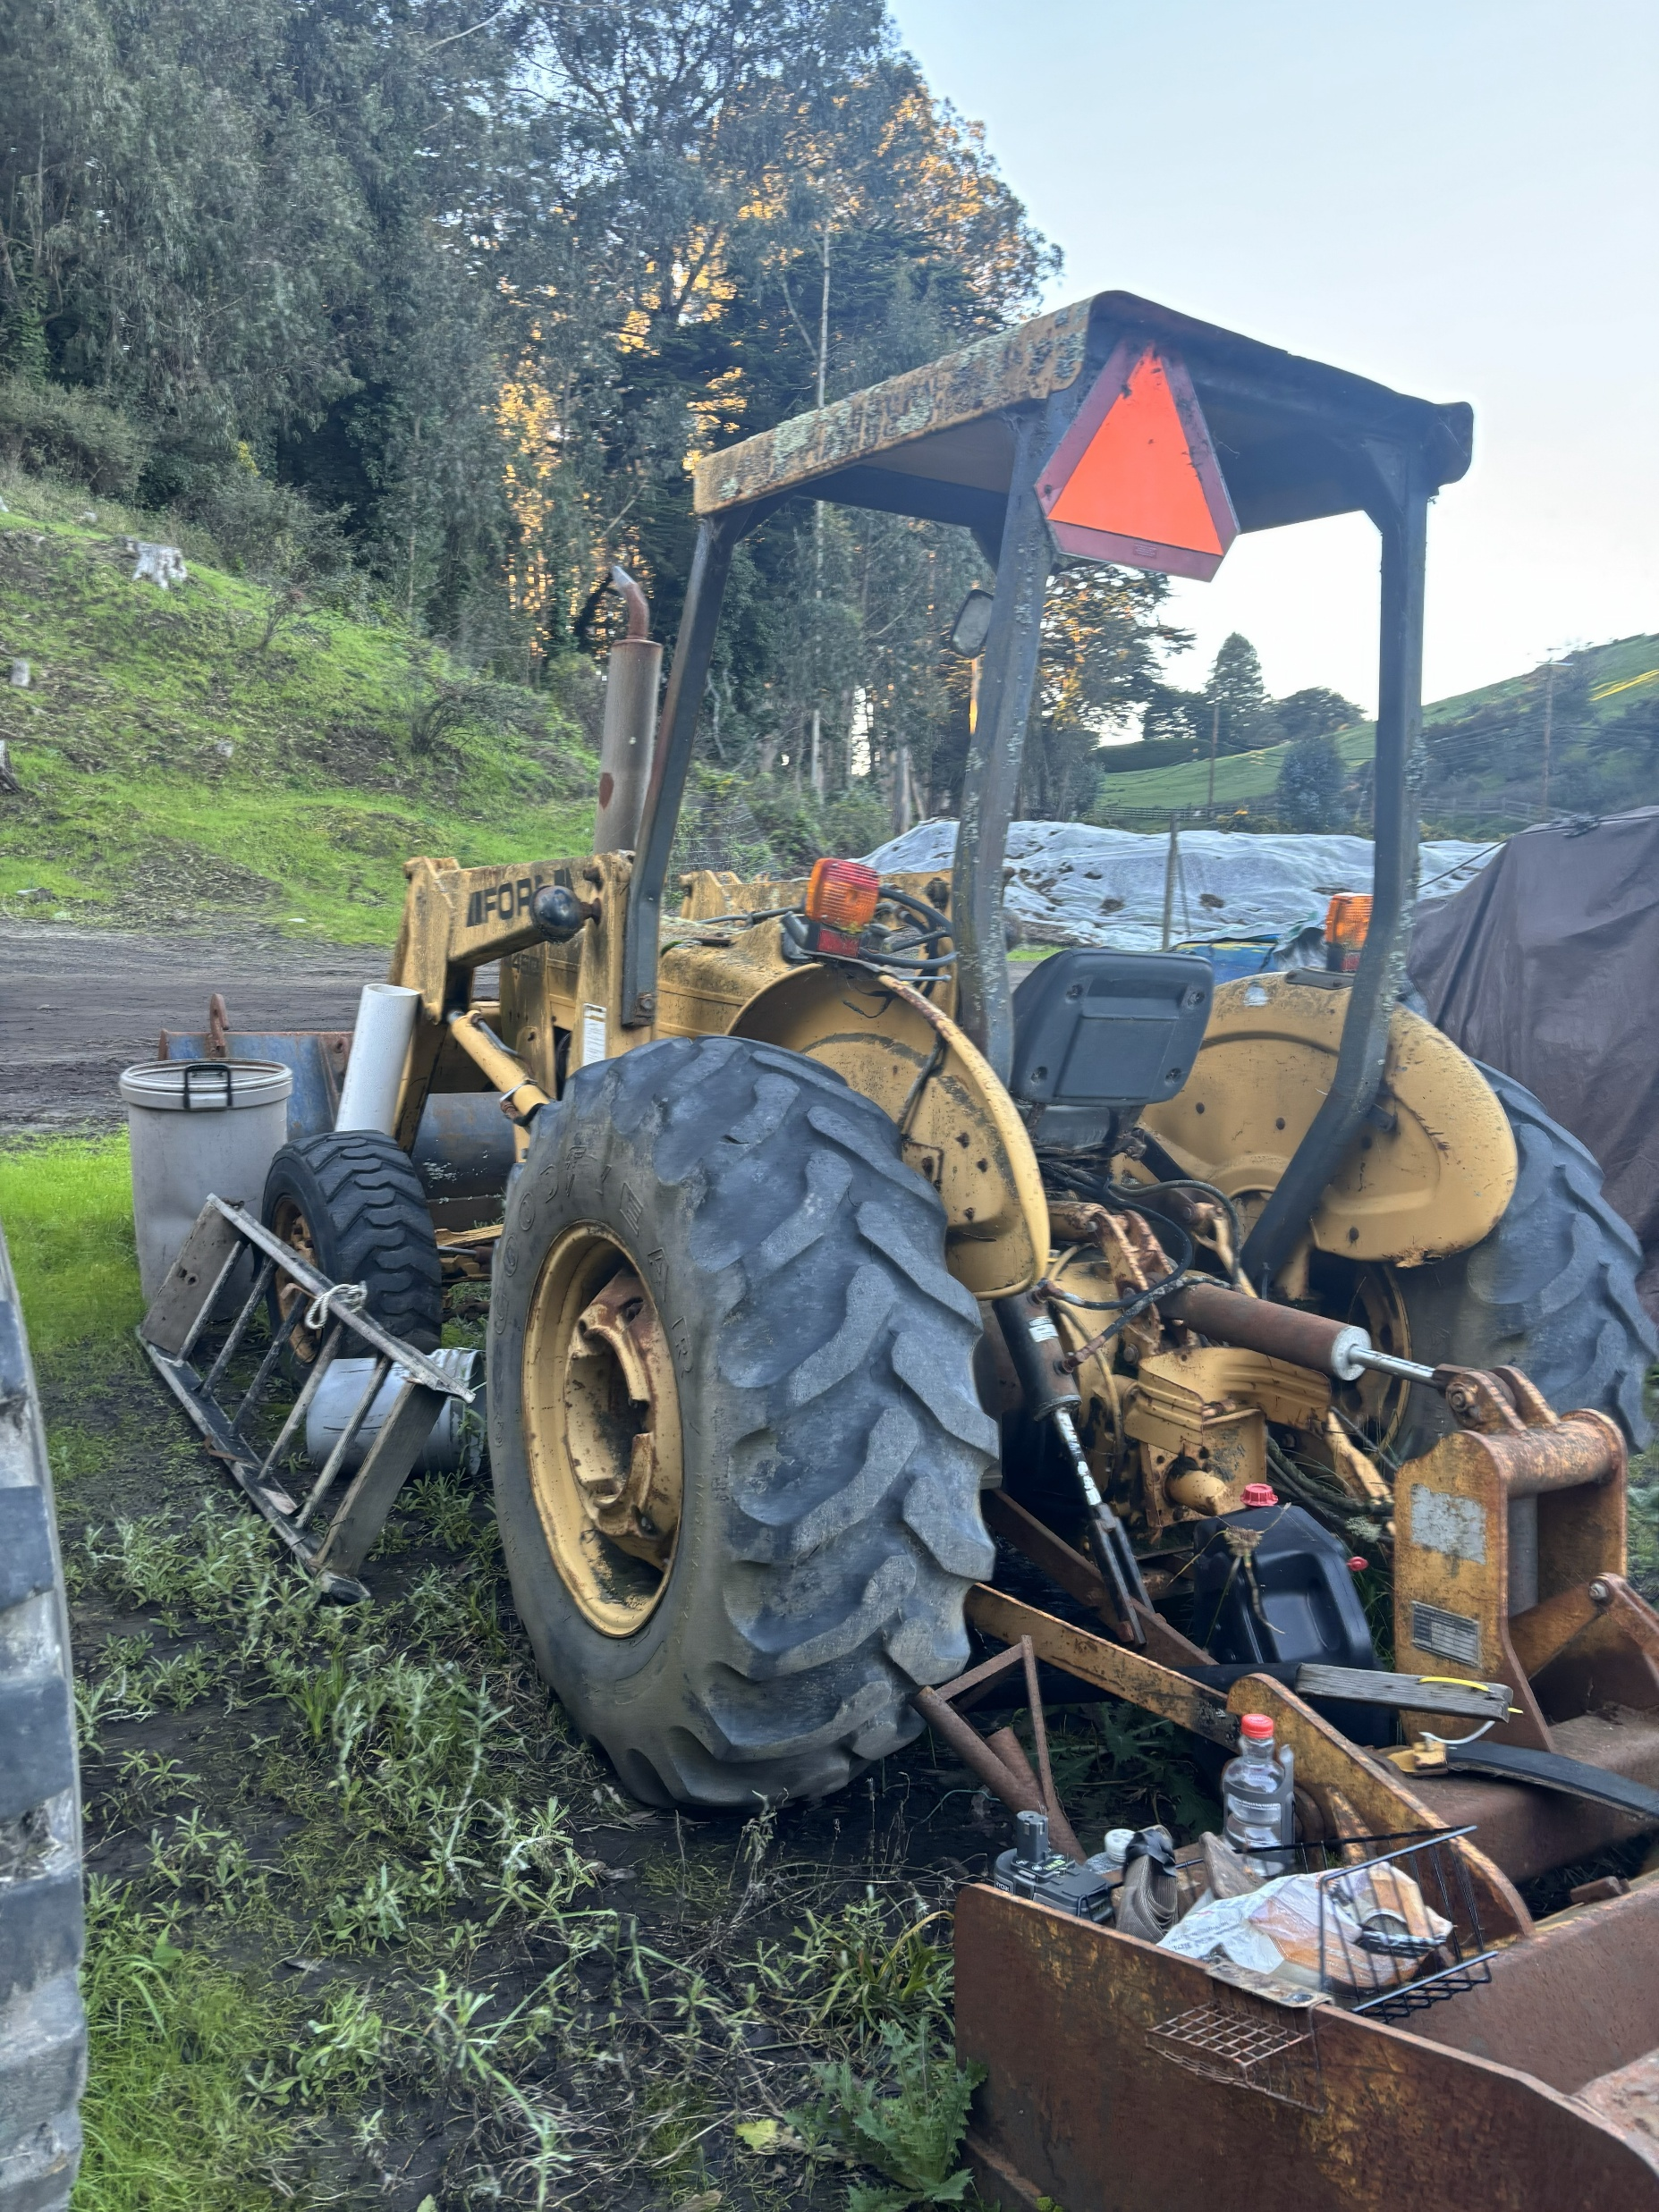
Mobile Equipment for Sale
The BCPUD is selling the following items:
1983 Case Backhoe 1996 Komatsu WA250 loader 1995 Ford 4450 New Holland skip loader
For more information, visit https://bcpud.org/mobile-equipment-for-sale/

Slide 18
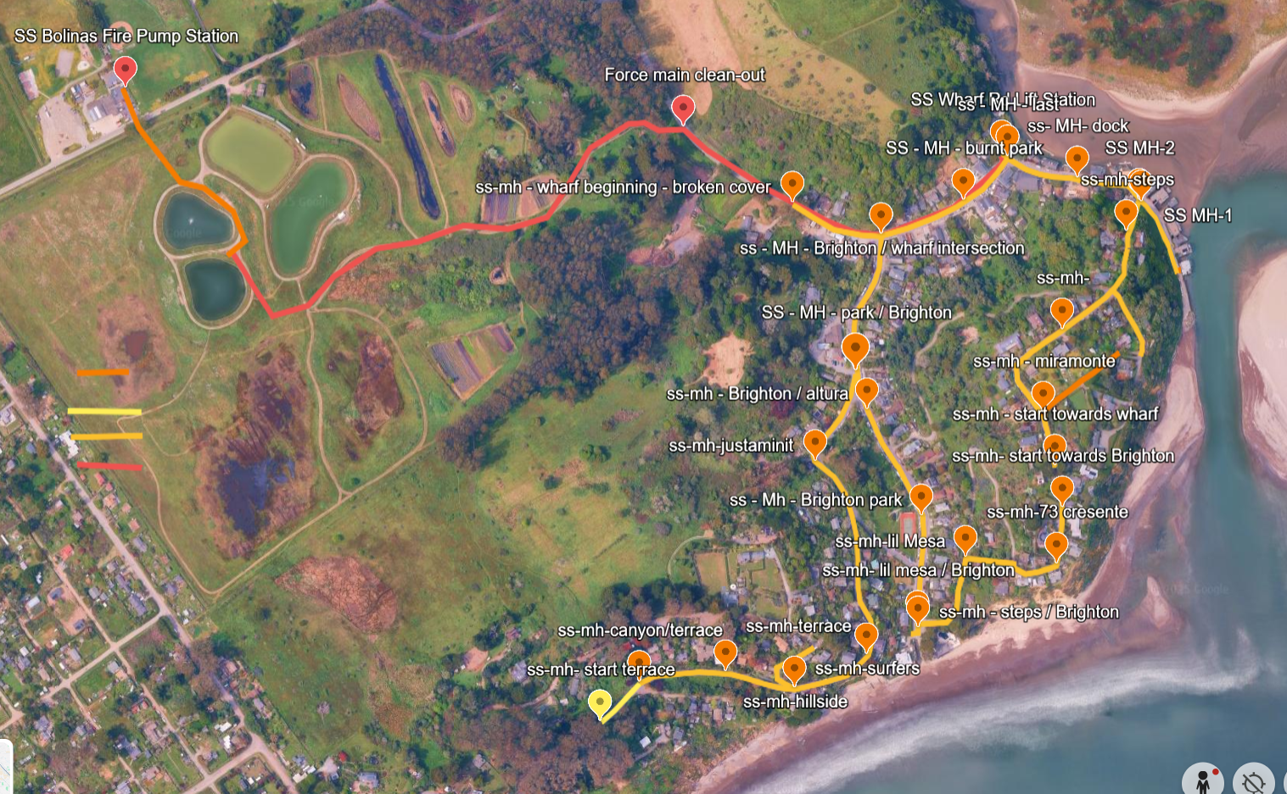
Operations Update (4 of 4): Ocean Protection Grant
Georgia continues to meet with Stinson Water, County Staff and West Yost regarding this project.
The Tasks that West Yost is undertaking to assess our Collection System ➔ washing happened last week, videoing will occur during the week of 1/26.
The Tasks that West Yost is undertaking to assess our Treatment System➔ continue to work on.
Private Pressurized Lateral
Private Gravity Lateral in County ROW
BCPUD's Gravity Mains
BCPUD's Force Main

Slide 19
Miscellaneous Updates

Slide 20
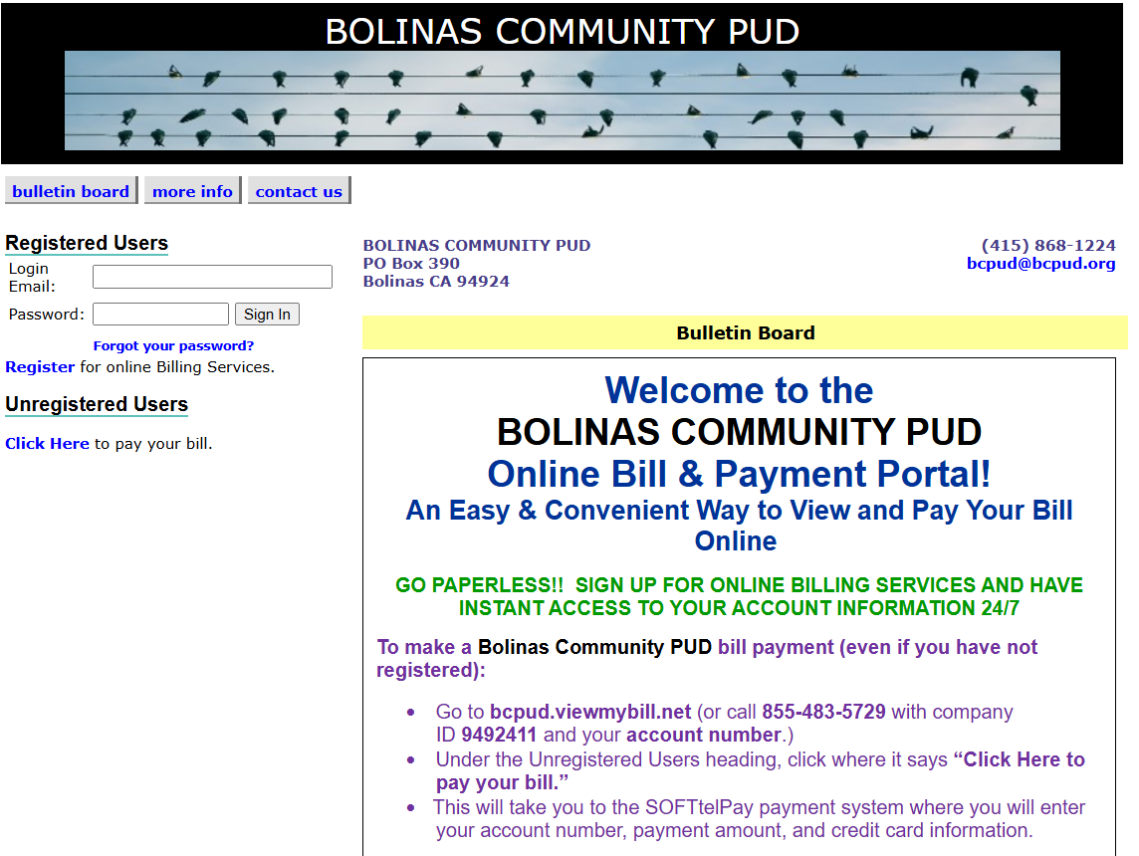
Miscellaneous Update (1 of 6): Automated Billing
Still urging folks to sign up for
e-billing (74 participants—up from 68 last month).
Please continue to sign up!

Slide 21

Miscellaneous Update (2 of 6): Bike Path Update
WRA is continuing to work on the Coastal Development Permit and will be submitting the application to the County shortly

Slide 22
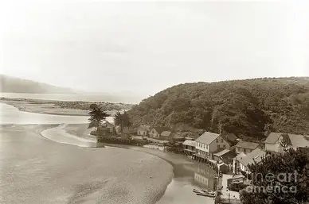
Miscellaneous Update (3 of 6): County Road Repair at 95 Wharf Rd
Updates:
Scheduled for week of 1-26-2026
BCPUD Staff met with contractors and county Engineers at the project site.
BCPUD Staff will be on site during the construction.
The District may provide a location on District Property to store offloaded materials.
Traffic Impacts:
Wharf Road will be closed at 95 Wharf Road 8:00 A.M. to 12:00 P.M., and 12:30 P.M. to 4:30 P.M. This will allow morning, mid-day and evening access to all properties beyond 95 Wharf Road.
To facilitate construction traffic, anticipate 5-minute delays on Wharf Road (8:00 AM - 5:00 PM) for the duration of the project.
Emergency vehicles will have access at all times (including access through road closures).

Slide 23
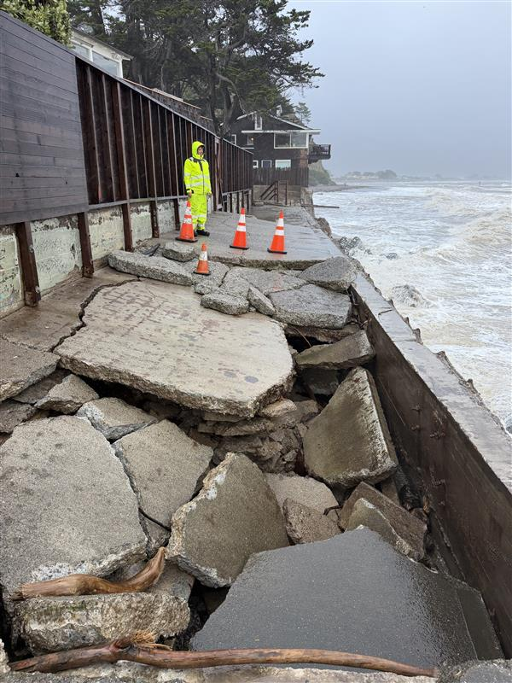
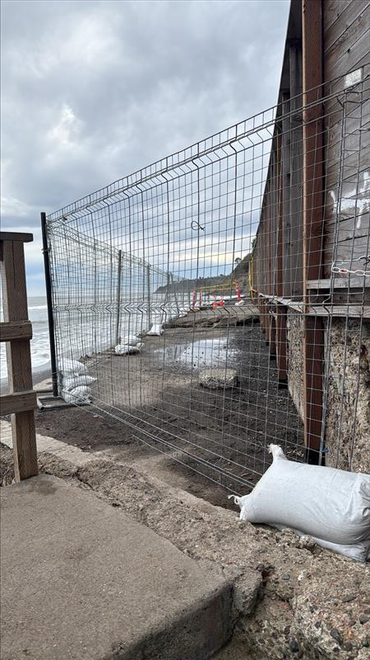
Miscellaneous Update (4 of 6): Damaged Sea Wall & Closure at Brighton
The seawall walkway on the beachside of 100 Brighton has caved in and is dangerous and should be avoided!

Slide 24
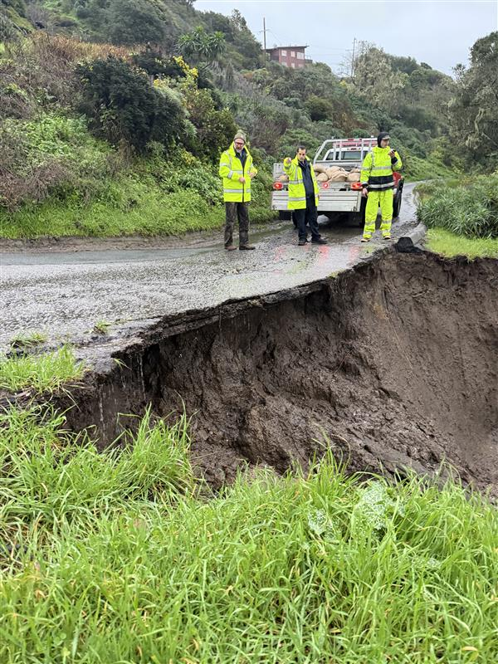
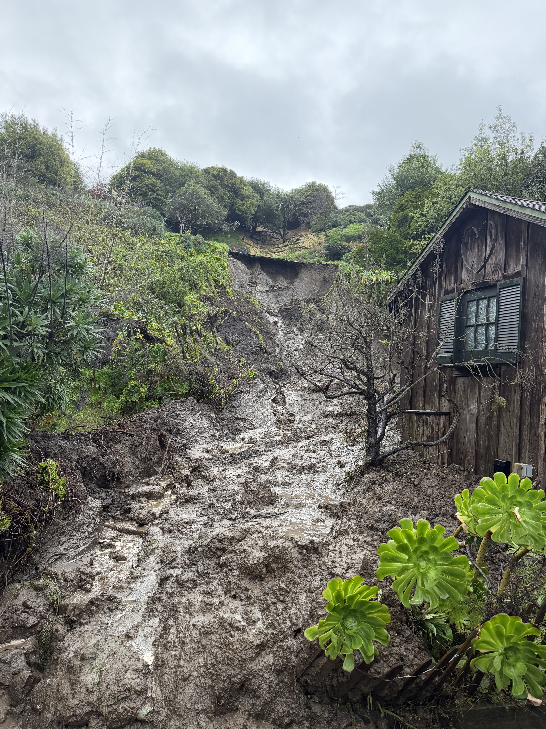
Miscellaneous Update (5 of 6): The mud-slide at Cliff
Update on the mudslide at Cliff Road on the Little Mesa:
Fortunately, we have no water or sewer infrastructure impacted by the slide and we can still access our infrastructure.
The traffic is 1 way in both directions on Altura (my understanding is that the fire district is setting-up a traffic light to direct alternating traffic).
We were originally asked to house the mud on District property—I'm not sure if that request will resurface.
We were also asked by Little Mesa Residents if we could help locate a dumpster for them (it looks like Mesa Park will be helping with that).

Slide 25
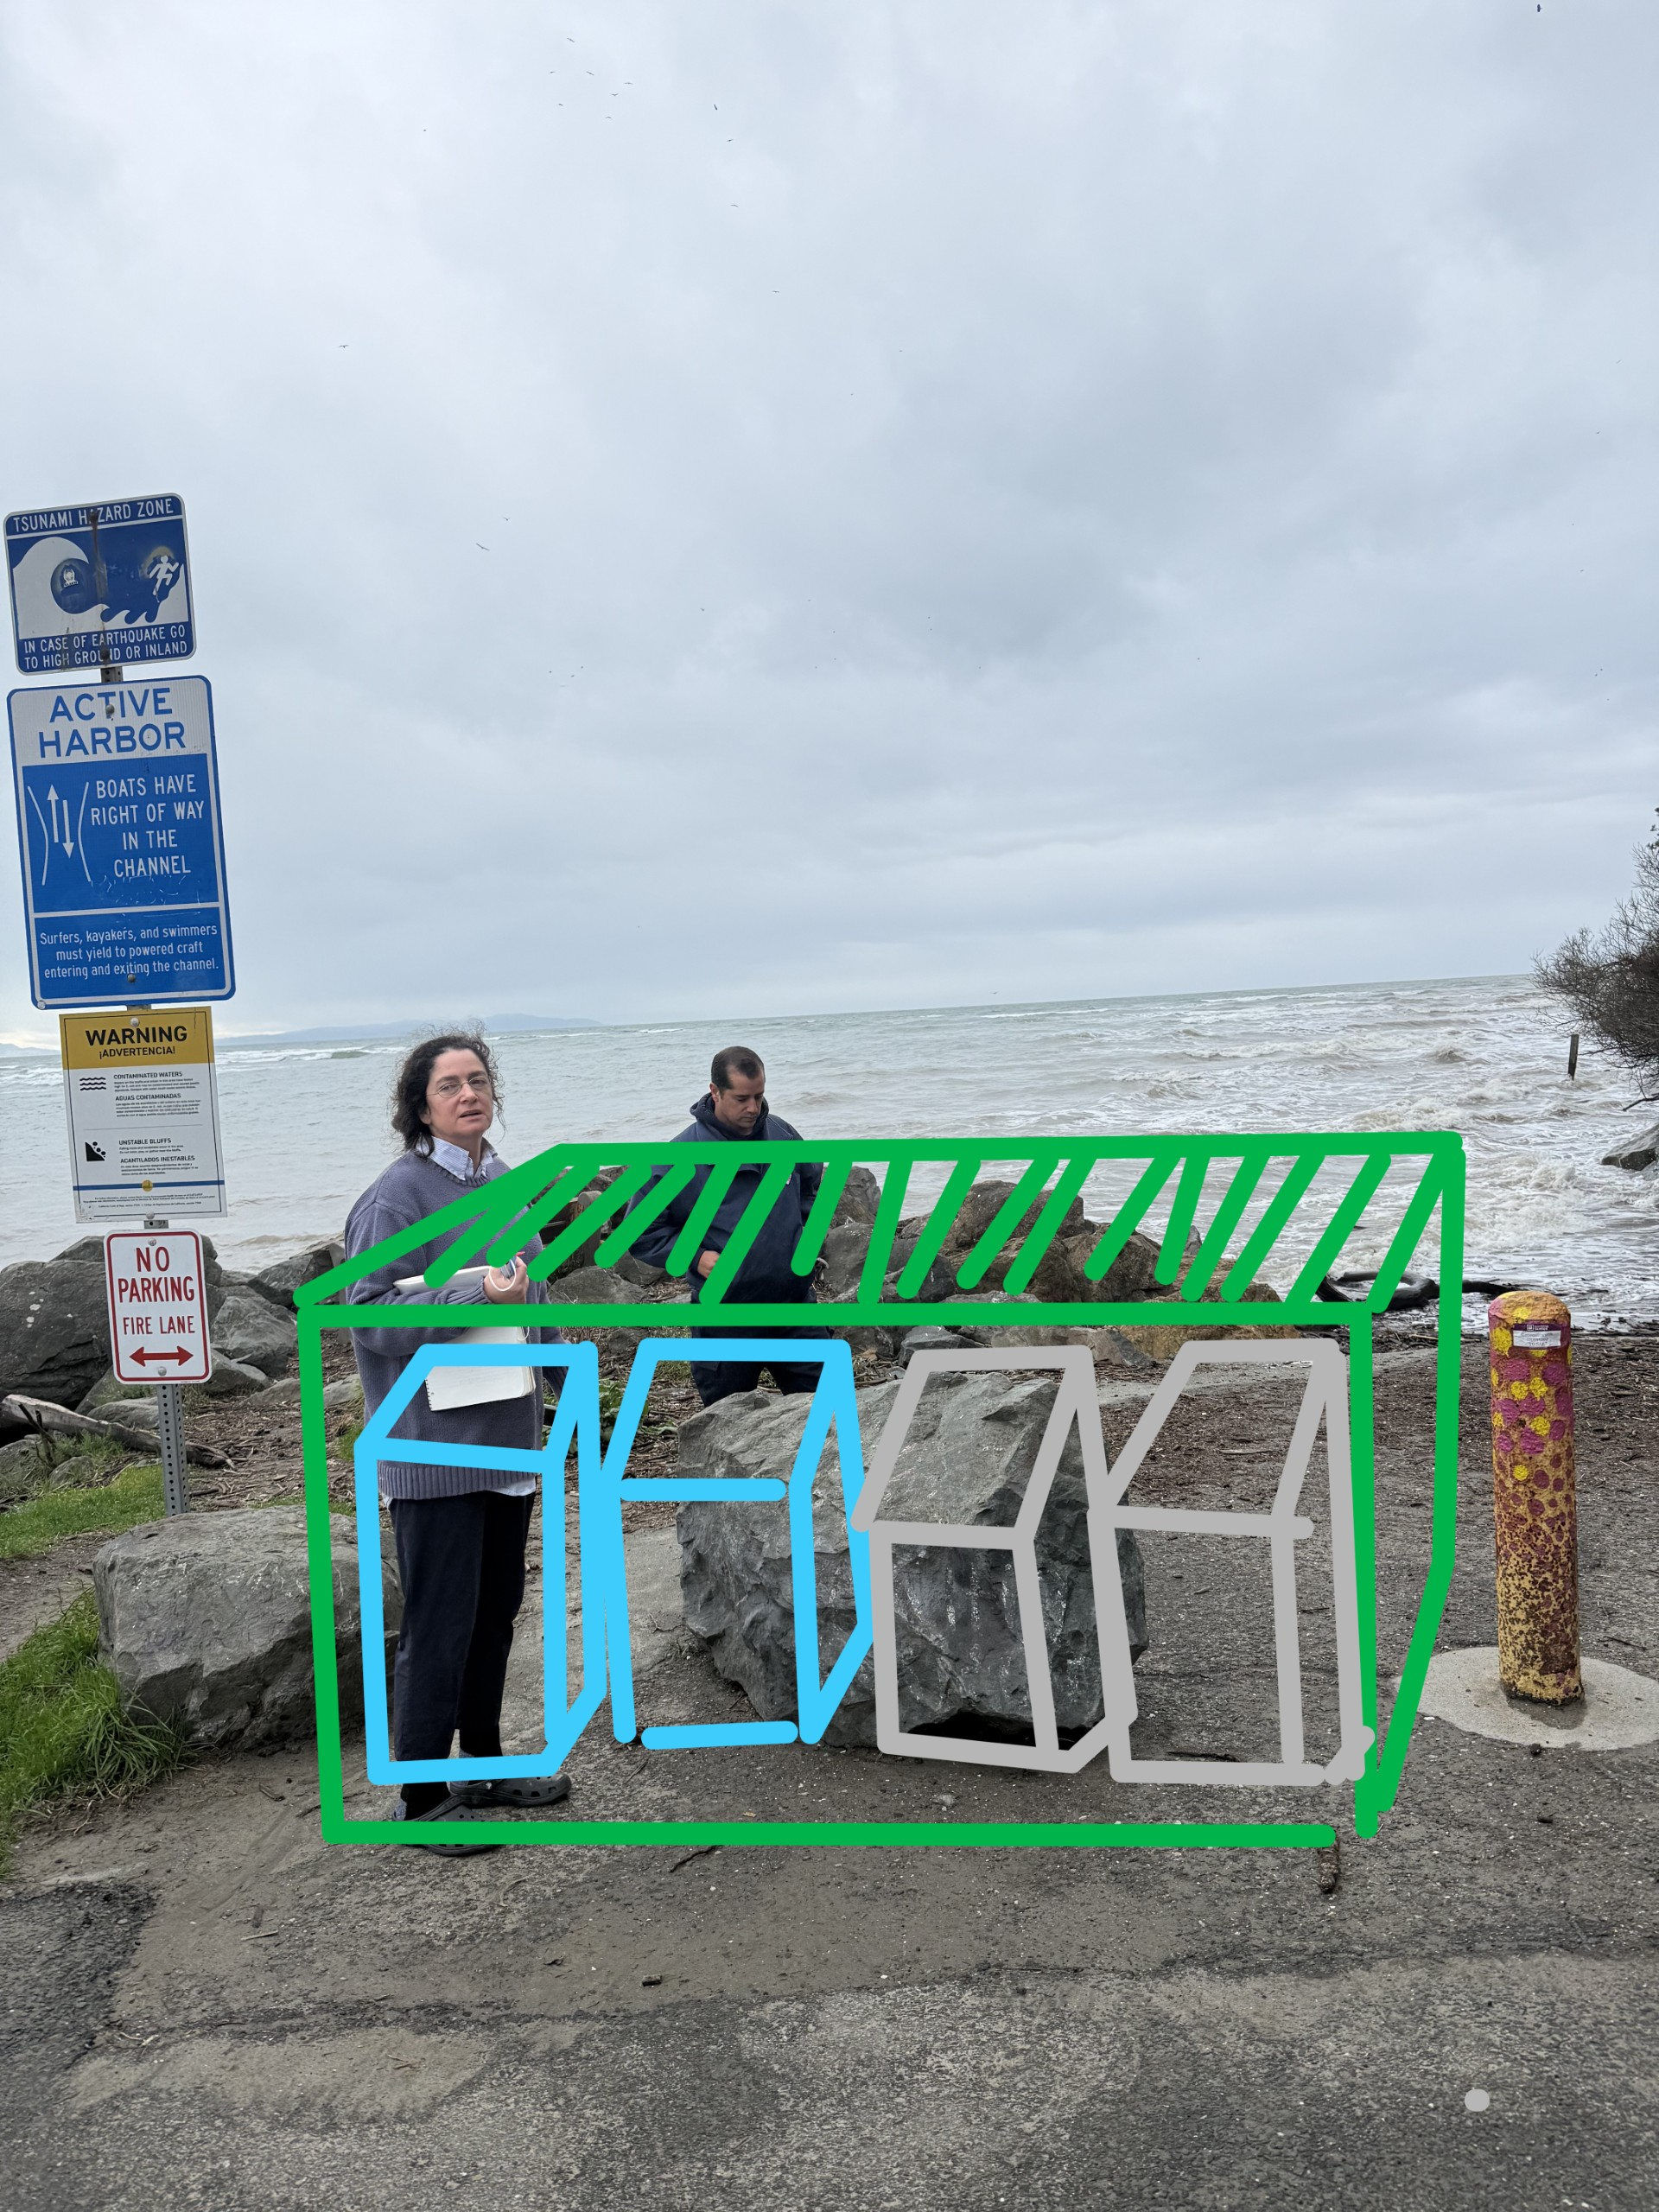
Miscellaneous Update (6 of 6): Garbage at the End of Wharf and Brighton
We know that this continues to be a problem, especially at Wharf Rd.
We continue to work on this important issue at both beach entrances.
This is an inter-agency issue—so please be patient with us as we try to improve the status of garbage collection at these sites.
We have been in contact with the Rod and Boat Club, the Fire District and the Lions Club.
We have also started to coordinate with County Parks.
We continue to work with Recology to ensure that they can service the site once it is up and ready for collection.

